Slide 1



Welcome to
User ID
Password
Log In
Forgot your Username or Password?
Content Management Portal
Register
If you don't have an account, create one so that you can begin using all of the customization features of this site.
Register Now!

Slide 2

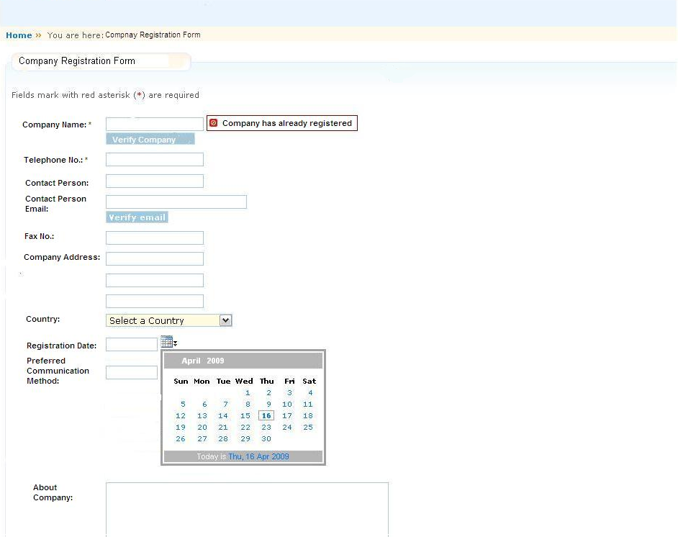
May 5, 2009
Feedback
Content Management Portal
Search Engine…
Home Page
About Us
Company Registration
Our Services
Contact Us
CM Portal Admin
User Admin
Content Category
>>Module
>>Exercise
>>Examination
>>Survey
*
Log In
*
Portal Help
Submit
Reset

Slide 3

May 5, 2009
Feedback
Content Management Portal
Search Engine…
Home Page
About Us
Company Registration
Our Services
Contact Us
CM Portal Admin
User Admin
Content Category
>>Module
>>Exercise
>>Examination
>>Survey
*
Log In
*
Portal Help
.
Registration Successful!
Confirmation of registration will be sent to your email box soon, please make the payment to activate your account. Payment method refer to the confirmation letter.
OK
Cancel
Submit
Reset

Slide 4

May 5, 2009
Feedback
Content Management Portal
Search Engine…
Home Page
About Us
Company Registration
Our Services
Contact Us
CM Portal Admin
User Admin
Home
>>
You are here: About Us
Content Category
About Us
>>Module
Welcome to Content Management Portal!
……
Our Vision:
To be a global recognized content management portal
Our Mission:
We are an integrated content management portal, we bring value to our customers and partners through our delivery of total, integrated quality content management solution and support.
Our Value:
……
>>Exercise
>>Examination
>>Survey
Log In
Portal Help

Slide 5
May 5, 2009
Feedback
Content Management Portal
Search Engine…
Home Page
About Us
Company Registration
Our Services
Contact Us
CM Portal Admin
User Admin
Home
>>
You are here: Our Services
Content Category
Our Services
>>Module
Services Type:
……
Services Method:
…….
>>Exercise
>>Examination
>>Survey
Log In
Portal Help

Slide 6
May 5, 2009
Feedback
Content Management Portal
Search Engine…
Home Page
About Us
Company Registration
Our Services
Contact Us
CM Portal Admin
User Admin
Home
>>
You are here: Contact Us
Content Category
Contact Us
>>Module
For general enquiries :
Tel : (65) 1234 5678
Fax : (65) 8765 4321
For registration enquiries :
Tel : (65) 1234 5678
Fax : (65) 8765 4321
Email : registration@cmp.com
Help Desk :
Tel : (65) 1234 5678
Fax : (65) 8765 4321
Email : cmpHelpDesk@cmp.com
>>Exercise
>>Examination
>>Survey
Log In
Portal Help

Slide 7
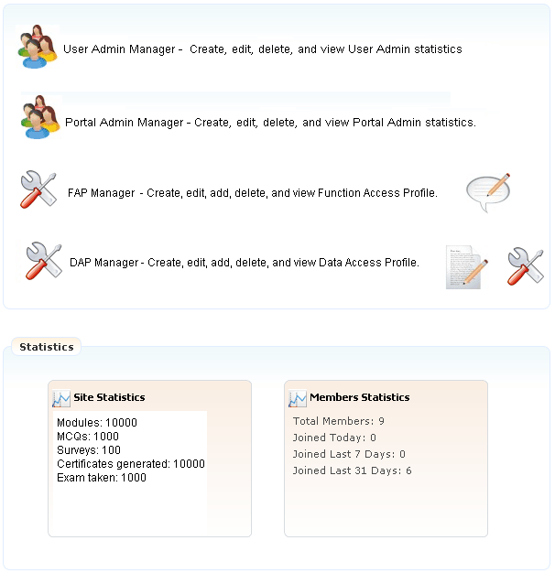
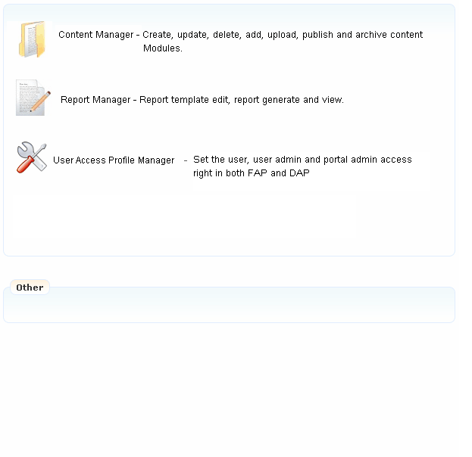
May 5, 2009
Feedback
Content Management Portal
Search Engine…
Home Page
User Admin Manager
Portal Admin Manager
FAP Manager
DAP Manager
CM Portal Admin
Content Manager
Report Manager
Role Manager
User Admin
Welcome Portal Admin: Kelly Mei
CM Portal Administration
>>
You are here: CM Portal Administration Page
Content Category
CM Portal Administration Page
>>Module
>>Exercise
>>Examination
>>Survey
Log Out
Role
Portal Help

Slide 8
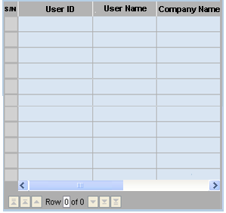
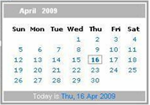
May 5, 2009
Feedback
Content Management Portal
Search Engine…
Home Page
User Admin Manager
Portal Admin Manager
FAP Manager
DAP Manager
CM Portal Admin
Content Manager
Report Manager
Role Manager
User Admin
Welcome Portal Admin: Kelly Mei
CM Portal Administration
>>
You are here: User Admin Manager
Content Category
User Admin Manager
>>Module
Create a new User Administrator
User Admin Lists
>>Exercise
User ID:
User Name:
Company Name:
Email Address:
User one time password:
User Role:
Module subscribed:
License No. subscribed:
Valid period:
>>Examination
>>Survey
Log Out
Portal Help
>>
Auto Set
>>
Select
>>
Select
100
Edit
Delete
From
To
Clear
Add
Update

Slide 9
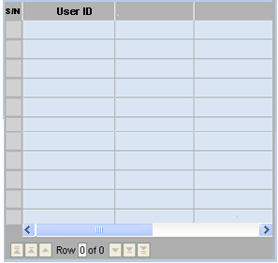
May 5, 2009
Feedback
Content Management Portal
Search Engine…
Home Page
User Admin Manager
Portal Admin Manager
FAP Manager
DAP Manager
CM Portal Admin
Content Manager
Report Manager
Role Manager
User Admin
Welcome Portal Admin: Kelly Mei
CM Portal Administration
>>
You are here: Portal Admin Manager
Content Category
Portal Admin Manager
>>Module
Create a new Portal Administrator
Portal Administrator List
>>Exercise
Employee ID
Department
>>Examination
User ID:
Employee ID:
Employee Name:
Department:
Date Joined:
Email Address:
User one time password:
>>Survey
Log Out
Portal Help
>>
Auto Set
Edit
Delete
Clear
Add
Update

Slide 10
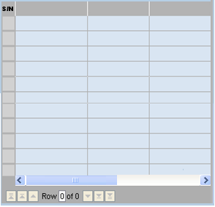
May 5, 2009
Feedback
Content Management Portal
Search Engine…
Home Page
User Admin Manager
Portal Admin Manager
FAP Manager
DAP Manager
CM Portal Admin
Content Manager
Report Manager
Role Manager
User Admin
Welcome Portal Admin: Kelly Mei
CM Portal Administration
>>
You are here: FAP Manager
Content Category
FAP Manager
>>Module
Create a new Functional Access Profile (FAP)
Functional Access Profile (FAP) List
>>Exercise
FAP ID
Function Name
Description
>>Examination
FAP ID:
Function Name:
Description:
>>Survey
Log Out
Portal Help
Clear
Add
Update
Edit
Delete

Slide 11
May 5, 2009
Feedback
Content Management Portal
Search Engine…
Home Page
User Admin Manager
Portal Admin Manager
FAP Manager
DAP Manager
CM Portal Admin
Content Manager
Report Manager
Role Manager
User Admin
Welcome Portal Admin: Kelly Mei
CM Portal Administration
>>
You are here: DAP Manager
Content Category
DAP Manager
>>Module
Create a new Data Access Profile (DAP)
Data Access Profile (DAP) List
>>Exercise
DAP ID
Module Name
Description
>>Examination
DAP ID:
Module Name:
Description:
>>Survey
Log Out
Portal Help
Clear
Add
Update
Edit
Delete

Slide 12
May 5, 2009
Feedback
Content Management Portal
Search Engine…
Home Page
User Admin Manager
Portal Admin Manager
FAP Manager
DAP Manager
CM Portal Admin
Content Manager
Report Manager
Role Manager
User Admin
Welcome Portal Admin: Kelly Mei
CM Portal Administration
>>
You are here: Role Manager
Content Category
Role Manager
>>Module
Create a new Role
User Access Profile (UAP) List
>>Exercise
Role Name
FAP
DAP
>>Examination
Role Name:
Description:
FAP:
DAP:
>>Survey
Log Out
Portal Help
>>
Select
>>
Select
Edit
Delete
Clear
Add
Update

Slide 13
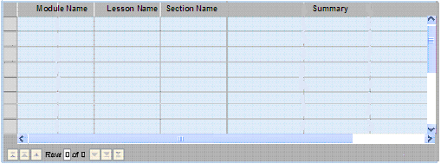
May 5, 2009
Feedback
Content Management Portal
Search Engine…
Home Page
User Admin Manager
Portal Admin Manager
FAP Manager
DAP Manager
CM Portal Admin
Content Manager
Report Manager
Role Manager
User Admin
Welcome Portal Admin: Kelly Mei
CM Portal Administration
>>
You are here: Content Manager
Content Category
Content Manager
>>Module
Create a Module
>>Exercise
Module Name:
Category:
Lesson Name:
Section Name:
Section file:
Section Summary:
>>Examination
>>
Browse
>>Survey
Select a Content Category
Select a Content Category……
Log Out
Lesson
MCQ
Portal Help
Survey
Upload
Save
Search by Module Name
Find
Edit
Delete
Publish

Slide 14

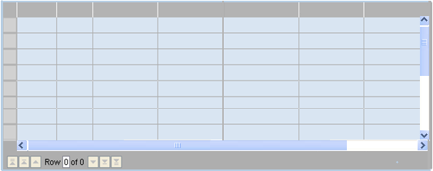
May 5, 2009
Feedback
Content Management Portal
Search Engine…
Home Page
User Admin Manager
Portal Admin Manager
FAP Manager
DAP Manager
CM Portal Admin
Content Manager
Report Manager
Role Manager
User Admin
Welcome Portal Admin: Kelly Mei
CM Portal Administration
>>
You are here: Content Manager
Content Category
Content Manager
>>Module
Create a Module
>>Exercise
Module Name:
Category:
Lesson Name:
Section Name:
Set Question:
Set Answer:
>>Examination
>>Survey
Select a Content Category
Select a Content Category……
Log Out
Lesson
MCQ
Portal Help
Survey
Upload
Save
Search by Module Name
Find
Module ID
MCQ ID
Module Name
Lesson Name
Section Name
Question
Description
Difficulty
Edit
Delete
Publish

Slide 15
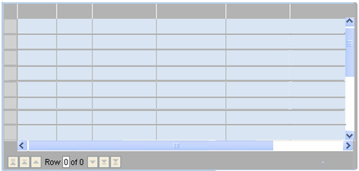
May 5, 2009
Feedback
Content Management Portal
Search Engine…
Home Page
User Admin Manager
Portal Admin Manager
FAP Manager
DAP Manager
CM Portal Admin
Content Manager
Report Manager
Role Manager
User Admin
Welcome Portal Admin: Kelly Mei
CM Portal Administration
>>
You are here: Content Manager
Content Category
Content Manager
>>Module
Create a Module
>>Exercise
Module Name:
Category:
Survey
Section Name:
Set Survey Questions:
>>Examination
>>Survey
Select a Content Category
Select a Content Category……
Log Out
Lesson
MCQ
Portal Help
Survey
Upload
Save
Search by Module Name
Find
Module
ID
Survey
ID
Module Name
Section Name
Question
Description
Edit
Delete
Publish

Slide 16
May 5, 2009
Feedback
Content Management Portal
Search Engine…
Home Page
User Admin Manager
Portal Admin Manager
FAP Manager
DAP Manager
CM Portal Admin
Content Manager
Report Manager
Role Manager
Welcome Portal Admin: Kelly Mei
User Admin
CM Portal Administration
>>
You are here: Report Manager
Content Category
Report Manager
>>Module
Create or update a report template
>>Exercise
Report Name:
Report Type:
Template:
>>Examination
>>Survey
Select a Report Type
Log Out
>>
Browse
Portal Help
Save
Report
ID
Report
Type
Template
Section Name
Question
Description
Delete
Upload
Generate

Slide 17
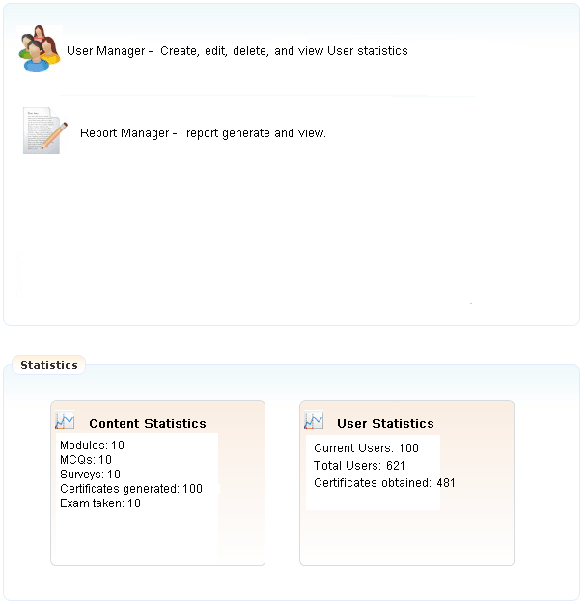
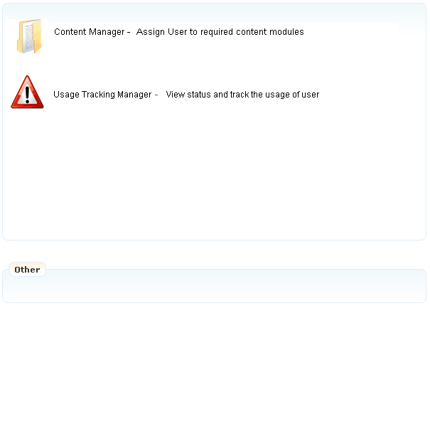
May 5, 2009
Feedback
Content Management Portal
Search Engine…
Home Page
User Manager
Report Manager
CM Portal Admin
Welcome Portal Admin: Kelly Mei
User Admin
User Administration
>>
You are here: User Administration Page
Content Category
User Administration Page
>>Module
>>Exercise
>>Examination
>>Survey
Log Out
Portal Help

Slide 18
May 5, 2009
Feedback
Content Management Portal
Search Engine…
Home Page
User Manager
Content Manager
Report Manager
Usage Tracking Manager
CM Portal Admin
Welcome Portal Admin: Kelly Mei
User Admin
User Administration
>>
You are here: User Manager
Content Category
User Manager
>>Module
Create or modify a user
>>Exercise
User ID:
Employee ID:
Employee Name:
Department:
Date Joined:
Email Address:
User one time password:
User Role:
Valid period:
Employee ID
Department
>>Examination
>>Survey
Log Out
Portal Help
>>
Auto Set
>>
Select
Edit
Delete
From
To
Clear
Add

Slide 19
May 5, 2009
Feedback
Content Management Portal
Search Engine…
Home Page
User Manager
Content Manager
Report Manager
Usage Tracking Manager
CM Portal Admin
Welcome Portal Admin: Kelly Mei
User Admin
User Administration
>>
You are here: Report Manager
Content Category
Report Manager
>>Module
Select a report type to be generated from the list
>>Exercise
Report Type:
Report Name:
>>Examination
Select a Report Type
>>Survey
Log Out
Generate
Save
Portal Help
Report
S/N
Date
Type
Report Name
Report Content
Delete
Print

Slide 20

May 5, 2009
Feedback
Content Management Portal
Search Engine…
Home Page
Module
Exercise
Examination
Survey
CM Portal Admin
Welcome Portal Admin: Kelly Mei
User Admin
Content Category
>>
You are here: Module
Content Category
Module Learning
>>Module
>>Exercise
Self-Learning Management:
Save current learning progress
as next log in
Learning progress map
>>Examination
Module 1: MTech Software Project Management
>>Survey
Section 1: Project Planning
Section 2: Project Analysis
Log Out
Section 3: Project Design
Portal Help
Module 2: IT Service Management
Module 3: ERP

Slide 21
May 5, 2009
Feedback
Content Management Portal
Search Engine…
Home Page
Module
Exercise
Examination
Survey
CM Portal Admin
Welcome Portal Admin: Kelly Mei
User Admin
Content Category
>>
You are here: Exercise
Content Category
Take Exercise
>>Module
>>Exercise
Self-Learning Management:
Save current learning progress
as next log in
Learning progress map
>>Examination
Module 1: MTech Software Project Management
>>Survey
Section 1: Project Planning
Section 2: Project Analysis
Log Out
Section 3: Project Design
Portal Help
Module 2: IT Service Management
Module 3: ERP

Slide 22
May 5, 2009
Feedback
Content Management Portal
Search Engine…
Home Page
Module
Exercise
Examination
Survey
CM Portal Admin
Welcome Portal Admin: Kelly Mei
User Admin
Content Category
>>
You are here: Examination
Content Category
Take Examination
>>Module
>>Exercise
Self-Learning Management:
Save current learning progress
as next log in
Learning progress map
>>Examination
Module 1: MTech Software Project Management
>>Survey
Module 2: IT Service Management
Module 3: ERP
Log Out
Portal Help

Slide 23
May 5, 2009
Feedback
Content Management Portal
Search Engine…
Home Page
Module
Exercise
Examination
Survey
CM Portal Admin
Welcome Portal Admin: Kelly Mei
User Admin
Content Category
>>
You are here: Examination
Content Category
Take Examination
>>Module
>>Exercise
Examination: Module 1: MTech Software Project Management
Self-Learning Management:
Save current learning progress
as next log in
Learning progress map
>>Examination
>>Survey
Question 1:
A) ..
B) …
C)…
D)…
Log Out
Portal Help
Question 2:
Continue
Edit
Submit

Slide 24
May 5, 2009
Feedback
Content Management Portal
Search Engine…
Home Page
Module
Exercise
Examination
Survey
CM Portal Admin
Welcome Portal Admin: Kelly Mei
User Admin
Content Category
>>
You are here: Survey
Content Category
Take Survey
>>Module
>>Exercise
Select a report type to be generated from the list
Self-Learning Management:
Save current learning progress
as next log in
Learning progress map
>>Examination
>>Survey
Survey Type:
Select a Survey
Log Out
Portal Help
Continue

Slide 25
May 5, 2009
Feedback
Content Management Portal
Search Engine…
Home Page
Module
Exercise
Examination
Survey
CM Portal Admin
Welcome Portal Admin: Kelly Mei
User Admin
Content Category
>>
You are here: Survey
Content Category
Take Survey
>>Module
>>Exercise
Survey Paper Once : Survey Name
Self-Learning Management:
Save current learning progress
as next log in
Learning progress map
>>Examination
>>Survey
Question 1:
A) ..
B) …
C)…
D)…
Log Out
Portal Help
Question 2:
Continue
Edit
Submit

Slide 26
Content Management Portal

Slide 27
May 5, 2009
Feedback
Content Management Portal
Search Engine…
Home Page
CM Portal Admin
User Admin
Content Category
>>Module
>>Exercise
>>Examination
>>Survey
Log In
Portal Help

Slide 28
May 5, 2009
Feedback
Content Management Portal
Search Engine…
Home Page
About Us
Company Registration
Contact Us
CM Portal Admin
User Admin
Content Category
>>Module
>>Exercise
>>Examination
>>Survey
Log In
Portal Help
Submit

Slide 29
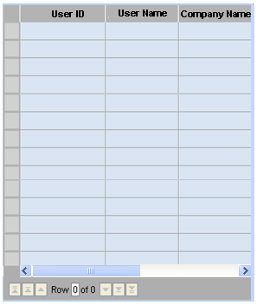
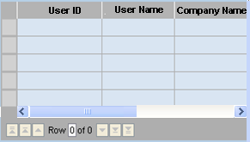
>>
Auto Set
>>
Select
>>
Select
1
From
To
1
1

