Slide 1
Content Management Portal
Project Planning Phase Presentation
SE16, Team 7S
11-April-2009

Slide 2
Project Background
Sponsor
Index Info Systems Pte Ltd (IIS)
Project
Content Management Portal
Business Objectives
  Provide online learning platform to subscribed members
  Host training materials
  Cost-cutting and effective approach
  Improve E-learning experience

Slide 3






Team Structure
Haiyang - Project Manager
Guru - System Architect
Thomas - Testing Manager
Karen - Quality Manager
May - Database Designer
Ravi - Technical Lead
Developer
Notes:
Haiyang – it’s me. Being a project manager, I will manage the whole team.
Karen – Quality Manager, in charge of the project quality
Thomas – Testing Manager, will work together with Quality Manager, but focusing on software testing.
Ravi – Technical Lead, provides technical support to the team
Guru – System Architect, will design the system architect.
May – Database Designer, will setup database, create tables etc.

Slide 4
Introduction – Core Modules
Content Manager System (CMS)
A platform for hosting training materials
Administration Control System (ACS)
User Management and Access Control
Multi-Choice Question (MCQ)
Generate multi-choice question papers as well as surveys
Report
- Usage Report, Certificate Report, System Log.

Slide 5







Introduction – Workflow
ACS
MCQ
REPORT
CMS

Slide 6
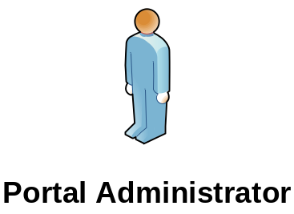
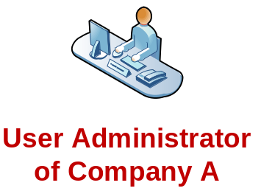
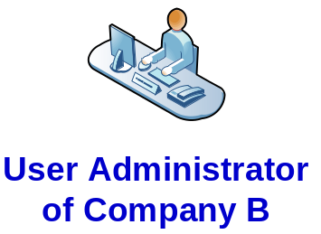


Content Management System
CMS
Module A
Module B

Slide 7



Multi-Choice Question
MCQ
Exercise
Exam
Question Pool
Survey

Slide 8






Administration Control System
Data Access Profile
Function Access Profile
User Profile

Slide 9
Technical Approach
Web Based Application
Three-tier
Microsoft .NET Framework 3.5
Visual Studio 2008
C#.NET
IIS (Internet Information Services)
SQL Server 2005
AJAX
3rd Party Tool – Issue Tracker.

Slide 10
Project Estimation – FPC
 | Simple | Average | Complex
EI (External Input) | 15 | 6 | 1
EO (External Output) | 4 | 2 | 0
EQ (External Query) | 6 | 2 | 2
ILF (Internal Logical File) | 7 | 0 | 0
EIF (External Interface File) | 0 | 0 | 0
Total Unadjusted FPC | 214
Adjustment Factor | 0.99
Total Adjusted FPC | 212

Slide 11
Project Estimation - COCOMO
Programming Language | C#.NET
Lines Per Functional Point | 59
Effort | 50.6 Months
Duration | 14.8 Months

Slide 12
Project Schedule
Task | Duration | Start Date | End Date
Initial Planning | 33 days | 07-Feb-09 | 11-Mar-09
Requirement Analysis | 52 days | 07-Feb-09 | 30-Mar-09
Prototype Development | 33 days | 20-Apr-09 | 22-May-09
Analysis Modeling | 35 days | 23-May-09 | 26-Jun-09
Design Modeling | 25 days | 27-Jun-09 | 21-Jul-09
Internal Training | 5 days | 22-Jul-09 | 26-Jul-09
Software Development | 60 days | 27-Jul-09 | 02-Oct-09
System Test | 84 days | 22-Jul-09 | 21-Oct-09
User Acceptance Test | 74 days | 03-Oct-09 | 15-Dec-09

Slide 13
Project Effort
Working Hour | 9:00pm - 11:00pm
Working Days Per Month | 30 days
Two Recess Weeks | 12 Apr - 19 Apr
 | 18 Aug - 23 Aug
Member | Hours | Days
Haiyang | 472 hrs | 57 days
Ravi | 524 hrs | 64 days
Guru | 506 hrs | 63 days
May | 471 hrs | 57 days
Karen | 453.5 hrs | 56 days
Thomas | 453.5 hrs | 56 days

Slide 14
Project Schedule – cont’
Feb | Mar | Apr | May | Jun | Jul | Aug | Sep | Oct | Nov | Dec
Initial Planning
Requirement Analysis
Prototype Development
Analysis Modeling
Design Modeling
Coding
Testing
UAT

Slide 15
Project Milestones
Finalize Quality Plan | 11-Mar-09
Finalize URS | 23-Mar-09
Finalize Project Plan | 11-Mar-09
Finalize Prototypes & User Interface Spec. | 19-May-09
Finalize Use Case Realn. Report | 21-Jun-09
Finalize Sequence Diagrams | 04-Jul-09
Finalize Design Modeling Report | 16-Jul-09
Complete Coding & Debugging | 02-Oct-09
Complete System Test | 21-Oct-09
Complete UAT | 30-Nov-09
Complete Enhancements | 14-Dec-09
Get User Sign Off | 15-Dec-09

Slide 16
Project Management
Progress Review Meeting
Work Instruction Form (WIF)
Timesheet
Email Communication
Document Review Process
Meeting Minutes
Version Control: Google Docs + SVN

Slide 17
Project Progress
Deliverable | Scheduled | Delivered
Project Plan | 11-Mar-09 | 30-Mar-09
Quality Plan | 11-Mar-09 | 28-Mar-09
User Requirement Spec. | 23-Mar-09 | 03-Apr-09
DELAYED

Slide 18
Progress Summary
Reasons for delay
Big change in team structure:
Technical Lead & Quality Executive left
2. Too much time spent on reviewing
What did we learn?
Review Control
Task Progress Monitoring
Notes:
Review control is that we control the review process, not allow infinite reviewing, reviewing must stop somewhere.

Slide 19
Risk Analysis
Risk | Impact | Solution
System Size & Functionality
Total Effort: 15,000-30,000 hours | High | De-scope
User organization and Systems requirements
Totally new system | High | Research on similar products
Real-time performance is Critical | Medium | Specific measurements in quality plan
Understanding User Requirements | High | Prototypes & Review
Technology & external dependencies
>75% of the software to be developed as new | High | Research on Existing Codes
Developer lacks experience | High | Internal Training + Task Assignment.
Project Management & Characteristics
No Team member has experience as Project Manager | High | Team members support each other; Get guidance from experienced PM
Only part-time developers. | High | Internal review and evaluation

Slide 20
Risk Analysis – Cont’
Risk : Project scope is too large.
Solution: Functional Point Count & De-scope.
Previous Scope:
CMS
MCQ
ACS
Report
Forum
Member Management
FPC: 669

Slide 21
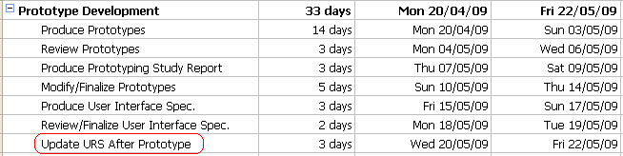
Risk Analysis – Cont’
Risk : Understanding of Requirements
Solution: Prototype & Review

Slide 22
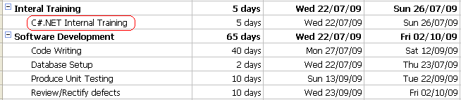
Risk Analysis – Cont’
Risk : Experience on C#.NET
Solution: Internal Training + Task Assignment
Notes:
Task assignment means assigning them some tasks other than technical things.

Slide 23
Project Next Phase
Prototype Developing
Use Case Analysis
Collaboration / Class Diagrams
Sequence Diagrams
System Architecture

Slide 24
Some Suggestions
Difficulty encountered on Project Management:
No incentive & penalty scheme
No special rights to Project Manager
Suggestions:
School may work more closely with Project Manager
Setup incentive & penalty scheme
More rights to Project Manager

Slide 25


