Slide 1
Content Management Portal
Final Presentation
Team SE16 – 7S
16 January, 2010

Slide 2
Agenda
Project Retrospect
Technical Approach
  Use Case Model
  System Architecture
  Application Architecture
Application Demo
Project Issues
  Technical Issues
  Management Issues
Project Progress
Lessons Learnt
Future Works

Slide 3
Project Retrospect - Background
Sponsor: Index Information Systems Pte Ltd
Web-based E-Learning Portal
Provide online learning platform to subscribed customers
Host training materials

Slide 4
Project Retrospect – Core Modules
Content Management System (CMS)
A platform for hosting training materials
Administration Control System (ACS)
User Management and Access Control
Multiple Choice Question (MCQ)
Generate multiple choice questions as well as surveys

Slide 5
Project Retrospect – Core Modules
Introduction to JMDCMS
A Free Open Source for Content Management
C#.NET + SQL Server
Create & Maintain content
WYSIWYG feature
Create & Maintain file manager

Slide 6
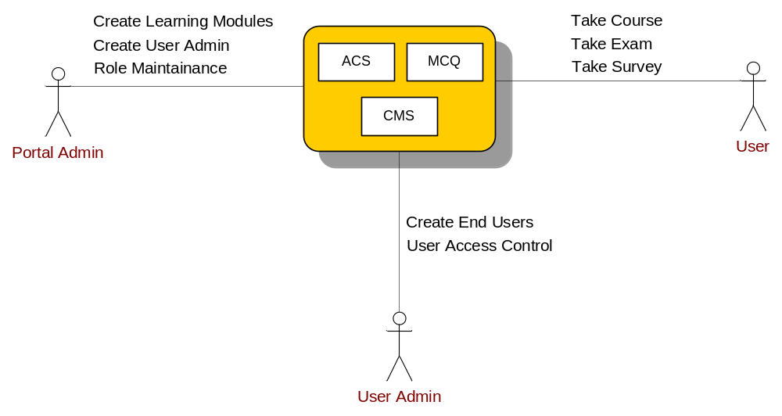
Project Retrospect – Actors
Notes:
User admin can distribute the modules among the user, and will assign the roles to user.

Slide 7
Technical Approach
Use Case Model
Global View

Slide 8
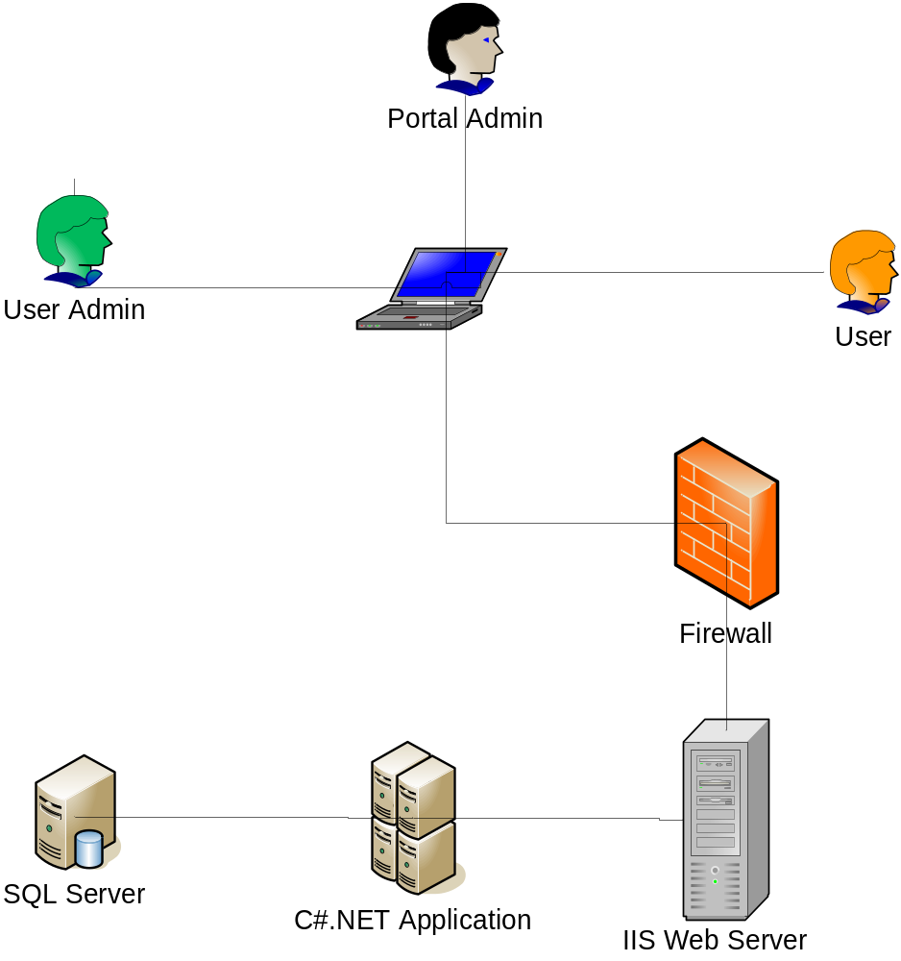
Technical Approach
System Architecture

Slide 9
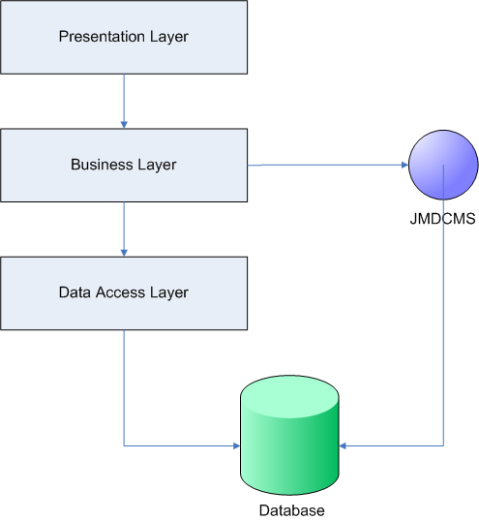
Technical Approach
Application Architecture

Slide 10
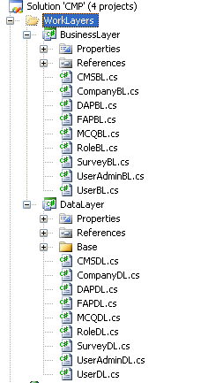
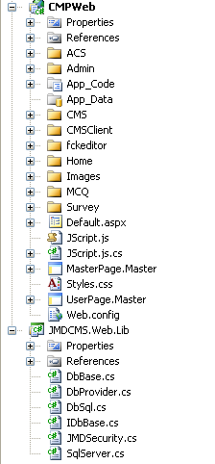
Technical Approach
Application Architecture

Slide 11
Application Demo

Slide 12
Project Issues – Technical Issues
Issue 1
Issue : JMDCMS (open source) creates virtual directory for each website.
Solution : Replaced with own codes.
Issue 2
Issue : JMDCMS has only one folder for hosting files.
Solution : Portal Admin manually upload content.

Slide 13
Project Issues – Management Issues
Loss of Man-power
Issue : Team members reduced from 8 to 6
Solution : Team re-structure and Project de-scope
Project De-scope
Issue : Auditors commented project too big in 1st Audit
Solution : Researched on 3rd-party tool - JMDCMS

Slide 14
Project Issues – Management Issues
Project Delay
Issue : Excessive Effort on Prototyping
Solution : Project re-plan (1st) and emergency plan
Change Request
Issue : Workflow changes requested by customer
Solution : Impact Analysis and re-plan (2nd re-plan)

Slide 15
Project Progress
Overall Effort Analysis
Effort (man-days) | Plan | Actual
Total Effort | 360 | 330
Average Effort | 60 | 55
Phase Effort Analysis
Phase | Man-days | Percentage
Requirements Gathering | 46.2 | 14%
Analysis | 142 | 43%
Design | 56 | 17%
Development | 59 | 18%
Testing | 23 | 7%

Slide 16
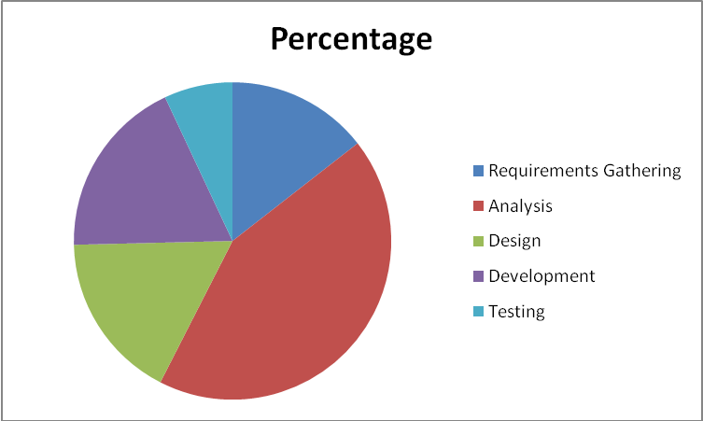
Project Progress
Effort Analysis By Phase

Slide 17
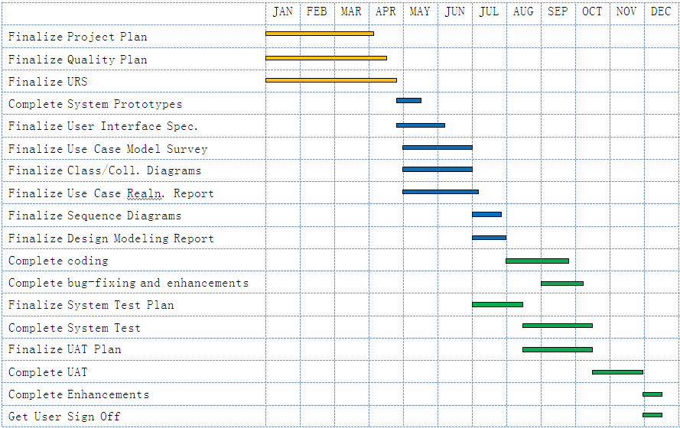
Project Progress
Initial Project Plan

Slide 18
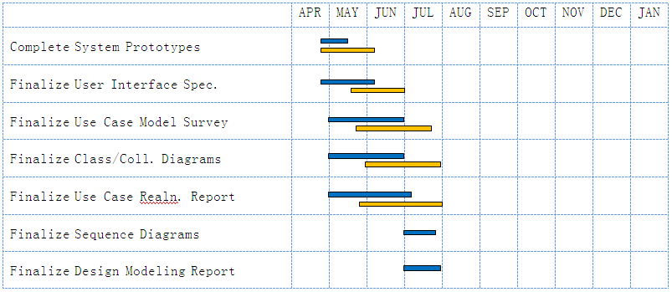
Project Progress
1st Project Re-plan
Plan Actual
Excessive Effort on Prototyping
Contingency Plan
Use buffer time
Extend from 13-Dec-09 to 10-Jan-10
Notes:
Put original plan, lengend.

Slide 19
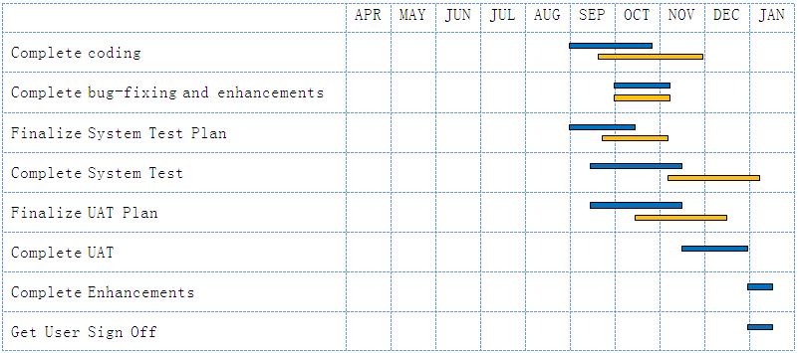
Project Progress
2nd Project Re-plan
Plan Actual
User Change Request
Impact Analysis
Deferred from 10-Jan-10 to 30-Jan-10
Notes:
Put original plan, lengend.

Slide 20
Lesson Learnt
Communication
Team build up
Project Monitoring
Open Source
Domain Knowledge
Notes:
Put original plan, lengend.

Slide 21
Future Works
User Training
UAT
Usability Improvement
Performance Testing & Improvement
Notes:
One more column as deliverables in documents.

Slide 22


