Slide 1
E-invoice System – API Sandbox
National Informatics Centre

Slide 2
Introduction to E Invoice Developer Portal
All information required for ERP and Financial Accounting Software developers to integrate e-Invoicing System through API
Registration for testing the APIs on Sandbox environment
General Information like Introduction, Overview, Benefits, Onboarding procedure, best practices, FAQs etc.
Announcements on latest developments etc.
API Documentation including specifications, Sample payloads, JSON schemas, Validation details etc.
Master lists, Sample Codes etc.
Online API Testing Tool

Slide 3
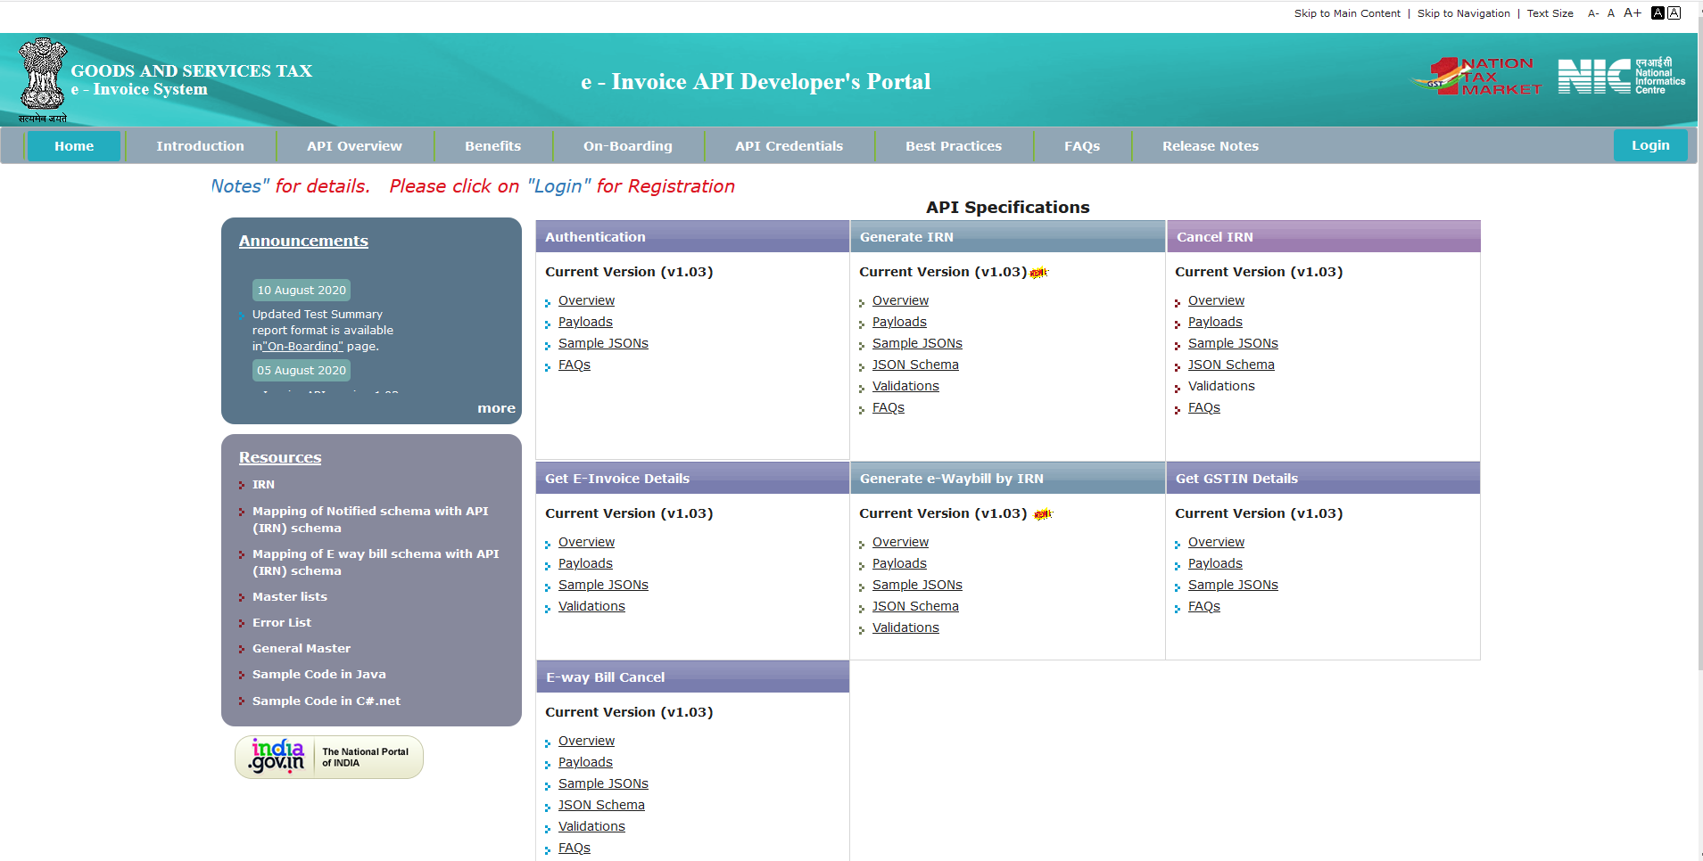

Slide 4
Registration
Eligible Tax Payers, GSPs can register for testing the APIs on the Sandbox
While registering, the OTP would be sent to the registered Mobile Number and eMail id.
Credentials include Client_Id, Client_Secret, User_Id and Password
After successfully registering, user has to login in to the portal for
  Checking the correctness of the credentials created
  To add additional accounts for eligible GSTINs by GSPs , additional GSTINs based on same PAN by Tax Payers
  To use the online API test tool to understand the working of the APIs before actually start coding
  To get the required end points for all APIs and Public Key
  To use and understand other tools like encryption / decryption, verification of digitally signed e-Invoice and QR code etc.
Facility for retrieving forgotten credentials

Slide 5
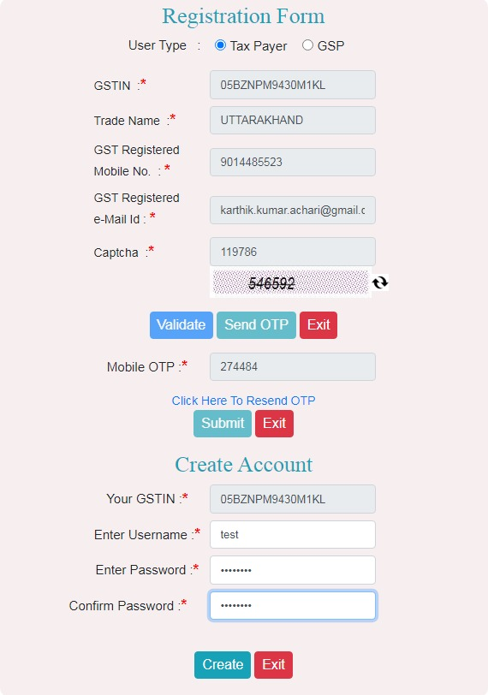

Registration form

Slide 6
Online Test Tool
Shows working of the APIs through step by step
To understand the working of APIs, alter the request payloads and see the effect of such changes
Compare the outputs in the intermediate stages such as output after encryption step, decryption step etc.
Can send the encrypted payload that is generated using own code through this tools to verify the encryption logic and similarly for decryption etc.

Slide 7
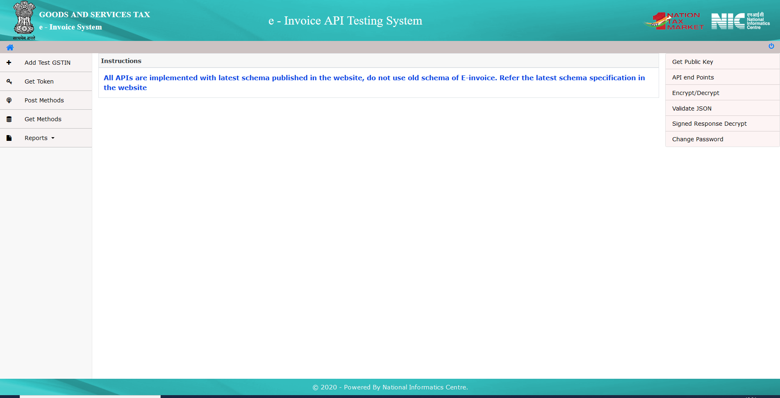

Slide 8
Add GSTIN
GSPs can add test account for any of their eligible users, users will use GSPs Client_Id, Client_Secret and their own User_Id and Password
Virtual ids similar to GSTINs are created for GSPs based on their PAN to test the APIs internally. GSPs can create one account each for each State
Tax payers can add the accounts for other GSTINs based on their own PAN and all users will use same Client_Id and Client_Secret
Registration process involves verification of registered mobile number and eMail

Slide 9
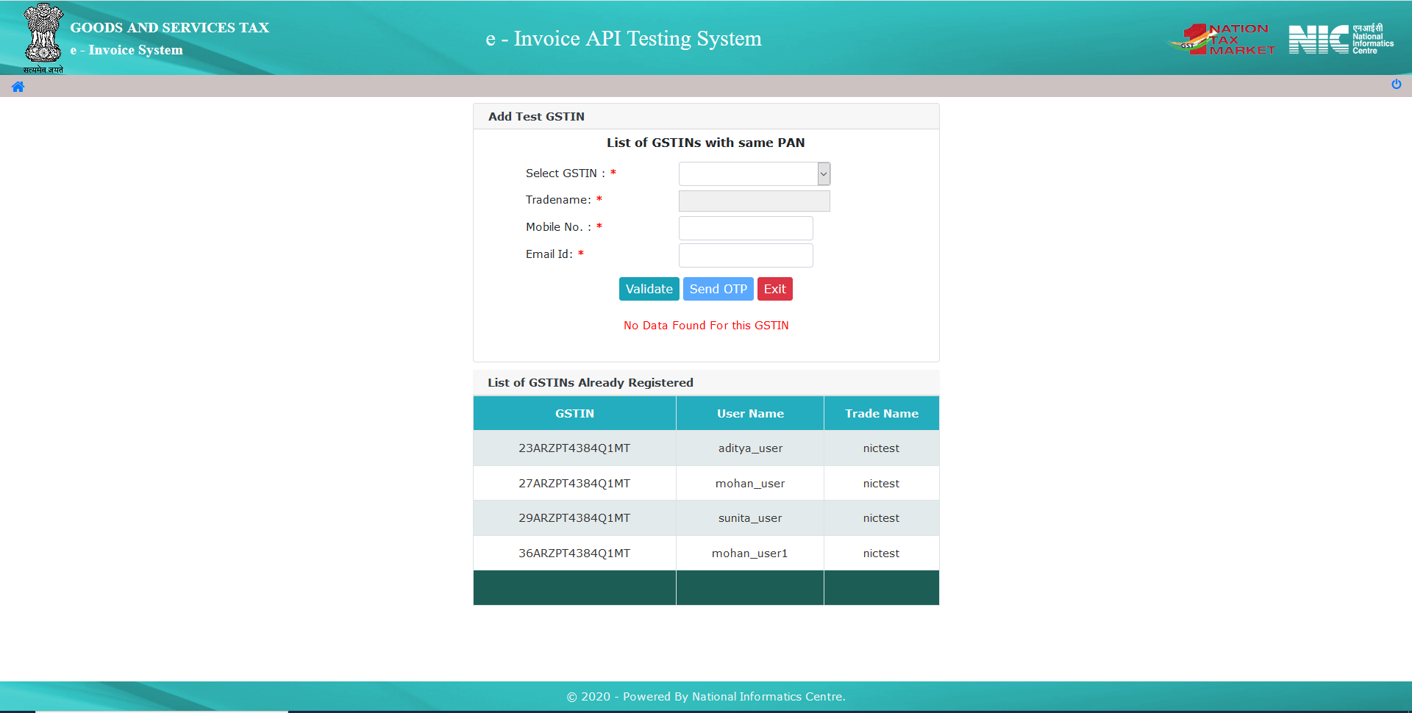

Slide 10
List of APIs
Authentication (POST)
Generate IRN (POST)
Cancel e-Invoice (POST)
Generate E Way Bill using IRN (POST)
Cancel E Way Bill (POST) – Separately added only for Sandbox testing
Get e-Invoice Details (GET)
Get GSTIN Details (GET)

Slide 11
Authentication API
Authentication of the e-Invoice System is mandatory to use any other APIs
Once authenticated successfully, an authentication and Session Encryption Key (SEK) will be provided. This pair will be valid for 6 hours In production and 1 hour in sandbox environment
Calls to this API while the token is still active will return same pair of token and SEK
Using the ‘ForceRefreshAccessToken’ attribute set to TRUE, one can get new token generated forcefully during last 10 minutes of validity of token
In the production environment, token can be generated either through e-Invoice System or E Way Bill System and can be used to call APIs of either system

Slide 12
Authentication
Client_Id and Client_Secret will be passed in the request header
Consuming application has to generate App_Key which is a random 32 byte array
Password and App_Key has to be encrypted using public key of the e-Invoice Sandbox environment
User_Id, encrypted Password, encrypted App_Key and flag for forcefull generation of token will be part of request JSON
Once authenticated successfully, auth. token and encrypted SEK will be returned in the response
Encrypted SEK has to be decrypted using locally generated App_Key that was sent in the request payload using symmetric algorithm
Subsequent POST API requests have to be encrypted using the SEK and responses of all APIs have to be decrypted using the same valid SEK

Slide 13
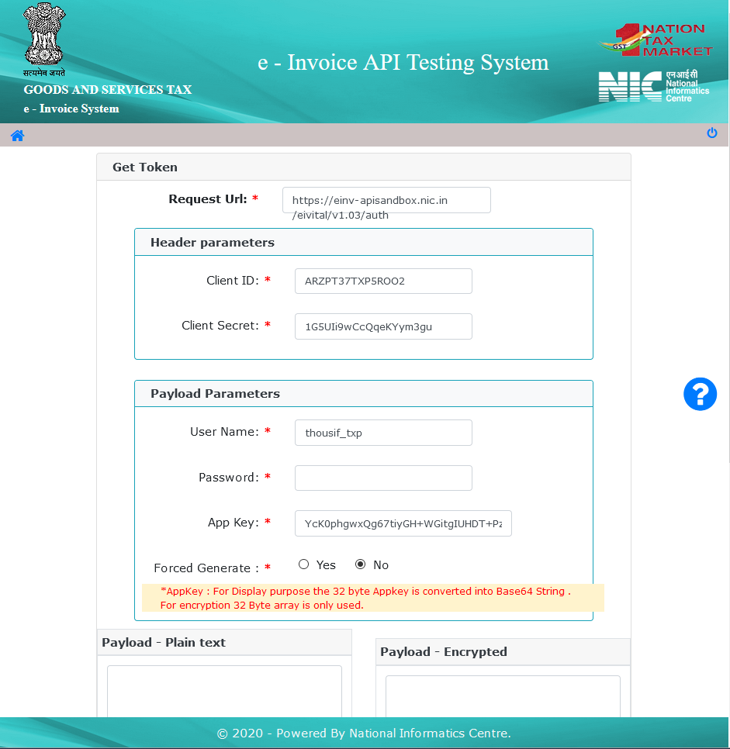
API Test Tool: Authentication
Clicking on “Get Token” will show the page that calls the Authentication API
All credentials except password are automatically populated
App_Key is created, (shown as string only for purpose of representation)
User has to enter the Password and scroll down
Enter password

Slide 14
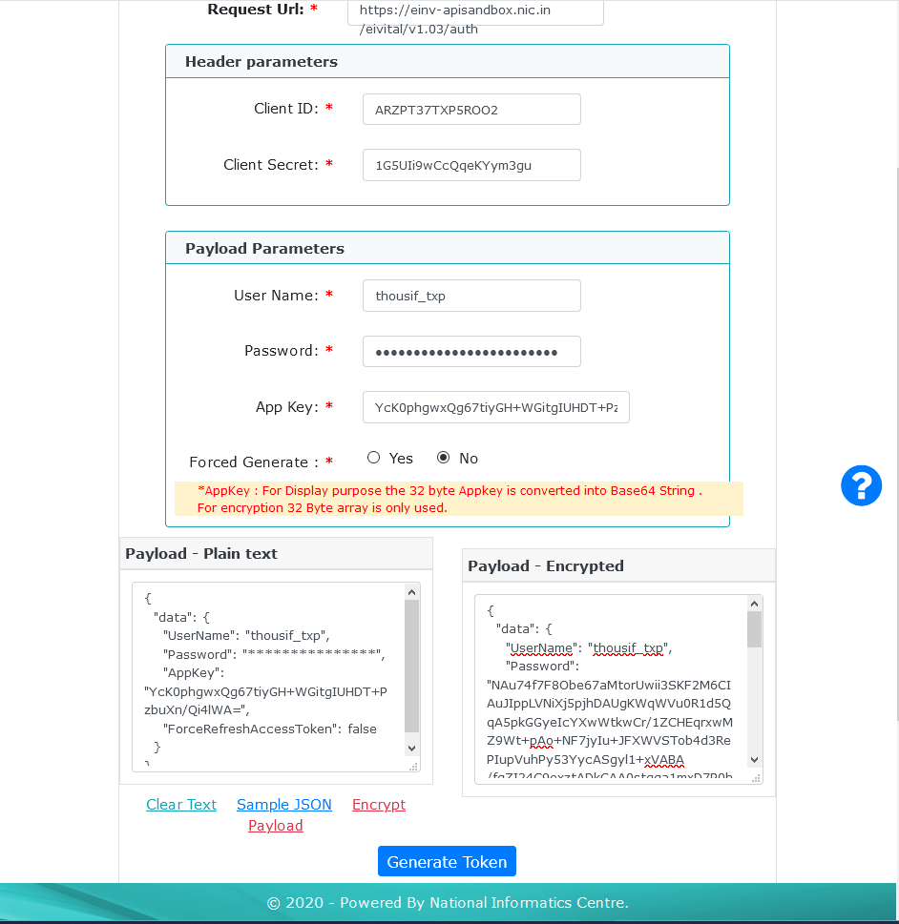
API Test Tool: Authentication
Clicking on “Sample JSON” will populate sample JSON in “Payload – Plain text” box
Password shown is only symbolic
Clicking on “Encrypt Payload” will encrypt the password entered in the “Password” field, encrypt the “App Key” generated internally, creates the actual payload to be posted and populates “Payload – Encrypted” text area
User generated payload can be pasted in the “Payload – Encrypted” text area for testing
(1) Click to get Sample JSON
(2) Click to get Encrypted payload

Slide 15
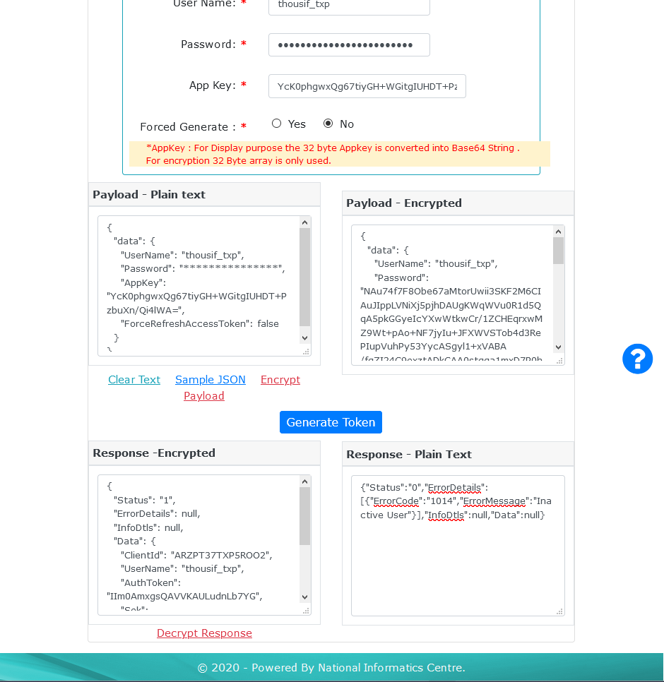
API Test Tool: Authentication
Clicking on “Generate Token” will post the request to the Auth. API end point and populates the response in the “Response – Encrypted” text area
If the call is successful, status will be equal to 1
SEK in response is encrypted using the App_Key that was sent as part of request
Clicking on “Decrypt Response” will decrypt the SEK and populate the response JSON in “Response – Plain Text” text area
One can paste the response received using own code, paste the JSON, change App_Key to test decryption algorithm
(1) Click to Call the API and post request
(2) Click to decrypt the SEK in response

Slide 16
API Test Tool: Generate IRN
API for generating the IRN
Request payload should conform to the notified schema and all validations published
If the payload contains valid E Way Bill request payload, E Way Bill also gets generated along with IRN
If E Way Bill payload has issues, IRN will be generated and error details related to E Way Bill are provided in the response
Request and Response payloads are encrypted using the SEK with symmetric algorithm

Slide 17
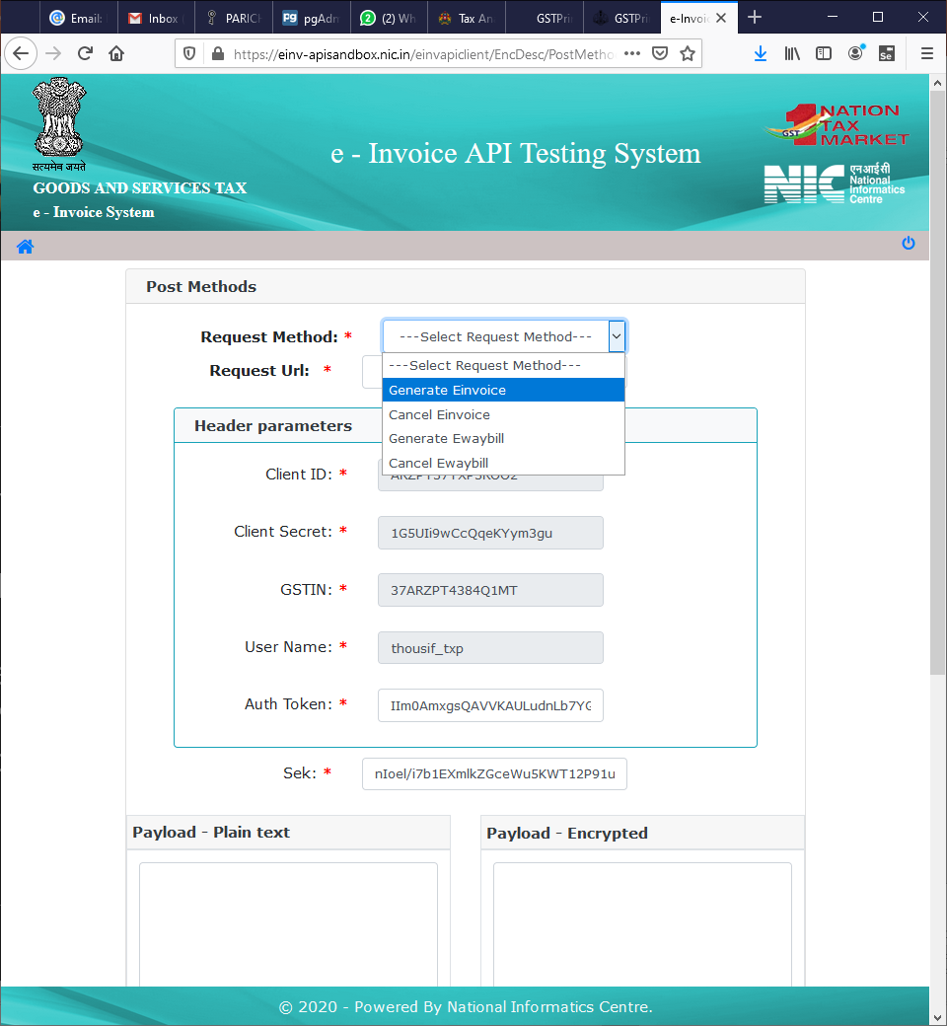
API Test Tool:
Generate IRN
Select the “Generate Einvoice” from the dropdown
End point will be populated, Header parameters are assigned automatically

Slide 18
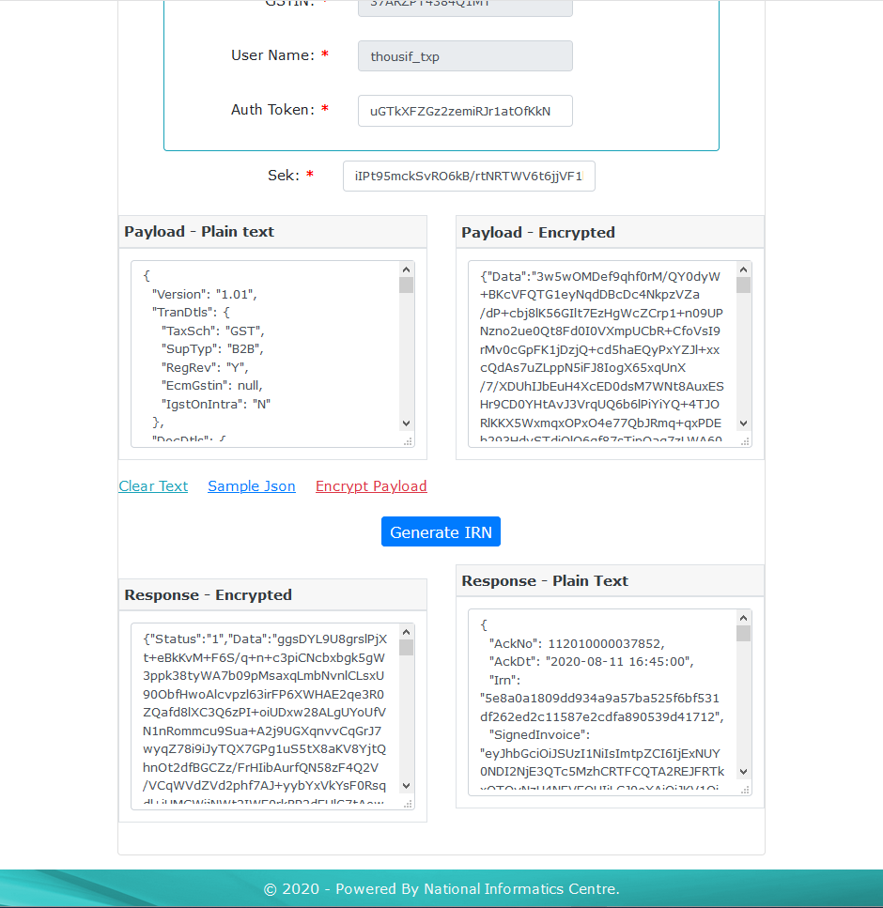
API Test Tool:
Generate IRN
Clicking “Sample Json” loads the sample JSON in “Payload – Plain text” text area.
Required changes in the JSON to satisfy validations to be made.
Clicking on “Encrypt Payload” will encrypt the payload using available SEK and populate the payload in “Payload – Encrypted” text area.
Clicking on “Generate IRN” will post the request payload to the respective endpoint, populates the response in “Response – Encrypted” text area, the encrypted response is decrypted using the SEK and populated in “Response – Plain text” text area
(2) Modify as required
(1) Click to get Sample JSON
(3) Click to get Encrypted payload
(4) Call the API

Slide 19
API Test Tool: Other POST APIs
Other POST APIs can be tested the similar way
The request payload and endpoints differ

Slide 20
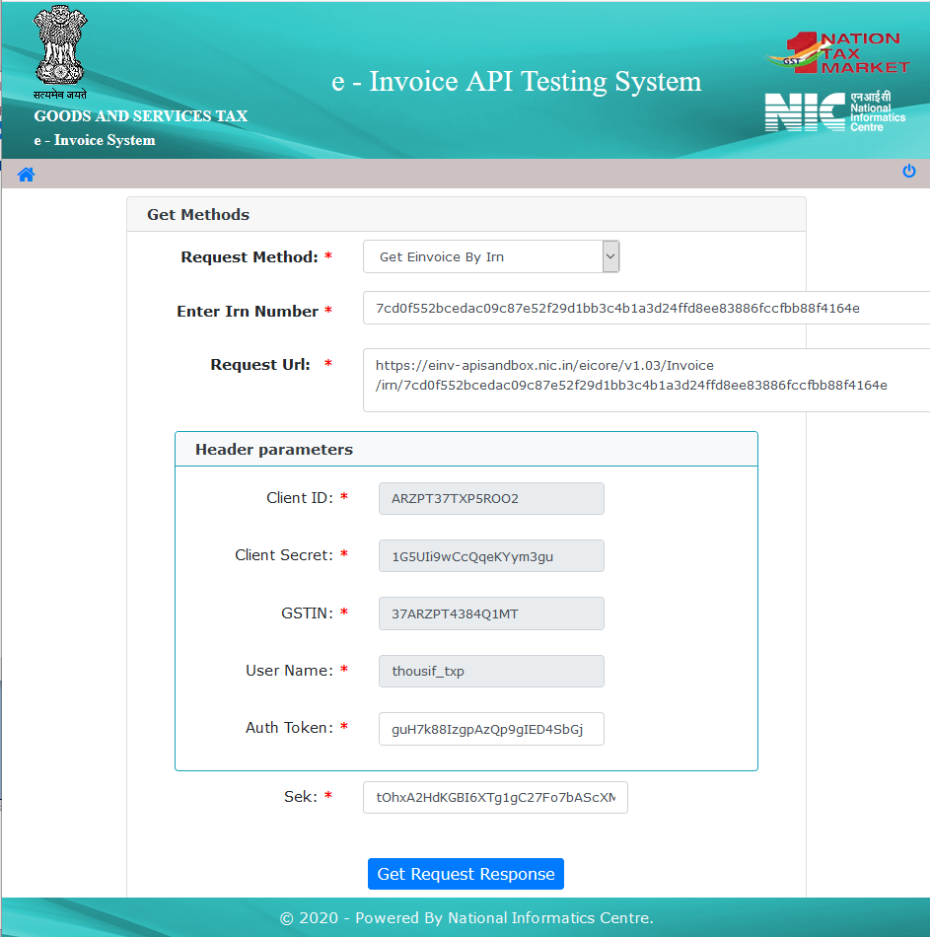
API Test Tool: Get e-Invoice Details
API to get the e-Invoice details
IRN to be pasted in “Enter Irn Number” textbox
Request URL along with the required parameter is created in “Request Url” box
Required header parameters are automatically populated
Clicking on the “Get Request Response” would call the API and get the response

Slide 21
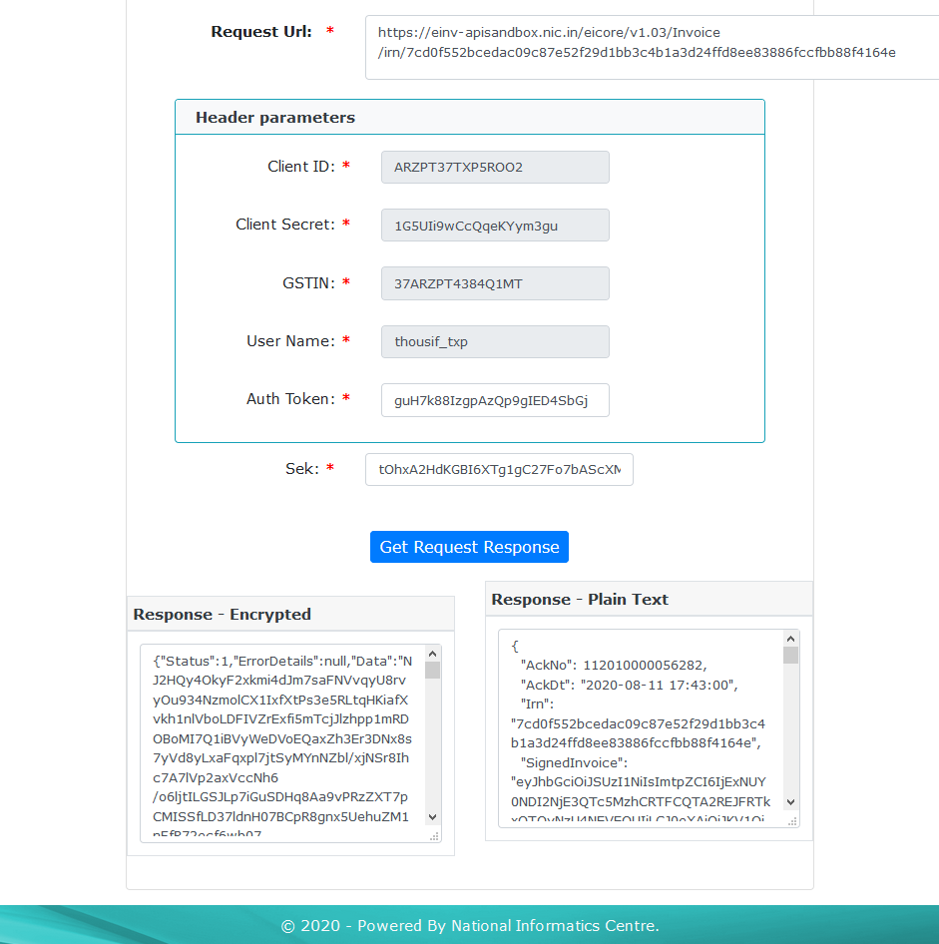
API Test Tool: Get e-Invoice Details
“Data” attribute in response JSON contains encrypted data
Decrypting the encrypted data using SEK with symmetric algorithm get the response in plain text and populates “Response – Plain Text” text area
Response in plain text contains
  Acknowledge number – unique number generated by system
  IRN generation date
  IRN
  Signed Invoice
  Signed QR Code
  Status
  E Way Bill details (if generated as part of IRN generation)

Slide 22
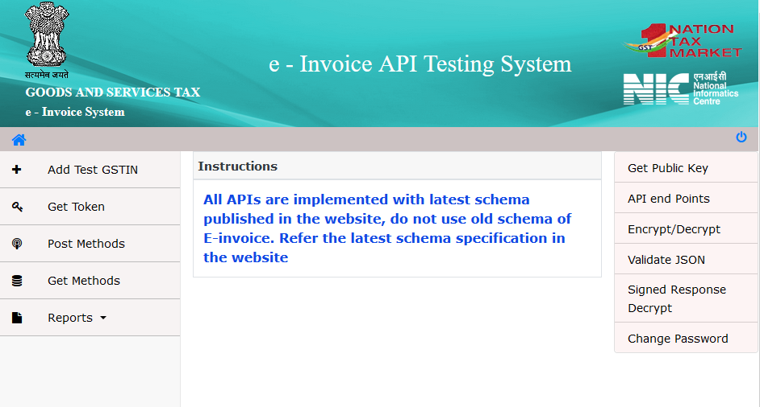
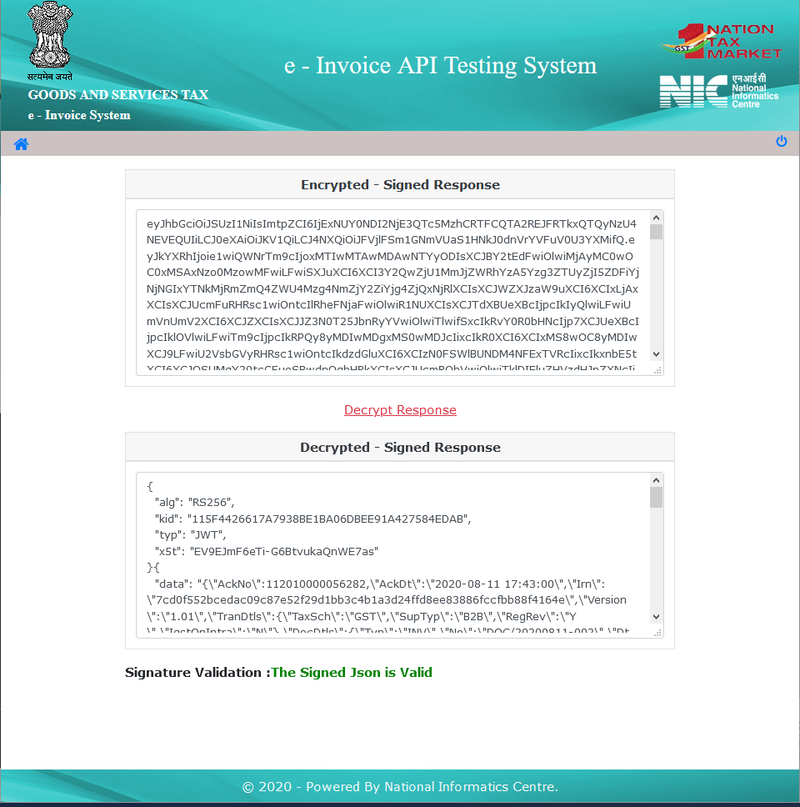
Other Utilities
The Public Key required for encrypting the password, App_Key and to verify signed e-Invoice and signed QR code
Endpoints for all APIs
Facility to Encrypt plain text data and decrypt encrypted data using the SEK provided
Tool to Check the syntax of JSONs
Verification of Signed e-Invoice data and Signed QR Code

Slide 23
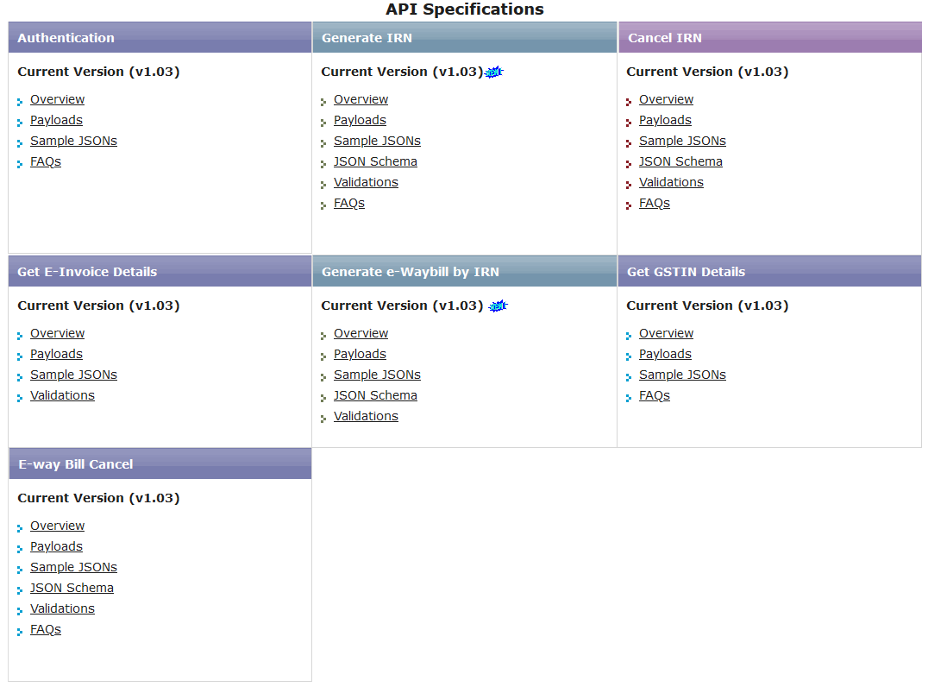
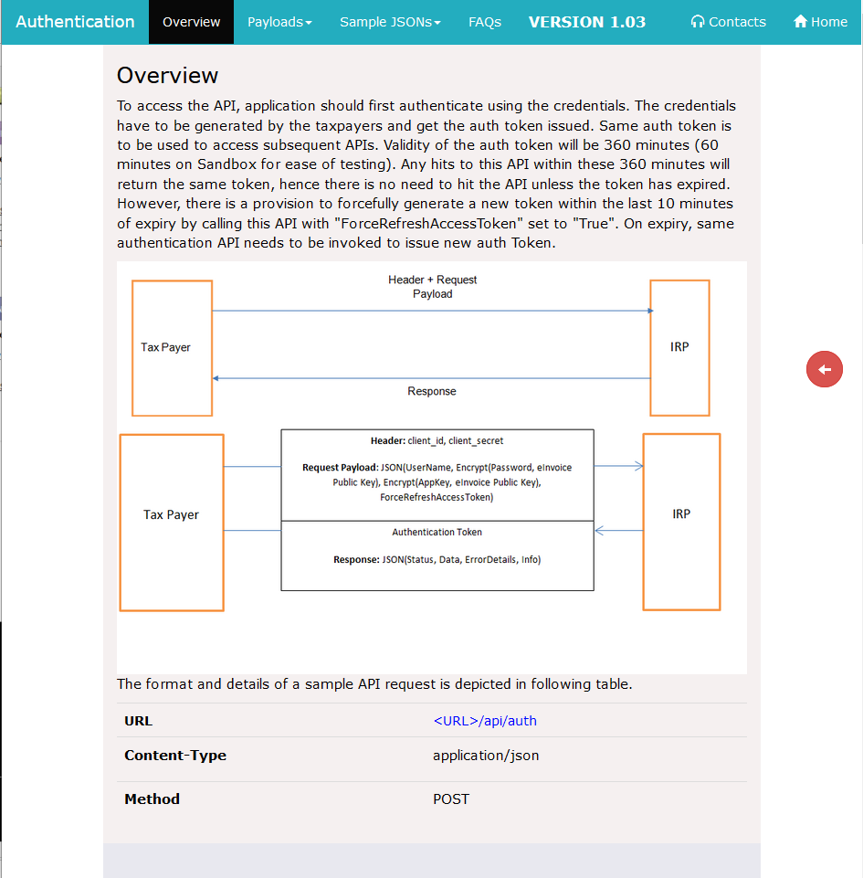
API Documentation
Detailed documentation on each of the APIs can be accessed from the home page itself
The documentation include
  Overview
  Descriptions of the Request and Response payloads
  Samples for Request and Response payloads
  Schema for the request payloads in case of POST APIs
  Validations and FAQs , as applicable

Slide 24


Thank you
support.einv.api@gov.in, support.web.api@gov.in
https://einv-apisandbox.nic.in, https://einvoice1.gst.gov.in/

