Slide 1
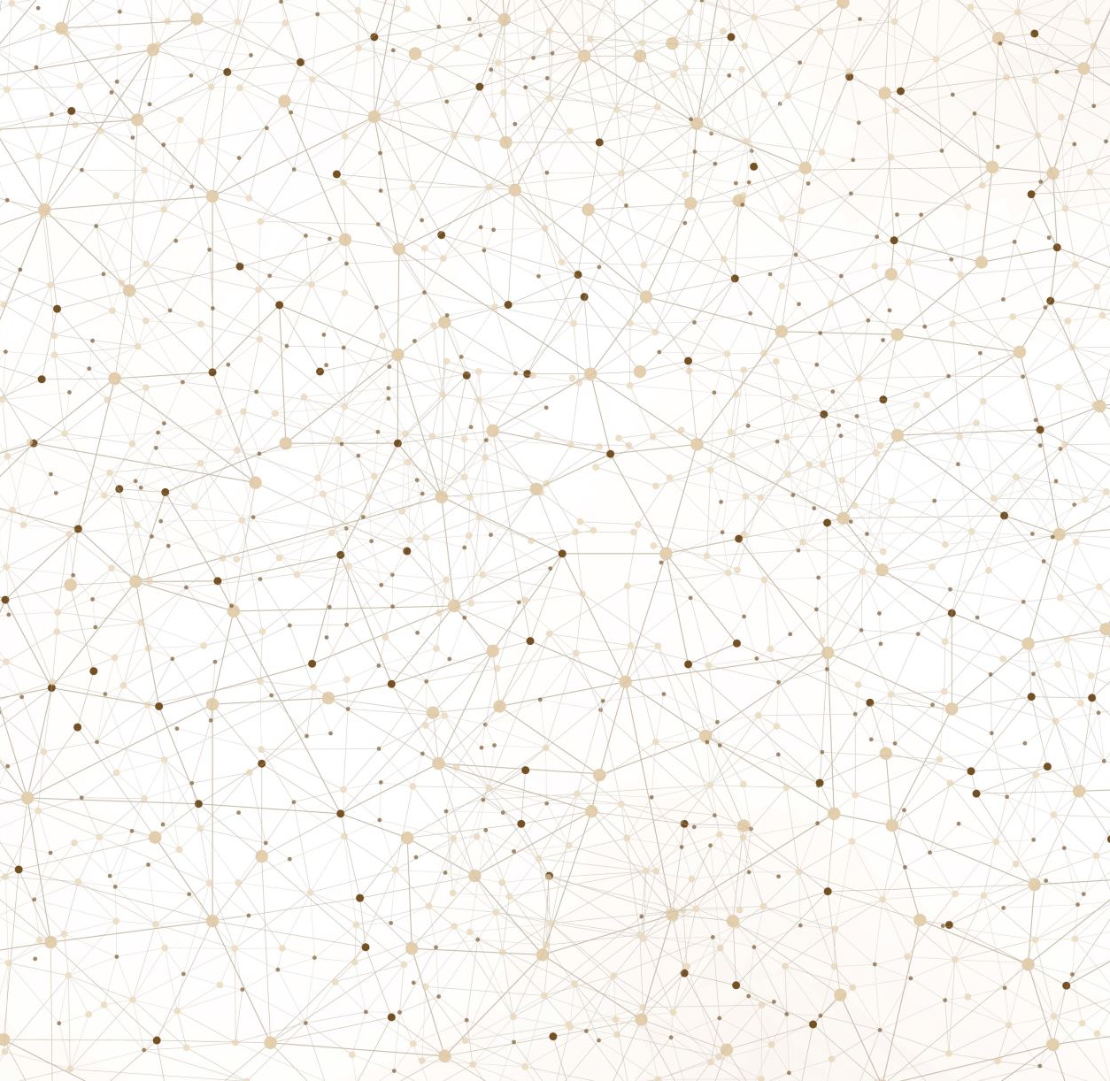
Using motif analysis to distinguish biased citation networks from unbiased ones
Yuanxi Fu
2022.04.21

Slide 2
Motivation
Question
Can citation bias be detected with a network-structure only method without intensive content analysis?
Benefit
- Scalability

Slide 3
General Methodology
Define a method to generate null models for observed citation networks (same node configuration, but randomized edge configuration) ({G_{sim}}).
Choose a network structure metric (η).
Obtain the network data of a biased citation network G_{biased} and an unbiased citation network G_{unbiased}. For each of the network do the following steps, and we will call each of them G_{obs} for the moment.
Compute the value of η on G_{obs} and {G_{sim}} to obtain η_{obs} and {η_{sim}}
Measure where η_{obs} sits in the distribution of {η_{sim}}

Slide 4
General Methodology (cont.)
If η can distinguish biased networks from unbiased ones, we expect there is a difference between where η_{obs} sits in the distribution of {η_{sim}} , in particular:
For the biased citation network, η_{obs} is a far outlier in the distribution of {η_{sim}} .
For the unbiased citation network, η_{obs} falls with in the distribution of {η_{sim}} .

Slide 5
Difference from what was proposed in CRB application
Yes, we do need observed biased and unbiased citation networks because observed networks can be different from randomized ones due to reasons other than citation bias. Without a comparison between observed biase and unbiased citation networks, we cannot rule that possibility out.

Slide 6
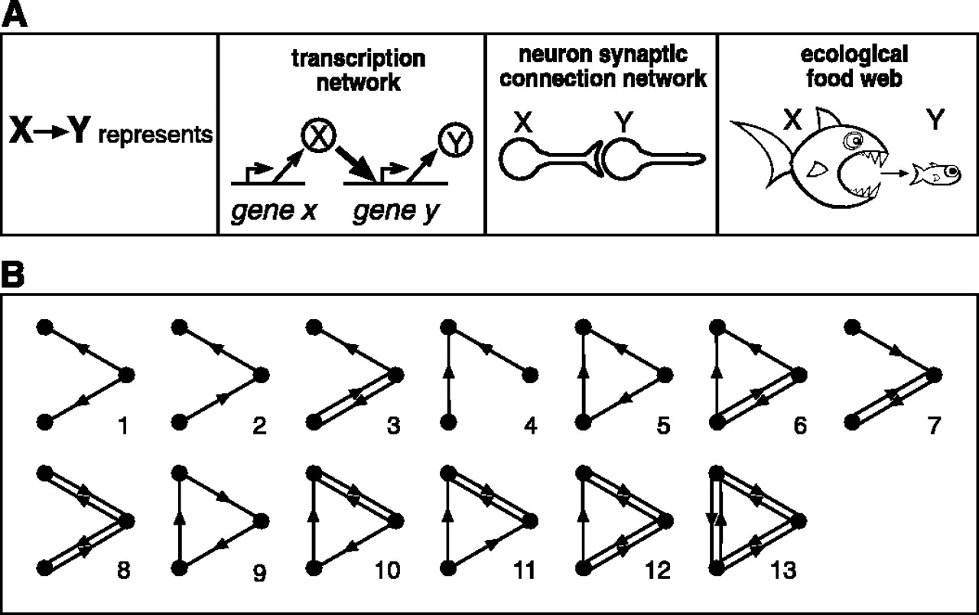
Counting network motifs – the η
What is network motif?
Small, recurring, statistically significant patterns in a network (Milo et al., 2002)
Made up of a few nodes.
First introduced in biological research, and often have functional significance.
(Milo et al., 2002)

Slide 7
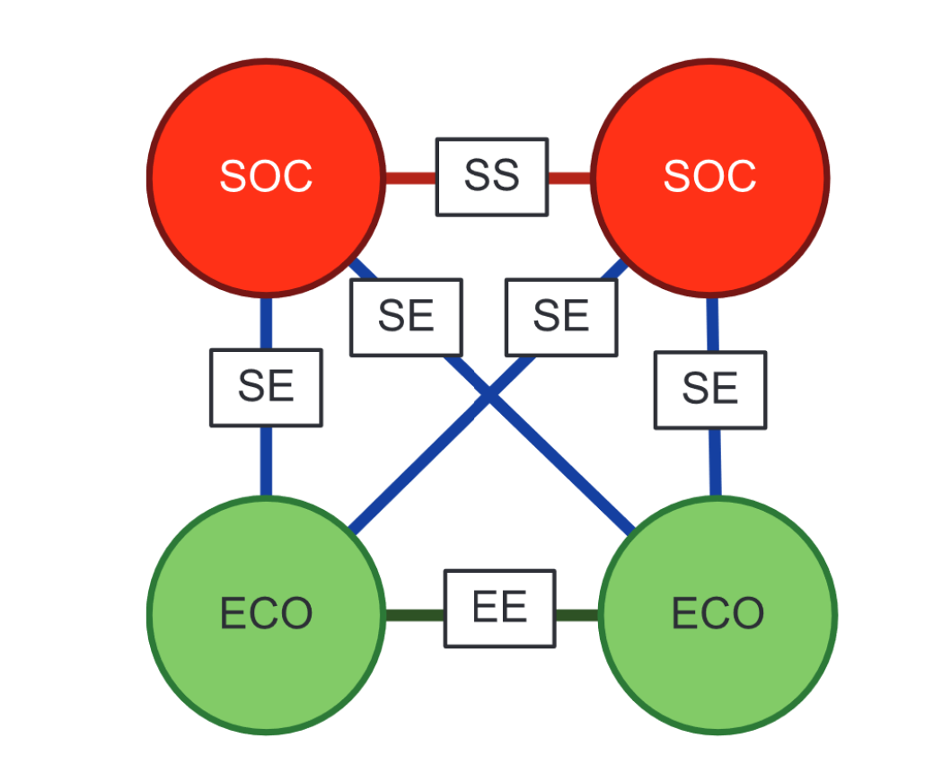
Multi-level network motifs
Inspired by the application of motif analysis in ecology (Bodin & Tengö, 2012).
Reviews and empirical studies are different “species” in the ecological system of scientific publications (Greenberg, 2011).
Bodin & Tengö’s work has been implemented in R (motifR) and Python (SESanalyzer).
(Bodin & Tengö, 2012)

Slide 8
Data
One biased citation network: the hygiene hypothesis dataset (Duyx et al., 2017)
One unbiased citation network: the diesel/lung cancer association dataset (Duyx et al., 2018)
Nodes: publications
Edges: citation relationship
Metadata: publication date, conclusion classification, study design, publication type (review or empirical studies) etc.

Slide 9
Method
Choose a few motifs
Compute the number of such motifs in observed networks (η_{obs})
Generate null model of the observed networks, by:
Set a gap period (365 days) and identify the papers that can possibly be cited by a paper (potential citations)
Randomize the edges (citations) of one paper among its potential citations to generate one network configuration.
Compute the number of η for this configuration (η_{sim})
Repeat the process for 500 times (to save computation time for now).
Obtain {η_{sim} }, the null model distribution.
Compare η_{obs} and the distribution {η_{sim} }

Slide 10
The Rub – network null model
You cannot randomize the edges in a network for 1000 times and call it a statistically valid ensemble, because there is no guarantee that your algorithm will sample all configurations with the correct probability.
However, in reality, that is what researchers do (Shizuka & McDonald, 2015).
Reason: there is not enough mathematicians/statisticians to develop statistically valid network null models for different research purposes (i.e., imposing their characteristic constraints). And plus, developing network null models is hard if not impossible.
The problem of network null model plagues motif analysis too, but this is the best people can do now (Artzy-Randrup et al., 2004).

Slide 11
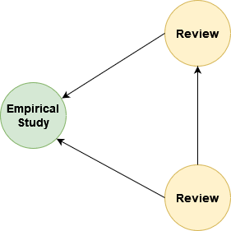
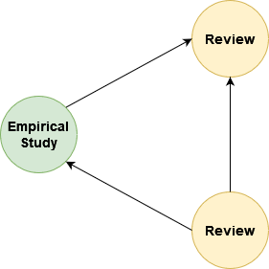
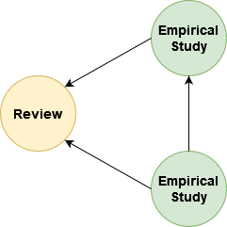
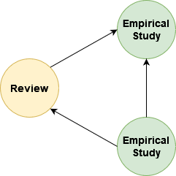
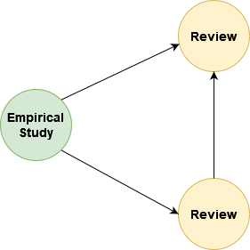
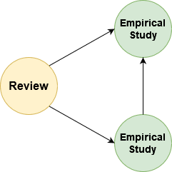
Motifs studied – only triads for the moment
1,2[II.C.1]
1,2[II.C.2]
2,1[II.C.1]
2,1[II.C.2]
1,2[II.C.5]
2,1[II.C.5]

Slide 12
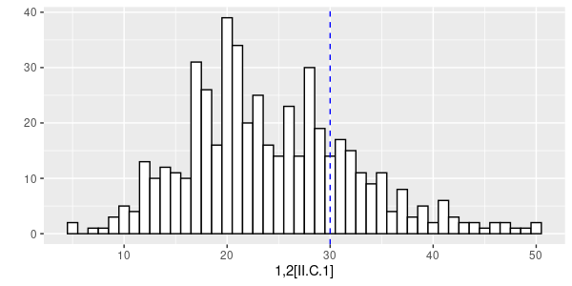
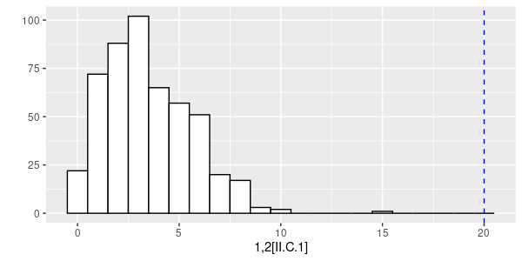

Unbiased
1,2[II.C.1]
Biased

Slide 13
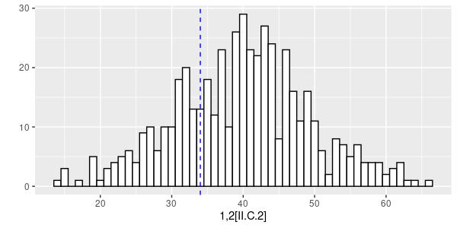
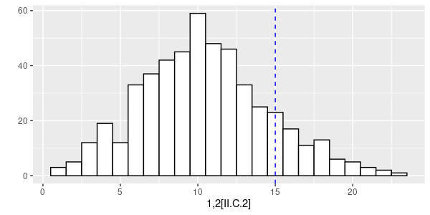

unbiased
1,2[II.C.2]
Biased

Slide 14
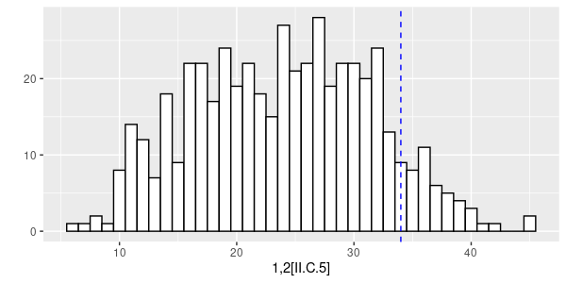
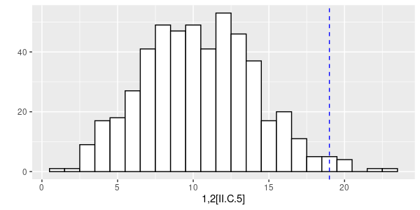
Unbiased
1,2[II.C.5]
Biased

Slide 15
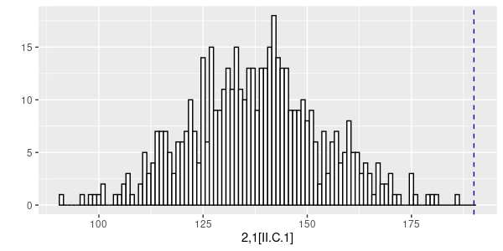
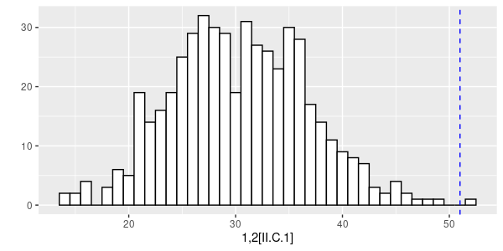
Unbiased
2,1[II.C.1]
Biased

Slide 16
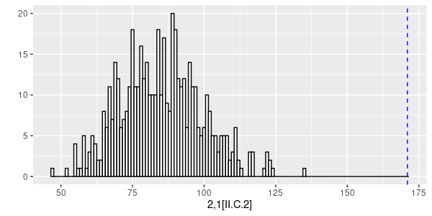
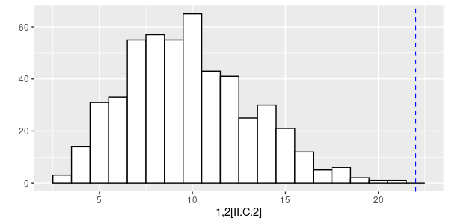
Unbiased
2,1[II.C.2]
Biased

Slide 17
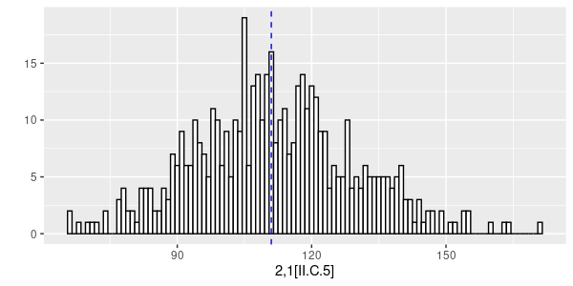
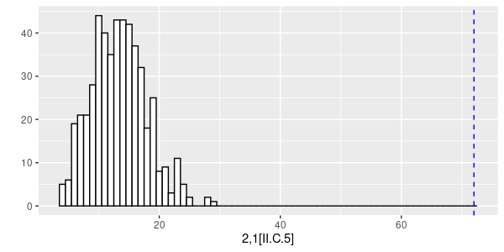
Unbiased
2,1[II.C.5]
Biased

Slide 18
Conclusion
The numbers of motif 1,2[II.C.1] and motif 2,1[II.C.5] have the potential to distinguish biased network from unbiased ones.

Slide 19
Future Work
Check code and results.
Increase simulation to 1000 times.
Contact the owner of the data for permission to publish the work. Currently the license of the two datasets may prohibit publications based on their data (CC-BY-NC-ND 4.0)
Find an explanation why M1 and M6, not others.
However, the two datasets are still different in other ways than biased vs unbiased. A definite answer will require studies with synthetic network by varying its degree of bias.

Slide 20
References
Artzy-Randrup, Y., Fleishman, S. J., Ben-Tal, N., & Stone, L. (2004). Comment on “Network Motifs: Simple Building Blocks of Complex Networks” and “Superfamilies of Evolved and Designed Networks.” Science, 305(5687), 1107–1107. https://doi.org/10.1126/science.1099334
Bodin, Ö., & Tengö, M. (2012). Disentangling intangible social–ecological systems. Global Environmental Change, 22(2), 430–439. https://doi.org/10.1016/j.gloenvcha.2012.01.005
Duyx, Bram; Urlings, Miriam; Swaen, Gerard; Bouter, Lex; Zeegers, Maurice, 2017, "Citation analysis of the published literature on the hygiene hypothesis", https://doi.org/10.34894/G0X6CS, DataverseNL, V3
Duyx, Bram; Urlings, Miriam; Swaen, Gerard; Bouter, Lex; Zeegers, Maurice, 2018, "Citation analysis of the Diesel Exhaust Exposure - Lung Cancer hypothesis", https://doi.org/10.34894/8NTFCX, DataverseNL, V4
Greenberg, S. A. (2011). Understanding belief using citation networks: Citation networks. Journal of Evaluation in Clinical Practice, 17(2), 389–393. https://doi.org/10.1111/j.1365-2753.2011.01646.x
Milo, R., Shen-Orr, S., Itzkovitz, S., Kashtan, N., Chklovskii, D., & Alon, U. (2002). Network Motifs: Simple Building Blocks of Complex Networks. Science, 298(5594), 824–827. https://doi.org/10.1126/science.298.5594.824
Shizuka, D., & McDonald, D. B. (2015). The network motif architecture of dominance hierarchies. Journal of The Royal Society Interface, 12(105), 20150080. https://doi.org/10.1098/rsif.2015.0080

