Slide 1
“This research is funded by”: Named Entity Recognition of Financial Information in Research Papers
Daria Alexander, Arjen P. de Vries

Slide 2
1. Introduction
Named Entity Recognition is the task of identifying named entities like person, location, organisation, drug, time, clinical procedure, biological protein in text
Our case: extracting funding information from research articles
It is important strategic information in academia
- which research output is linked to which research program
- what are the subsidies that fund this type of research
- recently: Google Scholar started using funding information to promote open access to papers

Slide 3
1. Introduction
Our aim: extract as much relevant funding information as possible
For that purpose we introduce a tool which is called AckNER
AckNER will be used to extract named entities from the ”Acknowledgements” and “Funding” sections of the scientific articles
It will later populate a Spinque knowledge graph

Slide 4
2.Related work
Ways of extracting named entities from the ”Acknowledgements”:
- Using regular expressions (Giles and Councill, 2005)
Using pre-trained named entity recognisers such as OpenCalais and AlchemyAPI (Khabsa et al.,2012), Stanford Core NLP and LingPipe (Kayal et al., 2019)
Using vocabularies for the extracting the names of funding organisations, for example CrossRef’s Open Funder Registry (Kayal et al., 2019)

Slide 5
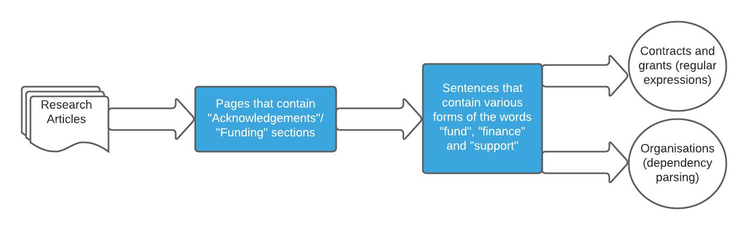
3. Methodology

Slide 6
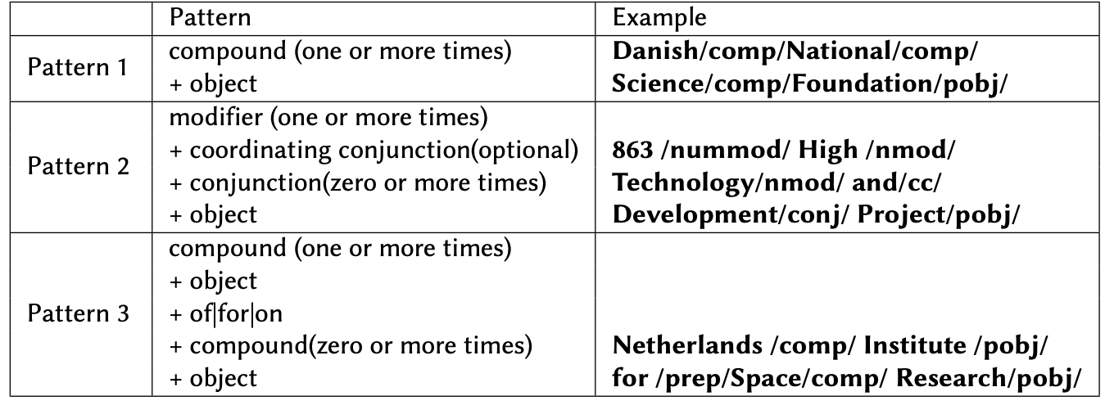
3. Methodology
1) Dependency patterns for extracting funding organisations
Full sentence pattern 1. This/det/work/nsubjpass/ was/auxpass/supported/ROOT/by/agent/
the/det/Danish/comp/ National/comp/ Science/comp/ Foundation/pobj/

Slide 7
3. Methodology
2) Regular expressions for extracting contracts and grants
a) For contracts:
[Cc]ontract (No\.)?[A-Za-z0-9-]+
b) For grants:
[Gg]rant ?([Aa]greement)? (No\.)?[A-Z0-9-\.\/\\]+

Slide 8
4. Evaluation
On the from a random sample from TU Delft’s institutional repository
321 research articles and dissertations
Out of them 102 contained “Acknowledgments” or “Funding” sections
Compared the results of AckNer with 4 state-of-the art NLP libraries
Spacy
Stanza (Stanford core NLP)
Flair
DeepPavlov
Extracted ORG labels (for organisations) and LAW labels (for contracts and grants)

Slide 9
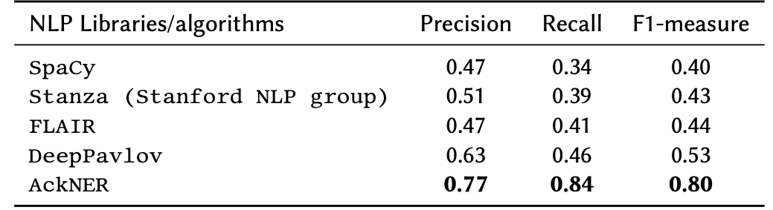
5. Results

Slide 10
6. Discussion
Why does AckNer perform better than the selected NLP libraries?
It extracts the entities that have non-capitalised parts (Smartmix funding program, ToKeN VindIT project)
E.g.: BSIK / BRICKS project
DeepPavlov and Flair: BSIK / BRICK
Stanza and Spacy: do not recognise at all
2) It extracts almost all contracts and grants:
AckNER : 13 out of 14
Flair : 3 out of 14
Spacy and DeepPavlov: 0 out of 14

Slide 11
7. Conclusion
Limitations:
The sample size is small (102 articles that contain an “Acknowledgments”/“Funding” section, out of 321)
Sometimes extracts sentences that do not contain funding information:
E.g.: We would like to thank G. Bihlmayer for technical support.
Findings:
- NER is not a solved problem
- as soon as you have unexpected data, NLP libraries do not perform that well
What’s next?
- run AckNER on a larger collection
- add extracted entities to a knowledge graph and link them to external and internal databases

Slide 12
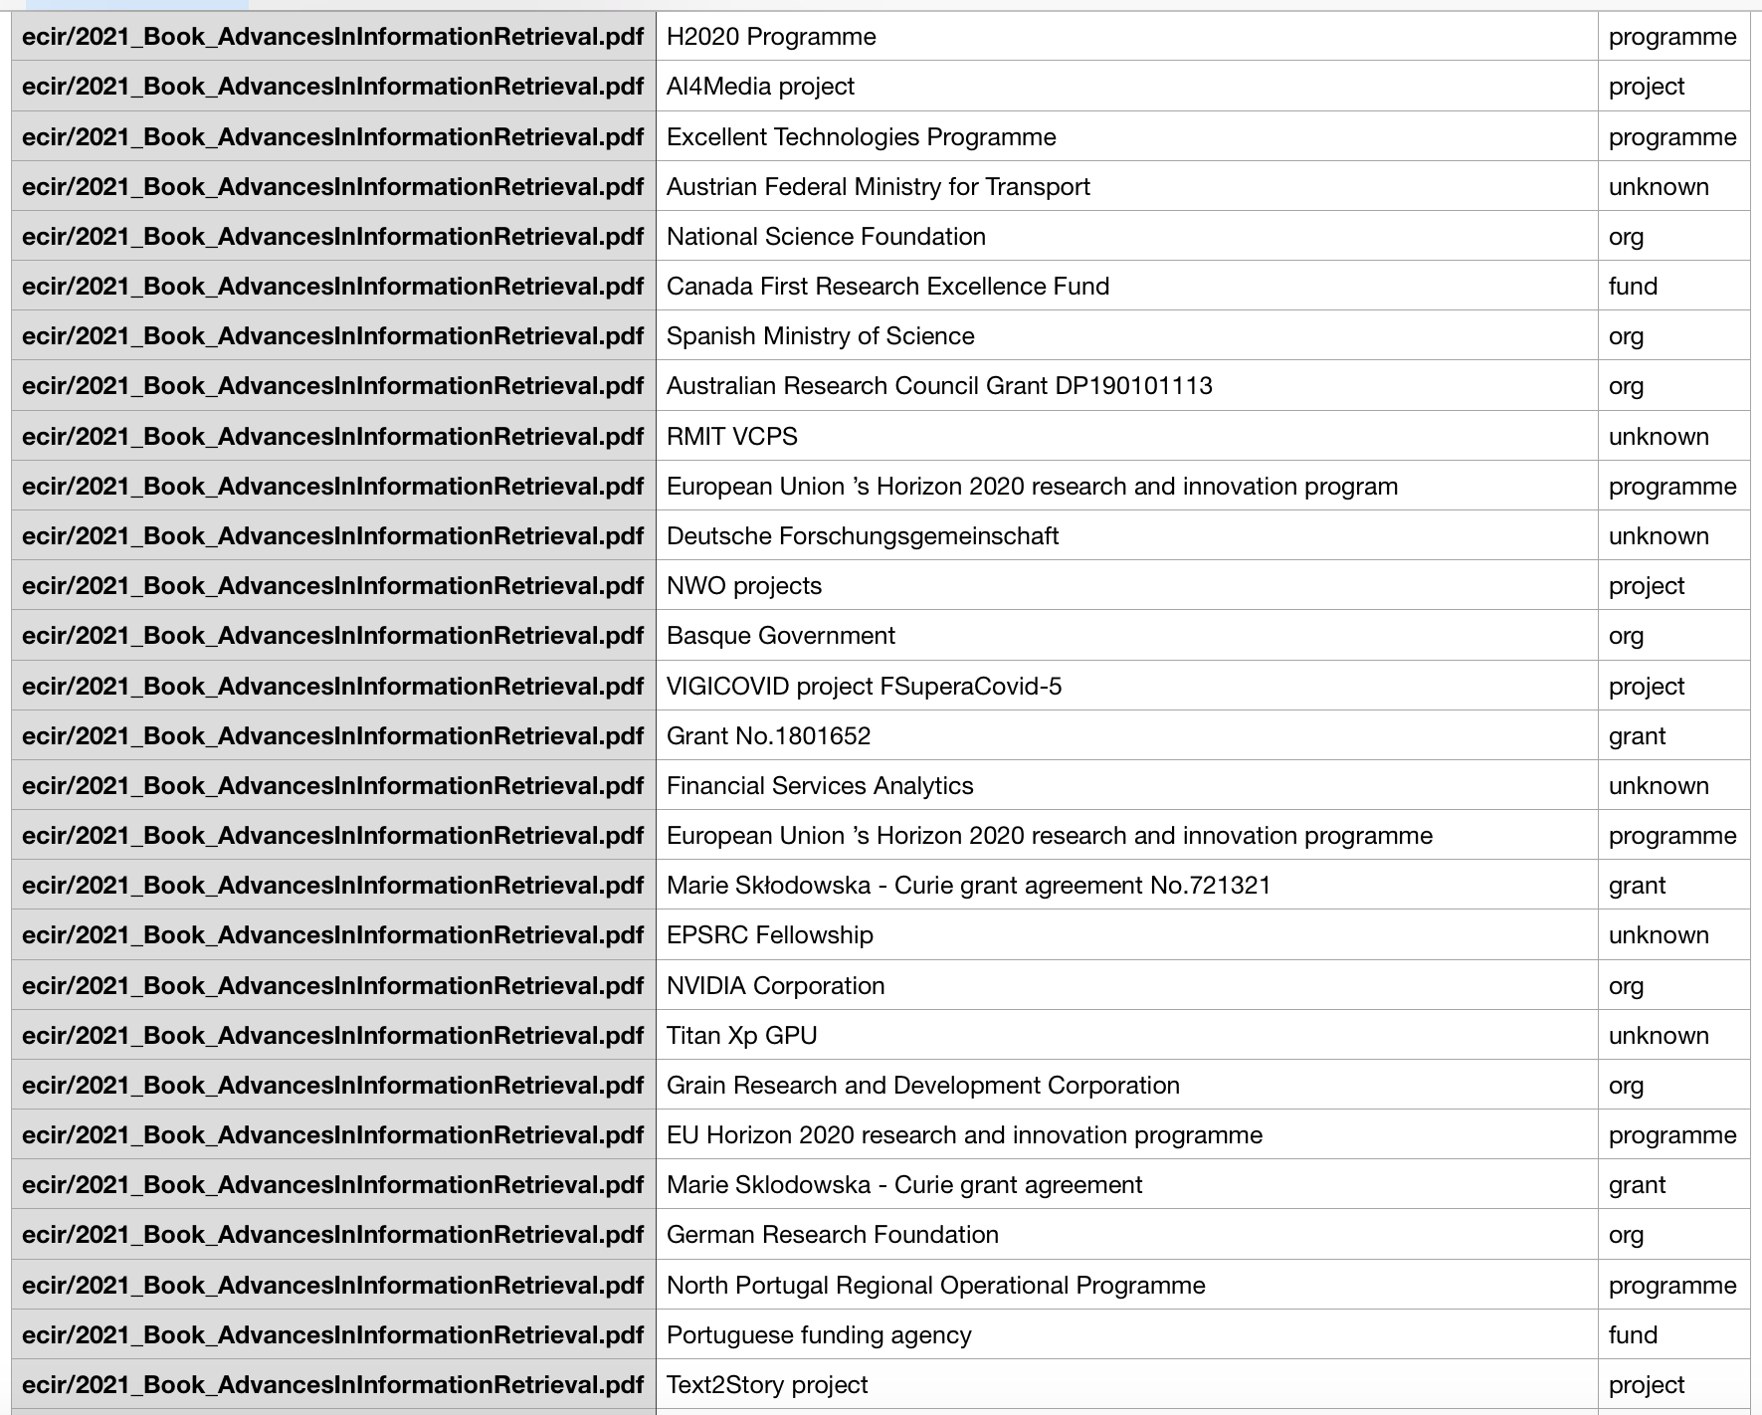

An extract from AckNer run on ECIR-2021 proceedings
Thank you for your attention!
Questions?

