Slide 1
Submitting Specimen/Imaging data
May 30, 2019

Slide 2
Overview
We now have a unified image model for all types of image data (histological images, in situ hybridization, immunofluorescence/immunohistochemistry)
This model includes some mandatory core data elements (species, stage, image file, etc.) that are common to all imaging modalities
There are also many optional data elements (antibodies, probes, expression regions, etc.) that are only relevant to some images.

Slide 3




Core Tables: Specimen and Image
Simple case
Multiple Images
Subdivided biosample
specimen
specimen
specimen
image
image
image
specimen
specimen
image
image
image

Slide 4
Example: Create a Specimen and Images
Create the specimen first
Fill in the form
Add an anatomical source
Then add the image(s)
Fill out the form (can do one or more at a time)
Optionally add channel info
If creating parent/child specimens, create the parent first, then add children, then children’s images
Shortcuts: copy, multi-add

Slide 5
Image Hints
If you upload a CZI file, the system will process it so it can be displayed in our viewer
This happens asynchronously, so you won’t see the result right away
If you upload a jpeg, please indicate the file type so the system knows it can be displayed inline.
Can also add video (very similar to image process)

Slide 6
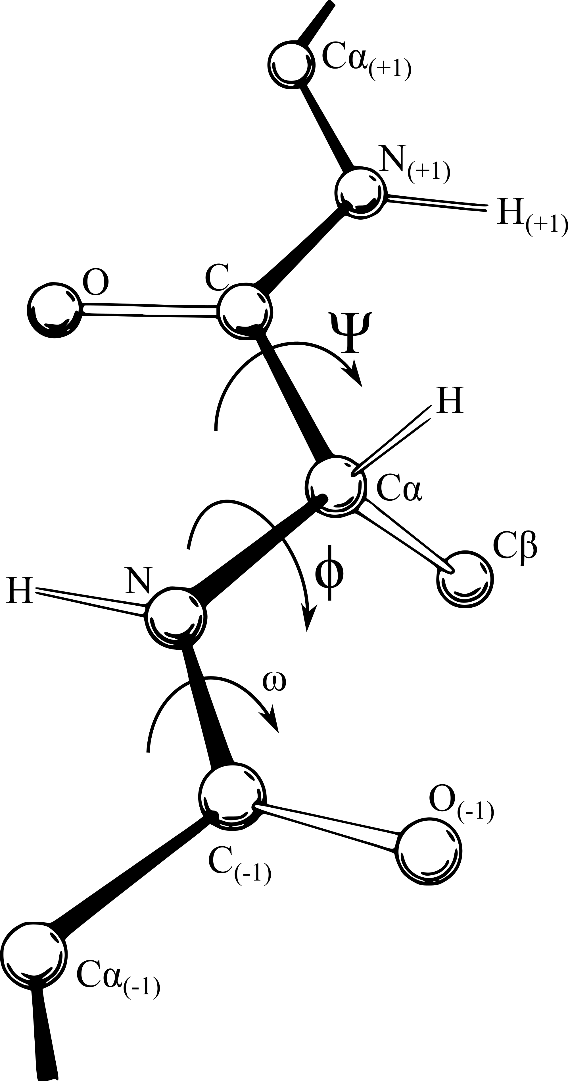


If You Used an Antibody…
protein
antibody
specimen-antibody
specimen
Protein:
Many are already in database (imported from NCBI)
You can add additional ones as necessary
Antibody
May be used by many people on many specimens
May already be in database; if not, you can create one
Specimen-Antibody: indicates which antibodies were used on which specimens
Must be created to link a specimen to an antibody (and thus to a protein)
Can optionally include additional information (e.g., dilution, secondary antibodies) about how the antibody was used.

Slide 7
Example: Link a Specimen to an Antibody
Add a specimen-antibody to a specimen
Note that the protein now appears on the specimen page

Slide 8

If You Used a Probe to Probe for a Gene…
gene
probe
specimen-probe
specimen
Gene: (you know what a gene is)
Already in database (imported from NCBI)
Probe: probes for a gene
May be used by many people on many specimens
May already be in database; if not, you can create one
Specimen-Probe: indicates which probes were used on which specimens
Must be created to link a specimen to a probe (and thus to a gene)
Can optionally include information about how the probe was used in that particular specimen.

Slide 9
Example: Link a Specimen to a Probe
Add a specimen-probe to a specimen
Note that the gene now appears on the specimen page

Slide 10


If You Did Expression Scoring
specimen
specimen-expression
Anatomy
By now, your specimen will have an indication of what gene/protein is being probed for.
If you’ve examined the specimen and determined that the gene/protein is (or isn’t) present, you can add specimen expression records to indicate your findings.
Specimen-expression records link specimens to fine-grained anatomy

Slide 11
Example: Specimen Expression
Add a specimen-expression to a specimen
Negative results (e.g., “not present”) can also be reported.

Slide 12
Final Steps
The “curation status” fields of each record determine whether those can be seen by anonymous users or not.
Records are created with a status of “In Preparation”.
If you change the status to “Submitted”, the system will immediately put it into “Biocurator Review”, and our biocurator will review it and then either get back to you with questions or change the status to “Release”, and anonymous users will be able to see it.
Consider adding your new specimen to a collection.

Slide 13
For more information
https://github.com/informatics-isi-edu/gudmap-rbk/wiki
“Help” menu in the menubar on RBK/GUDMAP pages
help@rebuildingakidney.org, help@gudmap.org

