Slide 1
Collection
02/08/2018

Slide 2
Agenda
Curation process
Collection data model
What is a collection for?
Permanent ID
Collection demo
Cell Line demo

Slide 3
- RNASeq: Studies, Replicates, Single cell metrics, Files
- IF videos
- Collections
1
PI
PI Review
Submitted
2
- RNASeq: Samples
- Antibody List, Antibody tests
- Cell lines, Mouse strains
- IF images
- H&E images
- ISH specimens
3
- Protocols
PI Lab Members
In preparation
Amendment
missing
metadata/ annotation
amended
metadata/ annotation
Biocuration Review
Release
Bio Curator
need model extension
extended model
missing
(meta)data
amended
(meta)data
Hub
Hub Attention
Notes:
The slide shows the curation process that has been approved by the GUDMAP and RBK PIs. The flow shows different curation status as we progress along the process. The curation status is used to communicate among the stakeholders of where we are in the process. Different user roles are shown on the vertical axis. From top to bottom are the PIs, lab members associated with the PIs, Bio curator (Todd is currently our curator) and the Hub.
Record preparation
While the lab members are working on the submission, they can mark their records as "In preparation". This allows them to spend their time preparing the data and save what they have as a draft while they are working on it.
Once the record is completed, they can change the status to "PI Review"
The PIs can then go to the system and perform the final checking of the data records. After PIs are satisfied with the data, they can change the status to "Submitted"..
Record Review and release
Once the curation status is "Submitted", there are 3 different scenarios that will happen depending on the data sets.
Path 1: For simple data sets that do not contain many scientific metadata such as RNASeq Studies that describe the study objectives, or RNAseq Replicate or Single Cell Metrics that contains data from instruments, or RNA Sequencing Files or IF videos that contains description and file metadata, they can go directly to release.
Path 2: For the majority of the data sets that contain scientific metadata such as RNASeq Samples, Antibody list, Antibody validation tests, Cell lines, IF images, H&E images, ISH specimens.. They will go to the "Biocuration Review" Process where a biocurator will review the data one more time.
If the biocurator finds missing metadata, they will mark the status to "Amendment" which signals the lab members or PIs to fix the problems. After the problem is fixed, the status can be changed back to "Biocuration Review" for final approval.
After everything is good to go, the biocurator will mark the status as "Release" which will then be visible to the public.
Path 3: The final scenario is for protocols. Instead of going to the biocurator, it will go to the hub who will check the formats and content completeness. For problems that the hub can't address, we will mark the record as "Amendment" for the PIs/lab members to fix it and resubmitting the records to us. Once everything is good, the status is changed to "Release".
Until the data is released, only the consortium members can see those records. The public will see records that are marked "Release"

Slide 4
Data Model Overview
Protocols
Immunofluorescence (IF) Images
Specimen
Genes
Antibody
Histological Images (HE)
Cell Lines
Anatomy
Collection
In-Situ Hybridization (ISH) Specimen
Mouse Strains
Developmental Stages
Sequencing Data

Slide 5
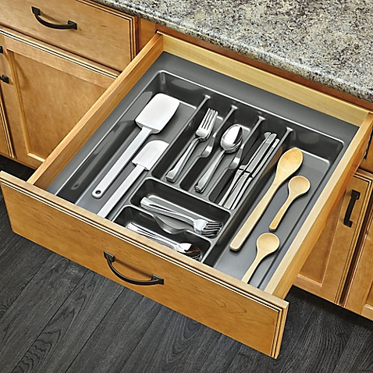
Collection: A set of data (one or more types)

Slide 6
Collection
Collection
HE Slide Collection
IF Slide Collection
IF Video Collection
ISH Specimen Collection
RNASeq Sample Collection

Slide 7
What is a collection for?
An upcoming publication
A collection can be properly cited in the paper
Data set citation (based on the Nature scientific data citation)
Example: McMahon, A. GUDMAP Consortium. https://doi.org/10.25548/BURB-6P44 (2017)
Readers can unambiguously obtain data referred in the paper → repeatable experiments!
A published publication
A collection can refer to the published paper in its description
Readers can unambiguously obtain data referred in the paper → repeatable experiments!
Collaboration
Create a specific set of data to be used for further discussion or collaboration

Slide 8
Permanent ID (DOI)
Digital Object Identifier (DOI)
DOI: 10.25548/BURB-6P44
DOI URL: https://doi.org/10.25548/BURB-6P44
DOI issuance process
The collection metadata (Title, Description, PI, Consortium) get registered with DOI registry
your data set is searchable!
The collection URL (our permalink URL) is registered with the DOI
When is a DOI issued?
When a flag for a DOI is marked "true"; and
The Curation Status of the collection is "Released"

