Slide 1


Data Submission Workshop: Submitting Protocols
Cristina Williams
Laura Pearlman
Hongsuda Tangmunarunkit
December 6, 2017

Slide 2
What we'll cover
Schema/Data Model
Curation Workflow
Creating the Base Protocol Record
Linking Authors, Subject Terms and Keywords
Adding Figures
Deleting Protocols
Questions?

Slide 3
Authentication Required
In order to edit records on the GUDMAP/RBK Data Browser, you must be a member of the “kidney-writers” group (via Globus).
Go to: https://www.globus.org/app/groups/af0b4010-5b75-11e6-9575-22000aef184d/about
If you have never signed into Globus before, choose your login (use your institution, Google, or ORCID ID credentials or create a unique GlobusID account).
Click “Join” to request membership to the “kidney-writers” group (approval required). You will receive email when your account has been added to kidney-writers.

Slide 4
Creating Protocol Records

Slide 5
Data Model Overview
Protocols
Immunofluorescence (IF) Images
Cell Lines
Genes
Antibody
Histological Images (HE)
Mouse Strains
Anatomy
RNASeq
In-Situ Hybridization (ISH) Specimen
Developmental Stages

Slide 6
Protocol Schema (Detailed)
Based on Nature Protocols

Slide 7
Protocol Model (Detailed)
Protocol
Author
Subject
Keyword
Figure
.jpg, .png, pdf, mp4, mov
Based on Nature Protocols

Slide 8
Curation Workflow
1
- RNASeq: Studies, Replicates, Single cell metrics, Files
- IF videos
PI Review
Submitted
2
PI
- RNASeq: Samples
- Antibody List, Antibody tests
- Cell lines, Mouse strains
- IF images
- H&E images
- ISH specimens
3
In preparation
- Protocols
Amendment
PI Lab Members
missing
metadata/ annotation
missing
metadata/ annotation
amended
metadata/ annotation
amended
metadata/ annotation
Bio Curator
Biocuration Review
Release (Visible to public!)
need model extension
extended model
need model extension
extended model
missing
(meta)data
missing
(meta)data
amended
(meta)data
amended
(meta)data
Hub
Hub Attention
Notes:
The slide shows the curation process that has been approved by the GUDMAP and RBK PIs. The flow shows different curation status as we progress through the process. The curation status is used to communicate among the stakeholders of where we are in the process. Different user roles are shown on the vertical axis. From top to bottom are the PIs, lab members associated with the PIs, Bio curator (Todd is currently our curator) and the Hub.
Record preparation
While the lab members are working on the submission, they can mark their records as "In preparation". This allows them to spend their time preparing the data and save what they have as a draft while they are working on it.
Once the record is completed, they can change the status to "PI Review"
The PIs can then go to the system and perform the final checking of the data records. After PIs are satisfied with the data, they can change the status to "Submitted"..
Record Review and release
Once the curation status is "Submitted", there are 3 different scenarios that will happen depending on the data sets.
Path 1: For simple data sets that do not contain many scientific metadata such as RNASeq Studies that describe the study objectives, or RNAseq Replicate or Single Cell Metrics that contains data from instruments, or RNA Sequencing Files or IF videos that contains description and file metadata, they can go directly to release.
Path 2: For the majority of the data sets that contain scientific metadata such as RNASeq Samples, Antibody list, Antibody validation tests, Cell lines, IF images, H&E images, ISH specimens.. They will go to the "Biocuration Review" Process where a biocurator will review the data one more time.
If the biocurator finds missing metadata, they will mark the status to "Amendment" which signals the lab members or PIs to fix the problems. After the problem is fixed, the status can be changed back to "Biocuration Review" for final approval.
After everything is good to go, the biocurator will mark the status as "Release" which will then be visible to the public.
Path 3: The final scenario is for protocols. Instead of going to the biocurator, it will go to the hub who will check the formats and content completeness. For problems that the hub can't address, we will mark the record as "Amendment" for the PIs/lab members to fix it and resubmitting the records to us. Once everything is good, the status is changed to "Release".
Until the data is released, only the consortium members can see those records. The public will see records that are marked "Release"

Slide 9
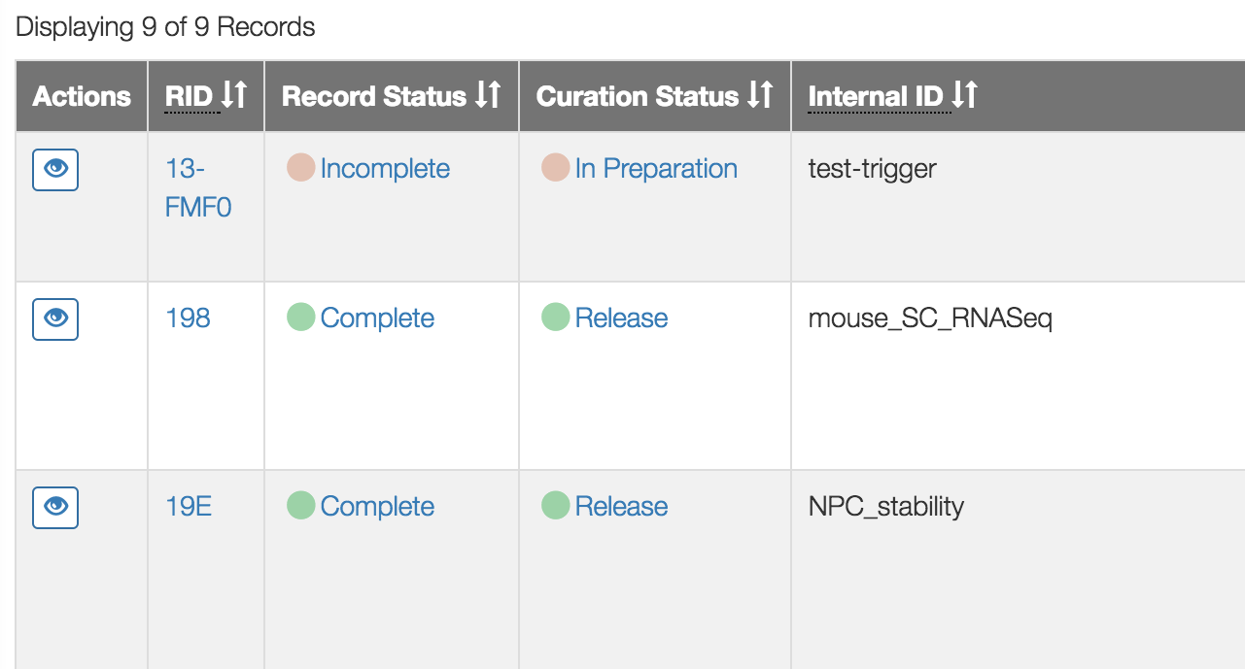
Record and Curation Status
Record Status – If data meets all requirements.
Curation Status – Current stage of curation workflow

Slide 10
Protocol Flow

Slide 11
Protocol Flow Overview
Go to the website, click Protocols and log in
Create the base protocol record. Required fields:
Title, Abstract, Procedure, Curation Status, Data Provider
Choose 3 Subject Terms (at least 1 required)
Choose 2 Keywords (at least 1 required)
To add a keyword, send email to todd@valeriuslab.org
Add Authors (at least 1 required)
Please search before you add!
(Optional) Add and embed figures (images and/or videos)
Upload files
Copy URL
Edit protocol and embed images (using icon)

Slide 12
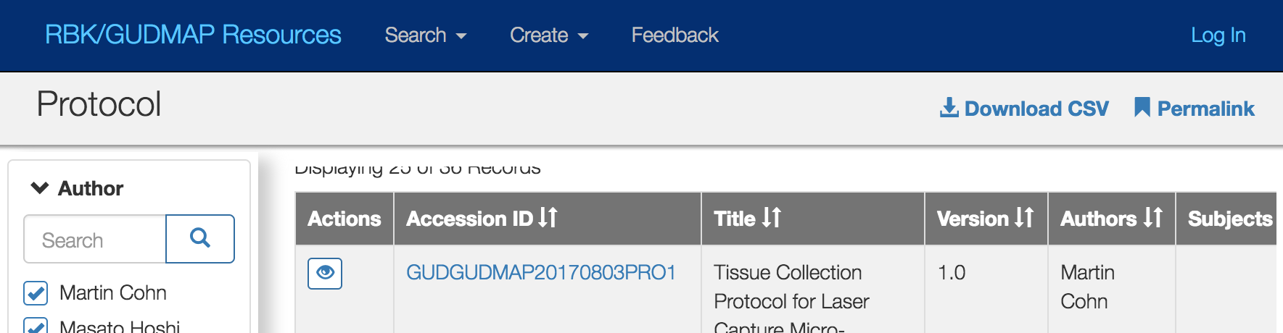
Log In
Go to the website, click Protocols and log in.
You can log in from any part of the Data Browser – indicated by the short blue header with “RBK/GUDMAP Resources”
You must be in the kidney-writers group to be able to edit.

Slide 13
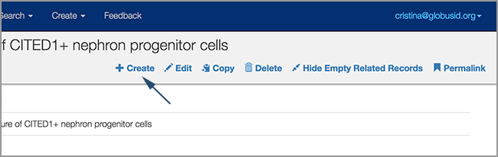
Create Base Record
In the record header, click Create

Slide 14
Fill in base Protocol record
The following are the minimum required fields:
Title: Please provide a concise but informative title that describes the protocol to unfamiliar users.
Abstract: Add a short paragraph describing the protocol further.
Procedure: Enter the actual steps to perform the protocol.
Curation Status:
In Preparation: While drafting
PI Review: When ready for review by PI or designated party
Submitted: When ready to send to Hub for final review before release
Data Provider: This is your lab's institution. If you need to add an institution, please contact the Hub.

Slide 15
Choose Subjects and Keywords
For a record to be considered complete, there must be at least one Subject and one Keyword.
However, more subjects and keywords will boost the ability of users finding your data. The Hub recommends:
3 Subject Terms
2 Keywords
The subject terms are static and based on Nature Protocols
It is possible to add a keyword if there is nothing in the list that is appropriate.
To add a keyword, send email to todd@valeriuslab.org

Slide 16
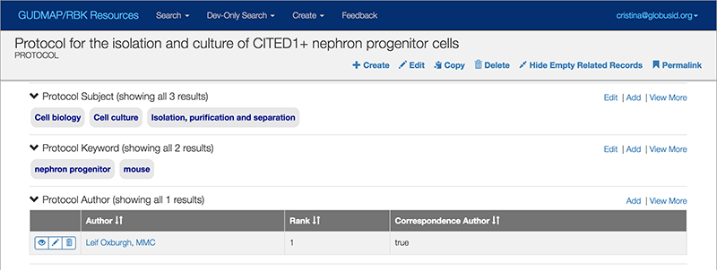
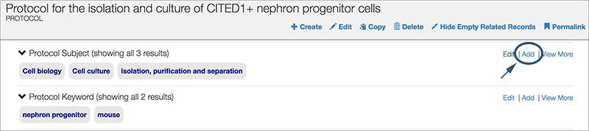

Slide 17
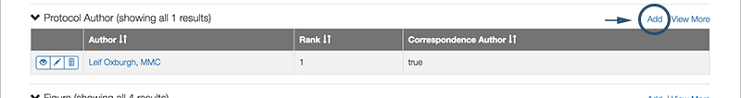
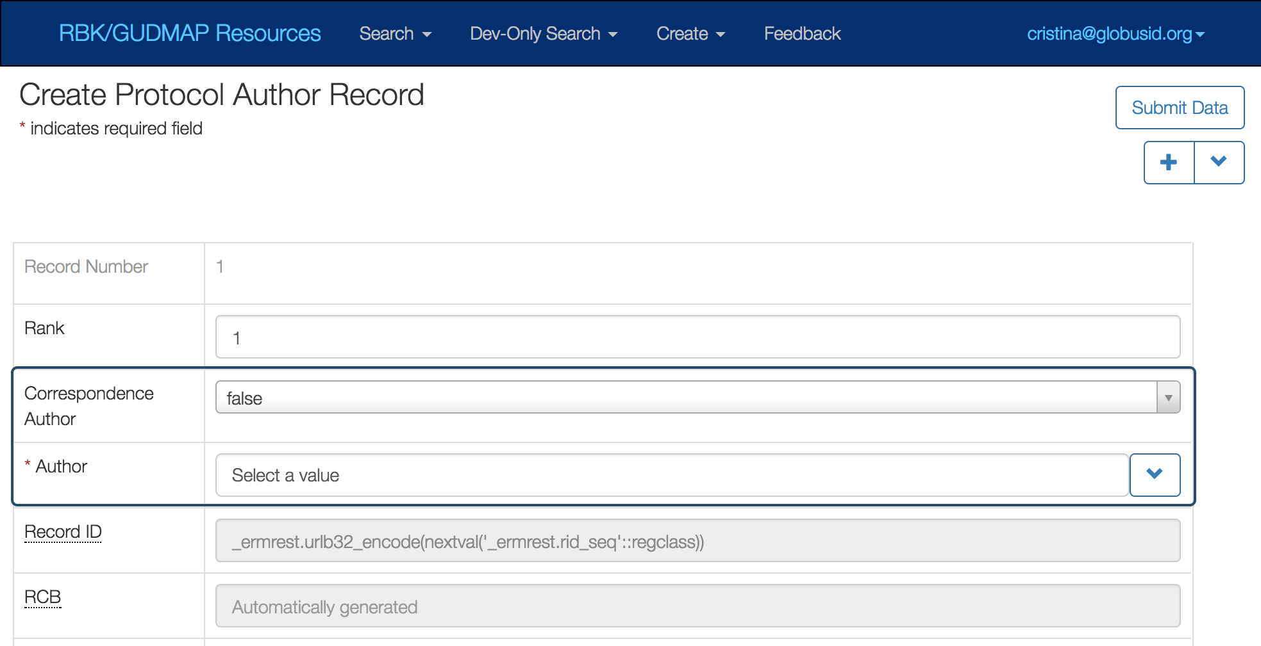
Add Protocol Author(s)
Add at least one Author
Correspondence Author: Use ‘true’ if this is the author users can contact with questions
Author: Click the dropdown field to choose the name.

Slide 18
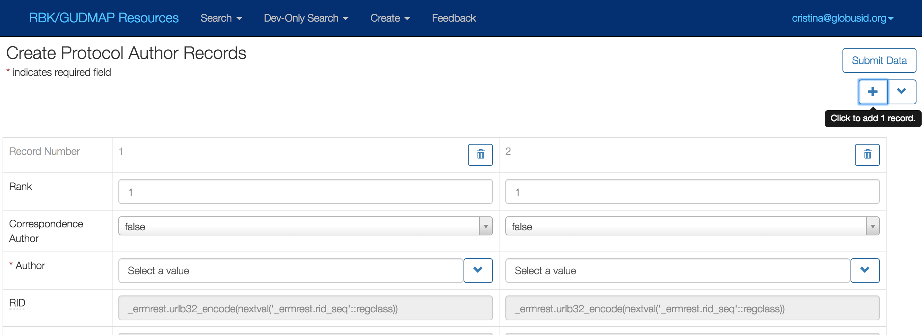
Add Protocol Author(s)
Batch add – To display fields for more than one author at a time, click the plus sign.

Slide 19
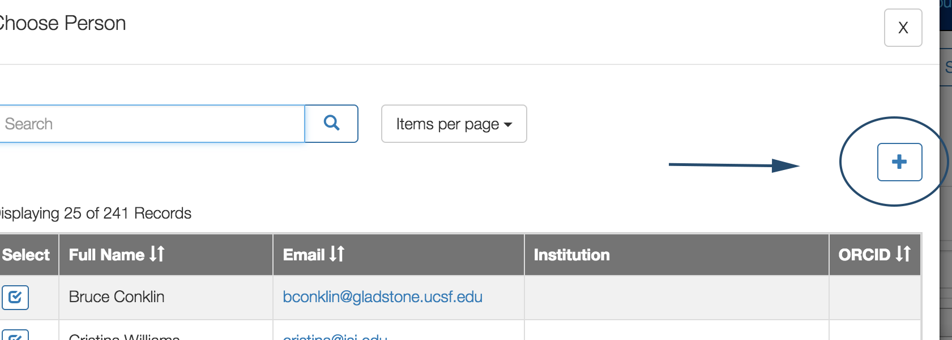
Add Protocol Author(s)
If you cannot find the author, please first make sure you’ve searched for the name.
If you still cannot find them, click the plus sign:

Slide 20
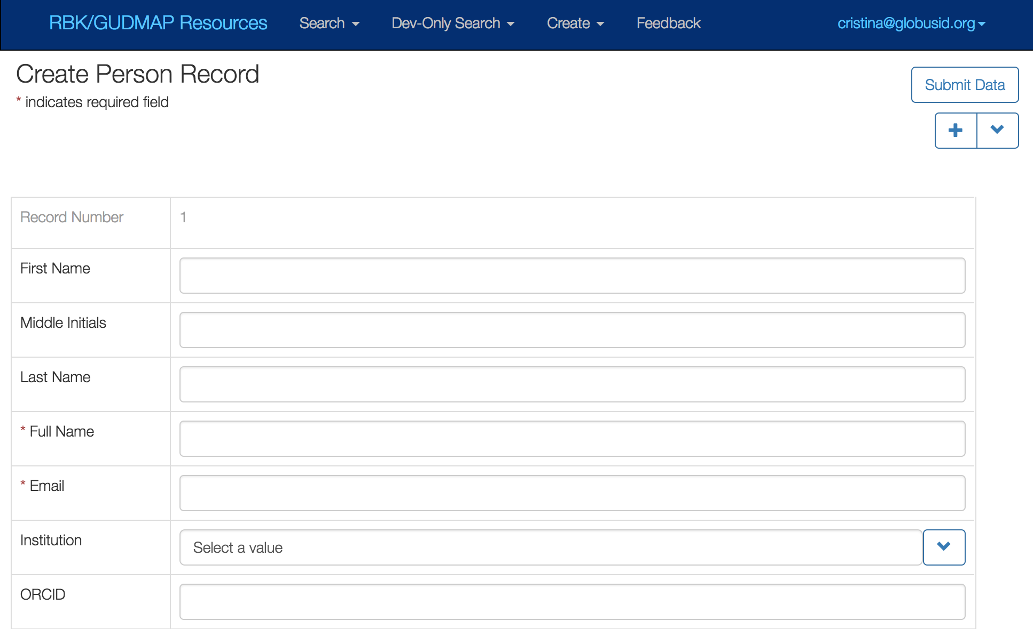
Add Protocol Author(s)
…and fill out the Full Name, Email and Institution. Only Full Name and Email are required – but we recommend Institution also

Slide 21
Add and Embed Figures
This is optional but helpful if you have images and/or videos.
Add a Figure record. For each figure fill out:
Label - This helps identify the figure.
URI – Click Select file to choose and upload the file
To embed an image within the protocol.
Copy the URI link from the Figure record.
Edit protocol (click Edit in record header)
Put your cursor where you want the image to appear and click the icon
Add alt text between the brackets and paste the link between the parentheses like below:
![Figure 2](https://www.rebuildingakidney.org/hatrac/resources/…/conicaltubes.png)

Slide 22
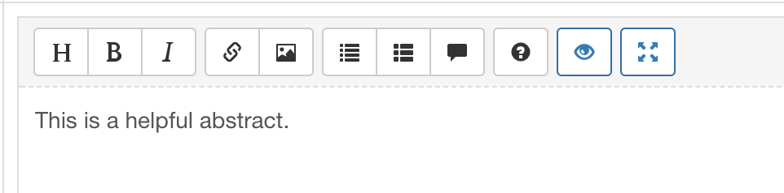
Formatting
Formatting in Markdown:
https://guides.github.com/features/mastering-markdown/
Use the WYSIWIG toolbar
(Hover your cursor over an icon to see what it does.)
Use Preview (eye) to see how it looks. Full screen preview (arrows) opens in a modal window.

Slide 23
Demonstration

Slide 24
Resources
Additional information (including documentation and videos) is at https://github.com/informatics-isi-edu/rbk-public/wiki
Feedback/questions: help@rebuildingakidney.org or help@gudmap.org

