Slide 1
Introduction to R Module One: Getting Started
Lisa Federer, MLIS, MA, AHIP
Research Data Informationist

Slide 2
Objectives
After this session, you should:
understand what R and RStudio are and why they are useful;
be able to install and configure R and RStudio;
understand some basic terminology about R;
know what packages are and how to install them.

Slide 3
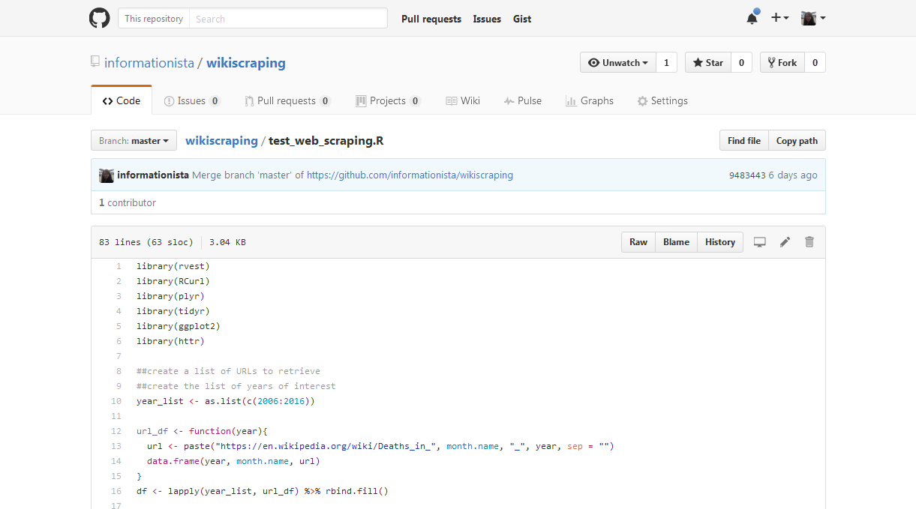
Enhances reproducibility

