Slide 1
FHH HealthVault Integration Project
Iteration 4 Review
Retrospective
Iteration 5 Plan
November 30, 2009

Slide 2
Agenda
SPRINT REVIEW (2.3 M4)
Review Actions from last meeting
Project Timeline
Demonstrate Iteration 4 Results
SPRINT PLANNING (2.3 M5)
Proposed Iteration 5 Objectives
Schedule Sprint Review
Conduct Retrospective
Iteration 5 Fine-grained Planning

Slide 3
Actions from last meeting
Wayne: Update JIRA task list (DONE)
Wayne: prepare agenda & demo script (DONE)

Slide 4
Project Timeline
Phase |  | Timeline | Objectives | Status
1 | Inception | 24-Jun 15-Jul | Explore how to enable a user to export family history to HealthVault import family history from HealthVault | Complete
2 | Elaboration | 13-Oct 24-Nov | Implement Communication Specification Establish user interface concepts Develop & Execute Regression Tests Demonstrate executable software | Incomplete
3 | Development | 30-Nov 2-Feb | Refine requirements Translate Family History Items Develop user interface Develop system & regression tests Support CBIT Recruit Testers Establish the Beta test environment
4 | Beta Testing | 3-Feb 16-Feb | Testing with current MFHP users Testing with current HealthVault users Testing with general users
5 | Transition | 17-Feb 10-Mar | Provide technical assistance to NCI team Close out the project

Slide 5
Schedule Issues
Beta test period seems very short
Should we extend it?
Add an Alpha test iteration?
Elaboration phase
Is it really complete?
Open issues surrounding data translation

Slide 6
Iteration 4
Phase 2 Objectives
Establish user interface concepts
Demonstrate executable software
Develop & Execute Regression Tests
Iteration 4 Task Themes
complete HTML wireframes
continue Selenium regression testing
demonstrate HealthVault Login
integrate new HTML pages
demo Save Wizard pages
demo pre- and post-login messages

Slide 7
Sprint 2.3 M4 Tasks

Slide 8
Burndown Charts
30 points + 10 added = 40
Some added tasks were blockers on other tasks
Slow start (developer resource constraints)
26 points completed (14 left)
2.3 M3 Burndown Chart
2.3 M4 Burndown Chart

Slide 9
Demo: User Interface Concepts
HTML mockups (Matt)
HealthVault Save Wizard
HealthVault pre-login notification and errors.
HealthVault post-login timeout and other errors.
HealthVault Save confirmation dialog
HealthVault Save error dialog
HealthVault Save completion dialog

Slide 10
Demo: User Interface Concepts
Icon for HealthVault co-brand (Matt)
Wireframe mockups (Wayne)
HealthVault pre-export proband feature
Requirements for Browser support (Wayne)

Slide 11
Browser Requirements
Confirmed with
Susanne Furman (HHS)
Chris Piepenbring (NCI/NIH)
Required Versions
Microsoft Internet Explorer version 6.0 or higher
Mozilla Firefox version 2.0 or higher
Opera version 9.0 or higher
Apple Safari version 3.0 or higher

Slide 12
Browser Requirements
Required standard
XHTML 1.0 Transitional standard
New HTML wireframes validated for compliance (Using validator.w3.org)
Automated regression tests will validate changed pages for compliance

Slide 13
Demo: executable software
“Save File" changed from browser default to active saving (Brian H.)
user can provide filename
Save Family History (Brian H.)
Use case: User Exports to HealthVault
steps 1-3
DEMO

Slide 14
Demo Script: Browser File Save
Open browser
Load a family history file
Choose “Save Family History”
System prompts for file name for Family History .xml file
System saved the file locally
View saved file

Slide 15
Demo Script: Save to HealthVault
(continued…)
Click on Save Family History button
HealthVault Manager Wizard step 1 appears
Click Cancel/Close; user returned to previous page
Click on Save Family History button
Click Download Now
HealthVault Manager Wizard step 2 appears
Click Cancel/Close; user returned to step 1
Click Save Now
HealthVault login screen appears
Point out new MFHP icon
Log in to HealthVault
HealthVault Manager successful connection page appears
“You are now connected to the Microsoft HealthVault account for [proband name]. ”

Slide 16
Demo: Automated Tests
Regression Tests (Khalid)
Creating a family history and saving it as a file
Creating a family history and saving a diagram
Loading a legacy .htm file
Adding a relative
New Feature Tests (Khalid)
Logging in to HealthVault through MFHP.

Slide 17
Test Coverage
Regression coverage (old features)
8 of 23 features = 24%
Requirements Traceability Matrix
Total coverage (old & new features)
Test Summary
OLD: 9 of 86 points = 5.7%
NEW: 13 of 71 points = 8.3%
TOTAL: 22 of 157 points = 14%

Slide 18
Agenda
SPRINT REVIEW (2.3 M4)
Review Actions from last meeting
Project Timeline
Demonstrate Iteration 4 Results
SPRINT PLANNING (2.3 M5)
Proposed Iteration 5 Objectives
Schedule Sprint Review
Conduct Retrospective
Iteration 5 Fine-grained Planning

Slide 19
Project Timeline
Phase |  | Timeline | Objectives | Status
1 | Inception | 24-Jun 15-Jul | Explore how to enable a user to export family history to HealthVault import family history from HealthVault | Complete
2 | Elaboration | 13-Oct 24-Nov | Implement Communication Specification Establish user interface concepts Develop & Execute Regression Tests Demonstrate executable software | Complete
3 | Development | 30-Nov 2-Feb | Refine requirements Translate Family History Items Develop user interface Develop system & regression tests Support CBIT Recruit Testers Establish the Beta test environment
4 | Beta Testing | 3-Feb 16-Feb | Testing with current MFHP users Testing with current HealthVault users Testing with general users
5 | Transition | 17-Feb 10-Mar | Provide technical assistance to NCI team Close out the project

Slide 20
Iteration 5 Objectives
BUILD SAVE FAMILY HISTORY EXPORT
refine Export requirements
Change Proband
Data Translation
develop Export
automate Export tests
demonstrate Export feature

Slide 21
Data Translation Issues
Reviewed issues from earlier Gap Analysis
Met with Brian Humphrey to understand current situation
Some issues already fixed on our end
Some issues can be worked around on HV side
Others can be worked around in MFHP side

Slide 22
Data Translation Issues
 | Prior Situation |  | Resolution
Issue | MFHP | HealthVault | MFHP | HealthVault
1-1 | HAS family tree structure | NO family tree structure | Use “Related Item” to store structure | No change
1-2 | MULTIPLE conditions per person allowed | ONLY ONE condition per person allowed | No change | FIXED – HealthVault allows multiple conditions for one person
1-3 | Person can exist without a condition | Condition can exist without a person | No change | FIXED – condition must be tied to a person

Slide 23
 | Prior Situation |  | Resolution
Issue | MFHP | HealthVault | MFHP | HealthVault
2 | DOESN’T handle all third-party condition coding systems | DOES handle all third-party condition coding systems | TO DO – store unrecognized codes as user-entered | No change
3 | DOESN’T recognize code synonyms | ALLOWS multiple code representing the same condition | No change | Fixed – HOW?
4 | ALLOWS Estimated dates & ages | DOES NOT allow estimated dates & ages – requires exact dates | TO DO (INTERIM) – store estimated dates/ages in text fields | To be fixed AFTER we go live.
5 | Ethnicity & Race represented differently | Ethnicity & Race represented differently | TO DO – Add Mixed/Other Race values; other??? | ???

Slide 24
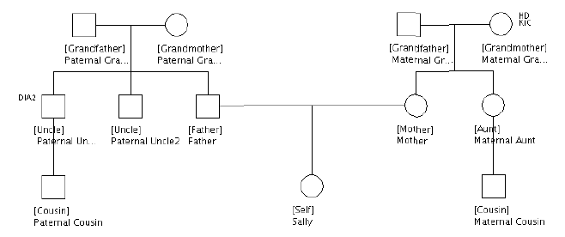

Sally’s Family

Slide 25
Save Family History Scenarios
1. Save
2. Save/Open
3. Open HV
4. Open 3rd
MFHP
?
?
HV
3rd PARTY

Slide 26
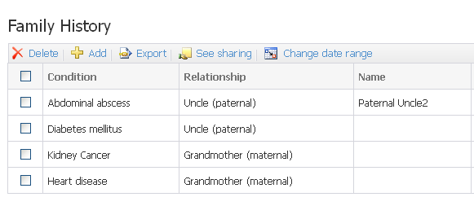
Scenarios 1,2: Create in FHH, Save/Open HealthVault

Slide 27
Sally’s Family History in HealthVault
Condition | Relationship | Name
<none> | Uncle (Paternal) | Paternal Uncle2
Diabetes | Uncle (Paternal) | Paternal Uncle1
Kidney Cancer | Grandmother (Maternal) | Maternal Grandmother
Heart Disease | Grandmother (Maternal) | Maternal Grandmother

Slide 28
Scenario 3: Create in HealthVault, Open in FHH
What family tree can/should we display?
How to resolve open issues?
Is a Wizard interface out of scope?
Ask user to resolve issues
?

Slide 29
Data Translation Issues
What is the data mapping, field-by-field?
Define unit test cases
Enable test-driven development
Identify open issues

Slide 30
Data Translation Issues: Name

Slide 31
Data Translation Issues: Relationship

Slide 32
Data Translation Issues: Relationship

Slide 33
Data Translation Issues: Ethnicity/Race
NOTE: if multiple values set in MFHP, set only the FIRST one in HV

Slide 34
Data Translation Issues: Ethnicity/Race

Slide 35
Issues With Change Proband
Export Use case Alternative flow 8a1
“User changes the proband (“Self”) on which the MFHP data orients itself ”
We agree that this requirement is questionable
Better to change proband BEFORE connecting to HealthVault
Feature name no longer appropriate on export to HealthVault
Old name: “Copy for Family Member”
New name:
“Center My Family History” ?
“Recenter My Family History” ?

Slide 36
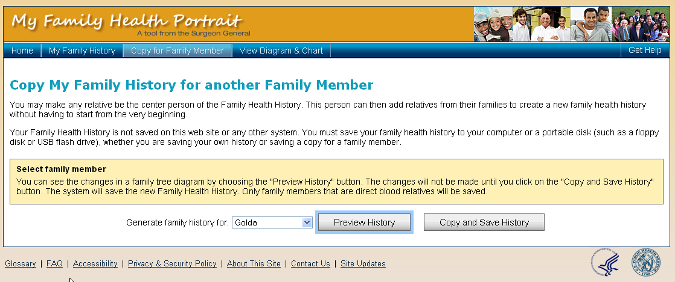
Current Page

Slide 37
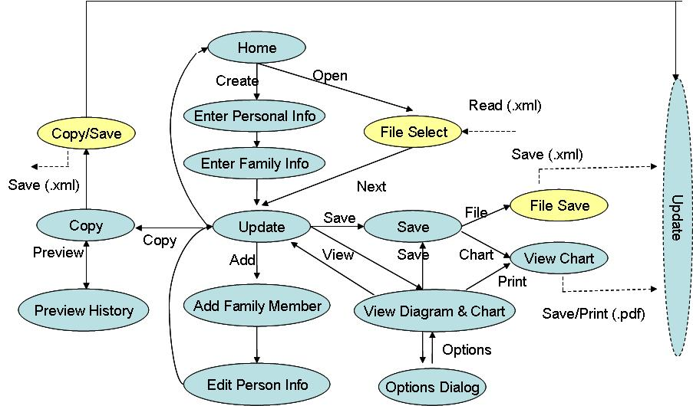
Current Navigation

Slide 38
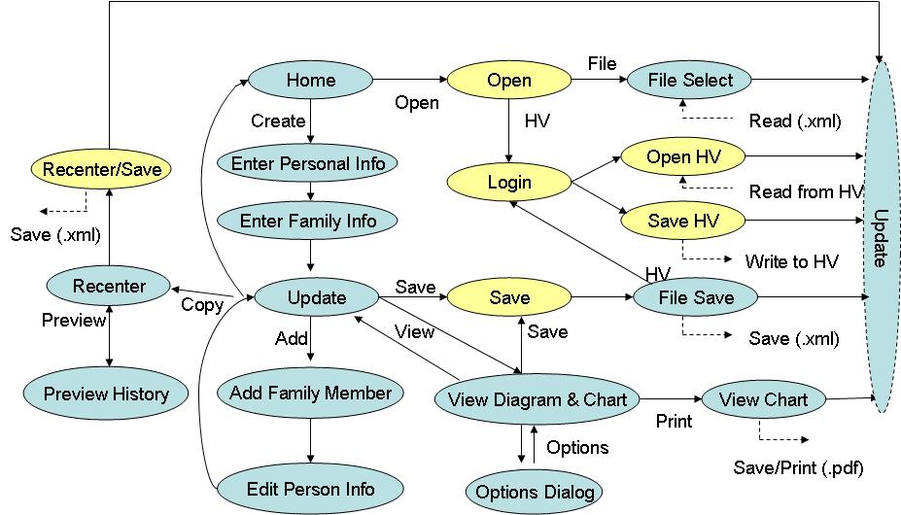
Future Navigation

Slide 39
Changes
Tab text
“Copy for Family Member” becomes…
“Recenter My Family History”
Headline text
“Copy My Family History for another Family Member” becomes…
“Recenter My Family History on another Family Member”
Button text
“Copy and Save History” becomes…
“Recenter and Save History”

Slide 40
Schedule Sprint Review
PROPOSED DATE/TIME
Monday, December 14
10:30-am – Noon
INVITEES
Chris Piepenbring, Greg Downing, Kevin Hughes, Greg Feero
Leslie Power, Dan Weikart
Project team

Slide 41
Sprint Retrospective
SAMALO:
Same as:
More of:
Less of:
2.3 M4 Wiki

Slide 42
Iteration 5 Planning
Risks
JIRA Tasks

Slide 43
Risks
Business Impacts
Mitigation Plans

Slide 44
Proposed JIRA Tasks
Schedule Sprint Review
Develop scenarios 1 & 2
Develop Save Proband
Develop Save Proband with One Condition
Develop Save Proband & Parents
Test (all of above)
Define additional data translation scenarios
Write Sprint Review agenda & demo script

Slide 45
Proposed JIRA Tasks
Define data translation architecture
Web service? API?
Unit test harness
Define data translation requirements
Create data translation test plan
Unit tests
Selenium automated tests
Develop data translation unit tests
Review source code to determine true requirements
Update regression test plan
Develop regression tests

