Slide 1
FHH HealthVault Integration Project
Iteration 5 Review
December 17, 2009

Slide 2
Iteration 5
What we set out to accomplish:
Increase Team Velocity
Complete Action Items from last meeting
Increase regression test coverage
Revised UI based on feedback
Refine Import requirements (risk mitigation)
Save to Health Vault (Proband only)
All items completed!

Slide 3
Phase |  | Timeline | Objectives | Status
1 | Inception | 24-Jun 15-Jul | Explore how to enable a user to export family history to HealthVault import family history from HealthVault | Complete
2 | Elaboration | 13-Oct 2-Dec | Implement Communication Specification Establish user interface concepts Develop & Execute Regression Tests Demonstrate executable software | Complete
3 | Development | 3-Dec 16-Dec | Refine Import requirements Develop user interface Increase regression test coverage Save data to HealthVault | Complete
 |  | 17-Dec 31-Dec | Importing and exporting Relatives and Conditions Translate Family History Items | Planning
 |  | 4-Jan 13-Jan | Handling bad data conditions Third party interoperability MS Go-Live Process ASPA Approval Start NCI Appscan process
 |  | 14-Jan 26-Jan | Recuit testers Establish beta test environment

Slide 4
Project Timeline
Phase |  | Timeline | Objectives | Status
4 | Beta Testing | 27-Jan 7-Feb | Testing with current MFHP users Testing with current HealthVault users Testing with general users
5a | Rollout | 8-Feb 15-Feb | deliver to production Provide technical assistance to NCI team
5b | Closeout | 16-Feb 10-Mar | Provide technical assistance to NCI team Close out the project

Slide 5
Team Composition & Velocity
 | Sprint Start | Delta | Sprint End
Staff | 2 developers 1 tester 1 analyst | + 2 developers +1 info architect | Team of 7
Points | 31.5 | 13.5 | 45

Slide 6
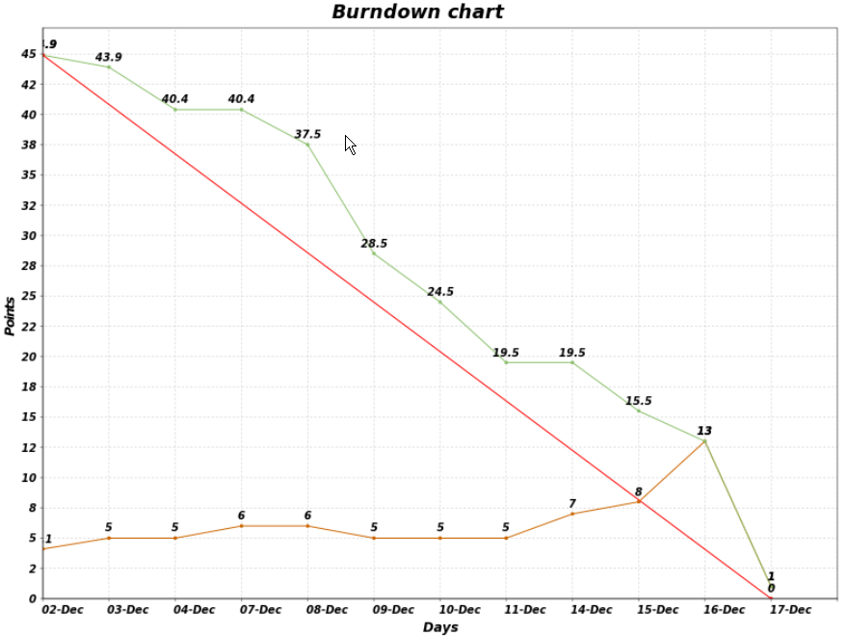
2.3 M5 Burndown Chart

Slide 7
Actions from last meeting
Action Item | Status
Data export: Need to handle MFHP data not directly supported by HealthVault | Met w/Lowell @ Microsoft Will extend family-history datatype
Data Import: Need to identify and handle HealthVault data not currently supported by MFHP | Developed options for handling HealthVault data not supported in MFHP Can build on existing framework for importing old-style HTM files
User Interface: clients identified new requirements relating to 3rd-party site warning and APSA | brought in Information Architect to revise & extend wireframes

Slide 8
Test Coverage
Regression coverage (old features)
45 of 47 features = 95%
Requirements Traceability Matrix
Remaining 2 features:
Error messages
Required fields
XML error messages
Alternate flows
Invalid HealthVault login credentials
Cancel/Close

Slide 9
Revised Wireframes
Input from George Komatsoulis (NCI), ASPA, others
Wireframes revised by Andy Evans, Information Architect
“Leaving FHH web site” warning
Save .XML file locally now OPTIONAL
User does NOT enter filename
Unified look & feel, vocabulary
Available on Gforge
FHH Save Process WF.pdf
FHH Open Process Flow - HealthVault.pdf
FHH Open Process Flow - Local File.pdf

Slide 10
Requirements for Import
Must recognize and handle HealthVault data MFHP can’t handle natively
Can reuse some existing HTM import features
Error message area
“item requires attention” icons
Can likely reuse existing “Condition not recognized” features
Some new interactive dialog may be required
Relationship
Other incompletely mapped data values

Slide 11
Demo: executable software
Save Family History
Simple case: save proband only
Visible HealthVault updates
Family History table entry
Audit trail history entry
Hidden HealthVault updates
Extended data types
Viewable via X-ray tool
DEMO

Slide 12
Demo Script: Save to HealthVault
Sign in to HealthVault
Click the Health Information tab
Click the Family History link
Show that the table is empty
Click on History of Changes
Click on All Changes in the last 30 days
View latest entries
Start a new browser tab
Go to My Family Health History (demo)
Load a family history with just one person (the proband)
Click on Save Family History button
HealthVault Manager Wizard step 1 appears
Click Cancel; user returned to previous page
Click on Save Family History button

Slide 13
Demo Script: Save to HealthVault
(continued)
HealthVault Manager Wizard step 2 appears
Click Cancel; user returned to step 1
Repeat & Click Save Now
“Leaving government web site” warning appears
HealthVault login screen appears
Log in to HealthVault
HealthVault Manager successful connection page appears
“You are now connected to the Microsoft HealthVault account for [accountholder name]. ”
Click on Save to HealthVault
HealthVault manager confirmation message appears – success!

Slide 14
Demo Script: Save to HealthVault
(continued)
Return to HealthVault
Click on History of Changes
Click on All Changes in the last 30 days
View new entries recording MFHP input
Click the Health Information tab
Click the Family History link
View the proband’s information in table
Name & Date of Birth
Relationship = self
Condition = none
Use X-Ray to view extended data types
Weight
Height

Slide 15
Iteration 6 Objectives
Continue development of Export Family History
Save proband’s condition
Save proband & immediate relatives
Save entire family
Begin development of Import Family History
Import previously-exported family history
Import HealthVault-created family history

Slide 16
Documents in Gforge
This Sprint Review presentation
https://gforge.nci.nih.gov/svnroot/fhh/hhs/fhh/trunk/documents/pm/FHH_Sprint5_Review_2009-12-17.pptx
Requirements Traceability Matrix
https://gforge.nci.nih.gov/svnroot/fhh/hhs/fhh/trunk/documents/test/Automated_Test_Cases_Tracebility_Matrix.xlsx
Revised Wireframes
https://gforge.nci.nih.gov/svnroot/fhh/hhs/fhh/trunk/documents/ui/
Data Translation map
https://gforge.nci.nih.gov/svnroot/fhh/hhs/fhh/trunk/documents/requirements/

Slide 17
Schedule Next Sprint Review
PROPOSED DATE/TIME
Monday, January 4
11am – Noon
INVITEES
Chris Piepenbring
Leslie Power, Dan Weikart
Project team

Slide 18
Agenda
SPRINT PLANNING (2.3 M6)
Conduct Retrospective
Iteration 6 Fine-grained Planning

Slide 19
Sprint Retrospective
SAMALO:
Same as:
More of:
Less of:
2.3 M5 Wiki

Slide 20
Iteration 6 Planning
Risks
JIRA Tasks

Slide 21
Risks
Business Impacts
Mitigation Plans

Slide 22
Proposed JIRA Tasks
Create revised HTML wireframes for Export
Create wireframes for Import
Create HTML wireframes for Import
Write Test Scenarios for HealthVault Export
Develop Export proband & family w/relationships
Develop Export proband & family w/conditions
Develop Export proband & family w/race & ethn.
Write Test Scenarios for HealthVault Import
Develop Import proband w/ gender, race & ethn
Develop Import proband & direct blood relatives
Develop Import proband & all relatives
Write Sprint Review Agenda & Demo Script

Slide 23
Requirements for Import
Must recognize and handle HealthVault data MFHP can’t handle natively
Reviewed framework for handling import from old-style HTM files
Can reuse some existing Update page features
Error message area
“item requires attention” icons
Can likely reuse existing “Condition not recognized” features
Some new interactive dialog required
Relationship
Other incompletely mapped data values

Slide 24
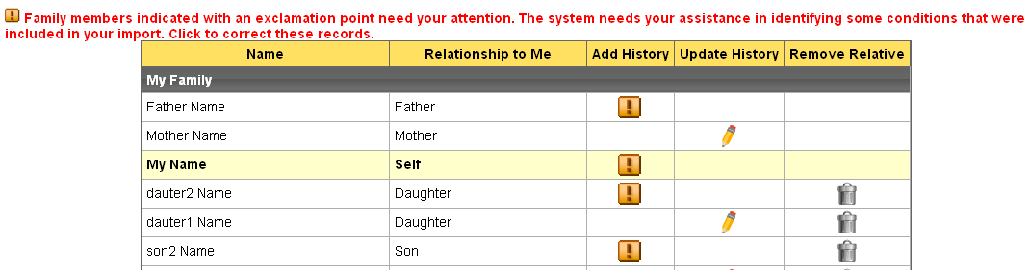
Recognizing Bad Data

Slide 25
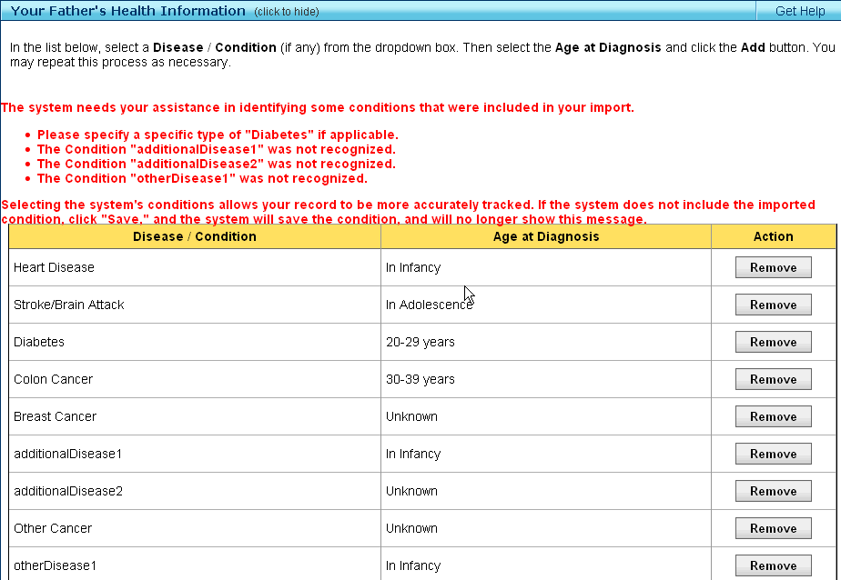

Slide 26
Relationship Data
Info messages here show why certain relatives were not imported
MFHP only tracks blood relatives. Since Joseph is a friend, this information will not be imported.
MFHP only tracks blood relatives. Since Barbara is a spouse, this information will not be imported.
Name | Relationship to Me | Add History | Update History | Remove Relative
Arthur | Father
Cindi | Aunt
Nancy | Aunt
My name | Self
Icons here indicate a problem with the Relationship field
i
i
i
i
i
i

Slide 27
Relationship Data
Click on the “requires attention” icon to reach dialogs
Radio buttons
Is Cindi your …
Maternal Aunt
Paternal Aunt
Who is the parent of Cousin1 ?
(Select relative)

Slide 28
Relationship Data
Link to Overview
Link to Spreadsheet

