Slide 1
FHH HealthVault Integration Project
Iteration 6 Review
January 5, 2010

Slide 2
Iteration 6
What we set out to accomplish:
Export to Health Vault
Demographic information
Diseases/Conditions
Import from HealthVault
Convert wireframes to HTML
All completed

Slide 3
Phase |  | Timeline | Objectives | Status
1 | Inception | 24-Jun 15-Jul | Explore how to enable a user to export family history to HealthVault import family history from HealthVault | Complete
2 | Elaboration | 13-Oct 2-Dec | Implement Communication Specification Establish user interface concepts Develop & Execute Regression Tests Demonstrate executable software | Complete
3 | Development | 3-Dec 16-Dec | Refine Import requirements Develop user interface Increase regression test coverage Save data to HealthVault | Complete
 |  | 17-Dec 4-Jan | Importing and exporting Relatives and Conditions Translate Family History Items | Complete
 |  | 5-Jan 13-Jan | Handling bad data conditions Third party interoperability MS Go-Live Process ASPA Approval Start NCI Appscan process
 |  | 14-Jan 26-Jan | Recruit testers Establish beta test environment

Slide 4
Project Timeline
Phase |  | Timeline | Objectives | Status
4 | Beta Testing | 27-Jan 7-Feb | Testing with current MFHP users Testing with current HealthVault users Testing with general users
5a | Rollout | 8-Feb 15-Feb | deliver to production Provide technical assistance to NCI team
5b | Closeout | 16-Feb 10-Mar | Provide technical assistance to NCI team Close out the project

Slide 5
Team Velocity

Slide 6
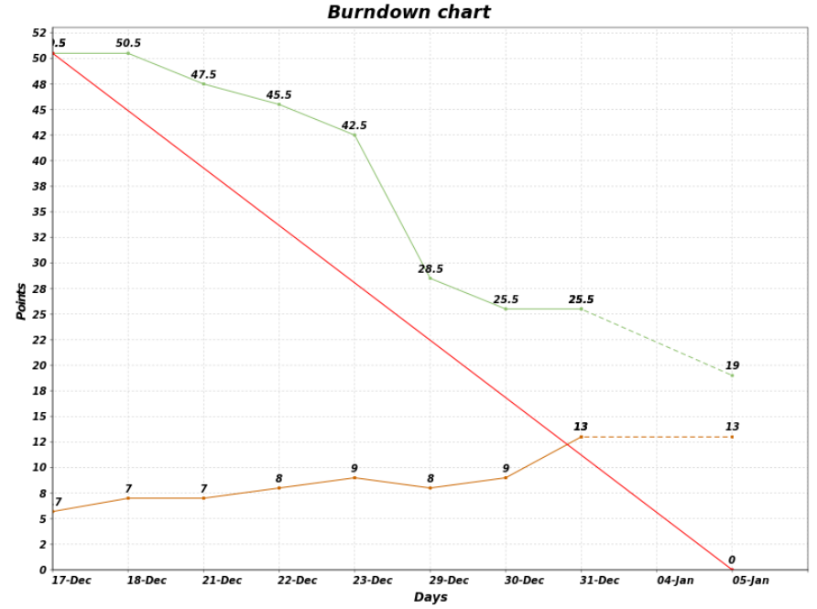
2.3 M6 Burndown Chart

Slide 7
Actions from last meeting
Action Item | Status
Data export: Finalize data schema for HealthVault extensions | Brian met w/Lowell, MP @ Microsoft Will follow Microsoft recommendations

Slide 8
Demo: executable software
Save Family History
In addition to proband, save:
Demographic info
Disease/Condition
Visible HealthVault updates
Family History table entry
Audit trail history entry
Hidden HealthVault updates
Extended data types
Viewable via X-ray tool
DEMO

Slide 9
Demo Script: Save to HealthVault
Sign in to HealthVault
Click the Health Information tab
Click on All Changes in the last 30 days
View latest entries
Start a new browser tab
Go to My Family Health History (demo)
Load a family history
Click on Save Family History button
HealthVault Manager Wizard step 1 appears
Click on Save Family History button
HealthVault Manager Wizard step 2 appears
Click Save Now
HealthVault login screen appears

Slide 10
Demo Script: Save to HealthVault
(continued)
Log in to HealthVault
HealthVault Manager successful connection page appears
Click on Save to HealthVault
HealthVault manager confirmation message appears
Return to HealthVault
Click on History of Changes
Click on All Changes in the last 30 days
View new entries recording MFHP input

Slide 11
Demo Script: Save to HealthVault
(continued)
Click the Health Information tab
Click the Edit Profile link
View the proband’s information in table
Name & Date of Birth
Relationship = self
Gender
Condition
Click on Show Optional Information
Ethnicity
Use X-Ray to view extended data types
Weight, Height, plus
Twin status
Adoption status

Slide 12
Demo Script: Load from HealthVault
Start a new browser tab
Go to My Family Health History (demo)
Click on Open a Saved History File button
Click on Load from Microsoft HealthVault button
Click on Continue button
Log in to Microsoft HealthVault
Click on Continue button
Click on Load from HealthVault button

Slide 13
Demo Script: Load from HealthVault
View the previously-saved Family History information
Name
Relationship to Me = self
Click on Update History icon
View other previously-saved information
Gender
Date of Birth
Twin status
Adoption status
Height, Weight
Disease / Condition
Race, Ethnicity

Slide 14
Requirements
Created & revised Use Cases based on data translation map developed earlier:
User Imports Translated Data from HealthVault
User Exports Translated Data to HealthVault
Highlights:
No pop-ups or Wizard to slow down user
Informational messages where appropriate
Display error messages when imported data violates standards
Available on Gforge (links above)

Slide 15
Information Architecture
Controlled Vocabulary
Analyzed all application text to derive a list of terms used throughout the application
Compiled terms into a controlled vocabulary
Chose the best term for each (or a completely new one that was better than any in use)
Updated wireframes and application resources in codebase to reflect new terms
Available on Gforge
https://gforge.nci.nih.gov/svnroot/fhh/hhs/fhh/trunk/documents/ui/FHH%20Controlled%20Vocab%20initial%20inventory.xlsx

Slide 16
Information Architecture
Other IA tasks this sprint:
Authored help text describing the FHH/HealthVault connection and privacy
Various ongoing adjustments to wireframes in prep for high-fidelity mockups next sprint
Finalized File Open process wireframes, including authoring text for new screens

Slide 17
Revised Mockups
Available on Gforge
Save Process WFs OG.pdf
FHH Open Process WFs OG – Save to HV.pdf
FHH Open Process WFs OG – Local File.pdf

Slide 18
Test Coverage - Regresssion
Regression coverage (old features)
59 of 60 features = 98%
Requirements Traceability Matrix
Remaining feature:
Alternate flows
Invalid HealthVault login credentials
Cancel/Close

Slide 19
Beta Test Planning
Beta Test steps
Verify Plan
Schedule beta test
Prepare beta test environment
Execute tests
Review test results
Identify issues
Publish test result reports
Available in Gforge:
FHH Master Test Plan.doc
FHH BETA Test Cases.xlsx

Slide 20
Beta Test Team Composition
Tech-savvy testers:
1 5AM employee not on the FHH team
1 Incremental employee not on the FHH team
1. Microsoft employee not on the HealthVault team
1 Mayo clinic employee/contractor
HeathCare-savvy users
1 HHS employee/contractor (not one of our stakeholders)
1 NCI employee/contractor (not one of our stakeholders)
General population users
friends/relatives recruited by each of the above. Should be:
mostly female (assumed to be core MFHP users)
geographically dispersed

Slide 21
Beta Test Surveys
Web-based survey tool
Flexible tools for creating and running user surveys
Common baseline for feedback
Chose SurveyMonkey.com
Three Beta Test Surveys
Kickoff survey (recruiting & training beta testers)
Feedback survey (workhorse – used over & over)
Wrapup survey

Slide 22
Iteration 7 Objectives
Implement new wireframes in HTML
Complete development of Export/Import Family History
Save immediate relatives
Save entire family
Implement user messages
Data translation informational messages
Data error messages
Handling bad data conditions
Test third-party interoperability (Mayo)
Prepare for rollout
MS Go-Live Process
ASPA Approval
Start NCI Appscan process

Slide 23
Documents in Gforge
This Sprint Review presentation
https://gforge.nci.nih.gov/svnroot/fhh/hhs/fhh/trunk/documents/pm/FHH_Sprint6_Review_2010-01-05.pptx
Revised Requirements
User Imports Translated Data from HealthVault
User Exports Translated Data to HealthVault
Controlled Vocabulary Initial Inventory
https://gforge.nci.nih.gov/svnroot/fhh/hhs/fhh/trunk/documents/ui/FHH%20Controlled%20Vocab%20initial%20inventory.xlsx
Wireframes
Save Process WFs OG.pdf
FHH Open Process WFs OG – Save to HV.pdf
FHH Open Process WFs OG – Local File.pdf

Slide 24
Documents in Gforge
HTML Wireframes
https://design.5amsolutions.com/projects/fhh/save/index.php https://design.5amsolutions.com/projects/fhh/save/downloading.php https://design.5amsolutions.com/projects/fhh/save/manage.php https://design.5amsolutions.com/projects/fhh/save/hv_transition.php https://design.5amsolutions.com/projects/fhh/save/hv.php https://design.5amsolutions.com/projects/fhh/save/hv_post_login.php https://design.5amsolutions.com/projects/fhh/save/hv_success.php https://design.5amsolutions.com/projects/fhh/save/save_hv_canceled.php https://design.5amsolutions.com/projects/fhh/save/save_local_canceled.php
Requirements Traceability Matrix
https://gforge.nci.nih.gov/svnroot/fhh/hhs/fhh/trunk/documents/test/Automated_Test_Cases_Tracebility_Matrix.xlsx
Beta Test Plan & Surveys
FHH Master Test Plan.doc
FHH BETA Test Cases.xlsx
Kickoff survey
Feedback survey

Slide 25
Schedule Next Sprint Review
PROPOSED DATE/TIME
Thursday, January 14
11am – Noon
INVITEES
Chris Piepenbring
Leslie Power, Dan Weikart
Project team

Slide 26
Agenda
SPRINT PLANNING (2.3 M7)
Conduct Retrospective
Iteration 7 Fine-grained Planning

Slide 27
Sprint Retrospective
SAMALO:
Same as:
More of:
Less of:
2.3 M6 Wiki

Slide 28
Proposed JIRA Tasks
Develop Export proband & direct blood relatives
Develop Export proband & all relatives
Convert Import mockups to HTML wireframes
Integrate HTML wireframes for Import
Develop Import proband & direct blood relatives
Develop Import proband & all relatives
Develop Import data translation info messages
Develop Import data translation error message

Slide 29
Proposed JIRA Tasks
Create automated tests for XHTML 1.0 validation
Update Export Selenium tests
Create Import Selenium tests
Translate HealthVault help text to Spanish
Review revised application with ASPA
Coordinate Go-Live process with Microsoft
Coordinate NCI Appscan process
Test third-party interoperability (Mayo)
Begin recruiting Beta testers
Write Sprint Review presentation & Demo Script

