Slide 1
FHH HealthVault Integration Project
Iteration 5 Review
Retrospective
Iteration 6 Planning
December 17, 2009

Slide 2
Agenda
SPRINT REVIEW (2.3 M5)
Review Actions from last meeting
Project Timeline
Demonstrate Iteration 5 Results
SPRINT PLANNING (2.3 M6)
Proposed Iteration 6 Objectives
Schedule Sprint Review
Conduct Retrospective
Iteration 6 Fine-grained Planning

Slide 3
Actions from last meeting
(Brian H): Contact Lowell @ Microsoft re: HealthVault changes relating to Race & Ethnicity
DONE 12/7/09: meeting notes
must extend family-history datatype
Custom extensions NOT shown in HealthVault GUI
(Wayne): Review framework for translating old .HTM files formats to the current XML format (FHH-844)
Subtask of FHH-831: Define requirements for recognizing and handling HealthVault data MFHP can't handle natively.
Not file translation, but file importing & error checking
Recommendation: build on this existing framework (more later)

Slide 4
Project Timeline
Phase |  | Timeline | Objectives | Status
1 | Inception | 24-Jun 15-Jul | Explore how to enable a user to export family history to HealthVault import family history from HealthVault | Complete
2 | Elaboration | 13-Oct 2-Dec | Implement Communication Specification Establish user interface concepts Develop & Execute Regression Tests Demonstrate executable software | Complete
3 | Development | 3-Dec 2-Feb | Refine requirements Translate Family History Items Develop user interface Develop system & regression tests Support CBIT Recruit Testers Establish the Beta test environment | In progress
4 | Beta Testing | 3-Feb 16-Feb | Testing with current MFHP users Testing with current HealthVault users Testing with general users
5 | Transition | 17-Feb 10-Mar | Provide technical assistance to NCI team Close out the project

Slide 5
Iteration 5
Phase 2 Objectives
refine Export requirements
develop Export
automate Export tests
demonstrate Export feature
Iteration 5 Task Themes
Implement HealthVault authentication
Implement Save Proband only (baby step)
Create automated regression tests
Refine Import requirements (risk mitigation)

Slide 6
Burndown Charts
31.5 points + 11.5 added = 43
Fix demo build
Find way to avoid Selenium sleeps (for consistency on CI server)
Weight not being set correctly
Create screen notifying user entering third-party site
16.5 points completed (26.5 left)
2.3 M4 Burndown Chart
2.3 M5 Burndown Chart

Slide 7
Demonstrate Sprint Results
Demo: executable software
Connect to HealthVault & save proband
Automated tests
Performing consistently in improved environment
Regression, new features tested
Revised wireframes incorporating ASAP input
Requirements for Import
recognizing and handling HealthVault data MFHP can’t handle natively

Slide 8
Demo: executable software
FHH-759: Implement HealthVault integration on Save Family History screen (Brian H.)
FHH-827: As a user, after I authenticate with HealthVault, I see a manager screen and have the ability to Save my family health history. (Brian P.)
FHH-767: Implement Save proband only (Brian P.)
DEMO

Slide 9
Demo Script: Save to HealthVault
Sign in to HealthVault
Click the Health Information tab
Click the Family History link
Show that the table is empty
Click on History of Changes
Click on All Changes in the last 30 days
View latest entries
Start a new browser tab
Go to My Family Health History (demo)
Load a family history with just one person (the proband)
Click on Save Family History button
HealthVault Manager Wizard step 1 appears
Click Cancel; user returned to previous page
Click on Save Family History button

Slide 10
Demo Script: Save to HealthVault
(continued)
HealthVault Manager Wizard step 2 appears
Click Cancel; user returned to step 1
Repat & Click Save Now
HealthVault login screen appears
Log in to HealthVault
HealthVault Manager successful connection page appears
“You are now connected to the Microsoft HealthVault account for [accountholder name]. ”
Click on Save to HealthVault
HealthVault manager confirmation message appears – success!

Slide 11
Demo Script: Save to HealthVault
(continued)
Return to HealthVault
Click on History of Changes
Click on All Changes in the last 30 days
View new entries recording MFHP input
Click the Health Information tab
Click the Family History link
View the proband’s information in table
Name & Date of Birth
Relationship = self
Condition = none
Use X-Ray to view extended data types
Weight
Height

Slide 12
Automated Tests
Regression Tests (Khalid)
Creating a family history and saving it as a file
Creating a family history and saving a diagram
Loading a legacy .htm file
Adding a relative
Get Help
New Feature Tests (Khalid)
Logging in to HealthVault through MFHP.
XHTML 1.0 Transitional validator
On hold for next sprint

Slide 13
Test Coverage
Regression coverage (old features)
19 of 23 features = 83%
Requirements Traceability Matrix
Total coverage (old & new features)
Test Summary
OLD: 9 of 86 points = 5.7%
NEW: 13 of 71 points = 8.3%
TOTAL: 22 of 157 points = 14%

Slide 14
Revised Wireframes
Input from Greg Downing, APSA, others
“Leaving gov’t web site” warning
Save .XML file locally now OPTIONAL
Wireframes revised by Andy Evans, Information Architect
Unified look & feel, vocabulary
Available on Gforge here.
Next step: create HTML wireframes

Slide 15
Requirements for Import
Must recognize and handle HealthVault data MFHP can’t handle natively
Reviewed framework for handling import from old-style HTM files
Can reuse some existing Update page features
Error message area
“item requires attention” icons
Can likely reuse existing “Condition not recognized” features
Some new interactive dialog required
Relationship
Other incompletely mapped data values

Slide 16
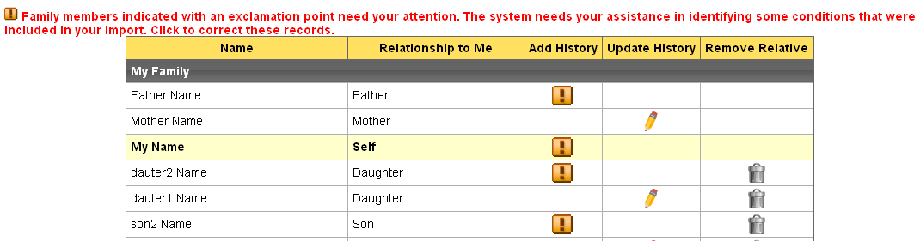
Recognizing Bad Data

Slide 17
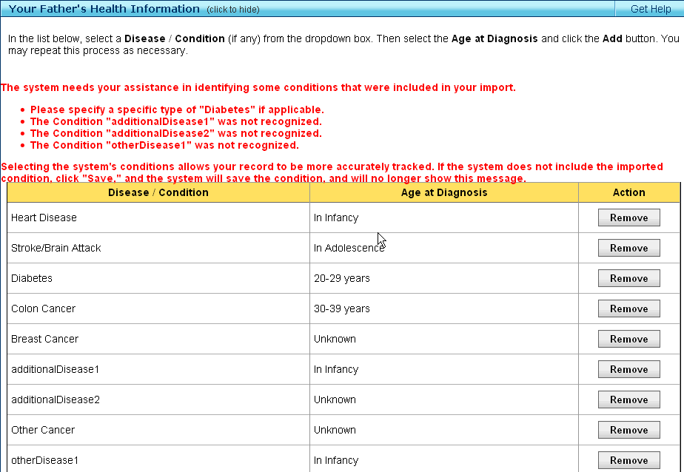

Slide 18
Relationship Data
Info messages here show why certain relatives were not imported
MFHP only tracks blood relatives. Since Joseph is a friend, this information will not be imported.
MFHP only tracks blood relatives. Since Barbara is a spouse, this information will not be imported.
Name | Relationship to Me | Add History | Update History | Remove Relative
Arthur | Father
Cindi | Aunt
Nancy | Aunt
My name | Self
Icons here indicate a problem with the Relationship field
i
i
i
i
i
i

Slide 19
Relationship Data
Click on the “requires attention” icon to reach dialogs
Radio buttons
Is Cindi your …
Maternal Aunt
Paternal Aunt
Who is the parent of Cousin1 ?
(Select relative)

Slide 20
Relationship Data
Link to Data Translation field map spreadsheet

Slide 21
Agenda
SPRINT REVIEW (2.3 M5)
Review Actions from last meeting
Project Timeline
Demonstrate Iteration 5 Results
SPRINT PLANNING (2.3 M6)
Proposed Iteration 6 Objectives
Schedule Sprint Review
Conduct Retrospective
Iteration 6 Fine-grained Planning

Slide 22
Iteration 6 Objectives
BUILD SAVE FAMILY HISTORY EXPORT
xxxx

Slide 23
Schedule Next Sprint Review
PROPOSED DATE/TIME
Monday, January 4 ??
11am – Noon
INVITEES
Chris Piepenbring, Greg Downing, Kevin Hughes, Greg Feero
Leslie Power, Dan Weikart
Project team

Slide 24
Sprint Retrospective
SAMALO:
Same as:
More of:
Less of:
2.3 M5 Wiki

Slide 25
Iteration 6 Planning
Risks
JIRA Tasks

Slide 26
Risks
Business Impacts
Mitigation Plans

Slide 27
Proposed JIRA Tasks
Schedule Sprint Review
xxx

Slide 28
Proposed JIRA Tasks
xxx

