Slide 1
Ligolo-ng
By Varun Sharma

Slide 2
WhoamI?
I am 6+ years experience in Application Security.Currently working as Senior in Accenture Security
Previously worked with KPMG and EY
Worked on Application Security.Mainly worked on Web Application and Infrastructure Penetration Testing.
linkedin.com/in/infosecvarun3
https://t.me/infosecvarun3
eJPT,eWAPT,eWPTv2,CRTP and OSCP(ongoing)

Slide 3
Ligolo-ng
Ligolo-ng is a lightweight and efficient tool designed to enable penetration testers to establish tunnels through reverse TCP/TLS connections, employing a tun interface. Noteworthy features include its GO-coded nature, VPN-like behavior, customizable proxy, and agents in GO.

Slide 4
Key Features
TCP/UDP Tunneling
Supports both protocols for versatile connections.
Ease of Use
Simple setup and user-friendly interface.
Reverse Shell Capabilities
Allows secure connections to compromised hosts.
Port Forwarding
Forwards remote ports to local machines.

Slide 5
Installation
Prerequisites
Go installed on system.
Installation Steps
On Kali 2024.2 or later
apt install ligolo-ng
Or
Clone the repository: https://github.com/nicocha30/ligolo-ng
Navigate to the directory and build: go build

Slide 6
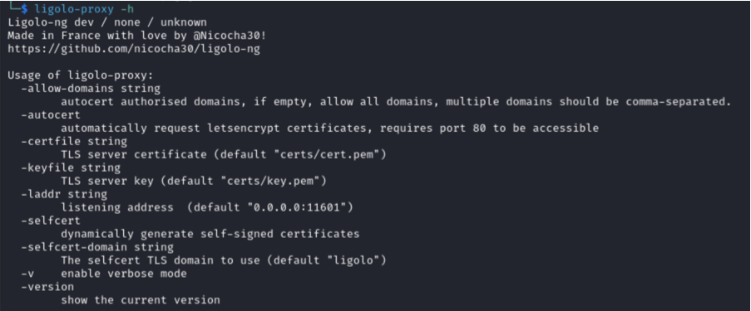
Ligolo-proxy

Slide 7
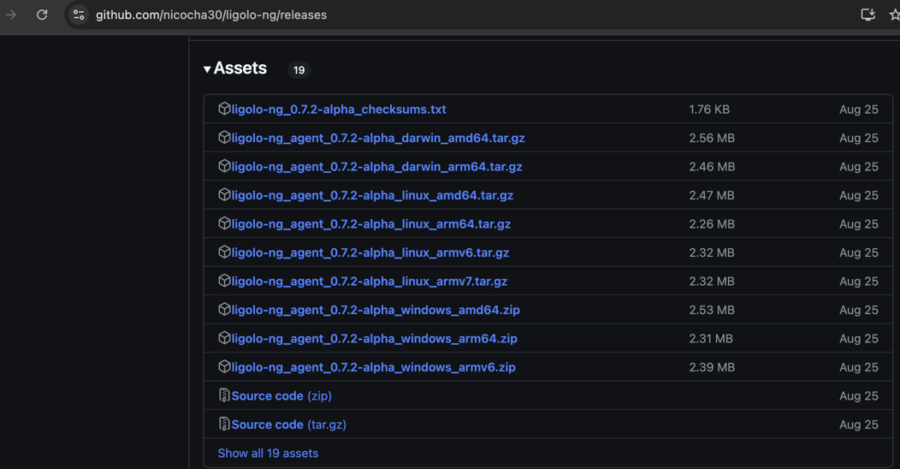
On victim box

Slide 8
Basic commands
Starting a Listener
Command: ./ligolo-ng –l [port]
Connecting to a Remote Host
Command: ./ligolo-ng –r [remote host] –p [port]

Slide 9
Use Cases
Penetration Testing
Helps testers to access internal networks securely.
Bypassing Network Restrictions
Useful in restricted environments
Reverse shells
Provides secure shells for remote access.

Slide 10
Security Considerations
Ethical Use
Ensure proper authorization before using Ligolo-ng
Detection Evasion
Techniques to minimize detection by security systems.

Slide 11
Benefits
Efficient and easier than SOCKS proxies.
TLS for secure communication with options for automatic certificate management through Let’s Encrypt
The agent file runs without elevated privileges
Dynamic Port forwarding

Slide 12
Demo

Slide 13
Other Alternatives Tools
Chisel – Moderate Reliability
SSHuttle – Primarily for TCP protocol

Slide 14
References
https://medium.com/@redfanatic7/guide-to-pivoting-using-ligolo-ng-efd36b290f16
https://www.hackingarticles.in/a-detailed-guide-on-ligolo-ng/
https://github.com/nicocha30/ligolo-ng/

Slide 15
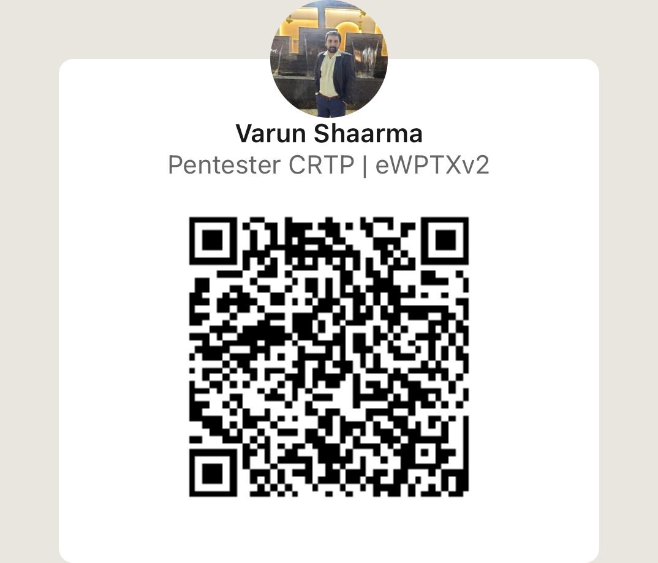
Q&A
Thank you

