Slide 1
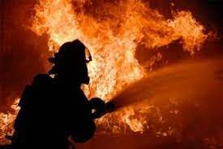
Firefighters project
Zespół QuantSquad
Based on Fire Incidents Dataset from Kaggle.com

Slide 2
Project goals
Model Goal:
Detecting situations when fire is a deadly threat to people
Aplication Goal:
Create application to help firefighters predict probability of potential civilian casualities for specific fire alarm

Slide 3
MODEL data
Original Data:
27 columns containing information about fire incidents as defined by the Ontario Fire Marshal related to Toronto. Starting from 2011 to 2018.
Our goal was to create application used by the rescue team at the time of reporting fire. We kept the most impotrant information which can be gained at that moment.

Slide 4
Prepearing data
Model Features:
Model Target:
Chosen columns have 561 unique values which were transformed in model features
„Civilian Casualities” is our target.
Value „0” means there are no fatal victims.
Other values (1,2,3,4,5,6,7,8,15) were transformed into number „1” - it means there is risk of fatalities.
Dataset is higly unbalanced: „1”- 8%

Slide 5
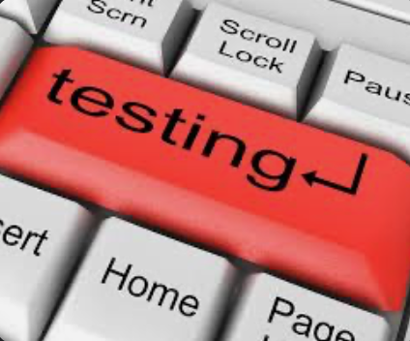
Different models tests
Tested Models:
Chosen Model
XGBoost – best params:
n_estimators = 200,
max_depth = 2,
booster = 'gbtree’,
learning_rate = 0.2,
eval_metric = ’auc’,
objective = 'binary:logistic’,
scale_pos_weight = 9,
importance_type = 'gain’,
min_child_weight = 2
LogisticRegression
DecisionTreeClassifier
RandomForestClassifier
SVC
KNeighborsClassifier
GradientBoostingClassifier
AdaBoostClassifier
ExtraTreesClassifier
GaussianNB

Slide 6
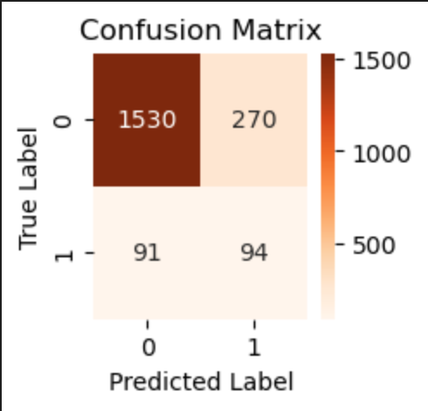
Model parametres
TRAIN scores:
TEST scores:

Slide 7
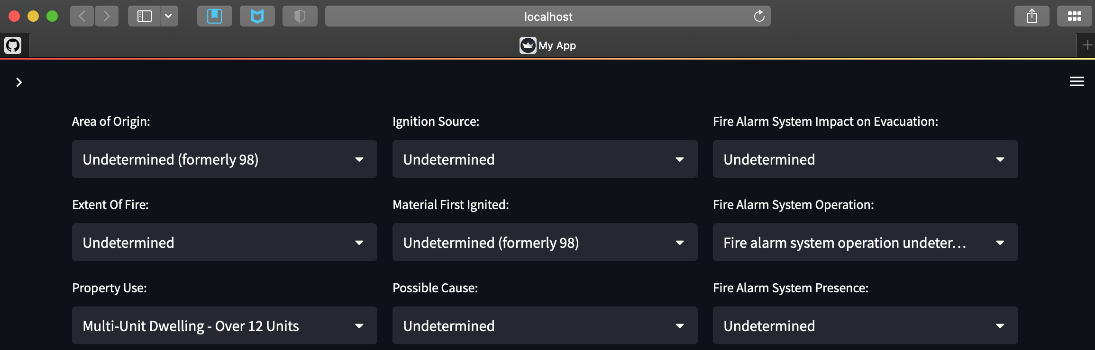

Presentation of Application
Application based on python library:

Slide 8

Conclusions
By nature of the problem we can only inform if ambulance shall be sent or could. Decision is still on person receiving alert.
In future use differend methods of encoding data
(James-Stein Encoder, CatBoost Encoder, etc.)
Make whole flow at beggining and later optimize different steps
instead of doing each step and optimize it before going to next step
Our main problem was time consuming calculations for limited hardware capacity
in paralell used for homework model calculations)
Area:
Cooking Area or Kitchen | 389
Living Area (e.g. living, TV, recreation, etc) | 185
Sleeping Area or Bedroom (inc. patients room, dormitory, etc) | 102
Ignition source:
Stove, Range-top burner | 299
Smoker's Articles (eg. cigarettes, cigars, pipes already ignited | 118
Candle | 46
Material First Ignited:
Cooking Oil, Grease | 227
Mattress, Pillow | 51
Upholstered Sofa, Chair, etc. | 51

