Slide 1
Docker
Package, deliver and scale with ease

Slide 2
Introduction to Docker
Docker concepts
Docker images and containers
Dockerfile
Build a Docker image
Run your container
Push image to Docker Hub
Deploy your app with Kubernetes
Conclusions

Slide 3
Introduction to Docker
Deploying an application typically requires packaging, delivery, configuration files, scripts, infrastructure configuration, etc.
Docker is a platform for developers and sysadmins to develop, deploy, and run applications with containers. The use of Linux containers to deploy applications is called containerization.

Slide 4
Introduction to Docker
Containerization is increasingly popular because containers are:
Flexible: Even the most complex applications can be containerized.
Lightweight: Containers leverage and share the host kernel.
Interchangeable: You can deploy updates and upgrades on-the-fly.
Portable: You can build locally, deploy to the cloud, and run anywhere.
Scalable: You can increase and automatically distribute container replicas.
Stackable: You can stack services vertically and on-the-fly.

Slide 5
Introduction to Docker
Docker simplifies the process by allowing to create an image which includes not only you application but also the infrastructure, libraries, environment variables and configuration files
Then the image can be run as an isolated individual container on any operating system

Slide 6
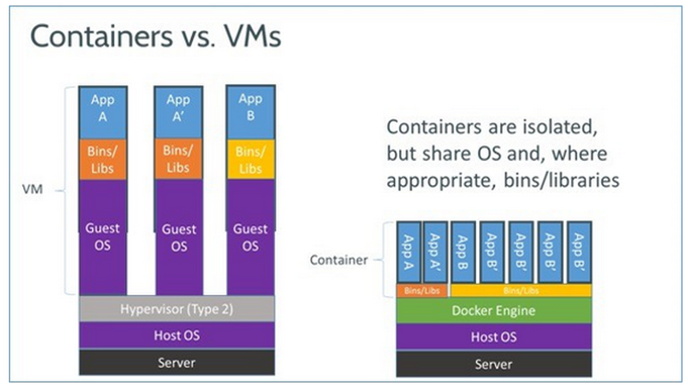
Introduction to Docker
A container runs natively on Linux and shares the kernel of the host machine with other containers. It runs a discrete process, taking no more memory than any other executable, making it lightweight
By contrast, a virtual machine (VM) runs a full “guest” operating system with virtual access to host resources through a hypervisor. In general, VMs provide an environment with more resources than most applications need.

Slide 7
Introduction to Docker
No more “It runs on my computer”
No more environment differences because of misconfiguration
Common set of runtime API, image format, toolset to manage the containers

Slide 8
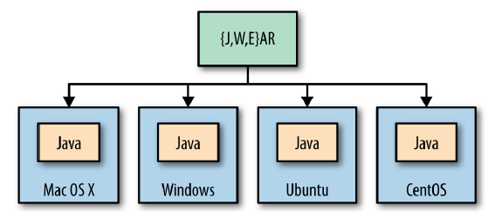
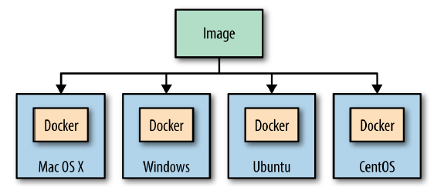
Introduction to Docker
Similar with Java philosophy “Write once, run everywhere”, Docker can be resumed in “Package once, deploy everywhere”
Java philosophy
Docker philosophy

Slide 9
Docker concepts
Build – facilitates the creation of containerized applications. The developer packages the application, its dependencies and infrastructure configuration in a read-only template called Docker image
Ship – share the application easily and securely via a Docker registry. Docker Hub is the default and publicly available registry
Run – deploy, manage and scale applications. A Docker container is a runtime process of an image. Containers can be created, deleted, started, stopped, scaled, moved

Slide 10
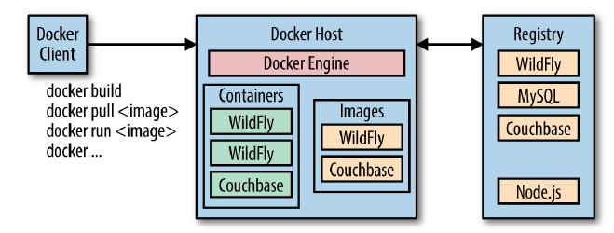
Docker concepts
Package, ship, run

Slide 11
Docker concepts
Docker host – a physical or virtual machine where the Docker Engine runs
Docker client – talks with the Docker engine. Can be located on the same or different machine as Docker Engine
Building an image – a client can download an already existing image from the repository with pull command, or create a new image using build command or run a container

Slide 12
Docker concepts
Downloading from the registry – Docker Engine first checks if the image already exists on the machine and if not it downloads it from the registry. Multiple images can be downloaded on the same machine and each one would represent a different software component
Running the container – a container can be started using run command. It represents an instance of the image definition. Multiple containers can be started on the same host

Slide 13
Docker concepts
Under the hood of images there are a series of layers. Docker makes use of union file system which allows files and directories from different filesystems to be combined as layers in a unified filesystem
The lightweight characteristic of Docker is given by the layers. When you deliver an update to your application a new layer is built. Thus when one updates the image it will only receive the update for that layer compared to the classical approach of the VM’s where the entire image must be downloaded. You deliver only the update.

Slide 14
Docker concepts
Speaking about versions, the registry can store multiple versions of the same image using the format image-name:tag
By default the tag is named ‘latest’ and typically refers to the latest image version. For example alpine:latest is the latest version of the small linux distro. Once the images is downloaded it can be started as one or multiple different containers

Slide 15
Toolbox
Docker Engine – is the central piece of Docker. It builds and runs your containers. The runtime consists of a daemon that talks with the client and execute commands. It uses Linux features like cgroups, kernel namespaces, union filesystem. These allow the containers to share the same kernel but run individually and isolated from each other with their own PID, filesystem structure and network interfaces
Docker Machine – allows to create Docker hosts on your computer, cloud hosts, datacenters. It create servers, installs Docker and configure Docker client.

Slide 16
Toolbox
Docker Compose – is a tool which allows you to define and run application that consists of multiple containers. One application might consists of a web application server, database, etc. These containers are defined I a configuration file then the Docker compose script is used to start, stop, scale the whole application

Slide 17
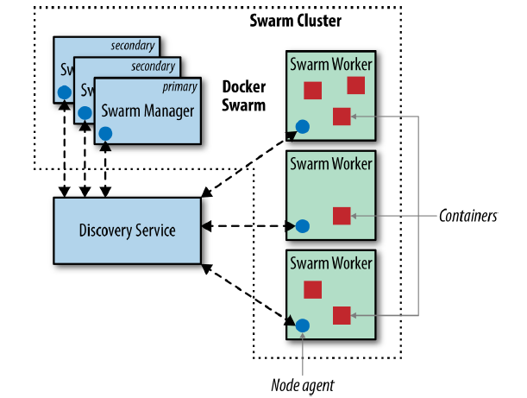
Toolbox
Docker Swarm – considering we have an application running on a single host, that makes that host a single point of failure(SPOF). This is an unwanted situation in case of problems with that host or its resources. To mitigate this, Docker Swarm allows you to manage, run and scale the application on different hosts.

Slide 18
Toolbox
Swarm manager – is the predefined host in the cluster and manages the cluster resources. It manages and orchestrates the containers in the cluster. for high availability it can be configured with a primary instance and multiple secondary instances
Discovery service – talks with a hosted discovery service which maintains a list of IP’s in the Swarm cluster.
Swarm worker – containers are deployed and started on hosts that need to be managed by Swarm manager. Each node runs a Docker Swarm agent that registers the Docker daemon, monitors and updates the node status in the discovery service

Slide 19
Toolbox
Scheduler strategy – you can choose different types of strategies in order to tell Docker Swarm where to deploy the containers. For example the strategy can be spread(default), binpack or random. The default strategy optimizes the nodes for the least number of running containers
Standard Docker API – Docker Swarm serves as the Docker API, thus any tool that is able to talk with a Docker host can easily scale to multiple hosts. That means a multi-container application can be configured to run on multiple hosts by configuring the Docker Swarm cluster

Slide 20
Docker and you first app
Dockerfile
Docker build images from a plain text file called Dockerfile. This file contains all the information and commands needed to have ensemble the image. The docker build command is used to build the image.
In the build command is also passed the context used during image creation. This can be a path or even a Git repository and is processed recursively. A .dockerignore file can be added in the root directory in which you can specify what directories should ne skipped when building the image.

Slide 21
Docker and you first app
Any image must be created from a base image. This is accomplished with FROM command. There are a lot of already created images in Docker Hub from which you can start yours. Often this images are already containing multiple software components like JDK+ MySql + Tomcat.
The Dockerfile can contain also CMD command. CMD provides defaults for executing the container. If multiple CMD instructions are listed then only the last CMD will take effect. This ensures that the Docker container can run one command, and only one.

Slide 22
Docker and you first app
Exercise
Create a new directory – this will contain the Dockerfile
Create a text file named Dockerfile that contains
FROM java
CMD [“java”, “-version”]
3. Build your image
docker build –t hello-java .
4. Run the container
docker run hello-java

Slide 23
Docker and you first app
The build command uses “–t” to name the image with the provided value
“.” is the context for the build image command. This is the directory used in case of COPY commands. No files in our case.
The java image is copied from Docker Hub with the latest version
The CMD command added as a new layer

Slide 24
Docker and you first app
To list the existing images you can use docker images
Each image can be tagged using name:tag so that you can create multiple versions of the same image. By default the images are tagged with “latest” value

Slide 25
Run your container
To run a container you use docker run followed by the image name:
docker run hello-java
There are also a few options that can be used along with the run command
-i Keep STDIN open even if not attached
-t Allocate a pseudo-TTY
-d Run container in background and print container ID
--name Assign a name to the container
--rm Automatically remove the container when it exits
-e Set environment variable
-P Publish all exposed ports to random ports on the host
-p Publish a container’s port(s) to the specified host port
-m Limit the memory

Slide 26
Docker Hub
Docker Hub is a public repository for Docker images where they can be pushed, pulled, updated, deleted. A list of Docker commands are available in order to interact with the hub:
login Register or log in to a Docker registry
search Search the Docker Hub for images
pull Pull an image or a repository from a registry
push Push an image or a repository to a registry
logout Log out from a Docker registry
tag Tag an image into a repository

Slide 27
Docker Hub
Search and pull commands can be used without needing to have an account on Docker Hub. If you want to push or update an image you will have to have an account. If we list the existing images we see that no account is associated with them:
REPOSITORY TAG IMAGE ID CREATED SIZE
hello-java latest 2547fe6782bd 3 minutes ago 642.9 MB
java latest 97d87da6866e 9 days ago 642.9 MB

Slide 28
Docker Hub
To associate an account with an image we can tag the image by its id:
docker tag aae0104e1169 emag/hello-java:latest
The associated account now is “emag”
REPOSITORY TAG IMAGE ID CREATED SIZE
emag/hello-java latest 2547fe6782bd 2 minutes ago 642.9 MB
hello-java latest 2547fe6782bd 6 minutes ago 642.9 MB
java latest 97d87da6866e 9 days ago 642.9 MB

Slide 29
Push image to Docker Hub
The image can now be pushed to the “emag” user repository
docker push emag/hello-java:latest
Now the image can be downloaded by everyone since the Docker Hub repository is public. Alternatively a container with the image can be started using run command

Slide 30
Docker cheat sheet
## List Docker CLI commands
docker
docker container --help
## Display Docker version and info
docker --version
docker version
docker info
## Execute Docker image
docker run hello-java
## List Docker images
docker image ls
## List Docker containers (running, all, all in quiet mode)
docker container ls
docker container ls --all
docker container ls -aq

Slide 31
Kubernetes
Kubernetes – is an open source, container agnostic, orchestration tool for managing containerized hosted in a cluster
It automates the deployment, scaling, and management of containerized applications. Originally designed by Google
It is important to understand the overall architecture of Kubernetes if you plan on using it to manage your production applications.

Slide 32
Kubernetes
Cluster – a set of physical or virtual machines and infrastructure resources that are used to run your containers. The machines that are managing the clusters are called masters and the machines that are running the containers are called nodes or workers or minions

Slide 33
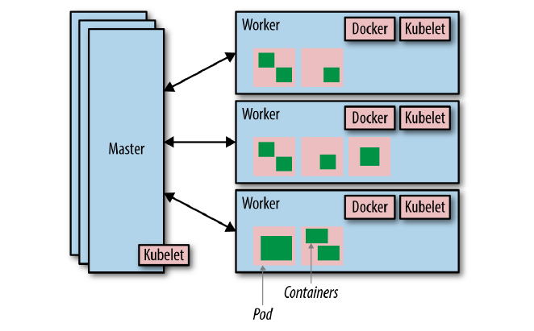
Kubernetes
Master(s) – At least one is required, use multiple for resilience
Node/Worker/Minion(s)

Slide 34
Kubernetes
Master - is the controller of the cluster and it consists of multiple services:
API server: The API server is the service through which Kubernetes commands are issued and Kubernetes specific information is queried.
Controller: The controller watches the state of the cluster and initiates changes in an attempt to comply with the desired state (desired state is defined to K8s by the K8s administrator and is typically stored in YAML files).
Scheduler: The scheduler is responsible for deciding where to run the Pods (collection of containers) based on the resources available on the Nodes.
etcd: distributed key value store containing data and container state information

Slide 35
Kubernetes
Nodes - also known as Workers or Minions, are responsible for running multiple services. These services consist of:
Kubelet: allows the node to be manageable by the master(s). Is responsible for starting and stopping the containers and provides a heartbeat back to the Master.
Kube-proxy: is a network proxy and load balancer that is responsible for routing traffic to the appropriate container based on the incoming request IP and port number.
Pod: the smallest deployable units that can be create, scheduled and managed. A logical collection of containers that belong to an application(typically an application consists of multiple pods). Each resource in Kubernetes can be defined in a configuration file
cAdvisor: cAdvisor is an agent (built into the Kubelet) that collects resource utilisation information which is used by the Kubernetes Master.

Slide 36
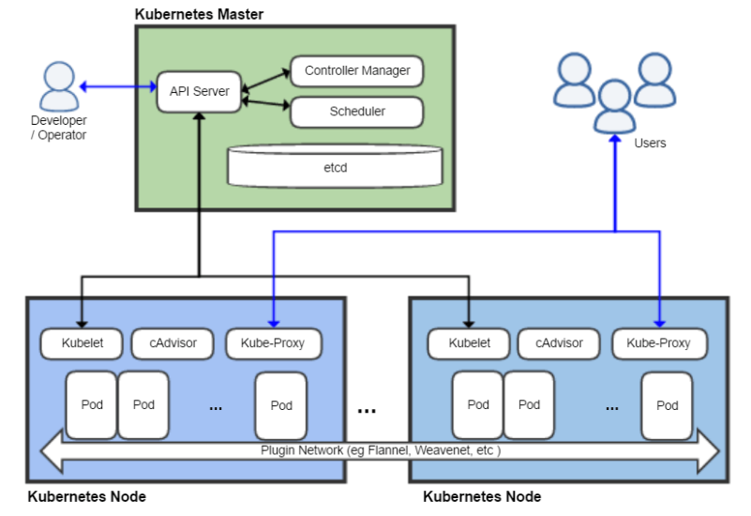
Kubernetes
Kubernetes architecture

Slide 37
Kubernetes
Pros
It can run one or multiple pods as is delegated by the masters.
Kubernetes automates the deployment and operation of containerized applications. Deployment descriptions in the form of a YAML files are given to the Master via the API server and then the requested images are started on those Nodes with available capacity.
As an example, a deployment may ask for 6 NGINX images to be started. Kubernetes will pull the NGINX Docker image and start 6 containers wrapped in Pods with that image across available Nodes. It will continue to ensure that there are 6 running. If an image should stop running a new one will automatically be started to replace it.
You don’t explicitly define where any of these images run, Kubernetes handles this automagically for you! Additionally the network routing and load balancing will be configured automatically and updated to reflect any changes to running containers.
The scaling up/down of the number of instances may be managed manually or automatically based on resource utilization. Managing rolling updates and running multiple versions are also all handled by Kubernetes.
This level of automation facilitates increased velocity in the continuous deployment of modern applications.

Slide 38
Kubernetes
Cons
Increased automation and the hiding of complexity is a good thing while all is working as expected.
The challenge is knowing what has broken or is misconfigured when things are not working as expected.
The standard Kubernetes dashboard only provides limited information while the command line tool provides deep information but not in an easily digestible form.
This limited visibility can be both challenging and time consuming when troubleshooting a problem with an application environment. By default the containers are distributed across available Nodes with sufficient resources available, this can make monitoring the technology in those containers difficult because they can be running anywhere and could move if restarted.
Monitoring both Kubernetes and the application environment(s) it is orchestrating is essential to ensure all is working as it should and the users of the application are receiving a prompt and error free service.

Slide 39
Conclusions
In the current context when time to market is crucial, the processes and tools behind software products need to be adapted to keep up
The classical way of installing the app server, database, web server, environment configuration, etc. is too time consuming and in-effective compared to what can be accomplished with the new tools
Docker is a standardized way for packaging and delivery for almost any software component/application

