Slide 1
The R Programming Language
Presentation by:
Barry Snowe
CIS 121
December 13, 2016

Slide 2
1. Background
History of R
The nature and purpose of the language
The RStudio IDE
The user community
Hadley Wickham and other developers

Slide 3
History of R
IBM S language
S Plus
R
Growth in popularity

Slide 4
The Nature and Purpose of R
Statistical programming
Functional paradigm
Similarities to C/C++, Python, etc.
Slow language, everything in main memory
Small scripts, interactivity on console

Slide 5
The RStudio IDE
Development team
Self-contained, can get work done in one place
Different windows (console, editor, plot/help/file viewer, history/workspace)
Can save plots to PNG, output to files, code to Markdown/HTML/PDF etc.

Slide 6
The R User Community
CRAN
R-Bloggers
DataCamp, Coursera, RPubs
StackOverflow, Reddit

Slide 7
Libraries and Developers
Hadley Wickham
plyr, dplyr, tidyr
ggplot2, ggvis
Many statistical analysis packages
Libraries for SQL, SPSS, SAS data
Libraries to handle XML or JSON
Libraries for documentation

Slide 8
2. Getting and Cleaning Data
Downloading data from the Internet
Importing data into the R workspace
Creating the data frame
Validating and evaluating the data frame
Identify key columns, subsets, and critical data
Clean up files, close connections, and address and missing data values

Slide 9
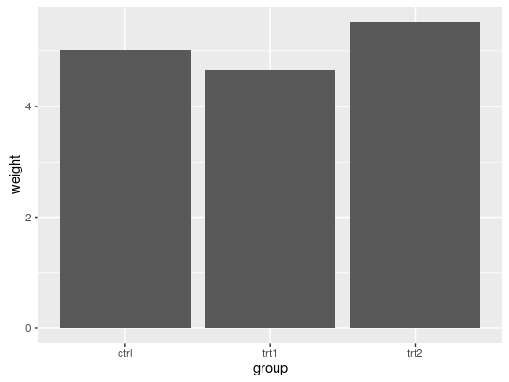

Slide 10
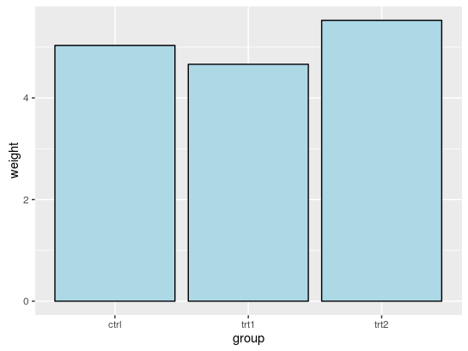

Slide 11
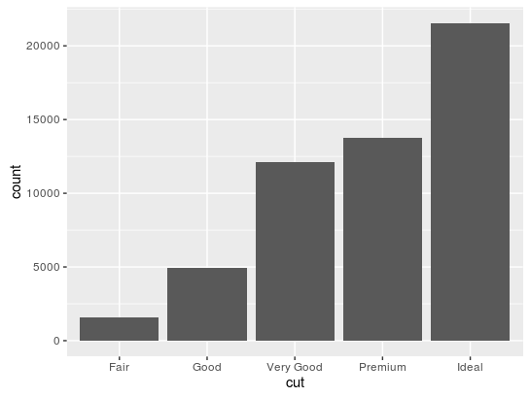

Slide 12
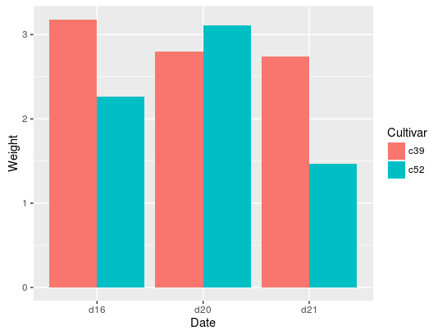

Slide 13
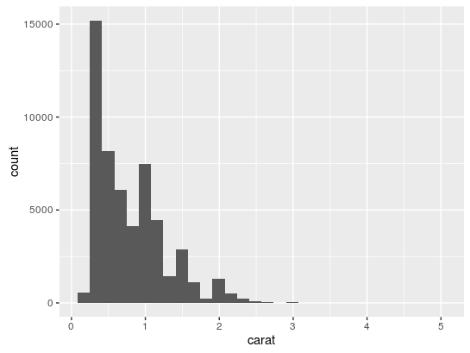

Slide 14
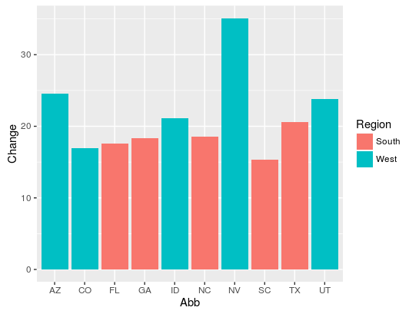

Slide 15
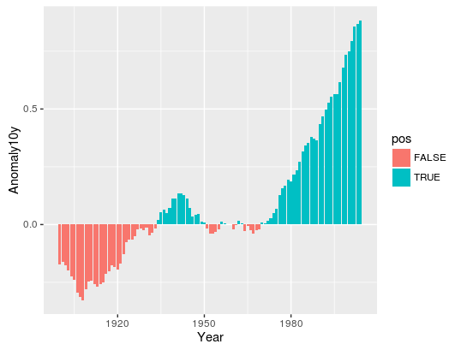

Slide 16
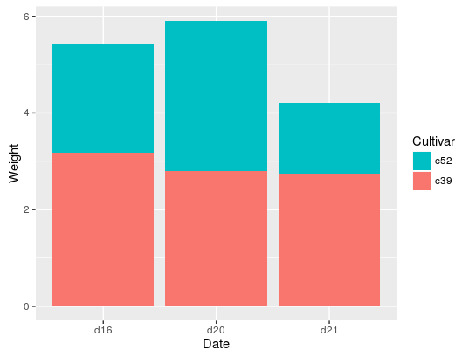

Slide 17
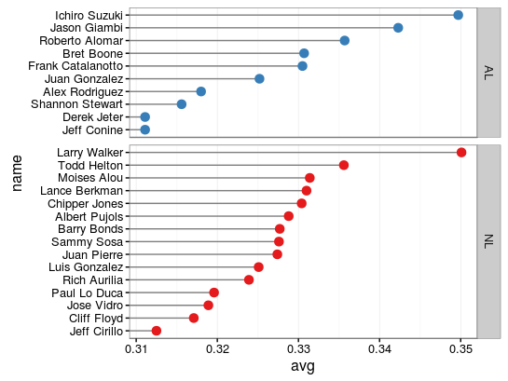

Slide 18
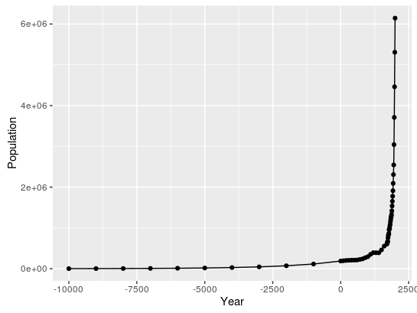

Slide 19
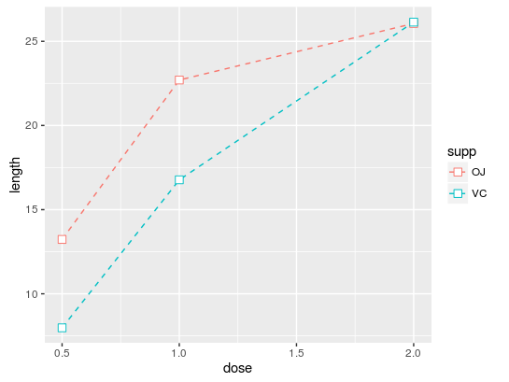

Slide 20
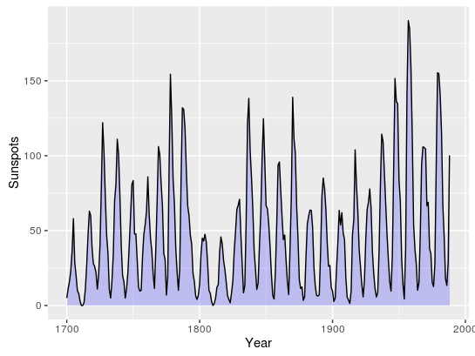

Slide 21
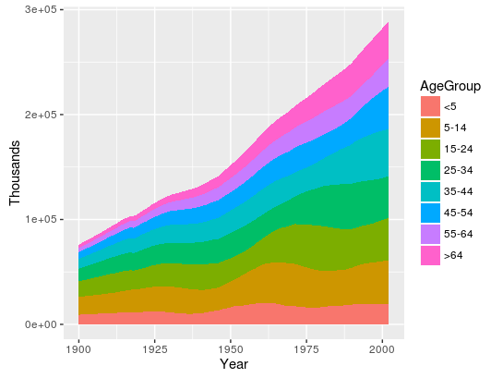

Slide 22
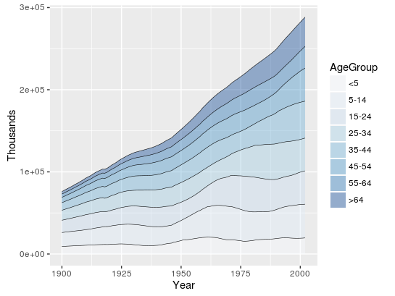

Slide 23
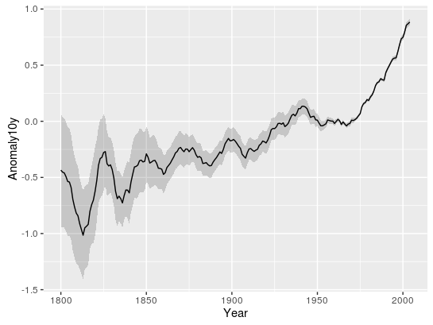

Slide 24
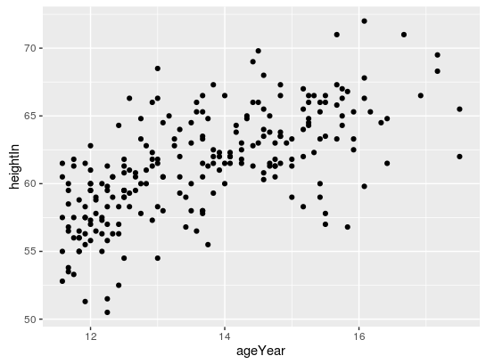

Slide 25
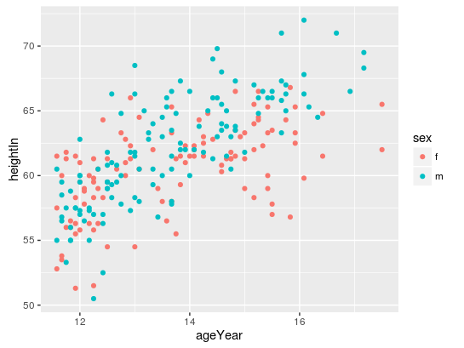

Slide 26
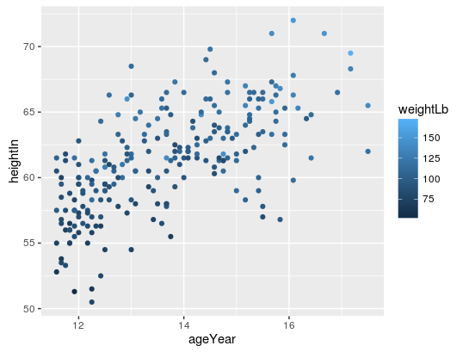

Slide 27
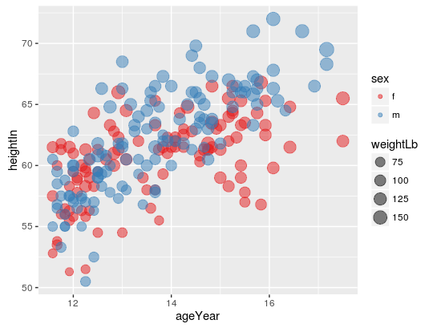

Slide 28
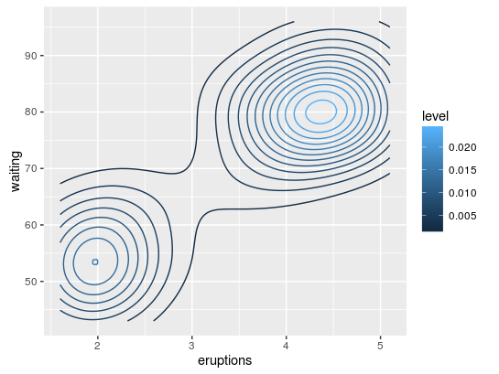

Slide 29
