Slide 1
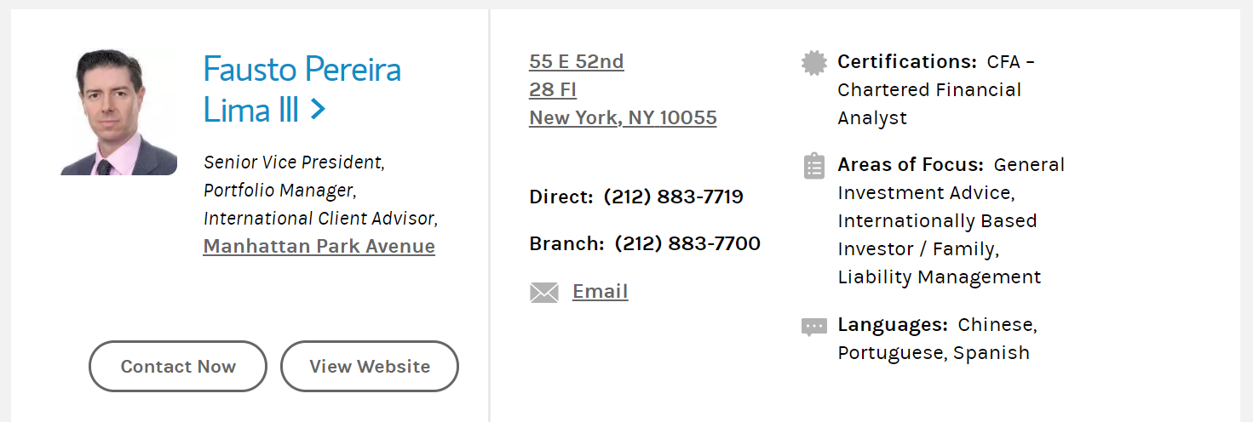
E
H
A
C
B
F
I
G
D
K
J
L
M
N

Slide 2
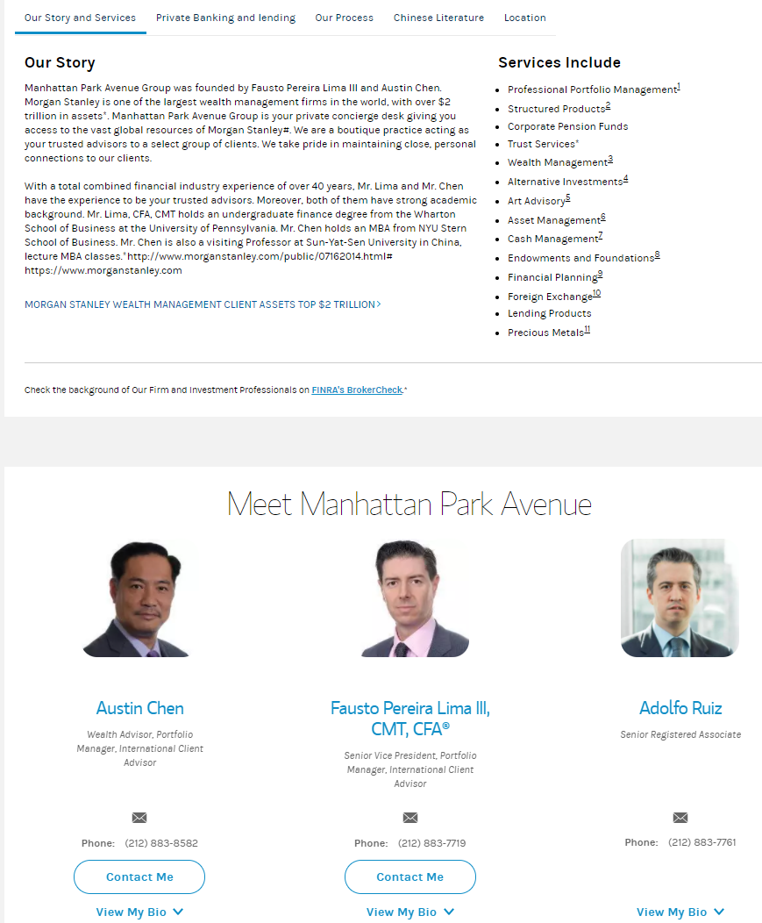
L
M
N

