Slide 1
🚗
Corporate Car Pooling System
Mid-Semester Dissertation Presentation
MTech (Software Engineering) | BITS Pilani
Presented by:
Prashant Sopan Berad
May 2025
MTech BITS Pilani | Corporate Car Pooling System | 2025

Slide 2
Agenda
What we'll cover today
01
Problem Statement & Motivation
02
Proposed Solution & Objectives
03
System Architecture & Tech Stack
04
Core Modules Overview
05
Database Design (ER Diagram)
06
System Diagrams (Use Case, Activity, Sequence, State Machine)
07
Progress Made So Far
08
Backend & Frontend Implementation
09
AI Agent Module
10
Future Roadmap
MTech BITS Pilani | Corporate Car Pooling System | 2025

Slide 3
Problem Statement
Why do we need a Corporate Carpooling System?
🚦 Urban Traffic Congestion — Thousands of employees driving separately causes severe road congestion around corporate campuses, increasing commute time by up to 45%.
🌍 Environmental Impact — Individual cars emit 4–5× more CO₂ per commute than shared rides. Corporate fleets remain the single largest source of avoidable employee carbon footprint.
💸 High Commute Costs — Fuel, parking, and vehicle maintenance cost employees ₹8,000–₹20,000 per month in metro cities, reducing effective take-home pay.
🔒 Safety Concerns for Solo Commuters — Women employees and night-shift workers face significant safety risks during early-morning or late-night commutes.
📭 No Centralized Platform — Organisations lack a dedicated system to coordinate carpooling; existing public apps (Ola, Uber) are not designed for closed corporate ecosystems.
📊 No Visibility for HR/Admin — Companies cannot measure commute patterns, carbon footprint, or employee transport costs without a dedicated system.
MTech BITS Pilani | Corporate Car Pooling System | 2025

Slide 4
Proposed Solution
CarpoolHub — A Corporate-Grade Ride Sharing Platform
A web-based corporate carpooling platform enabling same-organisation employees to offer and request shared rides, reducing individual car usage, CO₂ emissions, and commute costs.
Core Objectives
Safety & Reliability
✔ Enable drivers to post rides with route, timing, and seat count
✔ SOS emergency alert with guardian contact notification
✔ Smart matching of passengers to nearby drivers using geo-spatial algorithms
✔ Backup driver mechanism — auto-activate if primary cancels
✔ Real-time ride tracking via GPS pings
✔ Gender-preference filtering for ride matching
✔ In-app chat between driver and passengers
✔ Soft-delete and audit trails for data safety
✔ Integrated payment system (Razorpay)
✔ Organisation-scoped access (employees see only org rides)
✔ Mutual rating system after ride completion
✔ AI Agent for architecture & system Q&A (LangGraph)
MTech BITS Pilani | Corporate Car Pooling System | 2025

Slide 5
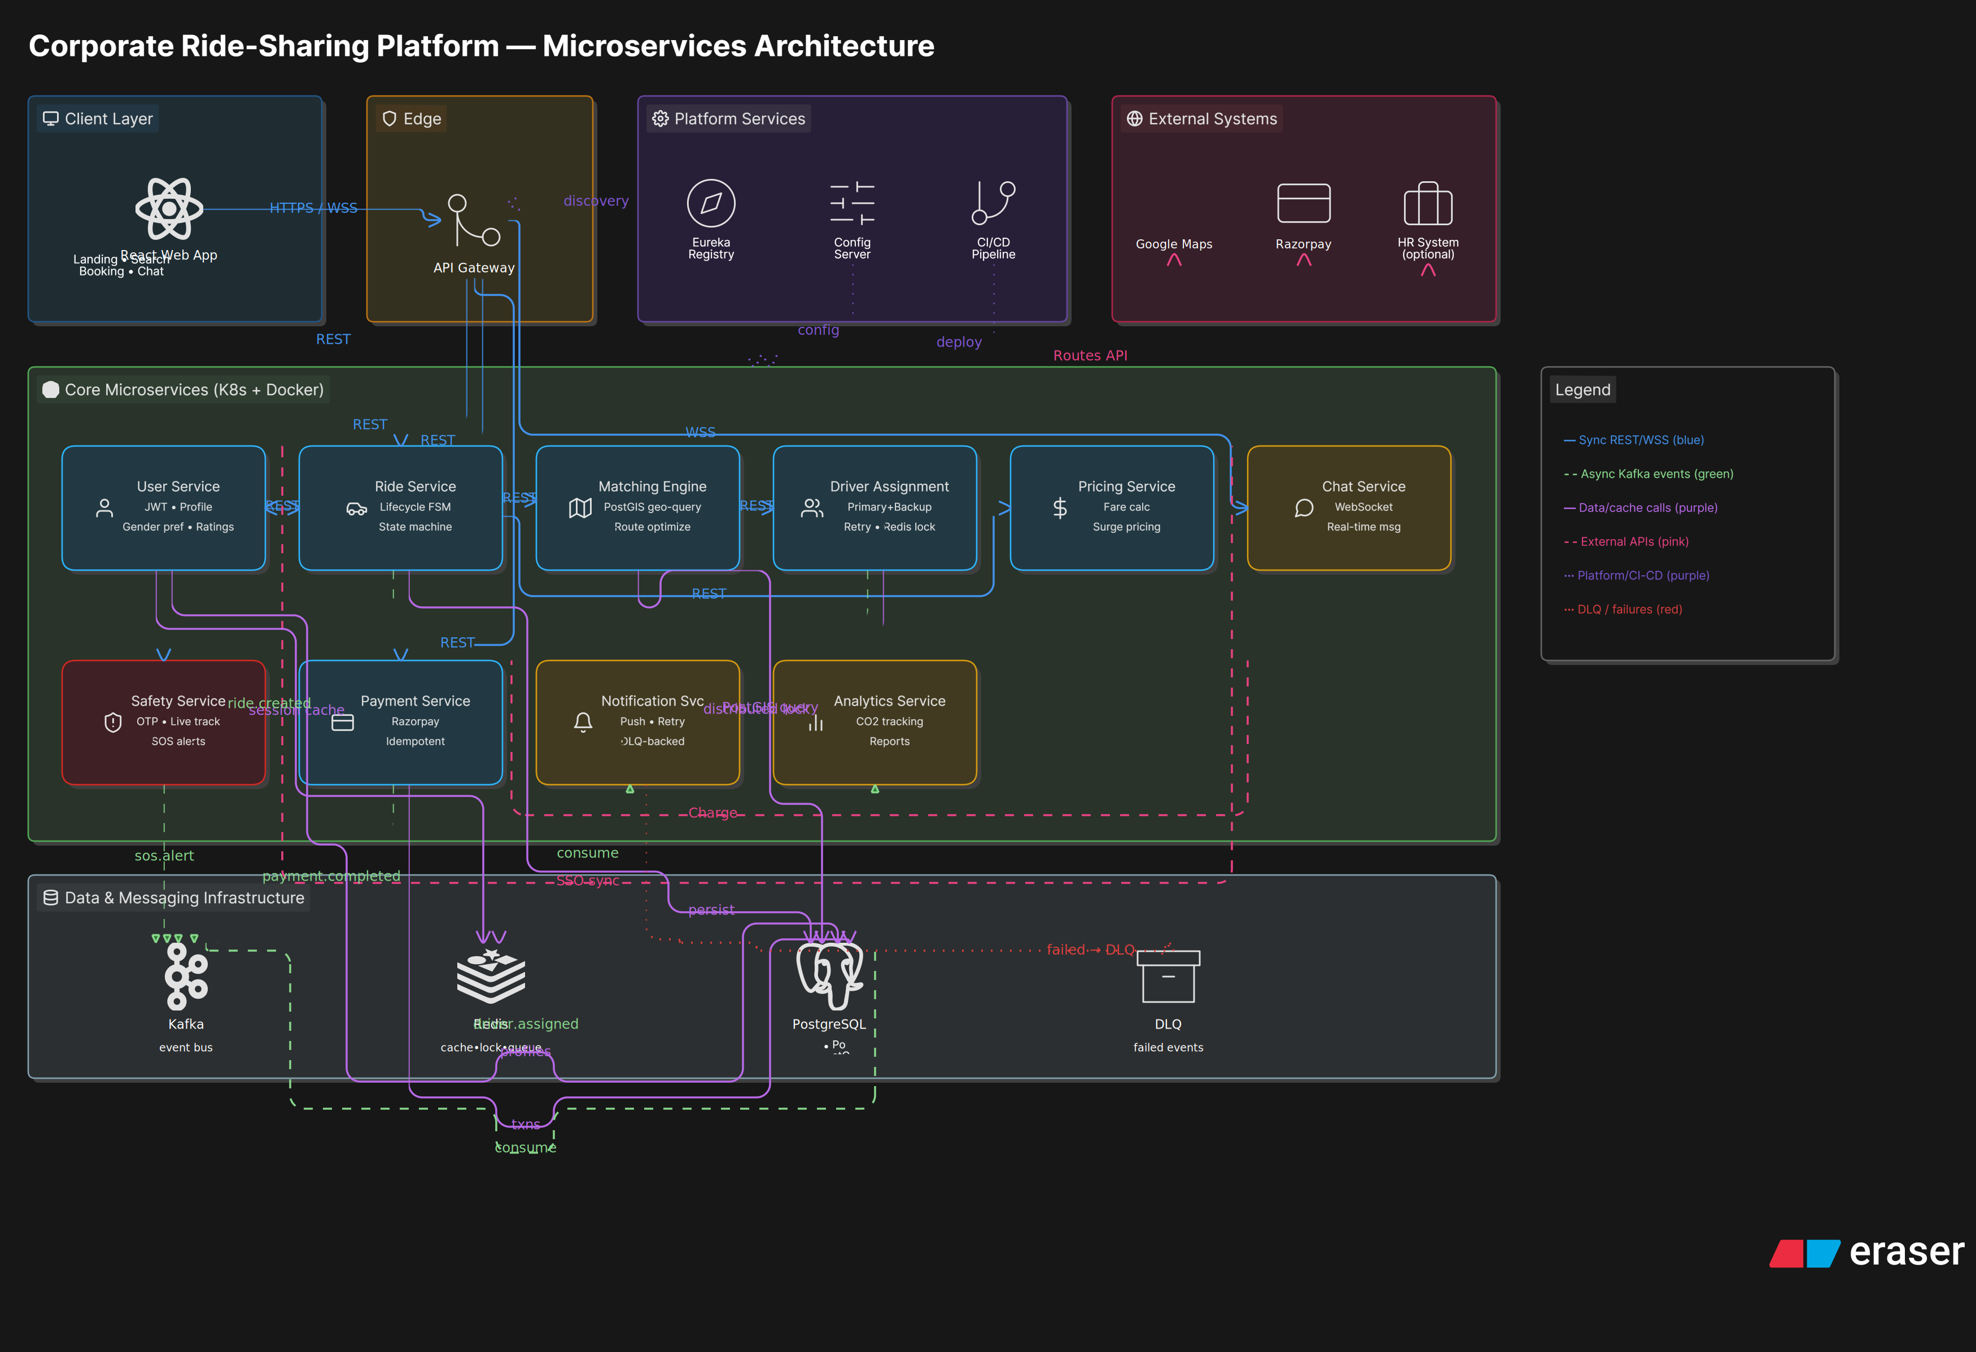
System Architecture
3-Tier Architecture with AI-Augmented Layer
MTech BITS Pilani | Corporate Car Pooling System | 2025

Slide 6
Technology Stack
Tools, Frameworks & Services
Frontend
Backend
Database
Integrations
DevOps / Infra
• React 18 (Vite)
• Spring Boot 3 (Java 21)
• PostgreSQL 16
• Razorpay (Payments)
• Git + GitHub
• React Router v6
• Spring Security + JWT
• PostGIS Extension
• Claude AI (Anthropic)
• Maven (build)
• Context API (state)
• Spring Data JPA
• ST_DWithin / ST_Distance
• LangGraph (AI Agent)
• Vite (frontend build)
• Axios (REST calls)
• Hibernate / Validation
• GEOGRAPHY(Point, 4326)
• FAISS (Vector Store)
• Python 3.11 (AI Agent)
• CSS Modules + Tokens
• WebSocket (STOMP)
• GEOMETRY(LineString, 4326)
• JWT / BCrypt
• PostgreSQL + PostGIS
MTech BITS Pilani | Corporate Car Pooling System | 2025

Slide 7
Core Modules
9 Functional Modules forming the complete system
👤 User Management
🚗 Ride Management
Registration, login, JWT auth, profile, soft-delete, org scoping
Create/update/cancel rides, seat tracking, status lifecycle
🔍 Matching Engine
📋 Request Handling
Geo-spatial matching via ST_DWithin, route overlap, detour %, gender filter, rating sort
Passenger ride requests, approval/rejection by driver, request lifecycle
📍 Live Tracking
💬 Chat System
GPS pings every N seconds, real-time location stream via WebSocket
Ride-based messaging, read receipts, WebSocket delivery
💳 Payment System
🛡 Safety (SOS)
Razorpay integration, INITIATED → SUCCESS → FAILED → REFUNDED
One-tap SOS, guardian contact notification, incident storage
🔄 Backup Driver
🔄 Backup Driver
Priority backup drivers per ride, auto-activation on primary cancel
Priority backup drivers per ride, auto-activation on primary cancel
MTech BITS Pilani | Corporate Car Pooling System | 2025

Slide 8
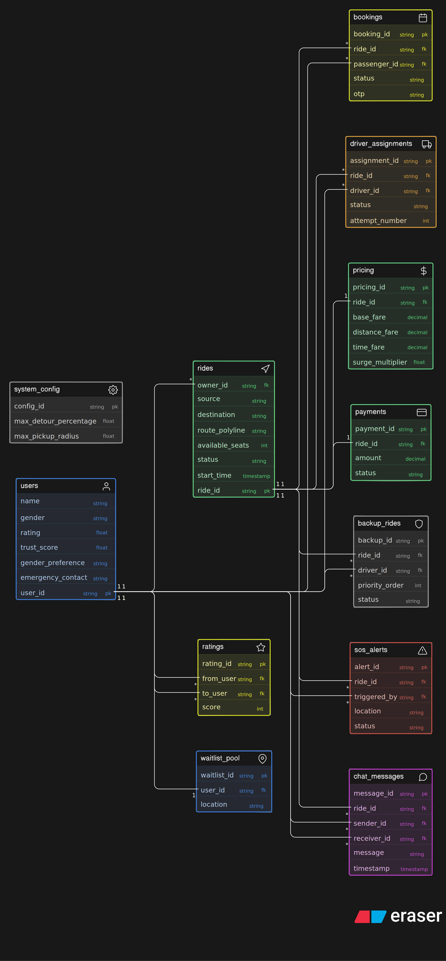
Database Design — ER Diagram
PostgreSQL 16 + PostGIS | 15 tables with geo-spatial support
MTech BITS Pilani | Corporate Car Pooling System | 2025
Notes:
Key tables: organisations, users, vehicles, routes, ride_schedules, ride_requests, ride_passengers, backup_rides, sos_incidents, transactions, ratings, chat_messages, ride_location_pings, ride_events, matching_logs

Slide 9
Database Design — Key Tables
15 tables | PostGIS geo-spatial extensions | Audit triggers
Table
Purpose
organisations
Company registry; scopes all users & rides
users
Auth, profile, is_online, is_deleted, org FK
vehicles
Driver's vehicles; one active vehicle per driver
routes
GEOMETRY(LineString) for driver's route path
ride_schedules
Core ride entity; lifecycle CREATED→ACTIVE→STARTED→COMPLETED
ride_requests
Passenger intent with GEOGRAPHY pickup/drop points
ride_passengers
Confirmed riders per ride (ACTIVE/CANCELLED/COMPLETED)
ride_location_pings
GPS pings for live tracking (GEOGRAPHY Point)
backup_rides
Backup driver entries; PENDING→ACTIVATED→USED/EXPIRED
chat_messages
Ride-scoped messages with is_read & sender_id
sos_incidents
SOS triggers with location & status
transactions
Razorpay payments per ride + user; full state machine
ratings
Post-ride mutual ratings (driver↔passenger)
ride_events
Full audit trail of every ride state change
matching_logs
Detour %, proximity, match decision per request
MTech BITS Pilani | Corporate Car Pooling System | 2025

Slide 10
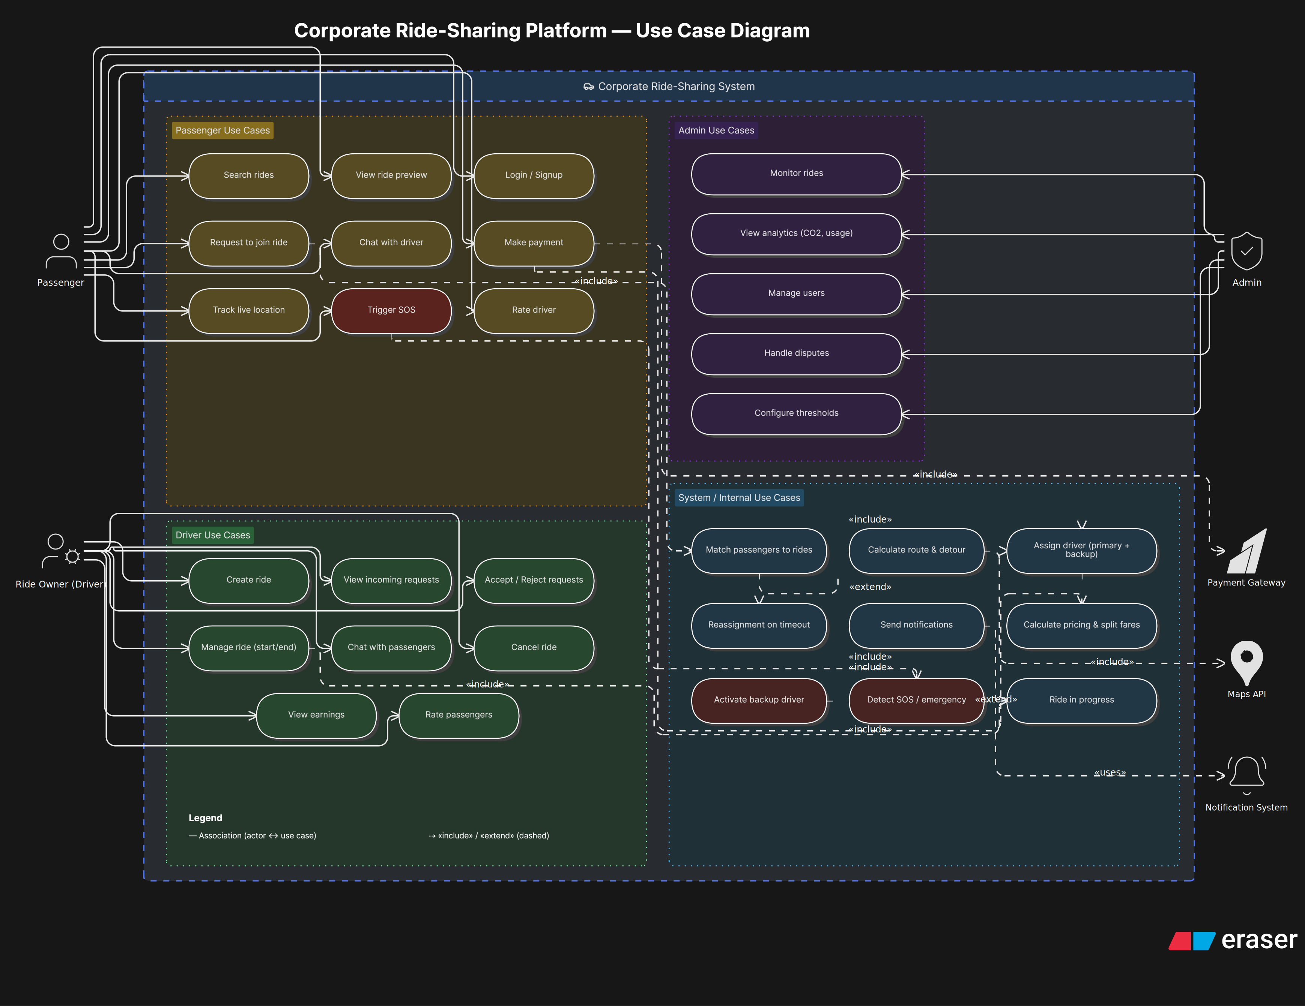
Use Case Diagram
Actors: Driver, Passenger, Admin | 20+ use cases
MTech BITS Pilani | Corporate Car Pooling System | 2025

Slide 11
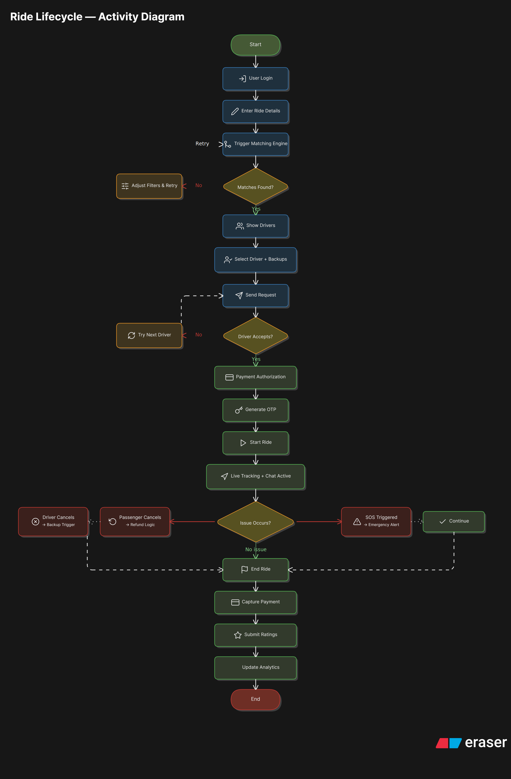
Activity Diagram — Overall Flow
End-to-end ride lifecycle from login to ride completion
MTech BITS Pilani | Corporate Car Pooling System | 2025

Slide 12
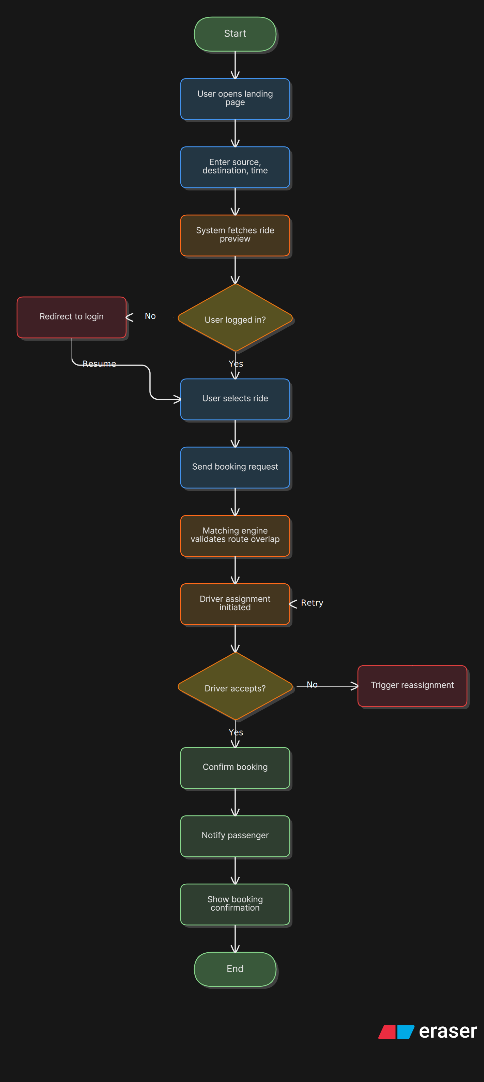
Activity Diagram — Ride Booking Flow
Passenger ride request → Matching → Acceptance → Tracking
MTech BITS Pilani | Corporate Car Pooling System | 2025

Slide 13
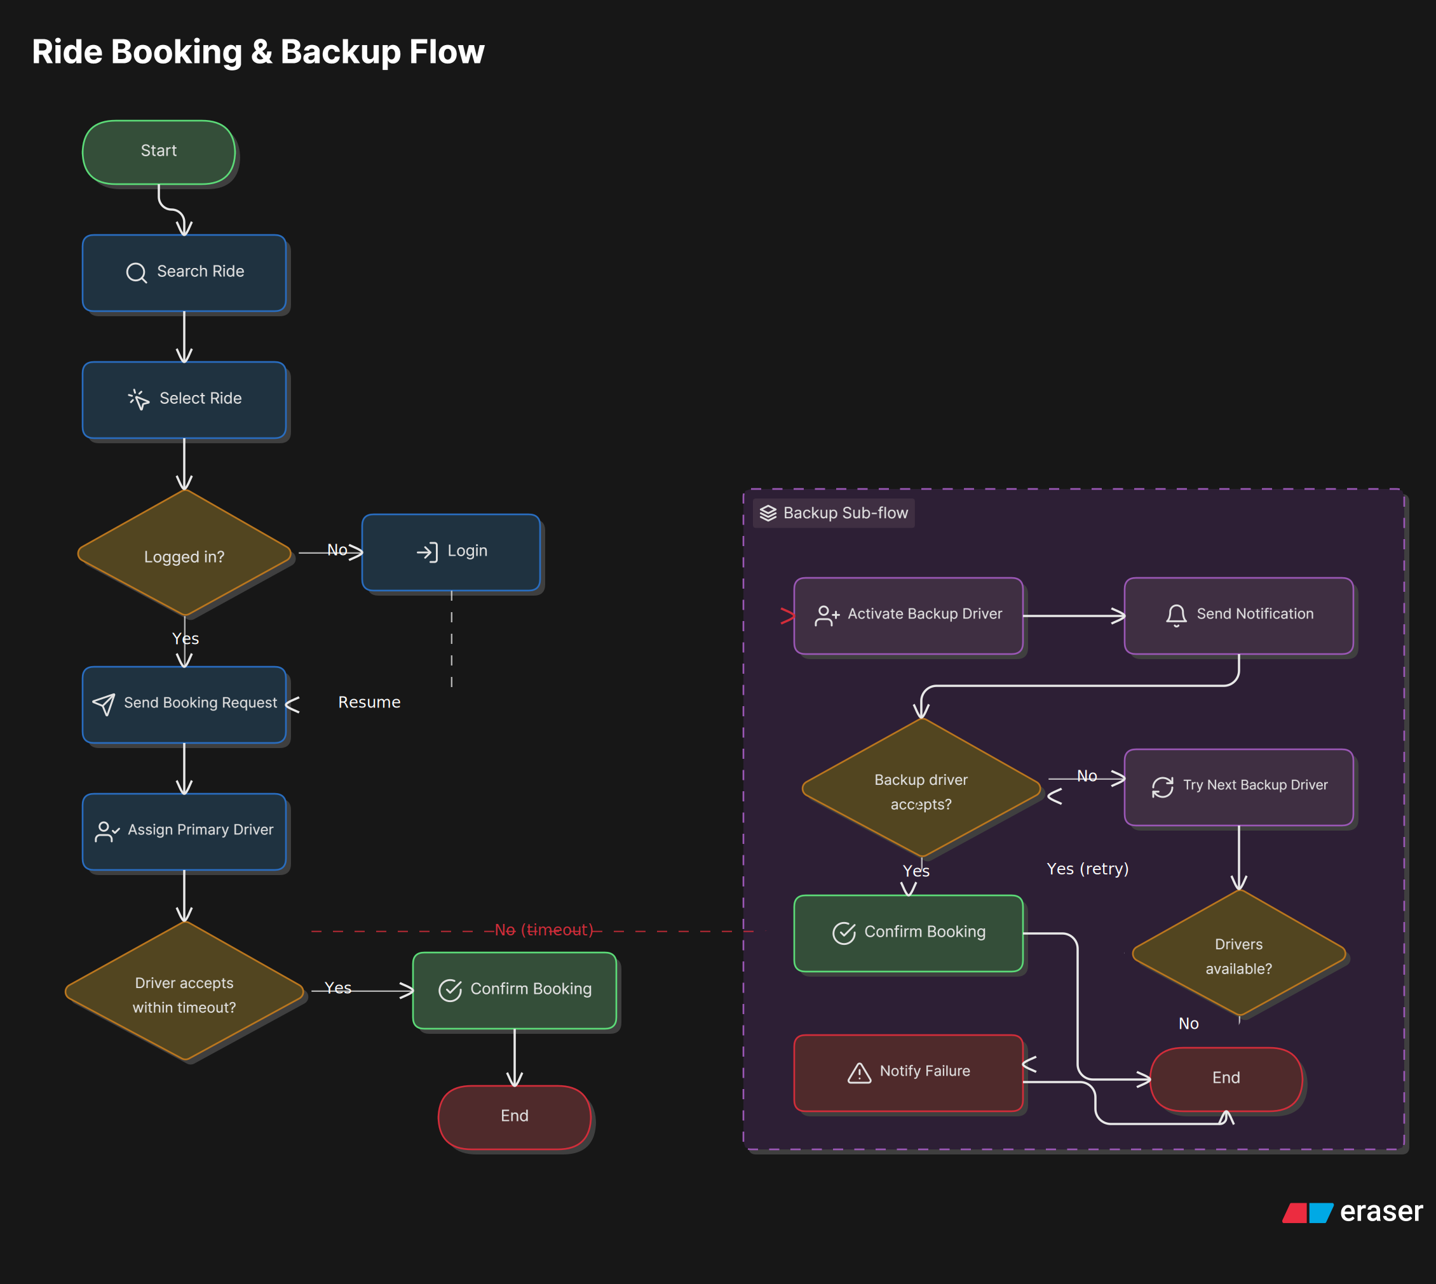
Combined Activity Flow Diagram
Unified view of Driver and Passenger parallel flows
MTech BITS Pilani | Corporate Car Pooling System | 2025

Slide 14
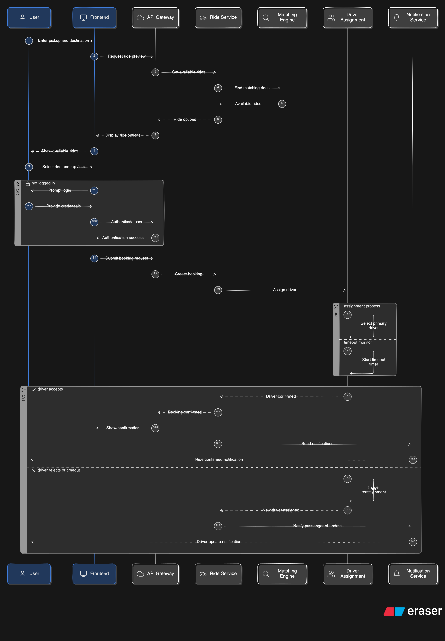
Sequence Diagram
System interactions between Frontend, Backend, DB and Payment Gateway
MTech BITS Pilani | Corporate Car Pooling System | 2025

Slide 15
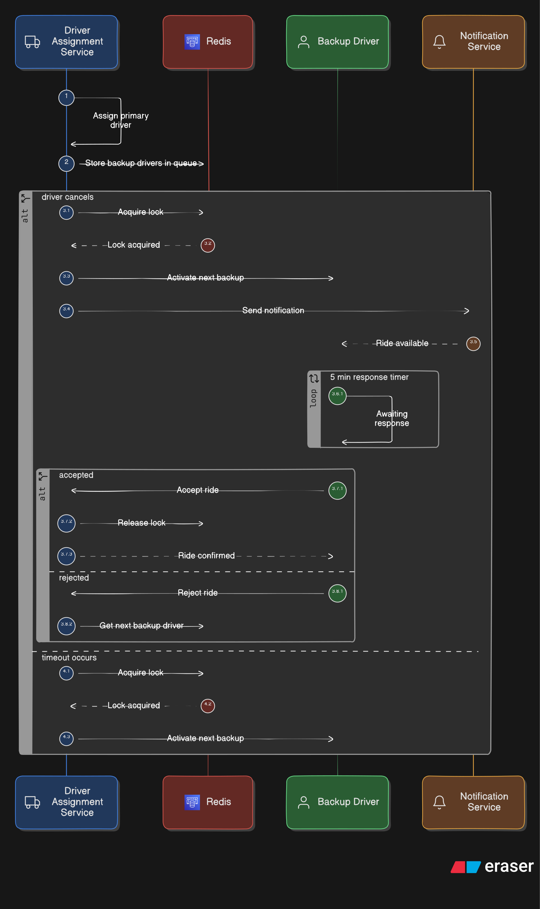
Backup Driver — Sequence Diagram
How the system activates a backup driver when primary cancels
MTech BITS Pilani | Corporate Car Pooling System | 2025

Slide 16
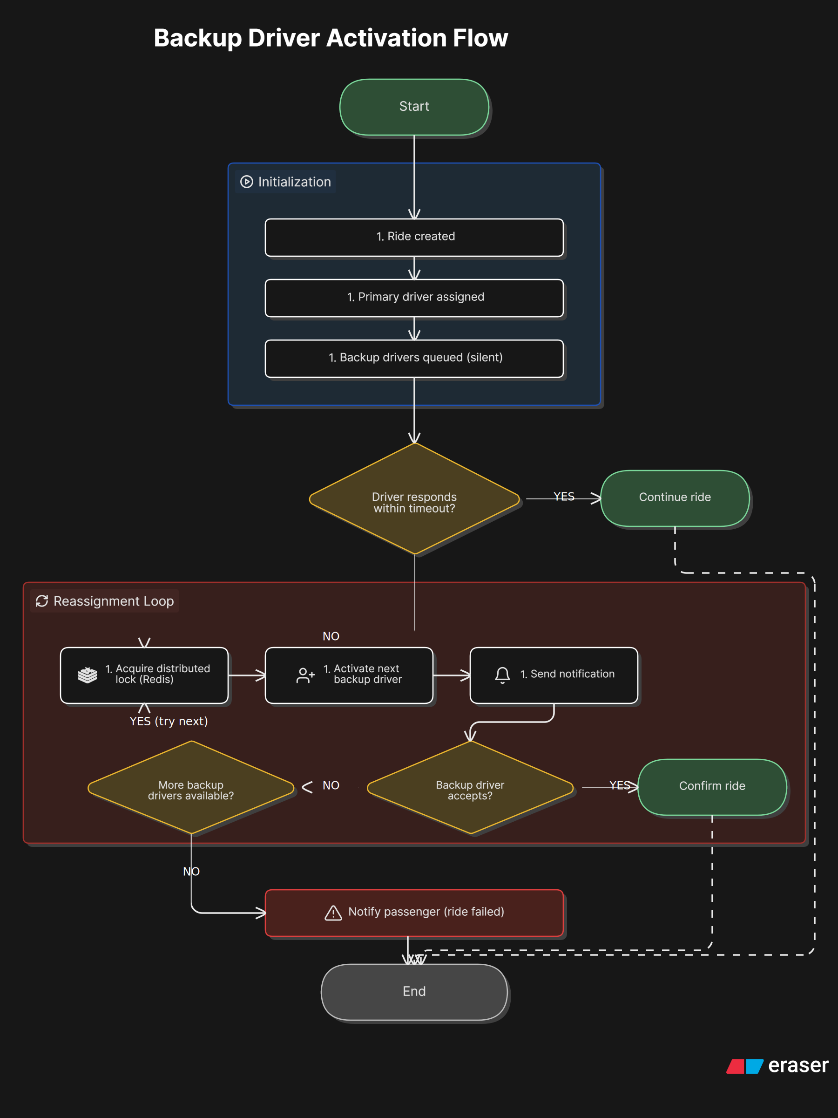
Backup Driver — Activation Flow
Priority-based backup selection and state transitions
MTech BITS Pilani | Corporate Car Pooling System | 2025

Slide 17
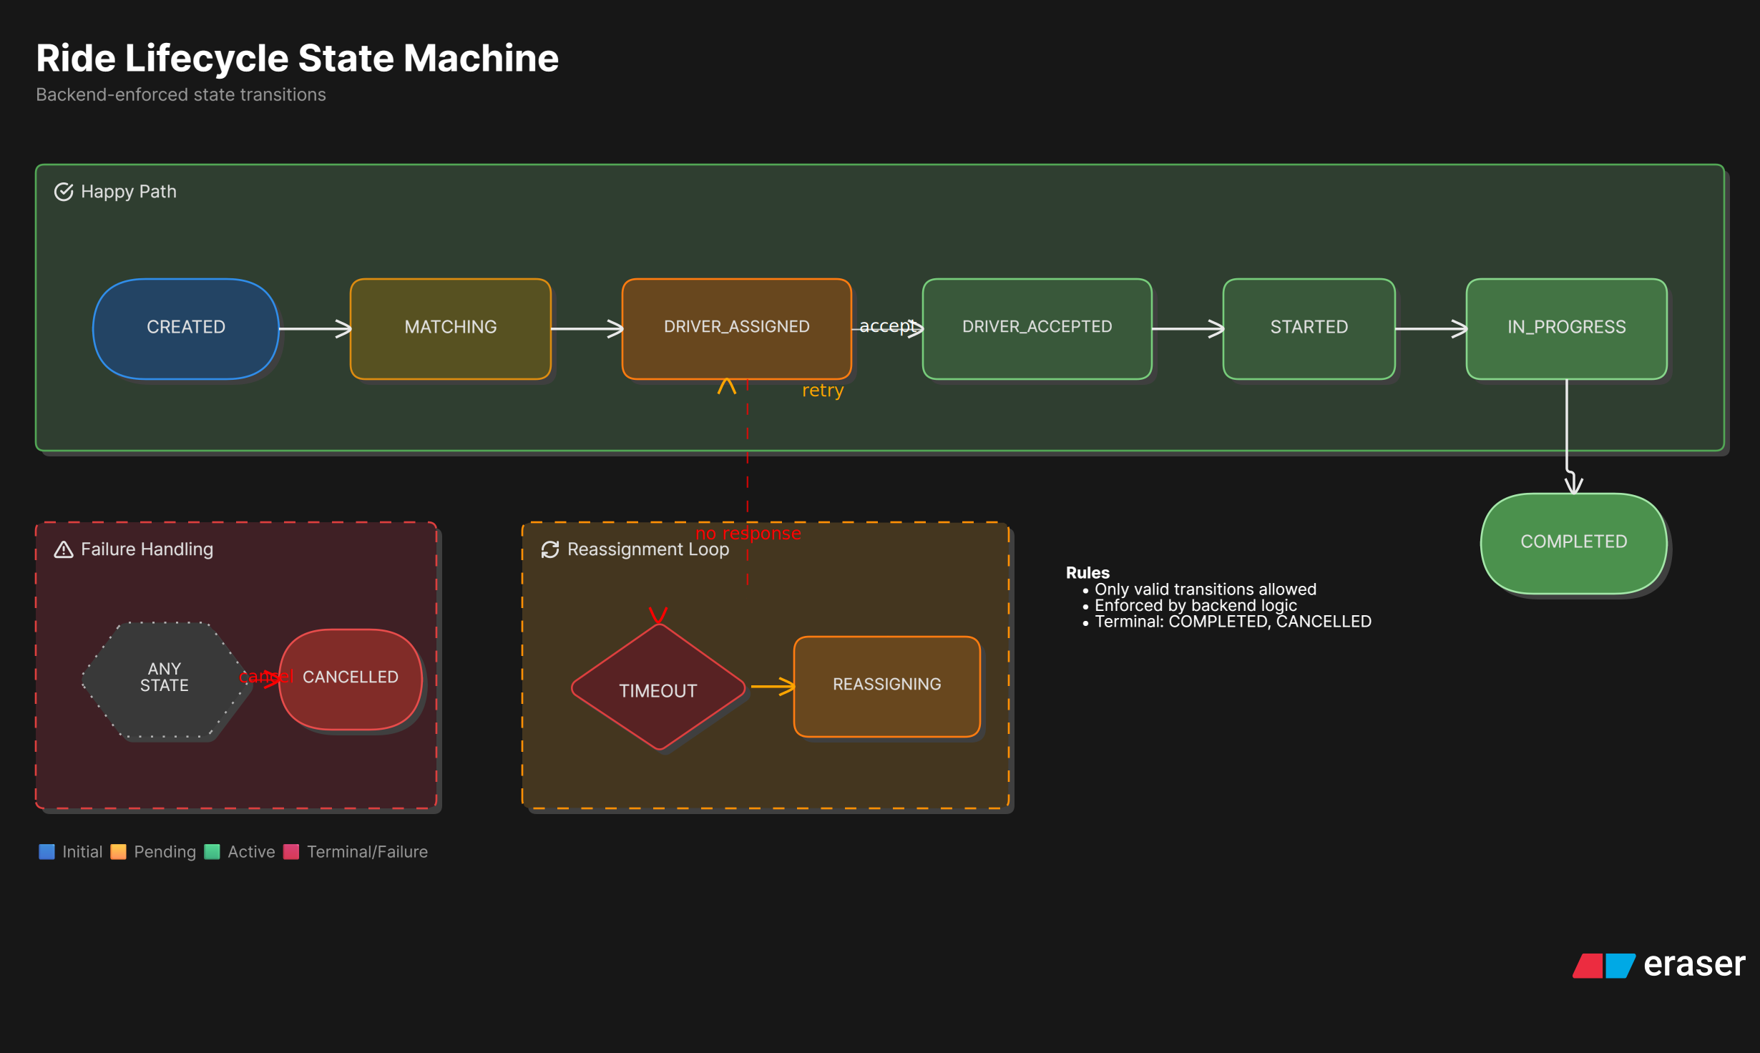
Ride Lifecycle — State Machine
States: CREATED → ACTIVE → STARTED → COMPLETED | CANCELLED
MTech BITS Pilani | Corporate Car Pooling System | 2025

Slide 18
Matching Engine — Core Algorithm
Geo-spatial ride matching using PostGIS
Step 1: Proximity Filter
1
ST_DWithin(driver.start_location, passenger.pickup_location, radius) → Find all active drivers within configurable radius (default 5 km)
Step 2: Route Overlap Check
2
ST_Distance(route.geometry, passenger.pickup) < threshold → Ensure driver's route passes near passenger pickup & drop
Step 3: Detour Calculation
3
detour% = (new_distance − original_distance) / original_distance × 100 → Filter out rides exceeding driver's detourLimitPercent
Step 4: Constraint Filters
4
available_seats ≥ 1 gender_preference matches passenger gender ride status = ACTIVE
Step 5: Ranking & Result
5
Sort by: distance ASC → rating DESC → departure time ASC → Return top N matches to passenger
MTech BITS Pilani | Corporate Car Pooling System | 2025

Slide 19
Backend Implementation — Progress
Spring Boot 3 | 16 REST Controllers | JWT Auth | Razorpay
REST Controllers (16):
Implemented Features:
Auth
User
Vehicle
✅ JWT authentication & Spring Security filter chain
Organisation
RideSchedule
RideRequest
✅ User management with soft-delete & org scoping
RidePassenger
Matching
Tracking
✅ Ride lifecycle: CREATED → ACTIVE → STARTED → COMPLETED
Chat
Payment
Rating
✅ Geo-spatial matching engine with PostGIS
Sos
BackupRide
GuardianContact
✅ Backup driver system with priority-based activation
RouteWaypoint
✅ Razorpay payment integration (initiate / confirm / refund)
✅ SOS system with guardian contact notifications
✅ Live GPS tracking (location ping storage)
✅ Chat system (REST; WebSocket planned)
✅ Rating system (driver ↔ passenger)
✅ Vehicle & Organisation management APIs
✅ Role-based access guard (owner-only delete)
✅ Passenger status check before joining rides
✅ Gender preference filtering in matching
MTech BITS Pilani | Corporate Car Pooling System | 2025

Slide 20
Frontend Implementation — Progress
React 18 + Vite | Context API | Axios | Responsive UI
Completed
In Progress / Planned
✅ Project scaffolded with Vite + React 18
🔲 Dashboard screen (Driver & Passenger views)
✅ Authentication screens (Login, Register)
🔲 Ride scheduling form with map picker
✅ Context API for auth state management
🔲 Ride request & matching results screen
✅ Axios API client with JWT interceptor
🔲 Live tracking map (Google Maps / Leaflet)
✅ Design system tokens (colours, spacing, typography)
🔲 Chat interface (WebSocket integration)
✅ Route setup with React Router v6
🔲 Payment flow screens (Razorpay SDK)
✅ Component library structure in place
🔲 SOS trigger button (persistent on ride screen)
✅ Admin module scaffolded
🔲 Rating & review screen post-ride
✅ Screens directory organised by role
🔲 Admin dashboard (ride analytics, user mgmt)
MTech BITS Pilani | Corporate Car Pooling System | 2025

Slide 21
AI Agent Module — CarpoolHub Query System
LangGraph + Claude AI + FAISS | Token-efficient architecture Q&A
An intelligent LangGraph-based AI agent that routes architecture queries to relevant knowledge sources, compresses context for token efficiency, and answers using Claude (Anthropic).
Intent Classifier
Routes queries to relevant sub-agents (DB, flows, services, architecture)
Vector Retriever
FAISS vector store over SVG diagram text & JSON data; semantic search
classifier.py
retriever.py
Context Compressor
Minimises tokens sent to Claude by pruning irrelevant context
LangGraph Nodes
Structured + vector retrieval nodes wired into directed graph
compressor.py
nodes.py
Orchestrator
LangGraph StateGraph managing query → retrieve → compress → answer
Knowledge Base
Structured JSON (DB schema, flows, services) + raw SVG text of all diagrams
graph.py
data/
Agent Flow: User Query → Intent Classification → Structured + Vector Retrieval → Context Compression → Claude AI → Answer
MTech BITS Pilani | Corporate Car Pooling System | 2025

Slide 22
Progress Summary
What has been completed so far
Database & Schema
Backend (Spring Boot)
Frontend (React)
AI Agent & Docs
• PostgreSQL 16 + PostGIS set up
• 16 REST Controllers implemented
• Project scaffolded & routing set up
• LangGraph AI agent implemented
• 15 production-grade tables designed
• JWT authentication & security filter
• Auth screens (Login/Register) done
• FAISS vector store created
• Migration scripts (V1, V2, V3) applied
• Ride lifecycle state machine
• Context API & Axios client ready
• All diagrams text-encoded
• Geo-spatial indexes (GIST) created
• Geo-spatial matching engine
• Design tokens defined
• Architecture diagrams (10 SVGs)
• Audit triggers on all tables
• Razorpay payment integration
• Admin & screens structure in place
• ER, Sequence, Activity, State Machine
• Constraints: seats ≥ 0, unique active ride/driver
• Backup driver & SOS systems
• Remaining screens under development
• OpenAPI / Swagger — in progress
MTech BITS Pilani | Corporate Car Pooling System | 2025

Slide 23
Future Roadmap
What we plan to complete before final submission
Phase 1 — Immediate (Next 2 Weeks)
→ Complete all React screens: Dashboard, Ride Scheduling, Matching Results
→ Integrate live map tracking (Leaflet.js / Google Maps)
→ Connect frontend to all backend APIs
→ Implement WebSocket-based real-time chat
→ Add Razorpay payment flow in frontend
Phase 2 — Short Term (Weeks 3–5)
→ SOS button with real-time guardian notification
→ Swagger / OpenAPI documentation for all 40+ endpoints
→ Backup driver activation UI
→ Rating & review screen post-ride
→ Admin dashboard (ride analytics, user management)
Phase 3 — Final Polish (Week 6)
→ End-to-end integration testing (Playwright / Jest)
→ Performance optimisation (DB query plans, indexing review)
→ Security audit (OWASP top 10, SQL injection checks)
→ Deployment setup (Docker / cloud hosting)
→ Final dissertation report & demo preparation
Future Scope (Post-MTech)
→ Native mobile apps (Android & iOS — React Native)
→ ML-based route prediction & proactive ride suggestions
→ Corporate analytics dashboard (CO₂ saved, cost reports)
→ Multi-organisation / SaaS model
→ Driver earnings & incentive system
MTech BITS Pilani | Corporate Car Pooling System | 2025

Slide 24
Thank You
Questions & Discussion Welcome
Prashant Sopan Berad
MTech (Software Engineering) BITS Pilani
Corporate Car Pooling System | May 2025
GitHub: github.com/infotechmaniac17/Corporate-Car-Pooling-System
MTech BITS Pilani | Corporate Car Pooling System | 2025

