Slide 1
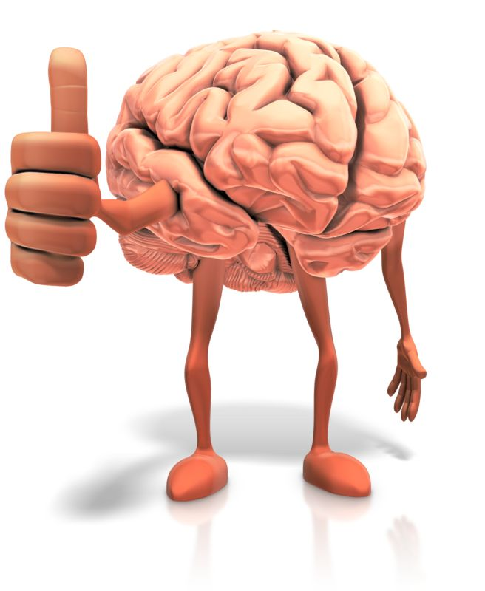

Slide 2
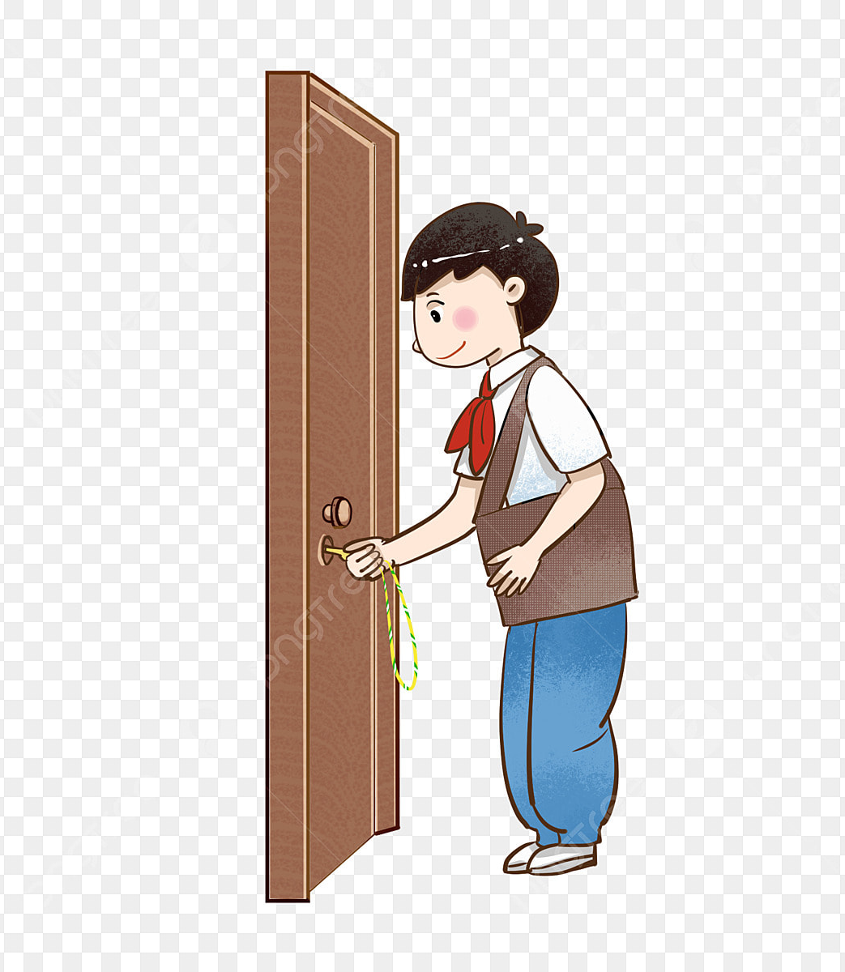
I have keys, but no locks. I have space, but no room. You can enter, but you can’t go outside. What am I?

Slide 3
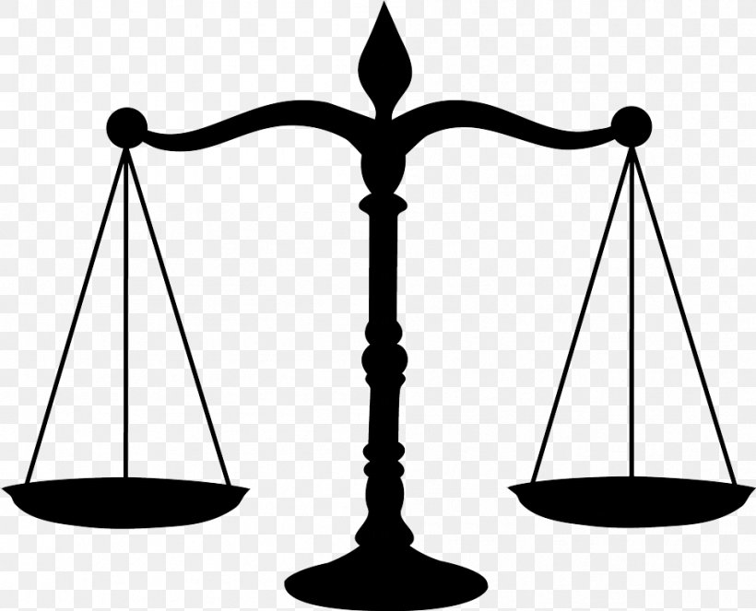
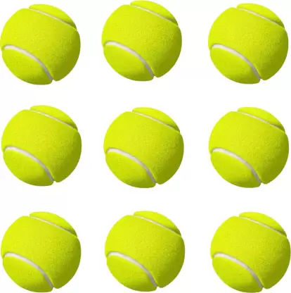
From 9 identical Tennis balls, 1 is heavy in weight. In how many minimum usages of weighing machine can you find heaviest Tennis Ball?

Slide 4
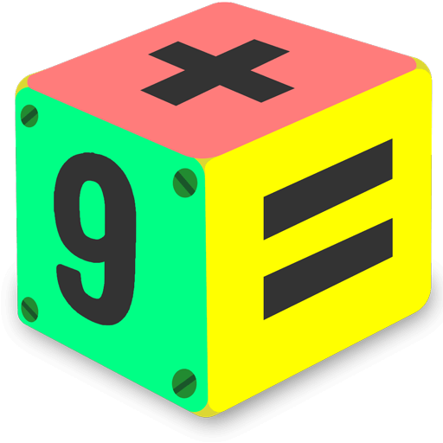
How can
8 + 8 = 4
?

Slide 5
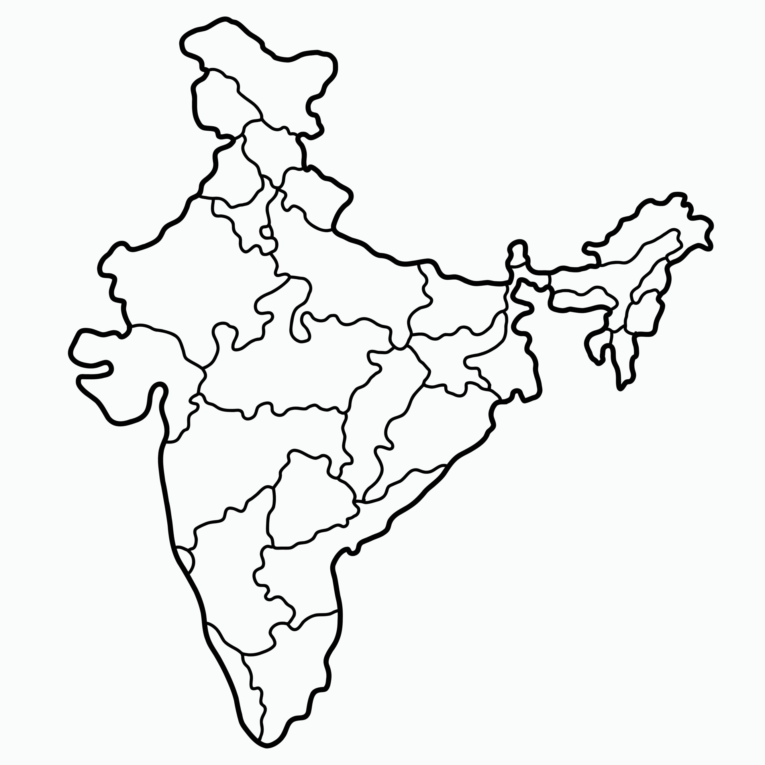
Which Indian states have the highest international boundaries?
Sikkim
Nagaland
Arunachal Pradesh
West Bengal

