Slide 1




Structured UI5 state management with mobx-state-tree
MobX
MobX state tree
Leon van Ginneken – Alliander
Caspár van Tergouw – Expertum
UI5CON
20 June 2019

Slide 2
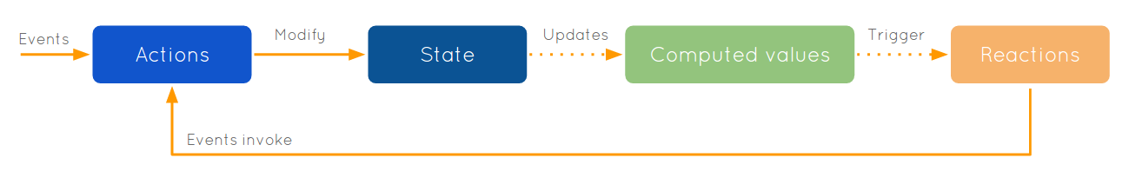
What is reactive programming?
“Anything that can be derived from the application state, should be derived. Automatically.”

Slide 3
What will (not) be discussed?
- Earlier talk (some repetition)
Alternatives
- Reactive programming in SAPUI5 (ManagedObjectModel)
- Redux
- Javascript accessors
- etc..

Slide 4
[demo]

Slide 5
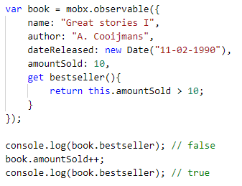
Mobx observables

Slide 6
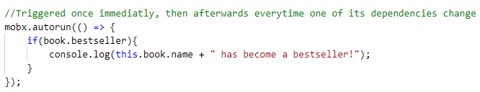
Mobx.autorun

Slide 7
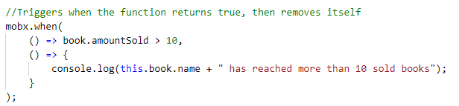
Mobx.when

Slide 8
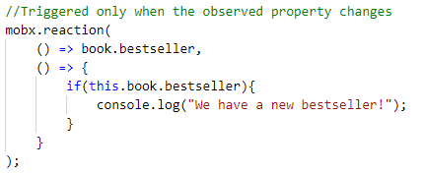
Mobx.reaction

Slide 9
[demo]

Slide 10
MobX state tree features
Strict datatypes
Protected data
Structure
Serialization

Slide 11
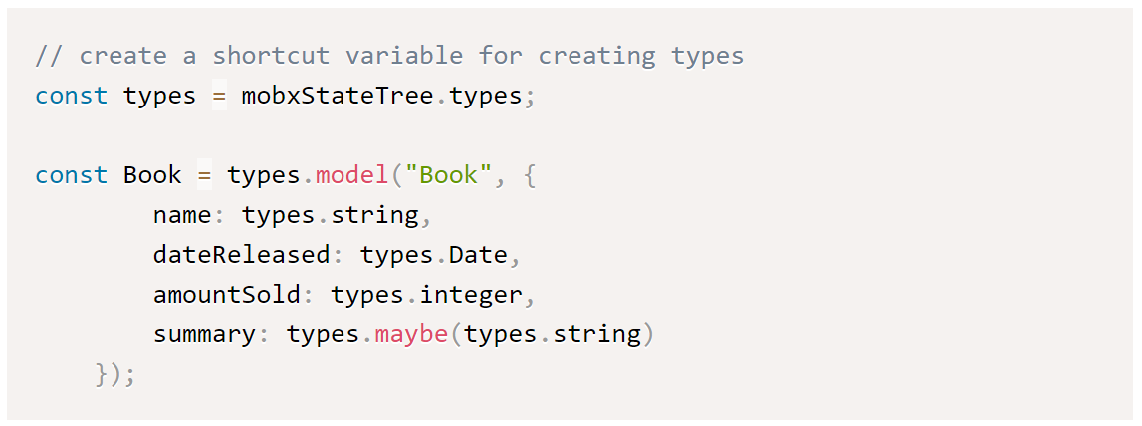
Model

Slide 12
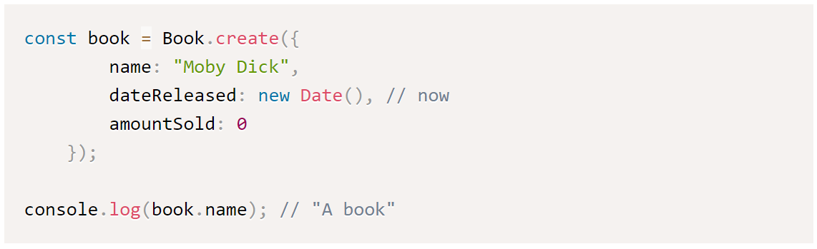
Instantiation (1/2)

Slide 13
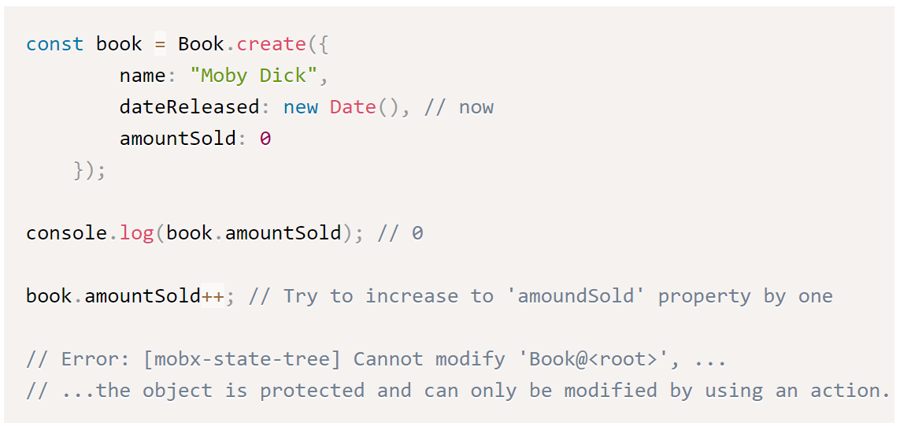
Instantiation (2/2)

Slide 14
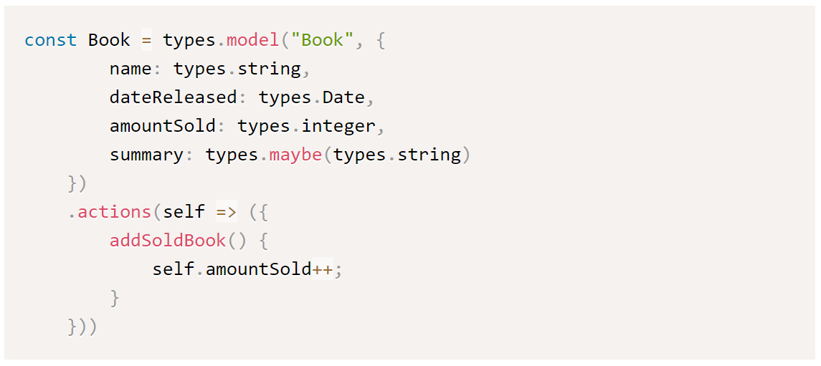
Actions

Slide 15
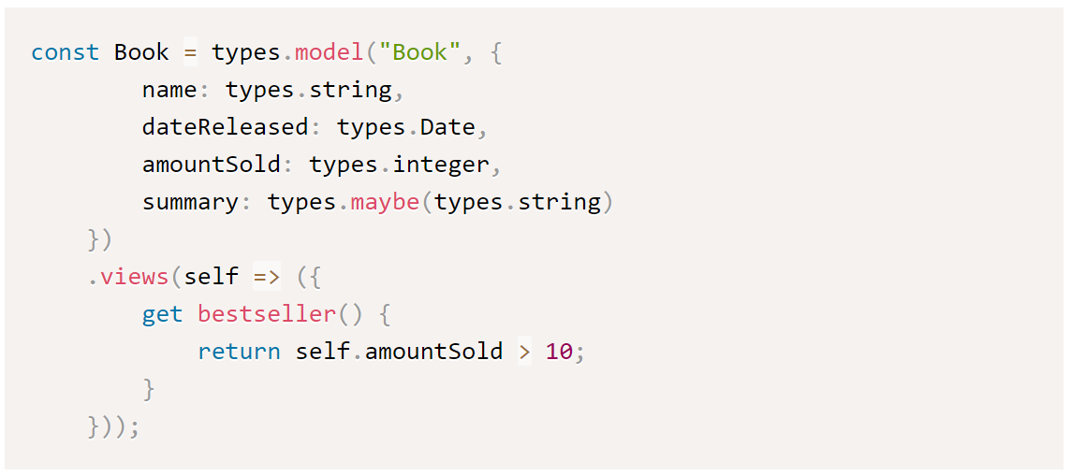
Views

Slide 16
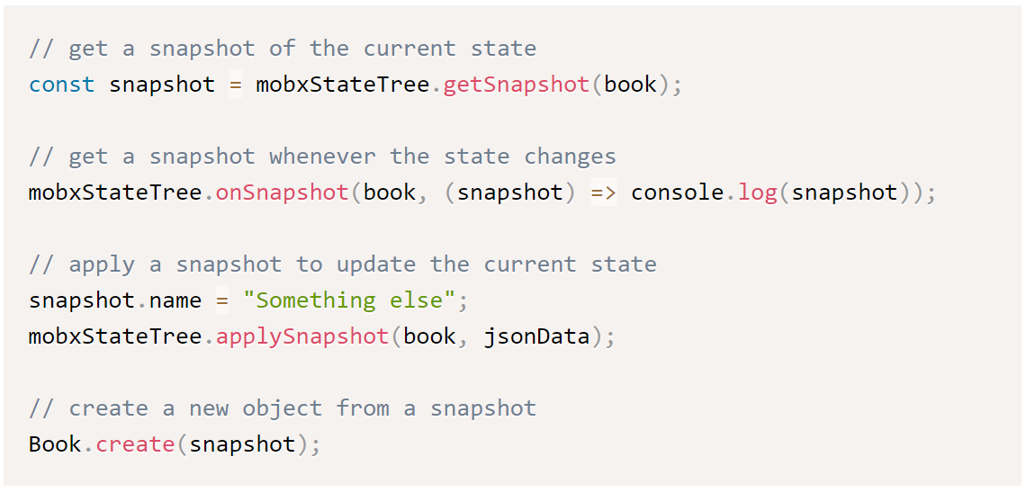
Snapshots

Slide 17
[demo]

Slide 18
Read more…
“UI5 reactive state management with MobX state tree”
https://blogs.sap.com/?p=834415
Example project
https://github.com/leonalliander/ui5-mobx-state-tree-examples

