Slide 1
MicroLib
Microservice Libraries
Tyson Midboe 1/10/21

Slide 2
MicroLib
Microservice Libraries
Instead of stand-alone executables talking over a network, build services as independently deployable libraries running in the same process.
Boost performance, consolidate footprint, and simplify integration and operations, without sacrificing data, deployment or development independence: i.e. enjoy the main benefits of microservices without the typical drawbacks.
Bring back the “DRY” principle and share code between services and across repos: no need to repeat code or use a monorepo.
Save time with MicroLib framework features.

Slide 3
“One main reason for using services as components (rather than libraries) is that services are independently deployable. If you have an application that consists of multiple libraries in a single process, a change to any single component results in having to redeploy the entire application.”
-Martin Fowler

Slide 4
FALSE
While there have been ways to do this (consider OSGi) they have been difficult to work with, until now…

Slide 5
…enter MicroLib
Microservice Library Host Framework
MicroLib is a lightweight API framework built on Node.js that uses module federation to host and integrate multiple, independently deployable services running in the same process.
It is designed with a view to hexagonal architecture and uses the port-adapter paradigm to simplify and control service integration and orchestration.
MicroLib is written in Javascript following functional programming principles, like immutability; and generally avoids inheritance, preferring functional composition instead.
Because mutation is avoided, updates generate shallow clones, which do not preserve the prototype chain.

Slide 6
MicroLib
Features
Dynamic import of remote modules
Dynamic API generation for imported modules
Dynamic persistence of imported modules
Dynamic port generation for imported modules
Dynamic port-adapter binding
Configuration-based service integration
Configuration-based service orchestration
Common broker for internal, shared events
Persistence API for cached datasources

Slide 7
MicroLib
…Features
Datasource relations for federated schemas
Dependency/control inversion (IoC)
Zero downtime, zero install deployment
Evergreen deployment and semantic versioning
Dynamic A/B testing deployment
Serverless deployment
Code reuse that works with multiple repos
Configurable serialization for network+storage I/O

Slide 8
Service Components
Federated Modules
MicroLib uses Webpack Module Federation to import remote modules into the host framework at runtime.
Service components, which are made up of modules, fall into three catagories: model, adapter and service.
A model is a domain entity/service that implements all or part of the service’s core logic. It also implements the MicroLib ModelSpecification interface. The interface has few requirements, but many options. The more options a service implements, the more framework capabilities it takes advantage of…

Slide 9
Service Components
…Federated Modules
One such capability is port generation. In a hexagonal or port-adapter architecture, ports handle I/O betwen the application and domain layers. An adapter implements the port ’s interface, facilitating communication with the outside world. The framework dynamically imports and binds adapters to ports at runtime.
A service provides an optional layer of abstraction for the adapter and usually implements a client library. The framework dynamically imports and binds services to adapters at runtime.

Slide 10
Ports and Adapters
Configure Service Integration
When ports are configured in the Model Specification, the framework dynamically generates methods on the domain model to invoke them. Each port is assigned an adapter, which either invokes the port (inbound) or is invoked by it (outbound).
Ports can be instrumented for exceptions and timeouts to extend the framework’s retry and compensation logic.
They can also be piped together in control flows by specifying the output event of one port as the input or triggering event of another.

Slide 11
Ports and Adapters
Configure Service Integration
An adapter either implements an external interface or exposes an interface for external clients to consume.
On the port side, an adapter always implements the port interface; never the other way around. Ports are a function of the domain logic, which should remain static.
Ports optionally specify a callback to process data received on the port before control is returned to the caller. The callback is passed as an argument to the port function.
Ports can be configured to run on receipt of an event, API request, or called directly from code.

Slide 12
Ports and Adapters
…Configure Service Integration
Ports also have an undo callback for implementing compensating logic, in the event a transaction has to be rolled back.
The framework remembers the order in which ports are called and invokes the undo callback of each port in reverse order, starting at the point of failure

Slide 13
APIs
REST API generation
When a domain model is imported, the framework generates APIs to create, update, find and delete it.
POST /api/model
PATCH /api/model/:id
PATCH /api/model/:id/:command
GET /api/model?key=value…
GET /api/model/:id?relation|command=name
DELETE /api/model/:id
μ

Slide 14
Persistence
Provided by default
The framework automatically perists domain models. In-memory, file-system, and MongoDB adapters are provided.
Domain models are stored as JSON documents. De/serialization can be customized through configuration.
Every write operation generates an event that can be forwarded to an external event source.

Slide 15
Persistence
Common Datasource Factory
A common datasource factory manages adapters and provides access to each service’s individual datasource.
The factory supports federated schemas through relations defined between datastores in the ModelSpec. Apart from this, services cannot access one another’s data.
Queries execute against an in-memory copy of the data. Datasources leverage this cache by extending the in-memory adapter.

Slide 16
Internal Events
Local Service Integration
In addition to in-memory function calls, services can communicate locally the same way they do remotely: by publishing and subscribing to events.
Using local, shared events, microservice libraries are virtually as decoupled as they would be running remotely in the standard out-of-process way.
The framework implements local events in an observer pattern: publish and subscribe functions are injected into domain models.
ServiceA.listen(event, handler)
ServiceB.notify(event, data)

Slide 17
External Events
Remote Service Integration
Services publish and subscribe to remote event sources the same way they do local ones.
Any communication outside the domain layer requires a port and adapter. The framework provides adapters for Kafka and WebSockets.

Slide 18
Orchestration
Configure Service Workflow
Orchestration is built on the framework’s port-adapter implementation. As mentioned, workflows are controlled by events.
Define a callback in the ModelSpec to process data received on the port before its output event is fired and the next port runs.
This implementation works equally well, whether services are local or remote, or a choreographed approach is taken.
μ

Slide 19
Cf. [Clean Micoservices: Building Composable Microservices with Module Federation](https://trmidboe.medium.com/clean-microservices-building-composable-microservices-with-module-federation-f1d2b03d2b27)
Using module federation (a la [Zack Jackson](https://github.com/ScriptedAlchemy)) and clean architecture (a la Uncle Bob), composable microservices combine the independence and agility of microservices with the integration and deployment simplicity of monoliths. This simple API framework supports CRUD operations for domain models whose source code, and that of any dependencies, is streamed over HTTP from a remote server at runtime. Following hexagonal architecture, the framework can be configured to generate ports and bind them dynamically to local or federated adapters. Similarly, adapters can be wired to remotely imported services at runtime. Ports can be piped together to form control flows by configuring the output event of one port as the input or triggering event of another. The history of port invocations is recorded so compensating flows are generated automatically.
The sample code in [composable-microservices-remotes](https://github.com/tysonrm/federated-monolith-services) shows a domain object, Order, whose ports are bound to a payment, inventory, and shipping service. The ports are configured to participate in a control flow that implements the saga orchestrator pattern to manage an order process from beginning to end.

Slide 20
Cf. [Clean Micoservices: Building Composable Microservices with Module Federation](https://trmidboe.medium.com/clean-microservices-building-composable-microservices-with-module-federation-f1d2b03d2b27)
Using module federation (a la [Zack Jackson](https://github.com/ScriptedAlchemy)) and clean architecture (a la Uncle Bob), composable microservices combine the independence and agility of microservices with the integration and deployment simplicity of monoliths. This simple API framework supports CRUD operations for domain models whose source code, and that of any dependencies, is streamed over HTTP from a remote server at runtime. Following hexagonal architecture, the framework can be configured to generate ports and bind them dynamically to local or federated adapters. Similarly, adapters can be wired to remotely imported services at runtime. Ports can be piped together to form control flows by configuring the output event of one port as the input or triggering event of another. The history of port invocations is recorded so compensating flows are generated automatically.
The sample code in [composable-microservices-remotes](https://github.com/tysonrm/federated-monolith-services) shows a domain object, Order, whose ports are bound to a payment, inventory, and shipping service. The ports are configured to participate in a control flow that implements the saga orchestrator pattern to manage an order process from beginning to end.

Slide 21
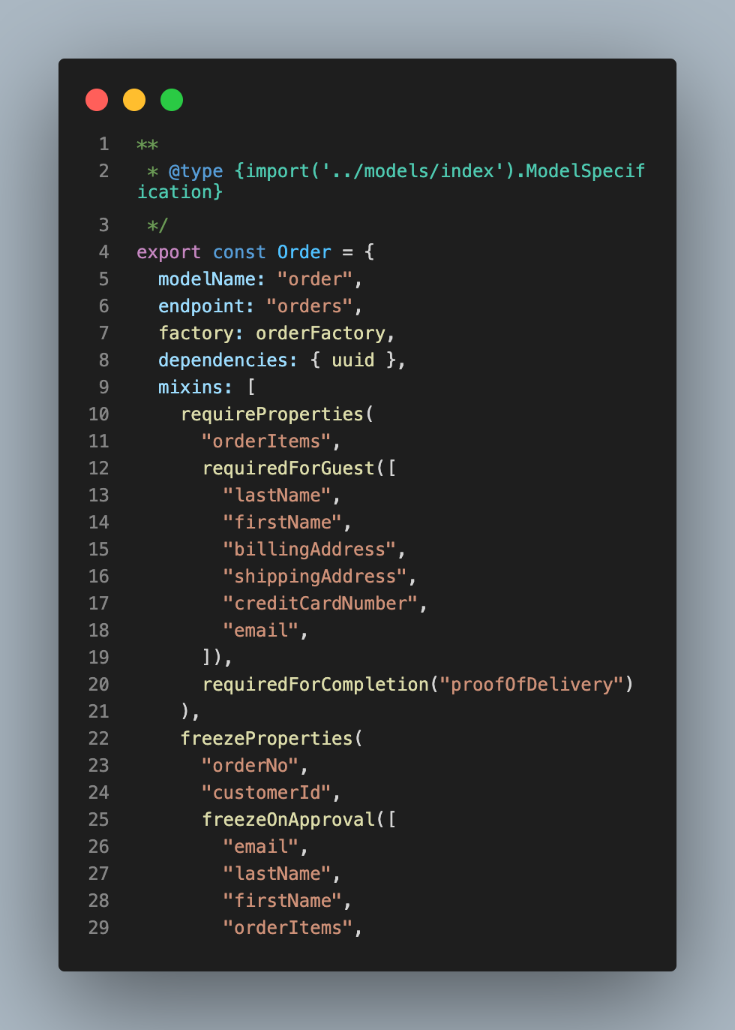
Model Specification
As much or as little as needed

Slide 22

Model Specification
Only 3 properties required

