Slide 1

Big Project 2025: Connect 4
Session 1

Slide 2
Project Overview – Connect 4
Session 1
Game loop
Helper functions
Terminal I/O
Session 2
Session 1 Recap
Reformatting - OOP
Session 3
Introduction to pygame
Creating a display
Drawing shapes
Handling mouse inputs
Session 4
Applying pygame into Connect Four
Playing our game

Slide 3
Ice Breaker - Kahoot

Slide 4
Before we begin...
All Sessions:
If you don’t have python installed:
Go to www.python.org/downloads
Download and install the appropriate version
Follow the instructions below.
If you have python installed:
Create a folder with an appropriate name
Create a new file with an appropriate name
Sessions 3 and 4:
If you don’t have pygame installed:
Open the terminal
Type “pip install pygame”
Wait for the download
Check correct set up by opening a python shell and typing “import pygame”
If you have pygame installed:
Make sure it works correctly

Slide 5
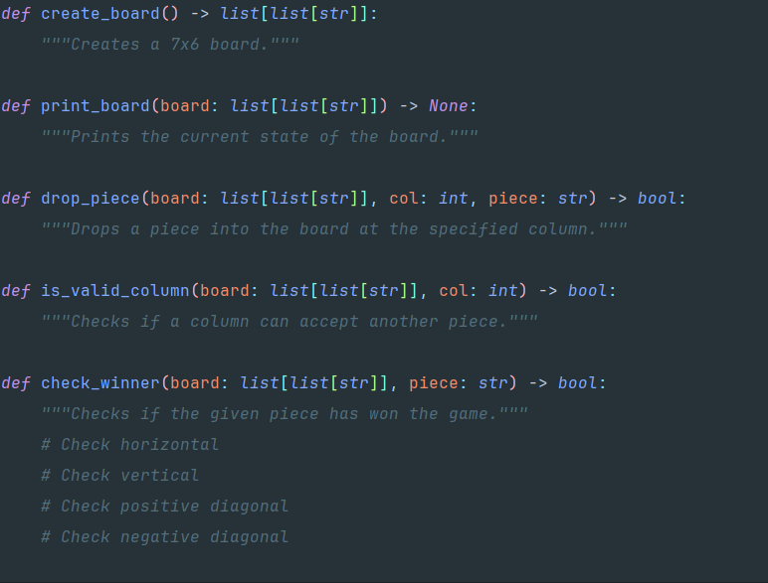
Helper Functions
We first need to create some helper function to assist our game loop.
Note: All type hints (data types after ‘:’ or ‘->’) are optional e.g.

Slide 6
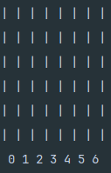
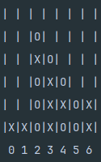
Helper Functions - Board
To create the board, we need to decide what structure we will use.
In this version, we suggest to use a list of lists of strings. It may sound complex but is easier to think about as:
The board is a list of columns
Each column is a list of pieces.
Each piece is either “X” or “O”
The print_board function will loop through the board and print the pieces in this format:
Note: All type hints (data types after ‘:’ or ‘->’) are optional e.g.

Slide 7
Helper Functions - Pieces
Next, we need logic to place pieces.
We want a function that takes in a column number and places a piece there.
To do this we need a checking system to verify that the specified column is free to use.
Hints:
Use len(col) to find this size of a column.
Use append(piece) to add pieces.
Remember indexing starts at 0.
Note: All type hints (data types after ‘:’ or ‘->’) are optional e.g.

Slide 8
Helper Functions - Winner
After a piece is placed, we need to check if someone has won.
There are 4 ways of winning:
A vertical [ | ]
A horizontal [ - ]
A positive diagonal [ / ]
A negative diagonal [ \ ]
Hints:
Think about all the possible positions a valid win may be in and how to generalise it inside a for loop
Remember indexing starts at 0.
Note: All type hints (data types after ‘:’ or ‘->’) are optional e.g.

Slide 9
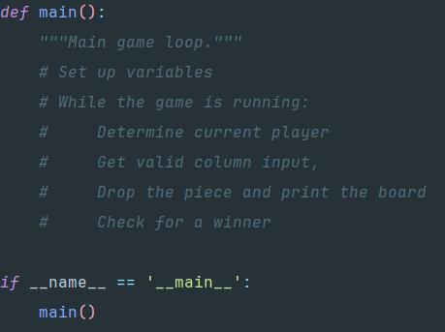
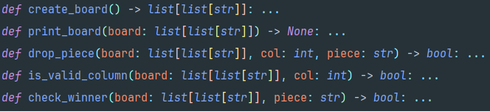
Game loop
We now need to create our main function that will contain the game loop.
Start with the initial variables. What should we keep track of throughout the game?
How should verify user input?
How should we handle a win?
Can we have a draw?
Our Helper functions

Slide 10
Conclusion
Thank you for coming!
See you next week.
Today:
We created helper functions for our program.
We created a main game loop.
Some should be able to play.
Next Session:
Session 1 Recap and Extra help.
Reformatting into OOP.

Slide 11
Big Project 2025: Connect 4
Session 2

Slide 12
Project Overview – Connect 4
Session 1
Game loop
Helper functions
Terminal I/O
Session 2
Session 1 Recap
Reformatting - OOP
Session 3
Introduction to pygame
Creating a display
Drawing shapes
Handling mouse inputs
Session 4
Applying pygame into Connect Four
Playing our game

Slide 13
Before we begin...
All Sessions:
If you don’t have python installed:
Go to www.python.org/downloads
Download and install the appropriate version
Follow the instructions below.
If you have python installed:
Create a folder with an appropriate name
Create a new file with an appropriate name
Sessions 3 and 4:
If you don’t have pygame installed:
Open the terminal
Type “pip install pygame”
Wait for the download
Check correct set up by opening a python shell and typing “import pygame”
If you have pygame installed:
Make sure it works correctly

Slide 14
Session 1 Recap
Last session we...
Created a main game loop to…
Get an input
Place the piece
Update the board
Display the new board
Loop until someone wins
Created helper functions to…
Create a board
Display the board
Place pieces
Check winners

Slide 15
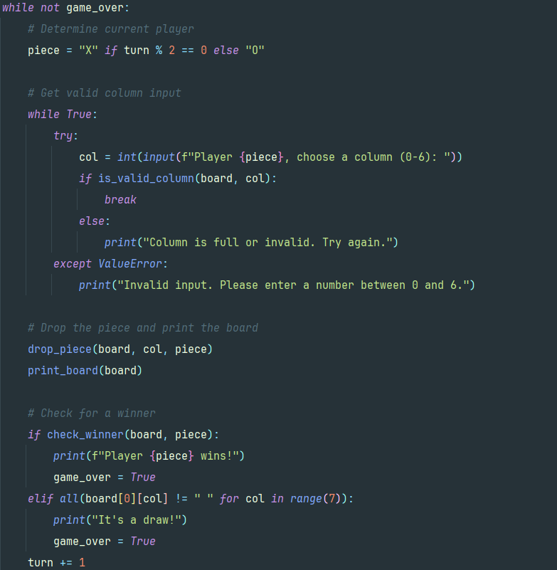
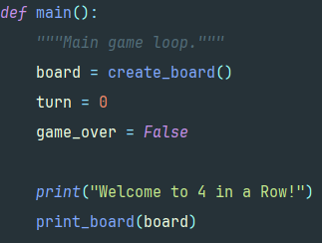
Game loop - Analysis
Here we see an example of our implementation of the full game loop.
Is it simpler than you think?
Can you understand each line?
What changes do we need to create a display?
Are there any issues?

Slide 16
Game loop - Display
We need to prepare our project to be displayed on the screen.
Our display loop will run each frame and will require concurrent access some data.
To do this, we need to reformat our functional code into an object-oriented program (OOP).

Slide 17
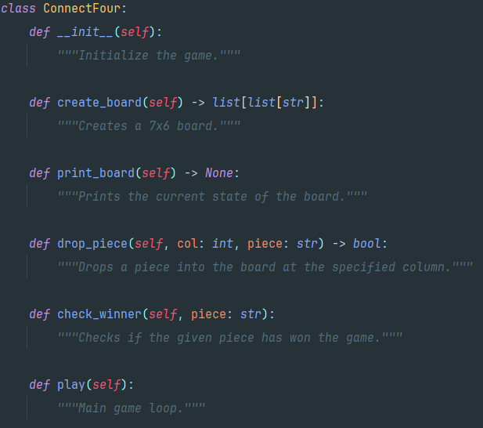
Reformatting - OOP
Here is a skeleton of our class.
We can copy our previous code and place it into this new structure. But we need to adjust the code to suite this structure
Some may see that we have removed board from the parameter of the methods (class functions).
Our board will be held as an attribute of this class and can be referred to with self.board. Similarly, other attributes can be accessed by adding ‘self.’ before each variable

Slide 18








Reformatting - OOP
Original Session 1 Code | New Session 2 Code
Here are some of the changes we made.

Slide 19
Conclusion
Today:
We Recapped Session 1.
We Reformatting into OOP.
Next Session:
Introduction to pygame
Creating a display
Drawing shapes
Handling mouse inputs
Thank you for coming!
See you next week.

Slide 20
Big Project 2025: Connect 4
Session 3

Slide 21
Project Overview – Connect 4
Session 1
Game loop
Helper functions
Terminal I/O
Session 2
Session 1 Recap
Reformatting - OOP
Session 3
Introduction to pygame
Creating a display
Drawing shapes
Handling mouse inputs
Session 4
Applying pygame into Connect Four
Playing our game

Slide 22
Before we begin...
If you don’t have python installed:
Go to www.python.org/downloads
Download and install the appropriate version
Follow the instructions below.
If you have python installed:
Create a folder with an appropriate name
Create a new file with an appropriate name
If you don’t have pygame installed:
Open the terminal
Type “pip install pygame”
Wait for the download
Check correct set up by opening a python shell and typing “import pygame”
If you have pygame installed:
Make sure it works correctly

Slide 23
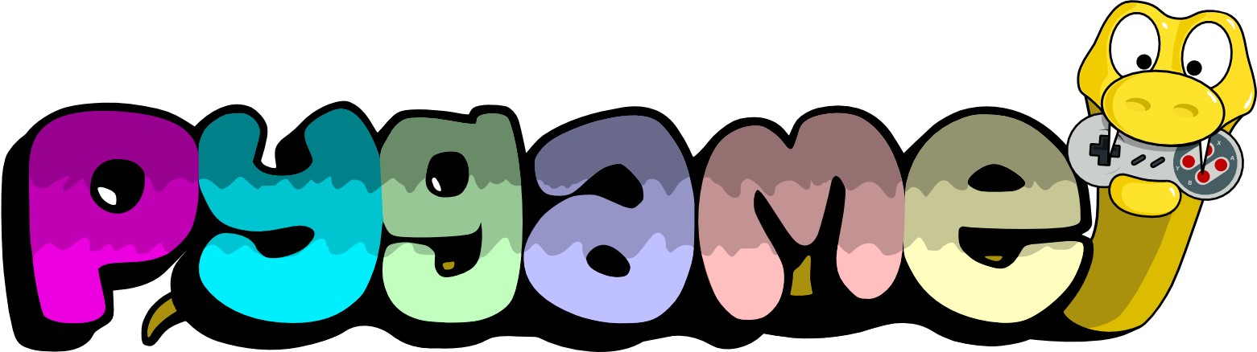
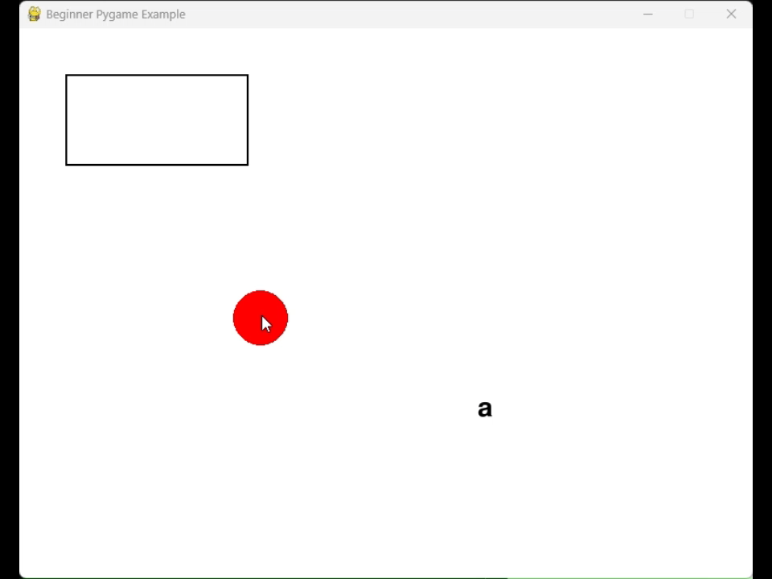
Today we will use it to create this program:
Pygame is a free and open-source cross-platform set of Python modules designed for writing video games.
It includes computer graphics and sound libraries designed to be used with the Python programming language.
For more information visit https://pypi.org/project/pygame

Slide 24
Our aim today is to create this program
It includes:
Creating a Display
Drawing Shapes
Handling Mouse Inputs
Displaying Text
Handling Keyboard Inputs

Slide 25
Creating a Display
Pygame uses ‘surfaces’
A surface in Pygame is like a blank canvas or a piece of paper where you can draw things, such as images, shapes, or text.
Everything you want to display in a Pygame window is drawn on a surface first, and then the surface is displayed on the screen.
There is a surface returned from calling pygame.display.set_mode(size, flags) which is the window for your application. Make sure you save this window.
Remember to import pygame and call pygame.init()

Slide 26
Events
Pygame gets inputs as events. For example, any mouse movement, key presses and even the window closing.
You can get all current events by calling pygame.event.get() then checking its type.
Remember once pygame.event.get() is called, the queue empties.
Hints:
Try to loop through each event.
Use pygame.K_[#] to check for the [#] key.

Slide 27
Drawing Shapes
Pygame has a module called draw. This allows the user to draw basic shapes such as:
Lines
Circles
Polygons
Rects
Pygame’s coordinate system is different to a standard system. (0, 0) is at the top left; as you increase x and y, the point moves to the bottom right corner
Hints:
All calls to pygame.draw require a surface and a colour to be passed into the function.

Slide 28
Our Basic Loop
Here are the first few steps for your program:
Create a display
Create any Variables
Start a loop
Empty the screen
Handle the events
Update anything
Draw onto the screen
Show the screen
Remember to import pygame and call pygame.init() at the start.
Don’t worry. You can ask for help.
Screen not updating? Make sure you call pygame.display.flip() each loop to show your work

Slide 29
Making Text
Did you know that you can write text onto the screen?
Pygame’s module ‘font’ is used to load a font and create a surface with text onto it.
First create a font object with a font name and size. Next call .render(text) to get a surface with the text written on it.
Hints:
You can get all a list of all available fonts using pygame.font.get_fonts()

Slide 30
Making Images
Pygame contains a module called image that can be used to load images into your program
All loaded images are a pixel to pixel to your program.
Want to scale or rotate your image? You can use pygame’s pygame.transform module to do so.
To load an image, you need to pass the image’s path into the .load(path) function.
Images taking some time to render? Call .convert() on an image to remove unnecessary data.

Slide 31
Conclusion
Today:
Introduction to pygame
Creating a display
Drawing shapes
Handling inputs
Writing text
Next Session:
Applying pygame into Connect Four
Playing our game
Thank you for coming!
See you next week.

Slide 32
Big Project 2025: Connect 4
Session 4

Slide 33
Project Overview – Connect 4
Session 1
Game loop
Helper functions
Terminal I/O
Session 2
Session 1 Recap
Reformatting - OOP
Session 3
Introduction to pygame
Creating a display
Drawing shapes
Handling mouse inputs
Session 4
Applying pygame into Connect Four
Playing our game

Slide 34
Before we begin...
If you don’t have python installed:
Go to www.python.org/downloads
Download and install the appropriate version
Follow the instructions below.
If you have python installed:
Create a folder with an appropriate name
Create a new file with an appropriate name
If you don’t have pygame installed:
Open the terminal
Type “pip install pygame”
Wait for the download
Check correct set up by opening a python shell and typing “import pygame”
If you have pygame installed:
Make sure it works correctly

Slide 35
Recap:
Last session we learnt how to use pygame to produce the program on the right.
This session we will apply pygame to our Connect 4 program.

Slide 36
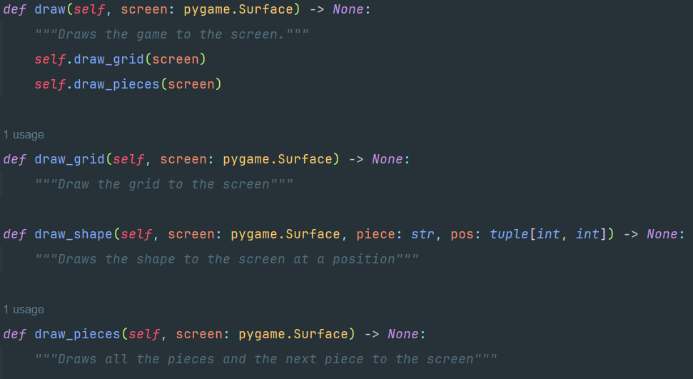
Where to Start?
Hints:
You may want to implement the methods below into your class
There are a few tasks to do for your program to be considered complete.
A complete pygame loop
Drawing a grid
Drawing each piece
Getting mouse input
Check for a winner.
Optionally:
Draw a grid
Draw the next piece
Display the winner

Slide 37
You should now be able to play.
Go around the room playing each other’s Connect Four versions.
After playing, tell the other person at least one thing that you liked and at least one improvement.
If you have some time, implement some suggested changes.

Slide 38
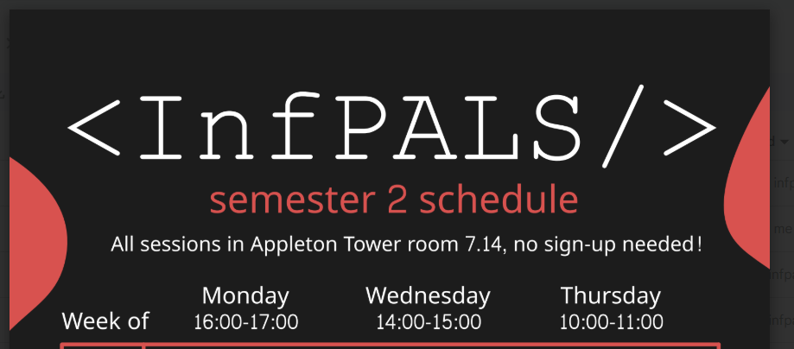
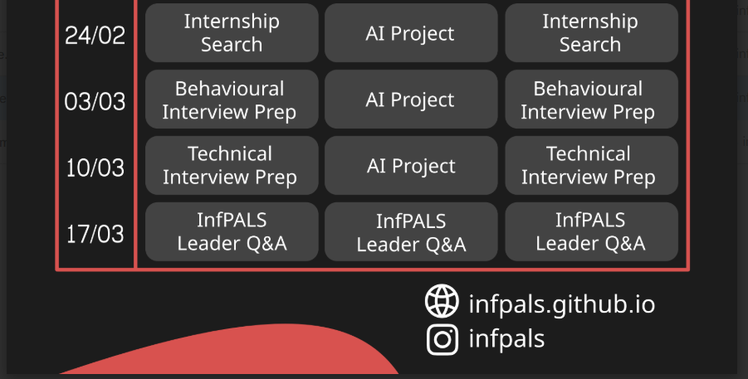
Conclusion
Today:
Applying pygame into Connect Four
Playing our game
Thank you for coming!

