Slide 1


COMPANY PROFILE
Vinchin is a professional provider of data protection solutions for enterprises.
2022

Slide 2
CONTENTS
1
Who We Are?
2
Milestone
3
4
Customer Stories
Our Partners

Slide 3

01
Who We Are?

Slide 4



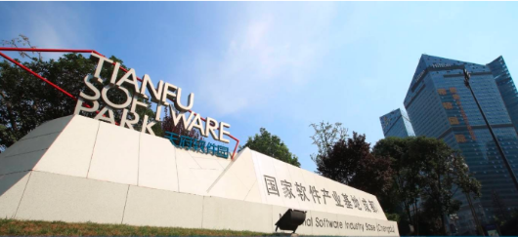
Since
2015
Right, Panda! The city where panda comes from is named Chengdu, which is also the Chinese national software industry base. This is the place where Vinchin was born in 2015.

Slide 5

About Us
Who we are ?
Vinchin is a professional provider of data protection solutions for enterprises. It provides a series of data backup, instant recovery, and offsite DR solutions for private cloud, public cloud and hybrid cloud environments.
Vinchin Backup & Recovery, the next generation VM backup solution self-developed by Vinchin, supports the world’s most mainstream virtual environments including VMware, XenServer/XCP-ng, Hyper-V, RHV/oVirt, OpenStack, Sangfor HCI, Oracle Linux Virtualization Manager and Huawei FusionCompute(Xen Based). It prevents the loss of critical business data due to human misoperation, viruses, attacks, hardware failures, natural disasters, wars, etc. It now supports Chinese, English, German, Czech, etc. languages.
Vinchin backup solutions have been successfully deployed and delivered in 100+ countries.Today, Vinchin solutions are available worldwide. You can join us as a channel partner or service provider. We look forward to providing you the excellent supports & services!

Slide 6
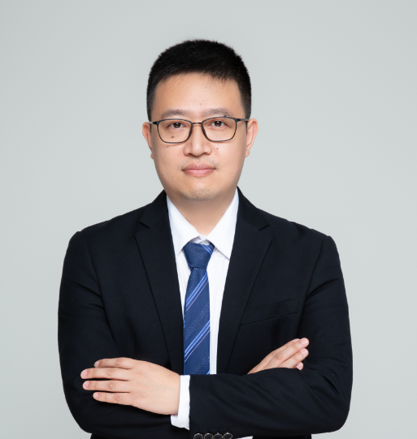

Leadership
Graduated as a PhD of Technical Science from Sichuan University, the top 1 seat of learning in Southwestern China, who specialized in science research of cloud computing security and cybersecurity, Mark has been dedicated in the industry for over 20 years. Due to his non-stop innovative mind with rich knowledge.
Xiaoqin Hu (Mark) | Founder & CEO, Vinchin
Mark now owns several national patents for invention, and wins authoritative approval from global academic circles with 10+ papers published on SCI and EI.
Mark built his career as a young yet experienced entrepreneur to explore greater possibilities of data protection in 2015, who now has been playing a leading role to prompt Chinese industry ecosystem, determined to bring new generation's advanced backup solution to the world, in the name of Vinchin.
Be dare to think, speak and achieve

Slide 7
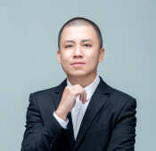
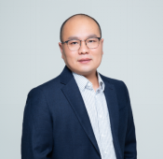
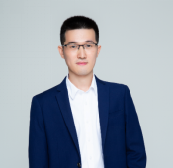
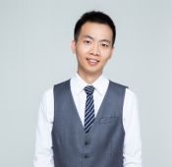
Leadership
Chuanbo.H
Lei.Tu
Peter Xie
Well Xie
Co-Founder &
CTO
Co-Founder &
Chief Revenue Officer
Co-Founder &
Chief System Architect
Co-Founder &
Marketing Director
Standing out as a PhD of Computer Science, Chuanbo knows exactly how to turn those innovative ideas into best practice, driving the brand of Vinchin to step higher with solid product functionalities.
Raymond is the one who makes you see through the real potential of product from Vinchin. With strong capability to exploit the business opportunities, he continues to bring innumerable product values of Vinchin within overall national market.
Peter is instrumental for construction of solid IT infrastructure to ensure Vinchin's excellent performance, by taking full advantage of his rich experience and technical skills since 2009, who previously worked in Microsoft for 6 years.
Well is responsible for Vinchin's global product image. As one of the co-founders of Vinchin, he is consistent to discover new paths for Vinchin to realize best customer satisfaction and business optimization.

Slide 8
02
Milestone

Slide 9
Our History
VINCHIN WAS BORN IN CHINA, AIMS TO SERVE THE WORLD.
2022…
2015
5 IT guys gathered together and founded a company and named it “Vinchin”, focusing on backup and disaster recovery technology development. Vinchin in Chinese means cloud + good fortune, in English “chin” means China.
2020
2018
Vinchin established oversea sales department and start the preparation of the product and marketing. The same year March, Vinchin Backup & Recovery v4.0 was released globally.
2018
2020
2015
After years exploring in the market, Vinchin has gained 300% sales increase both in China and oversea market in 2020 with 10000+ Customers and 1.6M+ VMs under protection all over the world.
2022…
We are expecting your join-in…

Slide 10
Our Releases
TO LET THE WORLD USE VINCHIN BACKUP SOFTWARE IS OUR VISION.
2015
2016
2018
2019
2020
2022
0
3.5
4.0
5.0
6.0
6.7
Vinchin was founded
Vinchin Backup & Recovery v3.5 was released, support Vmware, XenServer and other native virtual platform agentless backup
Vinchin Backup & Recovery v4.0 was released, support Hyper-V, oVirt/RHV, Sangfor HCI and OpenStack backup. In the same year, got the first patent for instant recovery technology in China.
Vinchin Backup & Recovery v5.0 was released, newly support backup copy to offsite for DR, file-level restore, also self-developed unique functions like BitDetectorTM and SpeedKitTM
Vinchin Backup & Recovery v6.0 was released, highly increased backup and recovery performance with more advanced features, support OLVM and XCP-ng backup, newly support archive backups to AWS and Alibaba Cloud
.
Vinchin Backup & Recovery v6.7 release!
V2v
MSP
Database Backup
GFS etc.
.

Slide 11
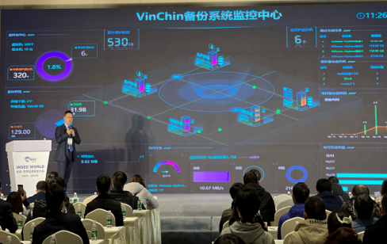
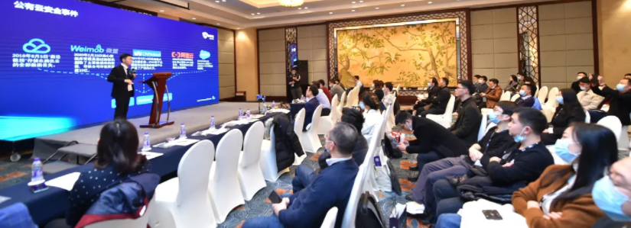
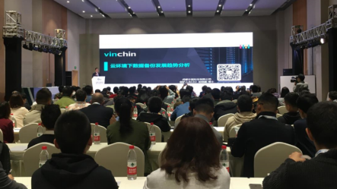
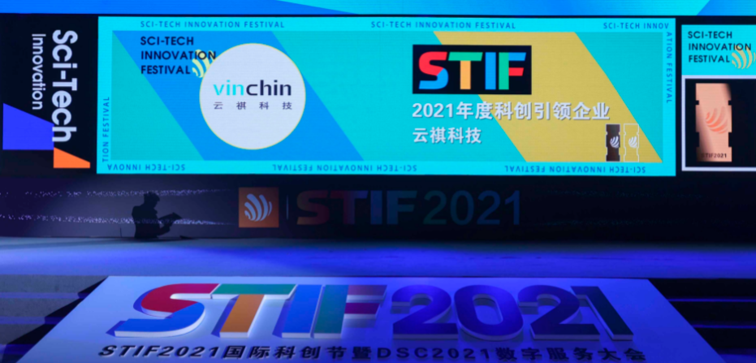
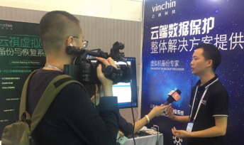
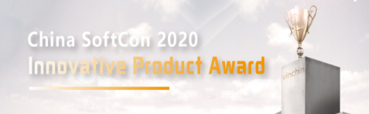
We are the very first virtual machine backup vendor in China
We self-develop and own complete intellectual property rights
We won the first patent for instant recovery technology in China
10 Platforms Protected
100+ Countries Implemented
10000+ Clients
1.6M+ VM protected
Our Glories

Slide 12
03
Our Partners

Slide 13










The first backup provider recognized by oVirt Community
Oracle Partner Network – Sole Chinese backup vendor listed in Oracle Linux and Virtualization ISV
VMware – Technology Partner & VMware Ready
Red Hat Technology Partner & Certified Technology
Sole Eco-System partner in China for XCP-ng backup
Our
Partner
OpenStack – The only Chinese backup vendor in OpenStack Support Organization
Citrix – Technology Partner & Citrix Ready
Huawei KunPeng Project Partner
Sangfor HCI Compatibility Certificate

Slide 14
04
Customer Stories

Slide 15
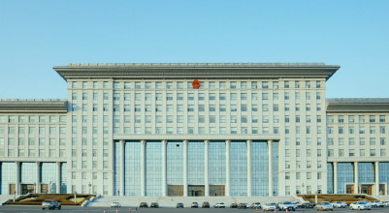

Customer Stories
WE VALUE THE PARTNERSHIP WITH OUR CUSTOMERS
We ended up choosing Vinchin Backup & Recovery as our preferred VM backup solution for protecting our thousands of Openstack VMs because it's highly intuitive and easy to use. The configuration is simple and flexible both when it comes to backing up, recovering, and monitoring with the web console and the reports.
Qiang Wang | Technical Consultant
Chengdu Municipal People's Government
Chengdu is the capital of Sichuan province, with a built-up area of 949.6 square kilometers and a permanent resident population of 16.581 million. It is an important central city in western China and has been known as the "land of abundance" since ancient times.
Chengdu municipal government Openstack cloud platform was established and operated in 2010, providing flexible, reliable, secure information infrastructure services including virtual machines, storage, and network for the municipal government departments.
240+ Government application systems
80+ municipal departments
Although the environment was complex, Vinchin support team only spent a short time on adapting and debugging in their datacenter, then smoothly deployed Vinchin Backup & Recovery in their Openstack platform. In the end, a backup of 1000+ virtual machines and over tens of TB data were completed within 2 days.

Slide 16


Customer Stories
WE VALUE THE PARTNERSHIP WITH OUR CUSTOMERS
We With Vinchin Backup & Recovery, our backup processes are now running successfully, predictably, and smoothly. We can achieve the high scalability on data protection with Vinchin Backup Server and extendable Nodes, to help us decentralize the workloads of overwhelming backup and recovery tasks.
Mr. Wang | IT Manager
The PetroChina Company Limited
PetroChina Company Limited (PetroChina) is the largest oil and gas producer and distributor, playing a dominant role in the oil and gas industry in China. PetroChina was established as a joint-stock company on November 5, 1999, as part of the restructuring of CNPC. It is not only one of the companies with the biggest sales revenue in China, but also one of the largest oil companies in the world. PetroChina is committed to the principle of steady development and pushes the strategies of resources, markets, internationalization, and innovation with the aim to build a world-class international energy company.
Fortune Global 500 (2017-2020) ranking, No. 4
Forbes Global 2000 (2020) ranking, No. 32
Asia's largest oil and gas producer
PetroChina South-West Branch owns 80 hosts, 160 sockets, running VMware platform. Although they’ve tested Veeam before knowing about Vinchin, they still chose Vinchin instead of Veeam due to its excellent performance and better support services! After deploying Vinchin, hundreds of VMware VMs with 80 TB+ data have been under protection since Dec,2019.

Slide 17


Customer Stories
WE VALUE THE PARTNERSHIP WITH OUR CUSTOMERS
I did not anticipate an impeccable solution until Vinchin offered one. Their product not only provides us the flexibility and reliability to back up data but also succeeds to recover data in seconds, which has greatly contributed to our cancer research data management.
Marek Dynowski, PhD|Head of Scientific Computing
Cancer Research UK Manchester Institute
The CRUK (Cancer Research UK) Manchester Institute is a leading cancer research institute originally from the University of Manchester, a world-known institution with a reputation for education and innovation. From investigating the molecular and cellular basis of cancer, to translational research and the development of therapeutics, it covers almost the whole spectrum of cancer research, and aims to transform people’s lives by making positive change across the world.
QS World University Ranking, No.27
As the institute’s cancer research has been continually making great progress, the need to keep important data safe is highly in demand, let alone it also has strong links with the Christie Hospital – the largest cancer center in Europe, treating more than 40,000 patients per year.
They have Vinchin deployed to protect their oVirt environment with 100+ Virtual Machines running there.

Slide 18



Customer Stories
WE VALUE THE PARTNERSHIP WITH OUR CUSTOMERS
Executive Environment Agency, Bulgaria
National Reference Centre within the European Environment Agency (EEA),
Member of EPA Network
ThaiHealth, Thailand
An autonomous state agency established by Health Promotion Foundation Act (2001)，Thailand
Powiat Jarociński
A unit of territorial administration and local government (powiat) in Greater Poland Voivodeship, west-central Poland

Slide 19
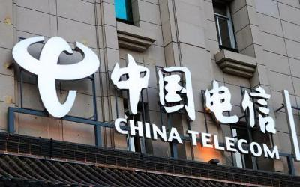
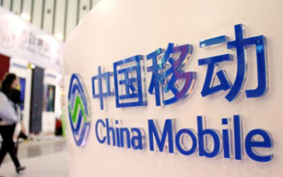
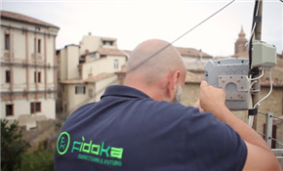
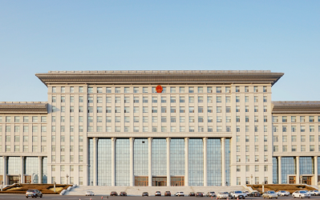
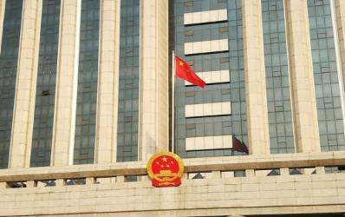
Customer Stories
WE VALUE THE PARTNERSHIP WITH OUR CUSTOMERS
Fìdoka, Italy
Italian widely known telecommunication company, established over 300 base stations in the Marche Region, Italy
China Telecom
Fortune Global 500 (2020) ranking, No. 158,
One of China’s three major telecom operators
China Mobile
Fortune Global 500 (2020) ranking, No. 65,
One of China’s three major telecom operators

Slide 20













Customer Stories
WE VALUE THE PARTNERSHIP WITH OUR CUSTOMERS
The largest energy producer in eastern Germany
University. Malaysia
Leading retail group with 800+ stores in and outside of France.
Finance IT Services.
South Africa
The 2nd oldest university in Portugal, COVID-19 Research project
Hospital. Brazil
Insurance Group. Argentina
2200+ employees
67 branches
30083 Linkedin followers
China Mobile
Fortune Global 500 (2020) ranking, No. 65,
One of China’s three major telecom operators
Finance Services. Mexico
Transportation. Swiss
Paper Manufacturer. US
IT Service. Brazil
IT Development. Chile
Public Service. Afghanistan
Public Service. Afghanistan

Slide 21
THANK YOU
Head Office
F5, Block 8, National Information Security Industry Park, No.333 YunHua Road, High-Tech Zone, Chengdu, China. P.C.610095
Sales Global
Tel: +86-135-5029-3426 Email: sales@vinchin.com
Support
Tel: +86-159-2884-8843 Email: technical_support@vinchin.com

