Slide 1
dLCMS
dynamic Learning Content
Management System
Samuel Schluep, schluep@iha.bepr.ethz.ch

Slide 2
Contents
dLCMS
Introduciton to Learning Objects
The dLCMS-Project
  Goals
  Architecture
  Implementation
Demo

Slide 3
E-Learning Content Today
dLCMS
Creating e-learning content is costly.
Existing electronic courses are seldom reused.

Slide 4
Learning Objects (LOs)
dLCMS
Small modular building blocks
Can flexibly be assembled to larger learning units
Can be shared among teachers, according to their specific needs
Reusable, accessible, interoperable, durable

Slide 5
Standardization
dLCMS
Learning objects standardization
  Metadata
  Packaging
No established standards for learning content and its structures!

Slide 6
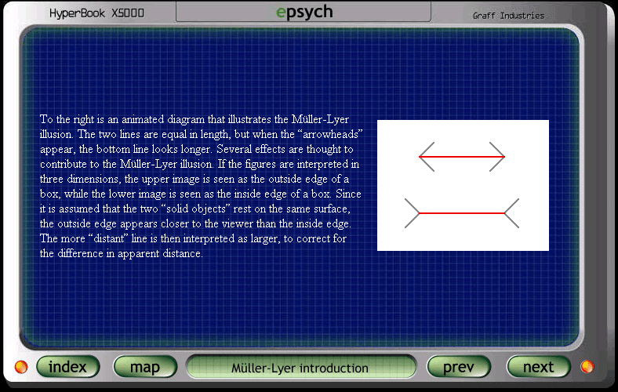
Learning Objects (1)
dLCMS
epsych - Psychology Department at Mississippi State University
http://epsych.msstate.edu/descriptive/Vision/muller_ly/index.html

Slide 7
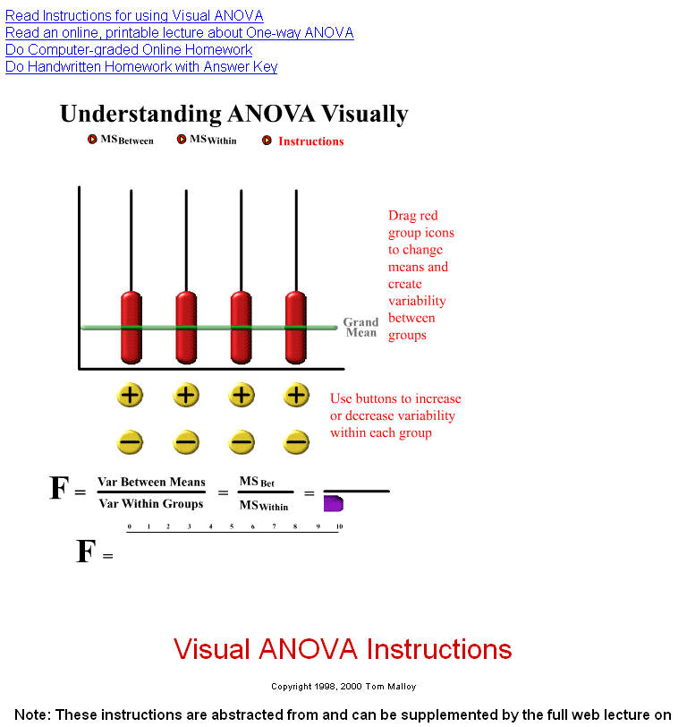
Learning Objects (2)
dLCMS
Tom Malloy
http://www.psych.utah.edu/stat/introstats/anovaflash.html

Slide 8
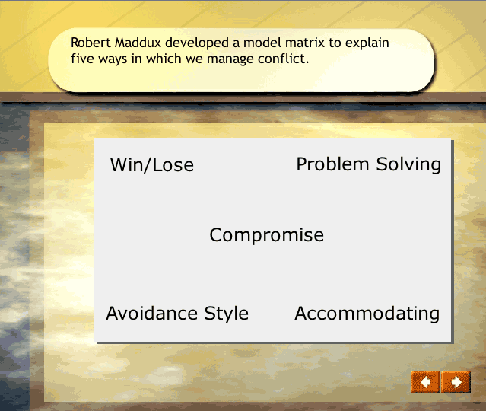
Learning Objects (3)
dLCMS
Robin Rathsack 2004
http://www.wisc-online.com/lrnobj/psycHR/PHR300/index.html

Slide 9
dLCMS Goals
Use of small modular learning objects
Standardized structuring to separate content and graphical presentation
Centralized content management
Flexible and easy-to-use assembly of learning objects to larger learning units
Flexible graphical layout and design
Future-proof data formats for learning content

Slide 10
dLCMS Architecture
Repository of LOs
Centralized repository
  Collaborative use of learning objects
  Flexible retrieval of learning resources
Authoring
  Easy to use online editor for XML-based content
  No programming skills needed

Slide 11
dLCMS Architecture
Repository of LOs
Learning Unit Builder
Learning unit builder
  Assembly of learning units
  Automatic generation of navigation and table of content
= Didactical Context

Slide 12
dLCMS Architecture
Repository of LOs
Learning Unit Builder
Learning Units are published as:
  Web
  LMS online courses (SCORM)
  Paper-based lecture notes (PDF)
Export
Coherent layout and styling with templates
= Didactical Context

Slide 13
dLCMS Implementation
No existing LCMS accesible
Development based on the Silva/Zope open-source CMS
Implementation as an Silva extension product
Prototype:
  Online editor
  Centralized repository
  Learning unit builder
  Flexible layout and graphical designs through style templates
  Export function as static web-site

Slide 14
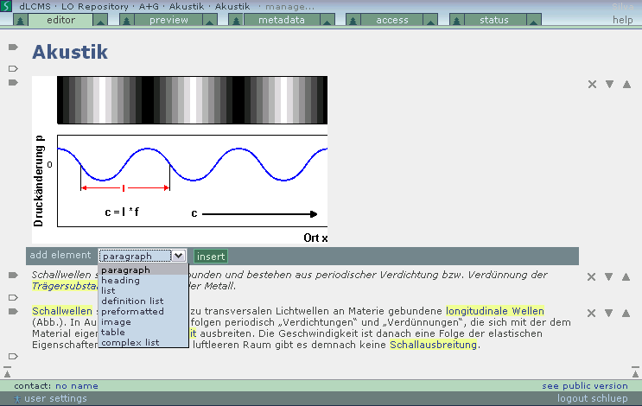
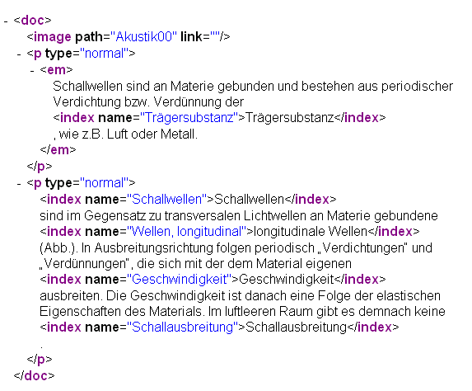
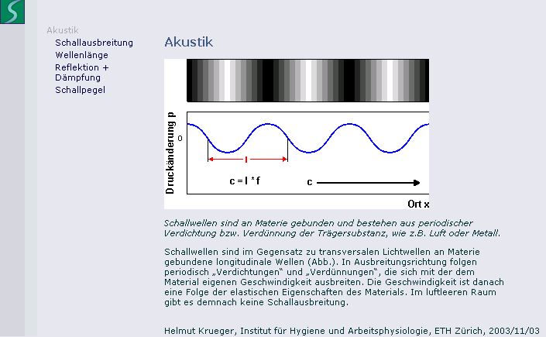
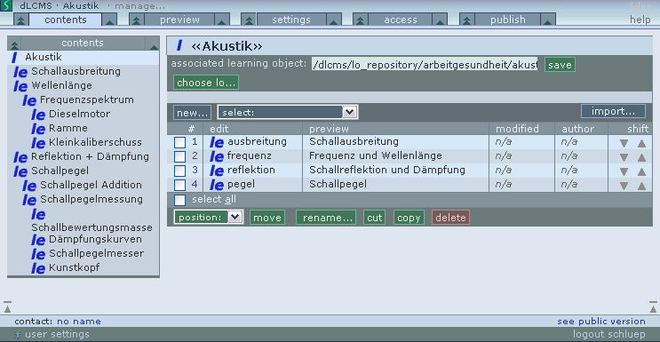
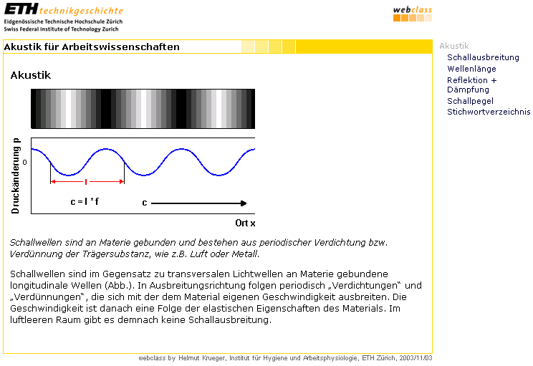
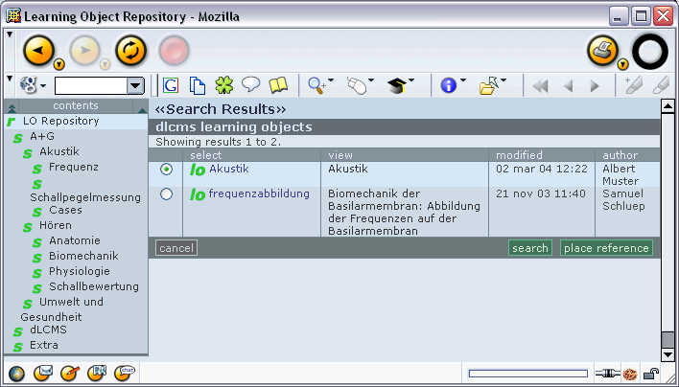
Demo
dLCMS
Online-editor
XML-based content structuring
Learning unit builder
Flexible graphical Design

Slide 15
Conclusions
dLCMS
dLCMS offers small modular building blocks and XML-based structured content
Authors can concentrate on content instead of programming languages
Flexible layout and graphical designs through style templates

Slide 16
Thank you for your attention
dLCMS
Samuel Schluep
Institute for Hygiene and Applied Physiology
ETH Zürich
schluep@iha.bepr.ethz.ch

