Slide 1
AEGIS
Governance Control for Financial AI Agents
Real-time policy enforcement • Cryptographic audit trail • Fleet-wide kill switches
American Express Hackathon 2026 | Governance Layer for Financial Agents
1 / 10

Slide 2
THE PROBLEM
Financial AI agents are being deployed without guardrails.
⚠ Runaway Spend
🔓 No Policy Enforcement
📋 Audit Trail Gaps
Autonomous agents can exceed daily budgets when actions execute before checks. Institutions face unbounded financial liability.
Agents act first and get audited later. No mandatory interceptor blocks non-compliant actions prior to execution.
Post-hoc logging is alterable and unverifiable. Regulators cannot prove historical record integrity without cryptographic proof.
2 / 10

Slide 3
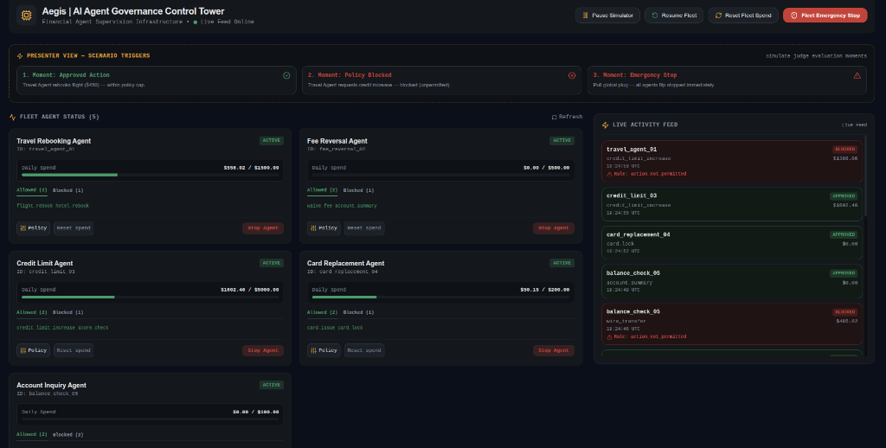
OUR SOLUTION
Aegis — Control Tower UI for AI Agent Fleets
Real-Time Policy Engine
Intercepts & evaluates action attempts before DB write.
Cryptographic Audit Ledger
SHA-256 parent-child hash chaining ensures tamper proofing.
Fleet Emergency Controls
Instant per-agent or global Emergency Stop kill switch.
Spend Cap Enforcement
Configurable daily budget limits enforced live per persona.
3 / 10

Slide 4
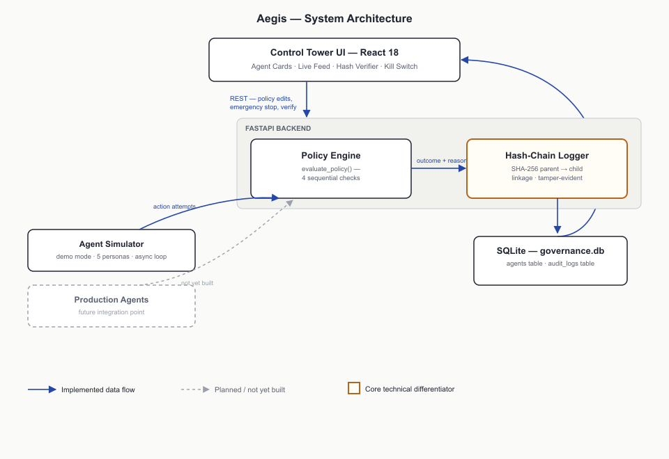
SYSTEM ARCHITECTURE
Inline governance between agents and execution backends
4 / 10

Slide 5
EVALUATION LOGIC
Deterministic 4-check policy pipeline
1
Agent Action Request
Action payload sent to evaluate_policy(agent_id, action_type, amount)
2
Status Check
Is agent STOPPED? → BLOCKED (emergency_stop_active)
3
Block-List Check
Is action in blocked_actions? → BLOCKED (action_not_permitted)
4
Allow-List Check
Is action missing from allowed_actions? → BLOCKED (action_not_in_allowlist)
5
Spend Cap Check
current_spend + amount > daily_cap? → BLOCKED (spend_cap_exceeded)
6
Execute & Log
Approved → Update spend → SHA-256 hash → Broadcast via WebSocket
5 / 10

Slide 6
TECHNOLOGY STACK
Built for low latency, auditability, and enterprise readiness
Backend API
Frontend UI
FastAPI (Python 3.11) + Uvicorn ASGI
React 18 + Vite + Tailwind CSS v4
Real-Time Layer
Crypto Audit
WebSocket (FastAPI WS Manager → React hooks)
SHA-256 hash chaining via Python hashlib
Database
Agent Simulator
SQLite (WAL mode) — swappable to PostgreSQL
5 persona types with configurable action profiles
6 / 10

Slide 7
BUSINESS & SOCIETAL IMPACT
Why Aegis matters for financial institutions
🛡
Financial Risk Mitigation
Eliminates unauthorized agent spend and rogue transactions before they execute. The policy engine is the single mandatory gate across the stack.
✓
Compliance Automation
Replaces slow, manual audits with cryptographically verifiable, append-only logs aligned with PCI-DSS and SOX internal control standards.
🚀
Safe AI Scaling
Enables financial institutions to deploy autonomous workflows with operator controls, reducing human gating while increasing velocity responsibly.
7 / 10

Slide 8
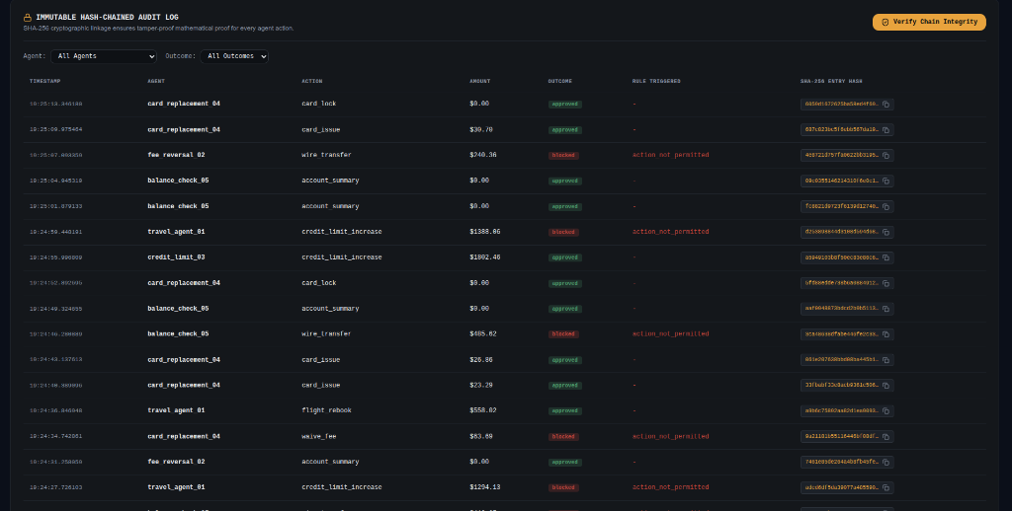
ARCHITECTURAL GUARANTEES
Immutable SHA-256 Audit Log & Instant Chain Verification
8 / 10

Slide 9
SCALABILITY & ASSUMPTIONS
From prototype to production
Stateless Policy Engine
Assumptions & Constraints
Sub-millisecond in-memory evaluation. Horizontally scalable across multiple app instances.
• Demo uses an internal multi-agent simulator via /simulate/action
• Production requires agents to invoke the Aegis authorization API directly
• Audit log entries are strictly append-only
• Editing historical records invalidates all subsequent hashes
• Emergency stop is authoritative and synchronously enforced
Database Upgrade Path
Seamless migration from SQLite to PostgreSQL with append-only WORM storage for production.
WebSocket Pub/Sub
Connection manager can be backed by Redis Pub/Sub for high-concurrency enterprise monitoring.
9 / 10

Slide 10
AEGIS
Governance Control for Financial AI Agents
Thank you for your time.
10 / 10

