Slide 1
Parallel Programming with MPI
Slides Available at https://anl.box.com/v/2019-ANL-MPI/
Pavan Balaji
Email: balaji@anl.gov
Web: http://www.mcs.anl.gov/~balaji
Rajeev Thakur
Email: thakur@anl.gov
Web: http://www.mcs.anl.gov/~thakur
Ken Raffenetti
Email: raffenet@mcs.anl.gov
Web: http://www.mcs.anl.gov/~raffenet
Giuseppe Congiu
Email: gcongiu@anl.gov
Web: http://www.mcs.anl.gov/~gcongiu
Huansong Fu
Email: hfu@anl.gov
Web: http://www.mcs.anl.gov/~hsfu

Slide 2
About the Speakers
All of us are deeply involved in MPI standardization (in the MPI Forum) and in MPI implementation
Pavan Balaji: Computer Scientist, MCS Division, Argonne
Group Lead: Programming Models and Runtime Systems
Leads the MPICH implementation of MPI
Chair of the Hybrid working group for MPI-3 and MPI-4
Rajeev Thakur: Deputy Director, DSL Division, Argonne
Involved in MPI for a long time
Co-chair of the RMA working group for MPI-3
Ken Raffenetti: Software Developer, MCS Division, Argonne
MPICH developer, Participates in the MPI Forum
Giuseppe Congiu: Postdoctoral Researcher, MCS Division, Argonne
MPICH developer, Participates in the MPI Forum
Huansong Fu: Postdoctoral Researcher, MCS Division, Argonne
MPICH developer, Participates in the MPI Forum

Slide 3
Outline
Morning
Session 1
Introduction to MPI
Basic concepts
MPI-1, MPI-2, MPI-3
Installing and running MPI
Point-to-point Communication
Collective Communication
Derived Datatypes
Session 2
MPI One-sided Communication (RMA)
Afternoon
Hybrid Programming
Thread safety specification in MPI and how it enables hybrid programming
MPI + OpenMP
MPI + shared memory
MPI + accelerators
3

Slide 4
General principles in this tutorial
Everything is practically oriented
We provide lots of example code to illustrate concepts
At the end, you should be able to use what you have learned and write and run real programs
Feel free to interrupt and ask questions

Slide 5
Introduction to MPI

Slide 6
Sample Parallel Programming Models
Shared Memory Programming
Processes share memory address space (threads model)
Application ensures no data corruption (Lock/Unlock)
Transparent Parallelization
Compiler works magic on sequential programs
Directive-based Parallelization
Compiler needs help (e.g., OpenMP)
Message Passing
Explicit communication between processes (like sending and receiving emails)

Slide 7
The Message-Passing Model
A process is (traditionally) a program counter and address space.
Processes may have multiple threads (program counters and associated stacks) sharing a single address space. MPI is for communication among processes, which have separate address spaces.
Inter-process communication consists of
synchronization
movement of data from one process’s address space to another’s.
Process
MPI
Process
MPI

Slide 8
The Message-Passing Model (an example)
Each process has to send/receive data to/from other processes
Example: Sorting Integers
Process1
O(N log N)
8
23
19
67
45
35
1
24
13
30
3
5
Process1
Process2
8
19
23
35
45
67
1
3
5
13
24
30
O(N/2 log N/2)
O(N/2 log N/2)
1
3
5
8
13
19
23
24
30
35
45
67
O(N)
Process1

Slide 9
Standardizing Message-Passing Models with MPI
Early vendor systems (Intel’s NX, IBM’s EUI, TMC’s CMMD) were not portable (or very capable)
Early portable systems (PVM, p4, TCGMSG, Chameleon) were mainly research efforts
Did not address the full spectrum of message-passing issues
Lacked vendor support
Were not implemented at the most efficient level
The MPI Forum was a collection of vendors, portability writers and users that wanted to standardize all these efforts

Slide 10
What is MPI?
MPI: Message Passing Interface
The MPI Forum organized in 1992 with broad participation by:
Vendors: IBM, Intel, TMC, SGI, Convex, Meiko
Portability library writers: PVM, p4
Users: application scientists and library writers
MPI-1 finished in 18 months
Incorporates the best ideas in a “standard” way
Each function takes fixed arguments
Each function has fixed semantics
Standardizes what the MPI implementation provides and what the application can and cannot expect
Each system can implement it differently as long as the semantics match
MPI is not…
a language or compiler specification
a specific implementation or product

Slide 11
MPI-1
MPI-1 supports the classical message-passing programming model: basic point-to-point communication, collectives, datatypes, etc
MPI-1 was defined (1994) by a broadly based group of parallel computer vendors, computer scientists, and applications developers.
2-year intensive process
Implementations appeared quickly and now MPI is taken for granted as vendor-supported software on any parallel machine.
Free, portable implementations exist for clusters and other environments (MPICH, Open MPI)
11

Slide 12
Following MPI Standards
MPI-2 was released in 1997
Several additional features including MPI + threads, MPI-I/O, remote memory access functionality and many others
MPI-2.1 (2008) and MPI-2.2 (2009) were released with some corrections to the standard and small features
MPI-3 (2012) added several new features to MPI (see next slide)
MPI-3.1 (2015) is the latest version of the standard with minor corrections and features
The Standard itself:
at http://www.mpi-forum.org
All MPI official releases, in both postscript and HTML
Other information on Web:
at http://www.mcs.anl.gov/mpi
pointers to lots of material including tutorials, a FAQ, other MPI pages

Slide 13
Overview of New Features in MPI-3
Major new features
Nonblocking collectives
Neighborhood collectives
Improved one-sided communication interface
Tools interface
Fortran 2008 bindings
Other new features
Matching Probe and Recv for thread-safe probe and receive
Noncollective communicator creation function
“const” correct C bindings
Comm_split_type function
Nonblocking Comm_dup
Type_create_hindexed_block function
C++ bindings removed
Previously deprecated functions removed
MPI 3.1 added nonblocking collective I/O functions

Slide 14
Status of MPI-3.1 Implementations
 | MPICH | MVAPICH | Open MPI | Cray | Tianhe | Intel |  | IBM |  |  | HPE | Fujitsu | MS | MPC | NEC | Sunway | RIKEN | AMPI
 |  |  |  |  |  | IMPI | MPICH-OFI | BG/Q (legacy) ¹ | PE (legacy) ² | Spectrum
NBC | ✔ | ✔ | ✔ | ✔ | ✔ | ✔ | ✔ | ✔ | ✔ | ✔ | ✔ | ✔ | ✔ | ✔ | ✔ | ✔ | ✔ | ✔
Nbr. Coll. | ✔ | ✔ | ✔ | ✔ | ✔ | ✔ | ✔ | ✔ | ✔ | ✔ | ✔ | ✔ | ✘ | ✔ | ✔ | ✔ | ✔ | ✔
RMA | ✔ | ✔ | ✔ | ✔ | ✔ | ✔ | ✔ | ✔ | ✔ | ✔ | ✔ | ✔ | (*) | ✔ | ✔ | ✔ | ✔ | Q2 ‘18
Shr. mem | ✔ | ✔ | ✔ | ✔ | ✔ | ✔ | ✔ | ✔ | ✔ | ✔ | ✔ | ✔ | ✔ | ✔ | ✔ | ✔ | ✔ | Q1 ‘18
MPI_T | ✔ | ✔ | ✔ | ✔ | ✔ | ✔ | ✔ | ✔ | ✔ | ✔ | ✔ | ✔ | * | ✔ | ✔ | ✔ | ✔ | Q2 ‘18
Comm-create group | ✔ | ✔ | ✔ | ✔ | ✔ | ✔ | ✔ | ✔ | ✔ | ✔ | ✔ | ✔ | * | ✔ | ✔ | ✔ | ✔ | ✔
F08 Bindings | ✔ | ✔ | ✔ | ✔ | ✔ | ✔ | ✔ | ✔ | ✘ | ✔ | ✔ | ✘ | ✘ | ✔ | ✔ | ✔ | ✔ | Q2 ‘18
New Dtypes | ✔ | ✔ | ✔ | ✔ | ✔ | ✔ | ✔ | ✔ | ✔ | ✔ | ✔ | ✔ | ✔ | ✔ | ✔ | ✔ | ✔ | ✔
Large Counts | ✔ | ✔ | ✔ | ✔ | ✔ | ✔ | ✔ | ✔ | ✔ | ✔ | ✔ | ✔ | ✔ | ✔ | ✔ | ✔ | ✔ | ✔
MProbe | ✔ | ✔ | ✔ | ✔ | ✔ | ✔ | ✔ | ✔ | ✔ | ✔ | ✔ | ✔ | ✔ | ✔ | ✔ | ✔ | ✔ | Q1 ‘18
NBC I/O | ✔ | ✔ | ✔ | ✔ | ✘ | ✔ | ✔ | ✘ | ✘ | ✔ | ✔ | ✘ | ✘ | * | ✔ | ✘ | ✔ | Q3 ‘18
Release dates are estimates; subject to change at any time “✘” indicates no publicly announced plan to implement/support that feature
Platform-specific restrictions might apply to the supported features
¹ Open Source but unsupported ² No MPI_T variables exposed * Under development (*) Partly done

Slide 15
Web Pointers
MPI Standard : http://www.mpi-forum.org/docs/docs.html
MPI Forum : http://www.mpi-forum.org/
MPI implementations:
MPICH : http://www.mpich.org
MVAPICH : http://mvapich.cse.ohio-state.edu/
Intel MPI: http://software.intel.com/en-us/intel-mpi-library/
Microsoft MPI: www.microsoft.com/en-us/download/details.aspx?id=39961
Open MPI : http://www.open-mpi.org/
IBM Spectrum MPI, Cray MPI, TH MPI, …
Several MPI tutorials can be found on the web

Slide 16
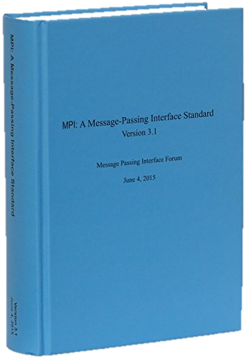
Latest MPI 3.1 Standard in Book Form
Available from amazon.com
http://www.amazon.com/dp/B015CJ42CU/

Slide 17
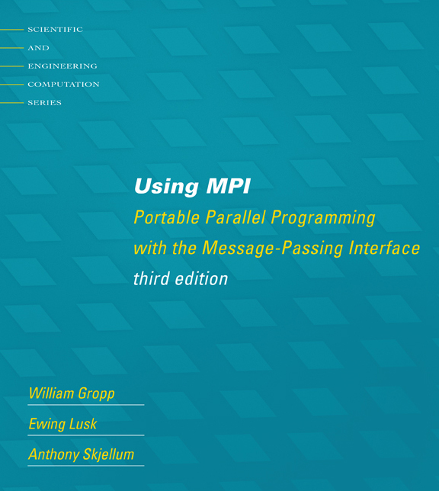
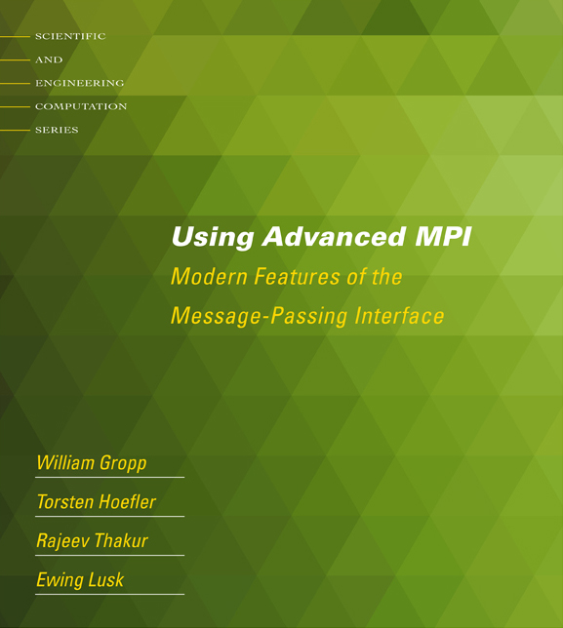
Tutorial Books on MPI
Basic MPI
Advanced MPI, including MPI-3

Slide 18
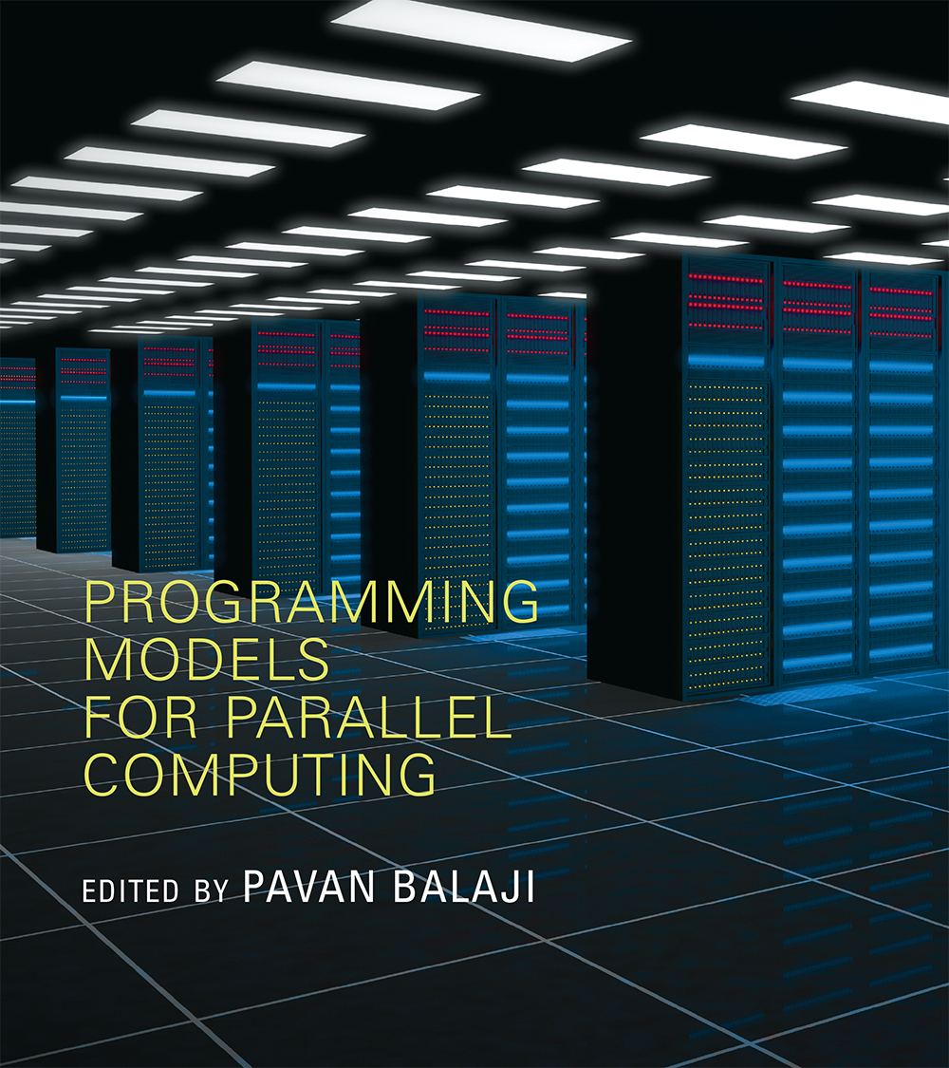
Book on Parallel Programming Models
Edited by Pavan Balaji
MPI: W. Gropp and R. Thakur
GASNet: P. Hargrove
OpenSHMEM: J. Kuehn and S. Poole
UPC: K. Yelick and Y. Zheng
Global Arrays: S. Krishnamoorthy, J. Daily, A. Vishnu, and B. Palmer
Chapel: B. Chamberlain
Charm++: L. Kale, N. Jain, and J. Lifflander
ADLB: E. Lusk, R. Butler, and S. Pieper
Scioto: J. Dinan
SWIFT: T. Armstrong, J. M. Wozniak, M. Wilde, and I. Foster
CnC: K. Knobe, M. Burke, and F. Schlimbach
OpenMP: B. Chapman, D. Eachempati, and S. Chandrasekaran
Cilk Plus: A. Robison and C. Leiserson
Intel TBB: A. Kukanov
CUDA: W. Hwu and D. Kirk
OpenCL: T. Mattson

Slide 19
Applications (Science and Engineering)
MPI is widely used in large scale parallel applications in science and engineering
Atmosphere, Earth, Environment
Physics - applied, nuclear, particle, condensed matter, high pressure, fusion, photonics
Bioscience, Biotechnology, Genetics
Chemistry, Molecular Sciences
Geology, Seismology
Mechanical Engineering - from prosthetics to spacecraft
Electrical Engineering, Circuit Design, Microelectronics
Computer Science, Mathematics

Slide 20
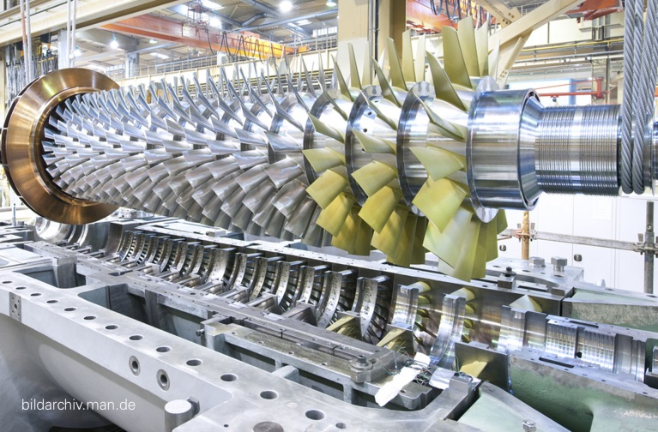
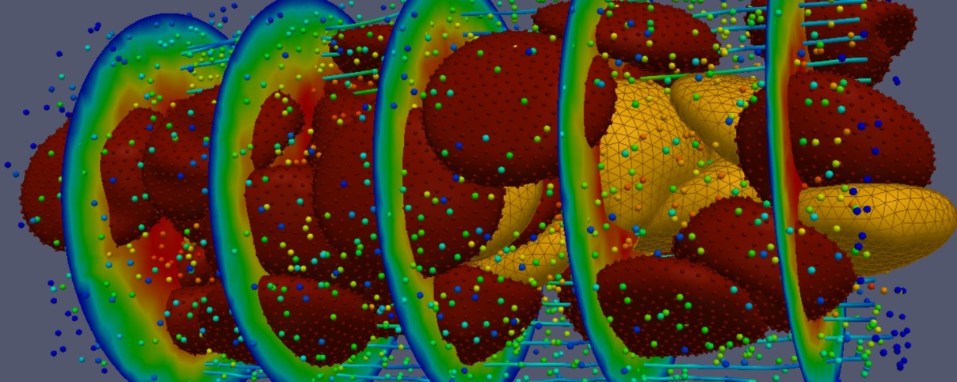
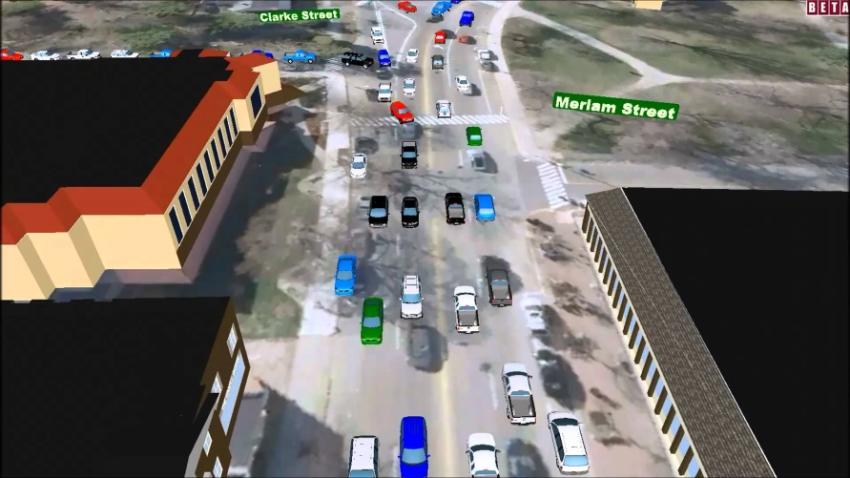
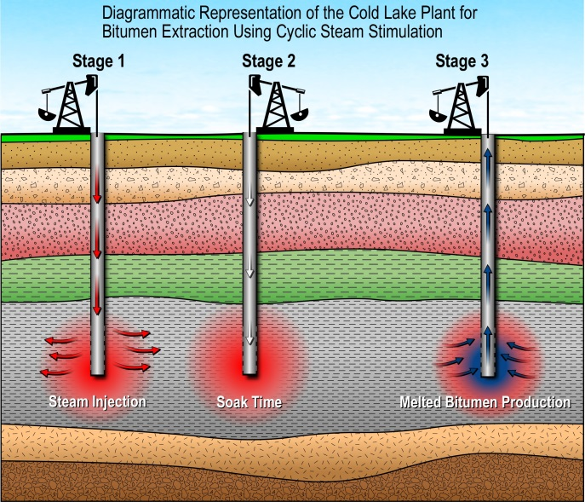

Biology (heart murmur simulation)
Turbo machinery (Gas turbine/compressor)
Transportation & traffic application
Drilling application
Astrophysics application
20

Slide 21
Reasons for Using MPI
Standardization - MPI is the only message passing library which can be considered a standard. It is supported on virtually all HPC platforms. Practically, it has replaced all previous message passing libraries
Portability - There is no need to modify your source code when you port your application to a different platform that supports (and is compliant with) the MPI standard
Performance Opportunities - Vendor implementations should be able to exploit native hardware features to optimize performance
Functionality – Rich set of features
Availability - A variety of implementations are available, both vendor and public domain
MPICH is a popular open-source and free implementation of MPI
Vendors and other collaborators take MPICH and add support for their systems
Intel MPI, IBM Blue Gene MPI, Cray MPI, Microsoft MPI, MVAPICH, MPICH-MX

Slide 22
Important considerations while using MPI
All parallelism is explicit: the programmer is responsible for correctly identifying parallelism and implementing parallel algorithms using MPI constructs

Slide 23
Approach in this Tutorial
Example driven
A few running examples used throughout the tutorial
Other smaller examples used to illustrate specific features
Example exercises available to download
23

Slide 24


How does MPI work? (1/2)

Slide 25
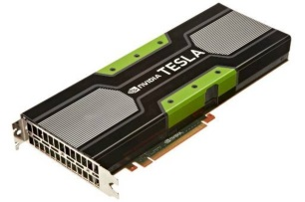
How does MPI work? Multicore Systems. (2/2)

Slide 26
Compiling and Running MPI applications (more details later)
MPI is a library
Applications can be written in C, C++ or Fortran and appropriate calls to MPI can be added where required
Compilation:
Regular applications:
% gcc test.c -o test
MPI applications
% mpicc test.c -o test
Execution:
Regular applications
% ./test
MPI applications (running with 16 processes)
% mpiexec –n 16 ./test

Slide 27
What is MPICH?
MPICH is a high-performance and widely portable open-source implementation of MPI
It provides all features of MPI that have been defined so far (including MPI-1, MPI-2.0, MPI-2.1, MPI-2.2, MPI-3.0 and MPI-3.1)
Active development led by Argonne National Laboratory
Several close collaborators who contribute many features, bug fixes, testing for quality assurance, etc.
Intel, Cray, Mellanox, The Ohio State University, Microsoft, and many others

Slide 28
Getting Started with MPICH
From UNIX distributions
Most UNIX/Linux distributions package MPICH for easy installation
apt-get (Ubuntu/Debian), yum (Fedora, Centos), brew/port (Mac OS)
Open-source for source-based installation
Download MPICH
Go to http://www.mpich.org and follow the downloads link
The download will be a zipped tarball
Build MPICH
Unzip/untar the tarball
% tar xvfz mpich-<latest_version>.tar.gz
% cd mpich-<latest_version>
% ./configure –-prefix=/where/to/install/mpich |& tee c.log
% make |& tee m.log
% make install |& tee mi.log
% Add /where/to/install/mpich/bin to your PATH

Slide 29
Compiling MPI programs with MPICH
Compilation Wrappers
For C programs:
For C++ programs:
For Fortran programs:
You can link other libraries are required too
To link to a math library:
You can just assume that “mpicc” and friends have replaced your regular compilers (gcc, gfortran, etc.)
% mpicc test.c –o test
% mpicxx test.cpp –o test
% mpifort test.f90 –o test
% mpicc test.c –o test -lm

Slide 30
Running MPI programs with MPICH
Launch 16 processes on the local node:
% mpiexec –n 16 ./test
Launch 16 processes on 4 nodes (each has 4 cores)
% mpiexec –hosts h1:4,h2:4,h3:4,h4:4 –n 16 ./test
Runs the first four processes on h1, the next four on h2, etc.
% mpiexec –hosts h1,h2,h3,h4 –n 16 ./test
Runs the first process on h1, the second on h2, etc., and wraps around
So, h1 will have the 1st, 5th, 9th and 13th processes
If there are many nodes, it might be easier to create a host file
% cat hf
h1:4
h2:2
% mpiexec –hostfile hf –n 16 ./test

Slide 31
Trying some example programs
MPICH comes packaged with several example programs using almost ALL of MPICH’s functionality
A simple program to try out is the PI example written in C (cpi.c) – calculates the value of PI in parallel (available in the examples directory when you build MPICH)
% mpiexec –n 16 ./examples/cpi
The output will show how many processes are running, and the error in calculating PI
Next, try it with multiple hosts
% mpiexec –hosts h1:2,h2:4 –n 16 ./examples/cpi
If things don’t work as expected, send an email to discuss@mpich.org

Slide 32
Interaction with Resource Managers
Resource managers such as SGE, PBS, SLURM or Cray ALPS are common in many managed clusters
MPICH automatically detects them and interoperates with them
For example with PBS, you can create a script such as:
#! /bin/bash
% cd $PBS_O_WORKDIR
# No need to provide –np or –hostfile options
% mpiexec ./test
Job can be submitted as:
“mpiexec” will automatically know that the system has PBS, and ask PBS for the number of cores allocated (4 in this case), and which nodes have been allocated
The usage is similar for other resource managers
% qsub –l nodes=2:ppn=2 test.sub

Slide 33
Introduction to MPI Communicators
Slides Available at https://anl.box.com/v/2018-ANL-MPI/
Pavan Balaji
Email: balaji@anl.gov
Web: http://www.mcs.anl.gov/~balaji
Rajeev Thakur
Email: thakur@anl.gov
Web: http://www.mcs.anl.gov/~thakur
Ken Raffenetti
Email: raffenet@mcs.anl.gov
Web: http://www.mcs.anl.gov/~raffenet
Giuseppe Congiu
Email: gcongiu@anl.gov
Web: http://www.mcs.anl.gov/~gcongiu
Huansong Fu
Email: hfu@anl.gov
Web: http://www.mcs.anl.gov/~hsfu

Slide 34
MPI Communicators
MPI processes can be collected into groups
Each group can have multiple colors (some times called context)
Group + color == communicator (it is like a name for the group)
When an MPI application starts, the group of all processes is initially given a predefined name called MPI_COMM_WORLD
The same group can have many names, but simple programs do not have to worry about multiple names
A process is identified by a unique number within each communicator, called rank
For two different communicators, the same process can have two different ranks: so the meaning of a “rank” is only defined when you specify the communicator

Slide 35
Communicators
% mpiexec -n 16 ./test
When you start an MPI program, there is one predefined communicator MPI_COMM_WORLD
Communicators do not need to contain all processes in the system
0
1
0
1
2
2
3
3
Every process in a communicator has an ID called a “rank”
4
5
Can make copies of this communicator (same group of processes, but different “aliases”)
4
6
5
7
6
7
The same process might have different ranks in different communicators
Communicators can be created “by hand” or using tools provided by MPI (not discussed in this tutorial)
Simple programs typically only use the predefined communicator MPI_COMM_WORLD

Slide 36
Communicators
Can be thought of as independent communication layers over a group of processes
Messages in one layer will not affect messages in another
1
3
3
2
2
7
7
3
0
3
1
6
6
11
1
2
3
7
2
5
0
5
5
10
15
2
6
7
11
0
1
4
7
4
9
10
14
15
4
5
6
6
11
0
1
13
14
15
5
9
10
0
4
8
12
13
14
4
8
9
8
12
13
12

Slide 37
Simple MPI Program Identifying Processes
#include <mpi.h>
#include <stdio.h>
int main(int argc, char ** argv)
{
int rank, size;
MPI_Init(&argc, &argv);
MPI_Comm_rank(MPI_COMM_WORLD, &rank);
MPI_Comm_size(MPI_COMM_WORLD, &size);
printf("I am %d of %d\n", rank + 1, size);
MPI_Finalize();
return 0;
}
Basic requirements for an MPI program

Slide 38
Example: Hello World!
communicators/hello.c
Basic program where each process prints its rank
Notes:
Remember to run example a couple times to show how output is re-ordered.

Slide 39
Blocking Point-to-Point Operations
Slides Available at https://anl.box.com/v/2018-ANL-MPI/
Pavan Balaji
Email: balaji@anl.gov
Web: http://www.mcs.anl.gov/~balaji
Rajeev Thakur
Email: thakur@anl.gov
Web: http://www.mcs.anl.gov/~thakur
Ken Raffenetti
Email: raffenet@mcs.anl.gov
Web: http://www.mcs.anl.gov/~raffenet
Giuseppe Congiu
Email: gcongiu@anl.gov
Web: http://www.mcs.anl.gov/~gcongiu
Huansong Fu
Email: hfu@anl.gov
Web: http://www.mcs.anl.gov/~hsfu

Slide 40
MPI Basic Send/Receive
Simple communication model
Application needs to specify to the MPI implementation:
How do you compile and run an MPI application?
How will processes be identified?
How will “data” be described?
Process 0
Process 1
Send(data)
Receive(data)

Slide 41
Data Communication
Data communication in MPI is like email exchange
One process sends a copy of the data to another process (or a group of processes), and the other process receives it
Communication requires the following information:
Sender has to know:
Whom to send the data to (receiver’s process rank)
What kind of data to send (100 integers or 200 characters, etc)
A user-defined “tag” for the message (think of it as an email subject; allows the receiver to understand what type of data is being received)
Receiver “might” have to know:
Who is sending the data (OK if the receiver does not know; in this case sender rank will be MPI_ANY_SOURCE, meaning anyone can send)
What kind of data is being received (partial information is OK: I might receive up to 1000 integers)
What the user-defined “tag” of the message is (OK if the receiver does not know; in this case tag will be MPI_ANY_TAG)

Slide 42
More Details on Describing Data for Communication
MPI Datatype is very similar to a C or Fortran datatype
int → MPI_INT
double → MPI_DOUBLE
char → MPI_CHAR
More complex datatypes are also possible:
E.g., you can create a structure datatype that comprises of other datatypes → a char, an int and a double.
Or, a vector datatype for the columns of a matrix
The “count” in MPI_SEND and MPI_RECV refers to how many datatype elements should be communicated

Slide 43
MPI Basic (Blocking) Send
MPI_Send(const void *buf, int count,
MPI_Datatype datatype, int dest, int tag,
MPI_Comm comm)
The message buffer is described by (buf, count, datatype).
The target process is specified by dest and comm.
dest is the rank of the target process in the communicator specified by comm.
tag is a user-defined “type” for the message
When this function returns, the data has been delivered to the system and the buffer can be reused.
The message may not have been received by the target process.

Slide 44
MPI Basic (Blocking) Receive
MPI_Recv(void *buf, int count, MPI_Datatype datatype,
int source, int tag, MPI_Comm comm, MPI_Status *status)
Waits until a matching (on source, tag, comm) message is received from the system, and the buffer can be used.
source is rank in communicator comm, or MPI_ANY_SOURCE.
Receiving fewer than count occurrences of datatype is OK, but receiving more is an error.
status contains further information:
Who sent the message (can be used if you used MPI_ANY_SOURCE)
How much data was actually received
What tag was used with the message (can be used if you used MPI_ANY_TAG)
MPI_STATUS_IGNORE can be used if we don’t need any additional information

Slide 45
Simple Communication in MPI
#include <mpi.h>
#include <stdio.h>
int main(int argc, char ** argv)
{
int rank, data[100];
MPI_Init(&argc, &argv);
MPI_Comm_rank(MPI_COMM_WORLD, &rank);
if (rank == 0)
MPI_Send(data, 100, MPI_INT, 1, 0, MPI_COMM_WORLD);
else if (rank == 1)
MPI_Recv(data, 100, MPI_INT, 0, 0, MPI_COMM_WORLD, MPI_STATUS_IGNORE);
MPI_Finalize();
return 0;
}
Notes:
Important concept is that each process is running the same program. Difference in rank determines behavior.

Slide 46
Example: Basic Send/Receive
blocking_p2p/sendrecv.c
Simple send/receive program to show basic data transfer

Slide 47
Parallel Sort using MPI Send/Recv
Rank 0
8
23
19
67
45
35
1
24
13
30
3
5
O(N log N)
Rank 0
Rank 1
8
19
23
35
45
67
1
3
5
13
24
30
O(N/2 log N/2)
Rank 0
8
19
23
35
45
67
1
3
5
13
24
30
O(N)
Rank 0
1
3
5
8
13
19
23
24
30
35
45
67

Slide 48
Parallel Sort using MPI Send/Recv (contd.)
#include <mpi.h>
#include <stdio.h>
int main(int argc, char ** argv)
{
int rank, a[1000], b[500];
MPI_Init(&argc, &argv);
MPI_Comm_rank(MPI_COMM_WORLD, &rank);
if (rank == 0) {
MPI_Send(&a[500], 500, MPI_INT, 1, 0, MPI_COMM_WORLD);
sort(a, 500);
MPI_Recv(b, 500, MPI_INT, 1, 0, MPI_COMM_WORLD, MPI_STATUS_IGNORE);
/* Serial: Merge array b and sorted part of array a */
}
else if (rank == 1) {
MPI_Recv(b, 500, MPI_INT, 0, 0, MPI_COMM_WORLD, MPI_STATUS_IGNORE);
sort(b, 500);
MPI_Send(b, 500, MPI_INT, 0, 0, MPI_COMM_WORLD);
}
MPI_Finalize(); return 0;
}

Slide 49
Example: Sorting with Two Processes
blocking_p2p/sort_2_procs.c
Sorting using two processes

Slide 50
Status Object
The status object is used after completion of a receive to find the actual length, source, and tag of a message
Status object is MPI-defined type and provides information about:
The source process for the message (status.MPI_SOURCE)
The message tag (status.MPI_TAG)
Error status (status.MPI_ERROR)
The number of elements received is given by:
MPI_Get_count(MPI_Status *status, MPI_Datatype datatype, int *count)
status return status of receive operation (status) datatype datatype of each receive buffer element (handle)
count number of received elements (integer)(OUT)

Slide 51
Using the “status” field (contd.)
#include <mpi.h>
#include <stdio.h>
int main(int argc, char ** argv)
{
[..snip..]
if (rank < world_size - 1) { /* worker process */
MPI_Send(data, rand() % 100, MPI_INT, world_size - 1, rank / 2,
MPI_COMM_WORLD);
}
else { /* master process */
for (i = 0; i < world_size – 1; i++) {
MPI_Recv(data, 100, MPI_INT, MPI_ANY_SOURCE,
MPI_ANY_TAG, MPI_COMM_WORLD, &status);
MPI_Get_count(&status, MPI_INT, &count);
printf(“worker ID: %d; task ID: %d; count: %d\n”,
status.MPI_SOURCE, status.MPI_TAG, count);
}
}
[..snip..]
}

Slide 52
Example: Master-worker Computation
blocking_p2p/master_worker_simple.c
Master-worker example
Each task is computed by three workers
Every worker knows statically what task it needs to compute
Results accumulated by the master
The amount of data sent by each worker is arbitrary, but less than 100 integers

Slide 53
Section Summary
MPI is simple
Many (if not all) parallel programs can be written using just these six functions, only two of which are non-trivial:
MPI_INIT – initialize the MPI library (must be the first routine called)
MPI_COMM_SIZE - get the size of a communicator
MPI_COMM_RANK – get the rank of the calling process in the communicator
MPI_SEND – send a message to another process
MPI_RECV – send a message to another process
MPI_FINALIZE – clean up all MPI state (must be the last MPI function called by a process)
For performance, however, you need to use other MPI features

Slide 54
Nonblocking Point-to-Point Operations
Slides Available at https://anl.box.com/v/2018-ANL-MPI/
Pavan Balaji
Email: balaji@anl.gov
Web: http://www.mcs.anl.gov/~balaji
Rajeev Thakur
Email: thakur@anl.gov
Web: http://www.mcs.anl.gov/~thakur
Ken Raffenetti
Email: raffenet@mcs.anl.gov
Web: http://www.mcs.anl.gov/~raffenet
Giuseppe Congiu
Email: gcongiu@anl.gov
Web: http://www.mcs.anl.gov/~gcongiu
Huansong Fu
Email: hfu@anl.gov
Web: http://www.mcs.anl.gov/~hsfu

Slide 55
Blocking vs. Nonblocking Communication
MPI_SEND/MPI_RECV are blocking communication calls
Return of the routine implies completion
When these calls return the memory locations used in the message transfer can be safely accessed for reuse
For “send” completion implies variable sent can be reused/modified
Modifications will not affect data intended for the receiver
For “receive” variable received can be read
MPI_ISEND/MPI_IRECV are nonblocking variants
Routine returns immediately – completion has to be separately tested for
These are primarily used to overlap computation and communication to improve performance

Slide 56
Blocking Communication
In blocking communication
MPI_SEND does not return until buffer is empty (available for reuse)
MPI_RECV does not return until buffer is full (available for use)
A process sending data will be blocked until data in the send buffer is emptied
A process receiving data will be blocked until the receive buffer is filled
Exact completion semantics of communication generally depends on the message size and the system buffer size
Blocking communication is simple to use but can be prone to deadlocks
if (rank == 0) {
MPI_SEND(..to rank 1..)
MPI_RECV(..from rank 1..)
Usually deadlocks → else if (rank == 1) {
MPI_SEND(..to rank 0..) ← reverse send/recv
MPI_RECV(..from rank 0..)
}

Slide 57
Blocking Send-Receive Diagram
T0:MPI_Recv
T1:MPI_Send
Once receive is called @ T0, buffer unavailable to user
time
T2
Sender returns @T2, buffer can be reused
T3: Transfer Complete
T4
Receive returns @T4, buffer filled
internal completion is soon
followed by return of MPI_Recv
Sender
Receiver
57
Notes:
57

Slide 58
Nonblocking Communication
Nonblocking operations return (immediately) ‘‘request handles” that can be waited on and queried
MPI_ISEND(buf, count, datatype, dest, tag, comm, request)
MPI_IRECV(buf, count, datatype, src, tag, comm, request)
MPI_WAIT(request, status)
Nonblocking operations allow overlapping computation and communication
One can also test without waiting using MPI_Test
MPI_Test(request, flag, status)
Anywhere you use MPI_Send or MPI_Recv, you can use the pair of MPI_Isend/MPI_Wait or MPI_Irecv/MPI_Wait

Slide 59
Nonblocking Send-Receive Diagram
High Performance Implementations Offer Low Overhead for Nonblocking Calls
T0:MPI_Irecv
T2:MPI_Isend
T1:Returns
Sender returns @T3, buffer unavailable
T3
time
Sender completes @T5, buffer available after MPI_Wait
T5
T6
T6:MPI_Wait
T9: Wait returns
T7: Transfer Finishes
T8
MPI_Wait, returns @ T8 here, receive buffer filled
internal completion is soon
followed by return of MPI_Recv
Sender
Receiver
59
Notes:
59

Slide 60
Multiple Completions
It is sometimes desirable to wait on multiple requests:
MPI_Waitall(count, array_of_requests, array_of_statuses)
MPI_Waitany(count, array_of_requests, &index, &status)
MPI_Waitsome(incount, array_of_requests, outcount,
array_of_indices, array_of_statuses)
There are corresponding versions of TEST for each of these

Slide 61
Message Completion and Buffering
For a communication to succeed:
Sender must specify a valid destination rank
Receiver must specify a valid source rank (including MPI_ANY_SOURCE)
The communicator must be the same
Tags must match
Receiver’s buffer must be large enough
A send has completed when the user supplied buffer can be reused
Just because the send completes does not mean that the receive has completed
Message may be buffered by the system
Message may still be in transit
*buf = 3;
MPI_Send(buf, 1, MPI_INT …)
*buf = 4; /* OK, receiver will always
receive 3 */
*buf = 3;
MPI_Isend(buf, 1, MPI_INT …)
*buf = 4; /* Receiver may get 3, 4, or
anything else */
MPI_Wait(…);

Slide 62
A Nonblocking communication example
int main(int argc, char ** argv)
{
[...snip...]
if (rank == 0) {
for (i=0; i< 100; i++) {
/* Compute each data element and send it out */
data[i] = compute(i);
MPI_Isend(&data[i], 1, MPI_INT, 1, 0, MPI_COMM_WORLD,
&request[i]);
}
MPI_Waitall(100, request, MPI_STATUSES_IGNORE)
}
else if (rank == 1){
for (i = 0; i < 100; i++)
MPI_Recv(&data[i], 1, MPI_INT, 0, 0, MPI_COMM_WORLD,
MPI_STATUS_IGNORE);
}
[...snip...]
}

Slide 63
Section Summary
Nonblocking communication is an enhancement over blocking communication
Allows for computation and communication to be potentially overlapped
MPI implementation might, but is not guaranteed to overlap
Depends on what capabilities the network provides
Depends on how the MPI library is implemented (e.g., some libraries might tradeoff between better overlap and better basic performance)
Critical for event-driven programming
Multiple outstanding operations, and the application performs a corresponding task depending on what completes next

Slide 64
Running Example: Stencil
Slides Available at https://anl.box.com/v/2018-ANL-MPI/
Pavan Balaji
Email: balaji@anl.gov
Web: http://www.mcs.anl.gov/~balaji
Rajeev Thakur
Email: thakur@anl.gov
Web: http://www.mcs.anl.gov/~thakur
Ken Raffenetti
Email: raffenet@mcs.anl.gov
Web: http://www.mcs.anl.gov/~raffenet
Giuseppe Congiu
Email: gcongiu@anl.gov
Web: http://www.mcs.anl.gov/~gcongiu
Huansong Fu
Email: hfu@anl.gov
Web: http://www.mcs.anl.gov/~hsfu

Slide 65
Running Example: Regular Mesh Algorithms
Many scientific applications involve the solution of partial differential equations (PDEs)
Many algorithms for approximating the solution of PDEs rely on forming a set of difference equations
Finite difference, finite elements, finite volume
The exact form of the differential equations depends on the particular method
From the point of view of parallel programming for these algorithms, the operations are the same
Five-point stencil is a popular approximation solution

Slide 66
The Global Data Structure
Each circle is a mesh point
Difference equation evaluated at each point involves the four neighbors
The red “plus” is called the method’s stencil
Good numerical algorithms form a matrix equation Au=f; solving this requires computing Bv, where B is a matrix derived from A. These evaluations involve computations with the neighbors on the mesh.

Slide 67
The Global Data Structure
Each circle is a mesh point
Difference equation evaluated at each point involves the four neighbors
The red “plus” is called the method’s stencil
Good numerical algorithms form a matrix equation Au=f; solving this requires computing Bv, where B is a matrix derived from A. These evaluations involve computations with the neighbors on the mesh.
Decompose mesh into equal sized (work) pieces

Slide 68
Necessary Data Transfers

Slide 69
The Local Data Structure
Each process has its local “patch” of the global array
“bx” and “by” are the sizes of the local array
Always allocate a halo around the patch
Array allocated of size (bx+2)x(by+2)
by
bx

Slide 70
Necessary Data Transfers

Slide 71
Necessary Data Transfers
Provide access to remote data through a halo exchange (5 point stencil)

Slide 72
Example: Stencil with Nonblocking Send/recv
nonblocking_p2p/stencil.c
Simple stencil code using nonblocking point-to-point operations

Slide 73
Blocking Collective Operations
Slides Available at https://anl.box.com/v/2018-ANL-MPI/
Pavan Balaji
Email: balaji@anl.gov
Web: http://www.mcs.anl.gov/~balaji
Rajeev Thakur
Email: thakur@anl.gov
Web: http://www.mcs.anl.gov/~thakur
Ken Raffenetti
Email: raffenet@mcs.anl.gov
Web: http://www.mcs.anl.gov/~raffenet
Giuseppe Congiu
Email: gcongiu@anl.gov
Web: http://www.mcs.anl.gov/~gcongiu
Huansong Fu
Email: hfu@anl.gov
Web: http://www.mcs.anl.gov/~hsfu

Slide 74
Introduction to Collective Operations in MPI
Collective operations are called by all processes in a communicator.
MPI_BCAST distributes data from one process (the root) to all others in a communicator.
MPI_REDUCE combines data from all processes in the communicator and returns it to one process.
In many numerical algorithms, SEND/RECV can be replaced by BCAST/REDUCE, improving both simplicity and efficiency.

Slide 75
MPI Collective Communication
Communication and computation is coordinated among a group of processes in a communicator
Tags are not used; different communicators deliver similar functionality
Non-blocking collective operations in MPI-3
Not covered in this tutorial (but conceptually simple)
Three classes of operations: synchronization, data movement, collective computation

Slide 76
Synchronization
MPI_BARRIER(comm)
Blocks until all processes in the group of the communicator comm call it
A process cannot get out of the barrier until all other processes have reached barrier

Slide 77
Collective Data Movement
P0
A
A
Broadcast
P1
A
P2
A
P3
A
P0
A
B
C
D
Scatter
A
P1
B
P2
C
P3
Gather
D

Slide 78
More Collective Data Movement
P0
A
A
B
C
D
Allgather
P1
B
A
B
C
D
P2
C
A
B
C
D
P3
D
A
B
C
D
P0
A0
A1
A2
A3
A0
B0
C0
D0
P1
B0
B1
B2
B3
Alltoall
A1
B1
C1
D1
P2
C0
C1
C2
C3
A2
B2
C2
D2
P3
D0
D1
D2
D3
A3
B3
C3
D3

Slide 79
Collective Computation
P0
A
f(ABCD)
Reduce
P1
B
P2
C
P3
D
P0
A
f(A)
Scan
P1
B
f(AB)
P2
C
f(ABC)
P3
D
f(ABCD)

Slide 80
MPI Collective Routines
Many Routines: MPI_ALLGATHER, MPI_ALLGATHERV, MPI_ALLREDUCE, MPI_ALLTOALL, MPI_ALLTOALLV, MPI_BCAST, MPI_GATHER, MPI_GATHERV, MPI_REDUCE, MPI_REDUCESCATTER, MPI_SCAN, MPI_SCATTER, MPI_SCATTERV
“All” versions deliver results to all participating processes
“V” versions (stands for vector) allow the chunks to have different sizes
MPI_ALLREDUCE, MPI_REDUCE, MPI_REDUCESCATTER, and MPI_SCAN take both built-in and user-defined combiner functions

Slide 81
MPI Built-in Collective Computation Operations
MPI_MAX
MPI_MIN
MPI_PROD
MPI_SUM
MPI_LAND
MPI_LOR
MPI_LXOR
MPI_BAND
MPI_BOR
MPI_BXOR
MPI_MAXLOC
MPI_MINLOC
Maximum
Minimum
Product
Sum
Logical and
Logical or
Logical exclusive or
Bitwise and
Bitwise or
Bitwise exclusive or
Maximum and location
Minimum and location

Slide 82
Exercise: Stencil using Alltoallv
In the basic version of the stencil code
Used nonblocking send/receive for each direction
Let’s try to use single alltoallv collective call
Start from nonblocking_p2p/stencil.c
Solution available in blocking_coll/stencil_alltoallv.c
count = by
count = bx
count = 0

Slide 83
Section Summary
Collectives are a very powerful feature in MPI
Optimized heavily in most MPI implementations
Algorithmic optimizations (e.g., tree-based communication)
Hardware optimizations (e.g., network or switch-based collectives)
Matches the communication pattern of many applications

Slide 84
MPI Derived Datatypes
Slides Available at https://anl.box.com/v/2018-ANL-MPI/
Pavan Balaji
Email: balaji@anl.gov
Web: http://www.mcs.anl.gov/~balaji
Rajeev Thakur
Email: thakur@anl.gov
Web: http://www.mcs.anl.gov/~thakur
Ken Raffenetti
Email: raffenet@mcs.anl.gov
Web: http://www.mcs.anl.gov/~raffenet
Giuseppe Congiu
Email: gcongiu@anl.gov
Web: http://www.mcs.anl.gov/~gcongiu
Huansong Fu
Email: hfu@anl.gov
Web: http://www.mcs.anl.gov/~hsfu

Slide 85
Necessary Data Transfers
Provide access to remote data through a halo exchange (5 point stencil)

Slide 86
The Local Data Structure
Communicating with contiguous data
Edge element may be stored non-contiguously
Manually packing and unpacking
by
bx

Slide 87
Introduction to Datatypes in MPI
Datatypes allow to (de)serialize arbitrary data layouts into a message stream
Networks provide serial channels
Same for block devices and I/O
Several constructors allow arbitrary layouts
Recursive specification possible
Declarative specification of data-layout
“what” and not “how”, leaves optimization to implementation (many unexplored possibilities!)
Choosing the right constructors is not always simple

Slide 88
Simple/Predefined Datatypes
Equivalents exist for all C, C++ and Fortran native datatypes
C int → MPI_INT
C float → MPI_FLOAT
C double → MPI_DOUBLE
C uint32_t → MPI_UINT32_T
Fortran integer → MPI_INTEGER
For more complex or user-created datatypes, MPI provides routines to represent them as well
Contiguous
Vector/Hvector
Indexed/Indexed_block/Hindexed/Hindexed_block
Struct
Some convenience types (e.g., subarray)

Slide 89
Derived Datatype Example
0
1
2
3
4
5
6
7
8
9
10
11
12
13
14
15
16
17
18
19
20
21
22
23
contig
contig
contig
indexed
vector
struct

Slide 90
MPI_Type_contiguous
MPI_Type_contiguous(int count, MPI_Datatype oldtype,
MPI_Datatype *newtype)
Contiguous array of oldtype
Should not be used as last type (can be replaced by count)
0
1
2
3
4
5
6
7
8
9
10
11
12
13
14
15
16
17
18
struct
struct
struct
contig
0
1
2
3
4
5
6
7
8
9
10
11
contig

Slide 91
MPI_Type_vector
MPI_Type_vector(int count, int blocklen, int stride,
MPI_Datatype oldtype, MPI_Datatype *newtype)
Specify strided blocks of data of oldtype
Very useful for Cartesian arrays
0
1
2
3
4
5
6
7
8
9
10
11
vector
0
1
2
3
4
5
6
7
8
9
10
11
12
13
14
15
16
17
18
19
20
struct
struct
struct
struct
vector

Slide 92
Commit, Free, and Dup
Types must be committed before use
Only the ones that are used!
MPI_Type_commit may perform heavy optimizations (and will hopefully)
MPI_Type_free
Free MPI resources of datatypes
Does not affect types built from it
MPI_Type_dup
Duplicates a type
Library abstraction (composability)

Slide 93
Use Datatype in Halo Exchange
contig (count=bx, MPI_DOUBLE, …) or
count with MPI_DOUBLE
by
vector (count=by, blocklen=1,
stride=bx+2, MPI_DOUBLE, …)
bx

Slide 94
Exercise 1: Stencil with Derived Datatypes (1/2)
In the basic version of the stencil code
Used nonblocking communication 👍
Used manual packing/unpacking of data 👎
Let’s try to use derived datatypes
Specify the locations of the data instead of manually packing/unpacking
What datatype do we need here?
by
What datatype do we need here?
bx

Slide 95
Exercise 1: Stencil with Derived Datatypes (2/2)
Nonblocking sends and receives
Data location specified by MPI datatypes
Manual packing of data no longer required
Start from nonblocking_p2p/stencil.c
Solution in derived_datatype/stencil.c

Slide 96
MPI_Type_create_hvector
MPI_Type_create_hvector(int count, int blocklen, MPI_Aint stride,
MPI_Datatype oldtype, MPI_Datatype *newtype)
Create byte strided vectors
Useful for composition, e.g., vector of structs
stride = 11 bytes
0
1
2
3
4
5
6
7
8
9
10
11
12
13
14
15
16
17
18
19
struct
struct
struct
struct
stride = 3 oldtypes
hvector
vector

Slide 97
MPI_Type_create_indexed_block
MPI_Type_create_indexed_block(int count, int blocklen,
int *array_of_displacements,
MPI_Datatype oldtype, MPI_Datatype *newtype)
Pulling irregular subsets of data from a single array
dynamic codes with index lists, expensive though!
blen=2
displs={0,5,8,13,18}
0
1
2
3
4
5
6
7
8
9
10
11
12
13
14
15
16
17
18
19
20
Indexed_block

Slide 98
MPI_Type_indexed
MPI_Type_indexed(int count, int* array_of_blocklens,
int *array_of_displacements,
MPI_Datatype oldtype, MPI_Datatype *newtype)
Like indexed_block, but can have different block lengths
blen={1,1,2,1,2,1}
displs={0,3,5,9,13,17}
0
1
2
3
4
5
6
7
8
9
10
11
12
13
14
15
16
17
18
19
20
indexed

Slide 99
MPI_Type_create_struct
MPI_Type_create_struct(int count,
int *array_of_blocklens,
int *array_of_displacements,
MPI_Datatype *array_of_types,
MPI_Datatype *newtype)
Most general constructor, allows different types and arbitrary arrays (also most costly)
0
1
2
3
4
struct

Slide 100
MPI_Type_create_subarray
MPI_Type_create_subarray(int ndims, int* array_of_sizes,
int *array_of_subsizes, int *array_of_starts,
int order, MPI_Datatype oldtype, MPI_Datatype *newtype)
Convenience function for creating datatypes for array segments
Specify subarray of n-dimensional array (sizes) by start (starts) and size (subsize)
(0,0)
(0,1)
(0,2)
(0,3)
(1,0)
(1,1)
(1,2)
(1,3)
(2,0)
(2,1)
(2,2)
(2,3)
(3,0)
(3,1)
(3,2)
(3,3)

Slide 101
MPI_BOTTOM and MPI_Get_address
MPI_BOTTOM is the absolute zero address
Portability (e.g., may be non-zero in globally shared memory)
MPI_Get_address
Returns address relative to MPI_BOTTOM
Portability (do not use “&” operator in C!)
Very important to
build struct datatypes
If data spans multiple arrays
int a = 4;
float b = 9.6;
MPI_Datatype struct;
MPI_Get_address(&a, &disps[0]);
MPI_Get_address(&b, &disps[1]);
MPI_Type_create_struct(count,
blocklens[], disps,
oldtypes[], &struct);

Slide 102
Other DDT Functions
Pack/Unpack
Mainly for compatibility to legacy libraries
You should not be doing this yourself
Get_envelope/contents
Only for expert library developers
Libraries like MPITypes¹ make this easier
MPI_Create_resized
Change extent and size (dangerous but useful)
http://www.mcs.anl.gov/mpitypes/

Slide 103
Datatype Selection Order
Simple and effective performance model:
More parameters == slower
predefined < contig < vector < index_block < index < struct
Some (most) MPIs are inconsistent
But this rule is portable
Advice to users:
Try datatype “compression” bottom-up
W. Gropp et al.: Performance Expectations and Guidelines for MPI Derived Datatypes

Slide 104
Section Summary
Derived datatypes are a sophisticated mechanism to describe ANY layout in memory
Hierarchical construction of derived datatypes allows them to be just as complex as the data layout is
More complex layouts require more complex datatype constructions
Current state of MPI implementations might be a bit lagging in performance, but it is improving
Increasing amount of hardware support to process derived datatypes on the network hardware
If the performance is lagging when you try it out, complain to the MPI implementer, don’t just stop using it!

