Slide 1
Solving CTF with Python
Name : 英格
Student ID : 4070E091

Slide 2
Google Colab
Colaboratory, or "Colab" for short, allows you to write and execute Python in your browser, with
Zero configuration required
Free access to GPUs
Easy sharing

Slide 3
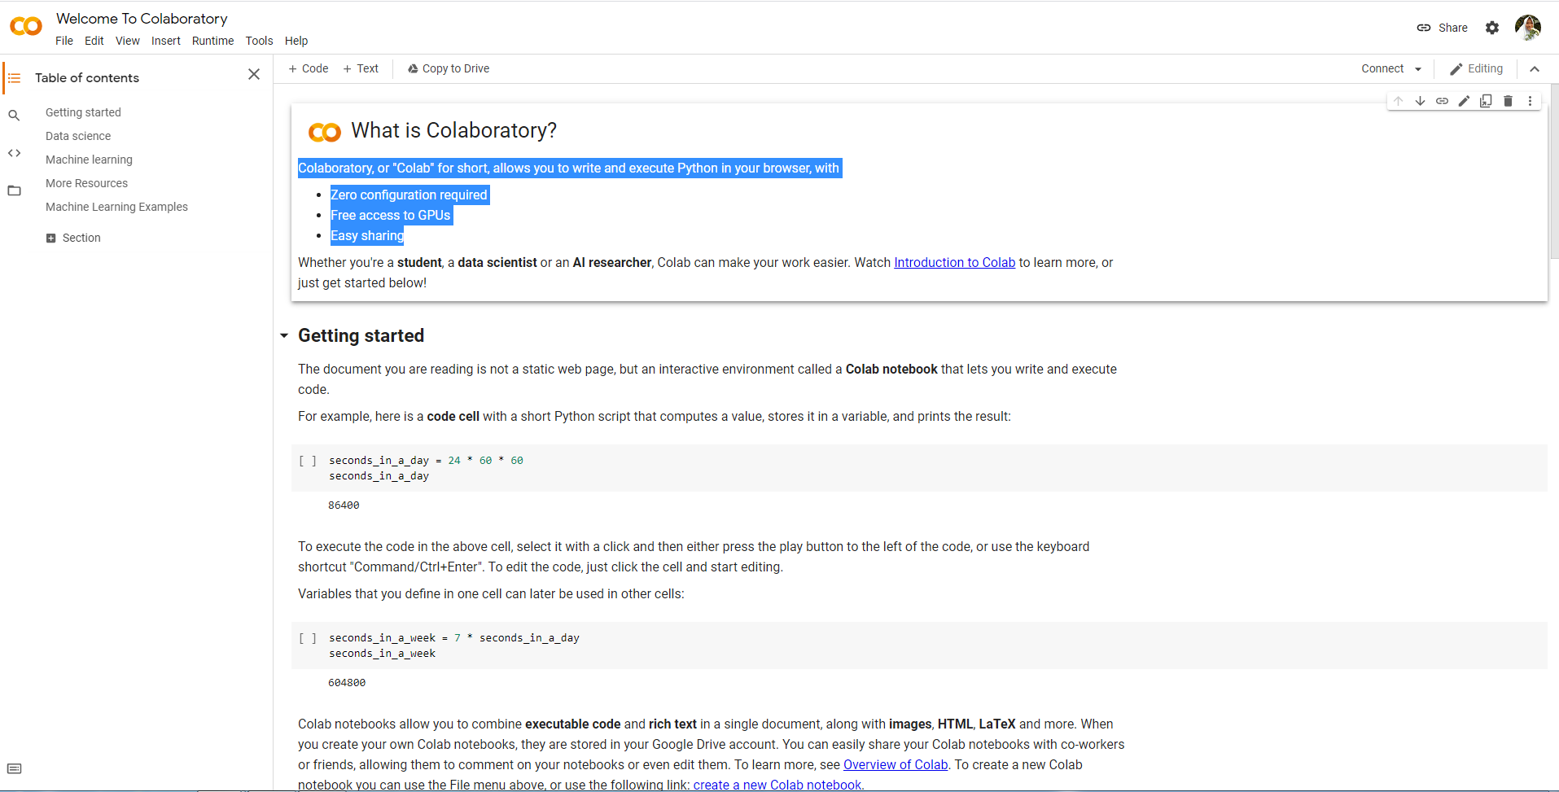

Slide 4
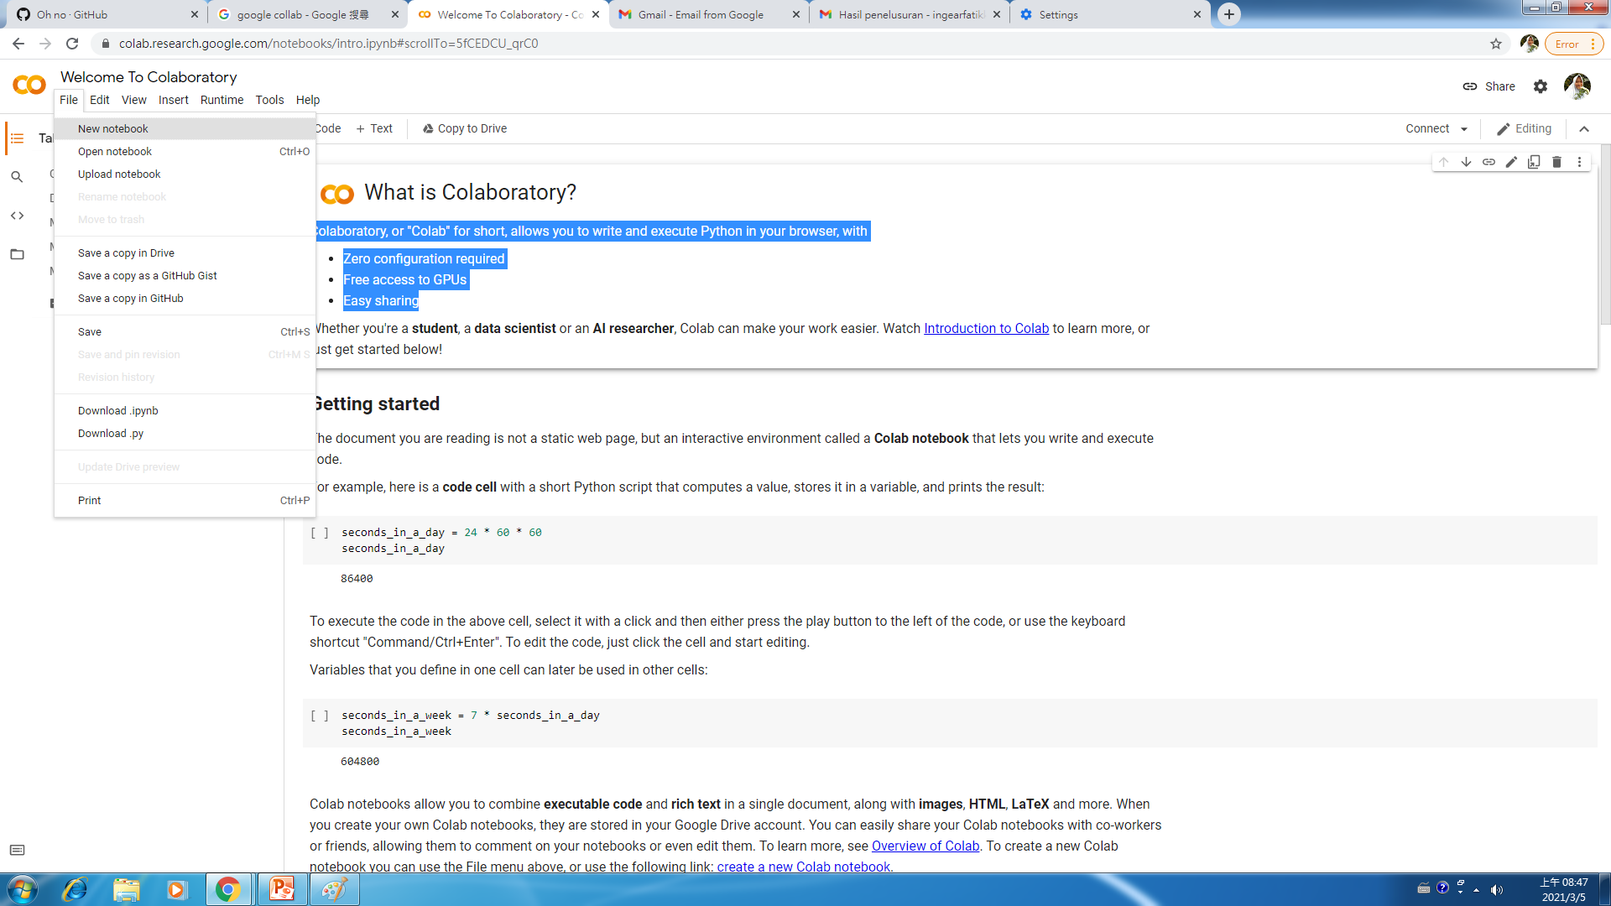

Slide 5
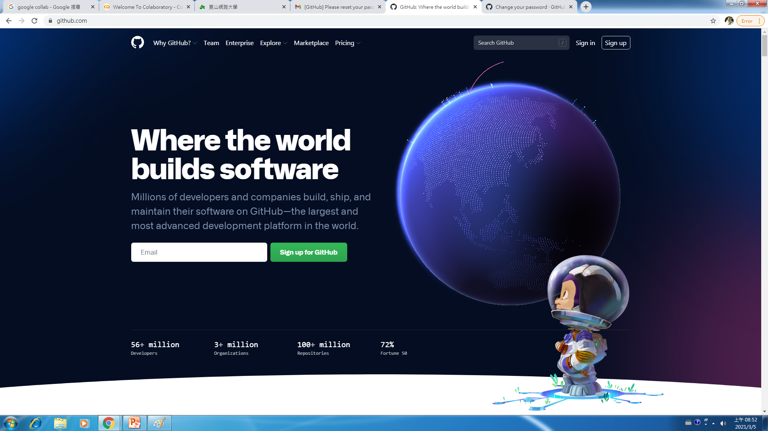

Slide 6
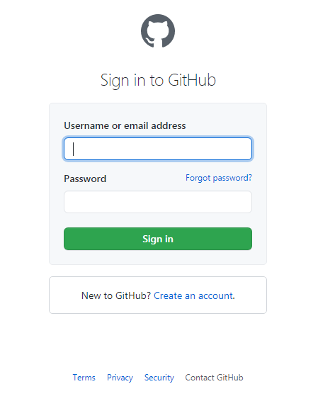
Login Github

Slide 7
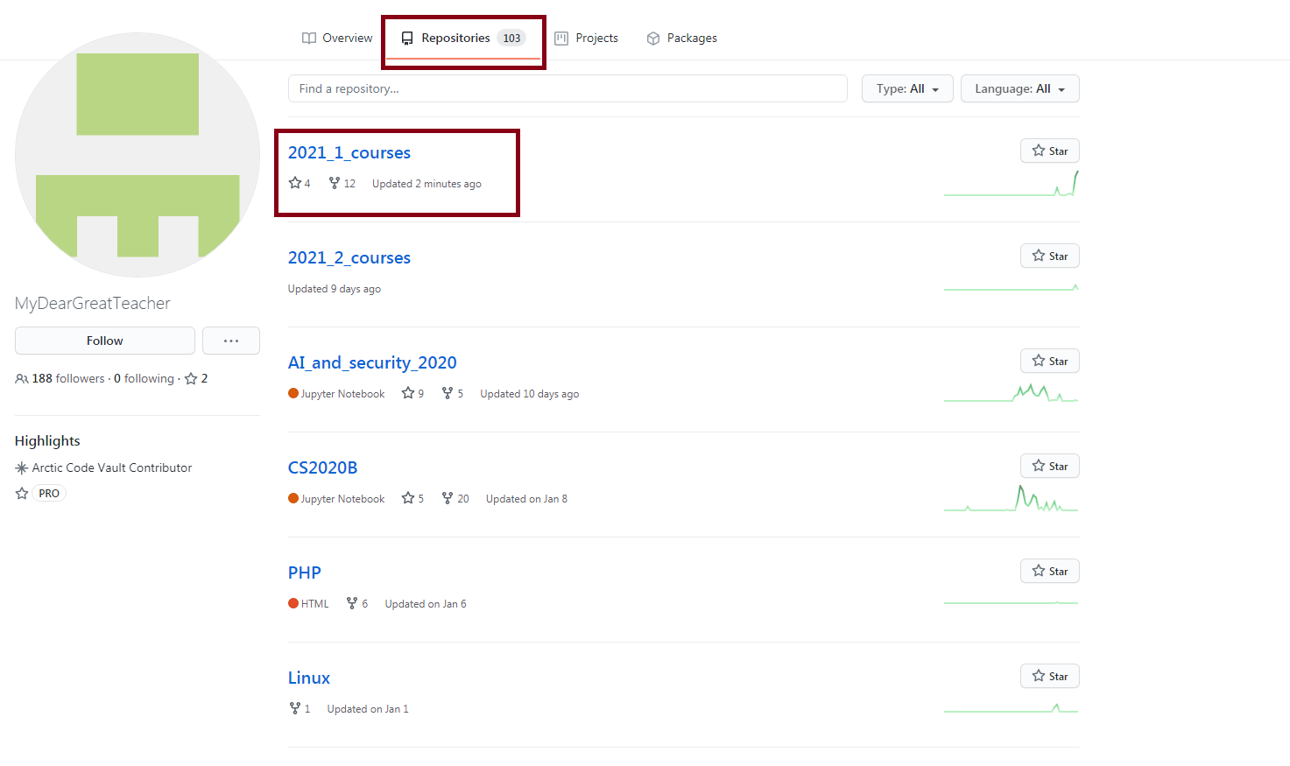
Go To https://github.com/MyDearGreatTeacher

Slide 8
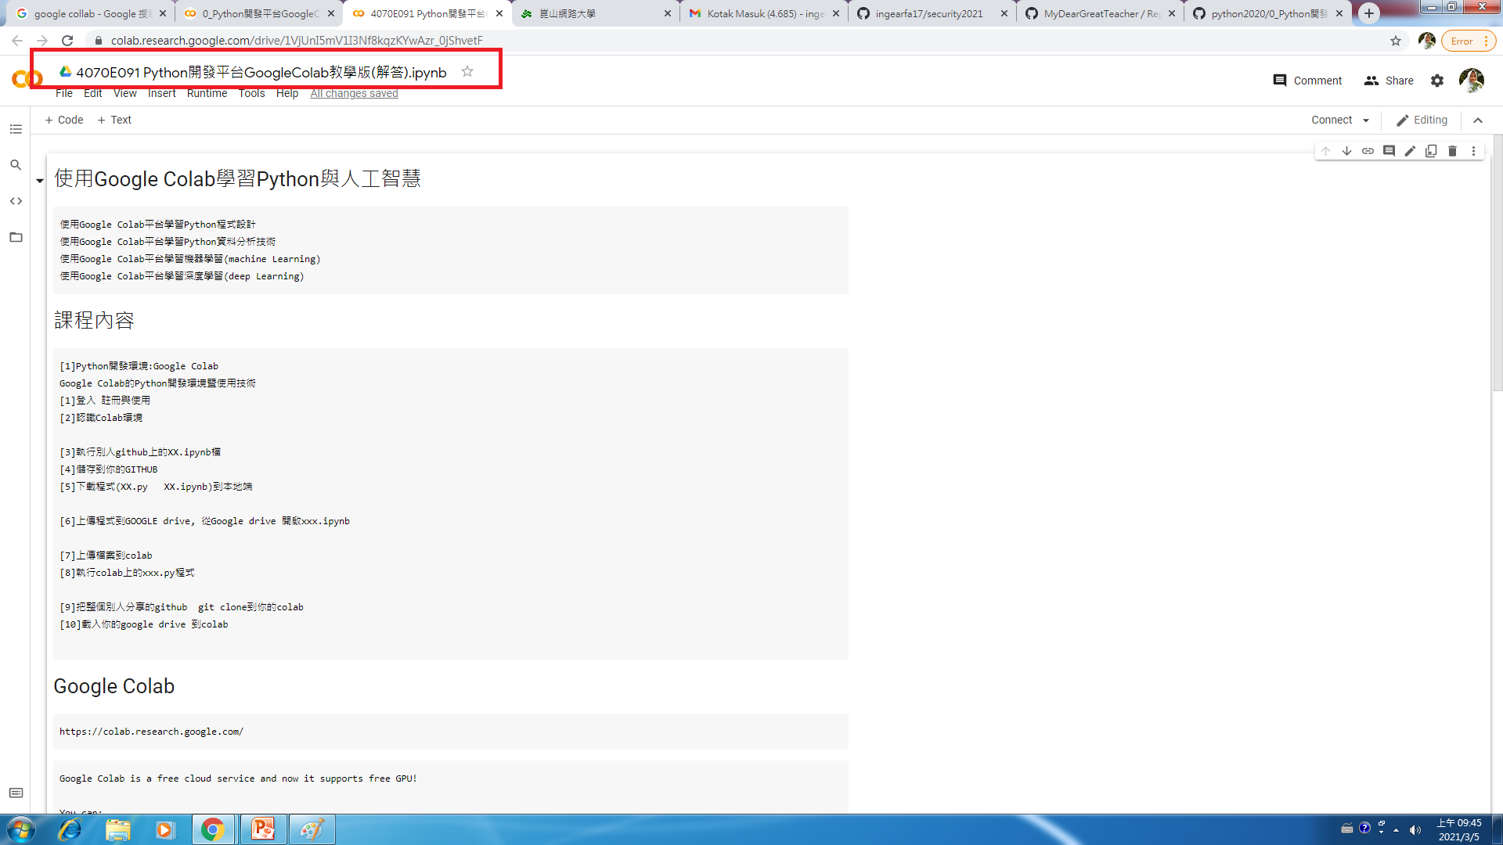

Slide 9
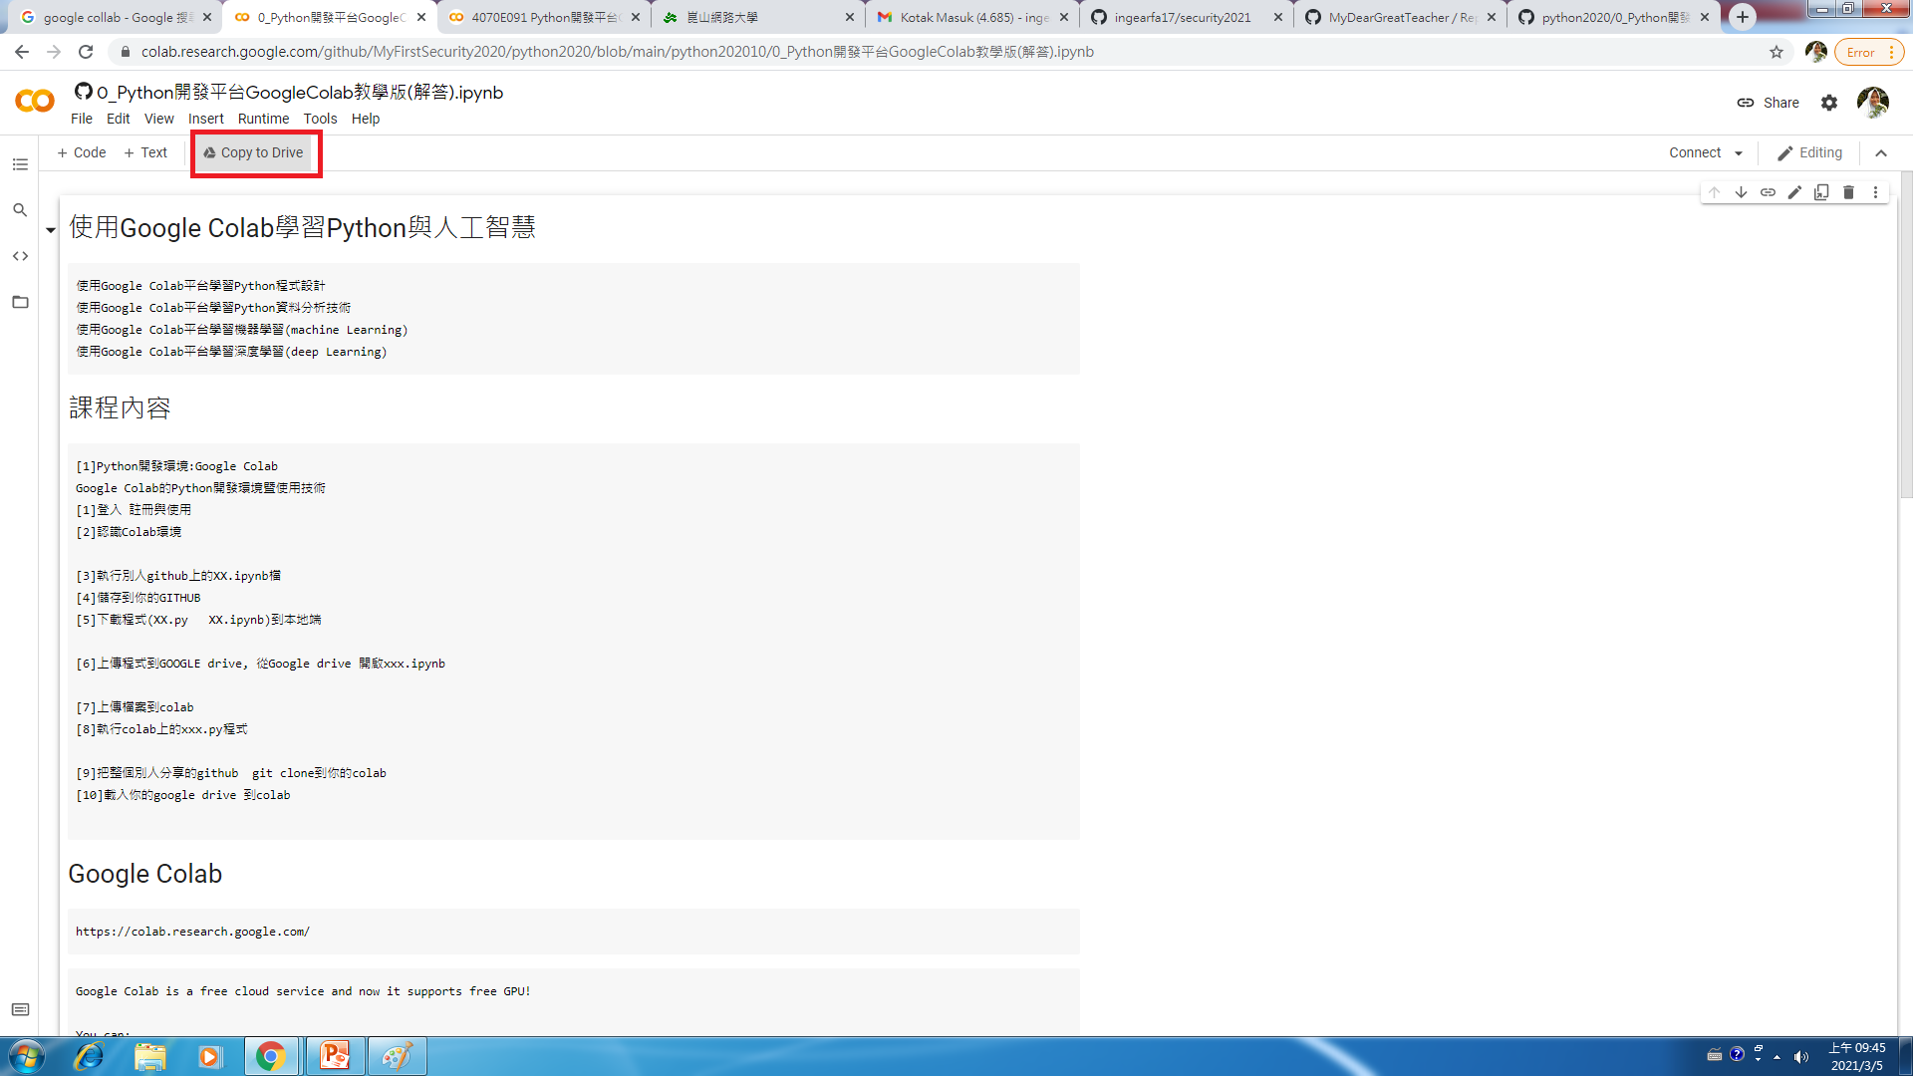

Slide 10
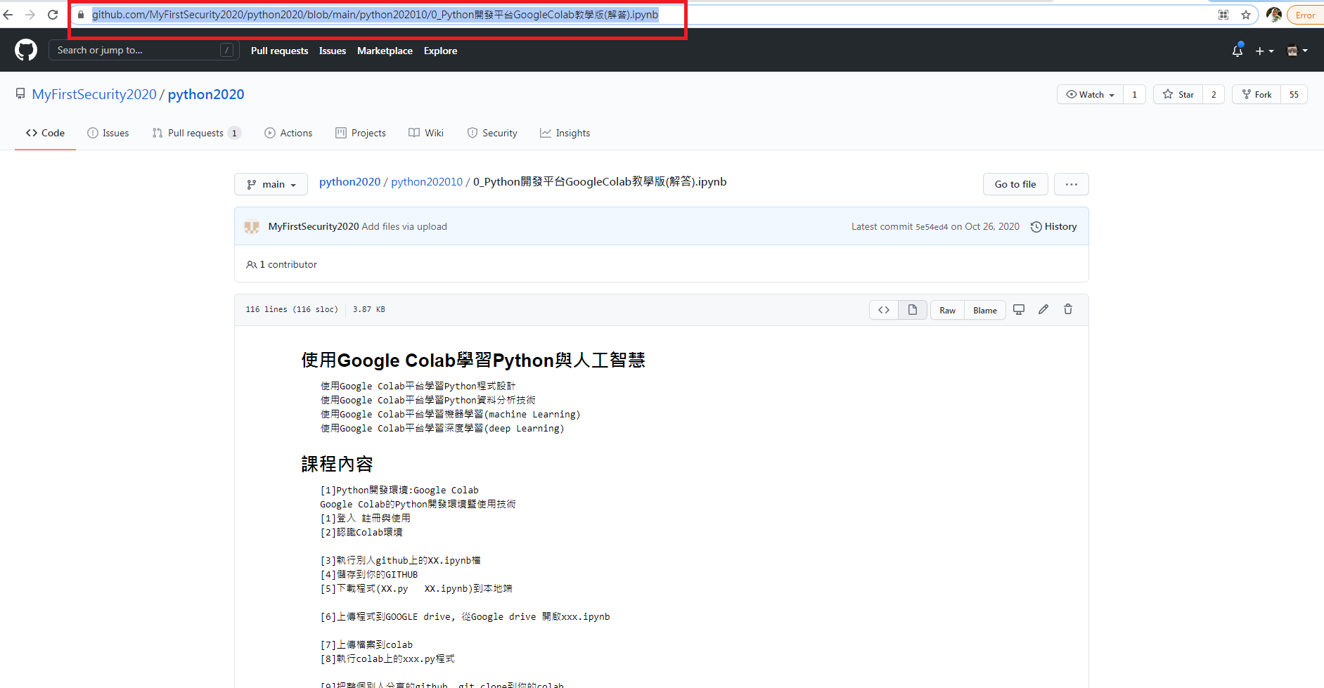

Slide 11
