Slide 1
Artificial Neural Network For Diabetes Predictions
Bassole Cedric Francois/Bouchaala Mohamed

Slide 2
Table of contents
01
02
Purpose
Methodology
03
04
Results & Analysis
Conclusions

Slide 3
Purpose statement
01

Slide 4
415 millions
Persons are affected by diabetes in the world.

Slide 5
Purpose statement
Python
Diagnostic diabete earlier
Using a Supervised learning alghorithm and Web Interface

Slide 6
Methodology
02

Slide 7
Procces
- Define measurable and quantifiable goals
- Use this stage to learn about the problem
Define Objectives
Data Preparation
Model Building
Model Deployment
Model Evaluation
- Normalization
- Transformation
- Missing Values
- Outliers
Study models accuracy
Do the results make sense in the context of the problem
- Data Splitting
Features Engineering
Estimating Performance
Evaluation and Model Selection
7

Slide 8
Methodology
Data preparation
Adapt the dataset
Split the datset into training and test set
Build the Convolutional
Import the sequential
Pick activation functionAdd Layers
Dataset
Compile and train the model
Chose a Loss function according to the outcome
Chose an optimiser and f
Evaluate the model
Get accuracy and plot confusion Matrix

Slide 9
Tools
1
2
3
Current situation
Scikit-Learn
Keras
Pandas
In order to run through this Project, We have installed Python, setup
notebook,and create a virtual environnement,and install all these packages:
-Define a network
-Compile a network
-Fit a network
-Evaluate and make predictions
-Data cleansing
-Data fill
-Data normalisation
-Data inspection
-Data visualisation
Predictive Data Analysis
Python libraries

Slide 10
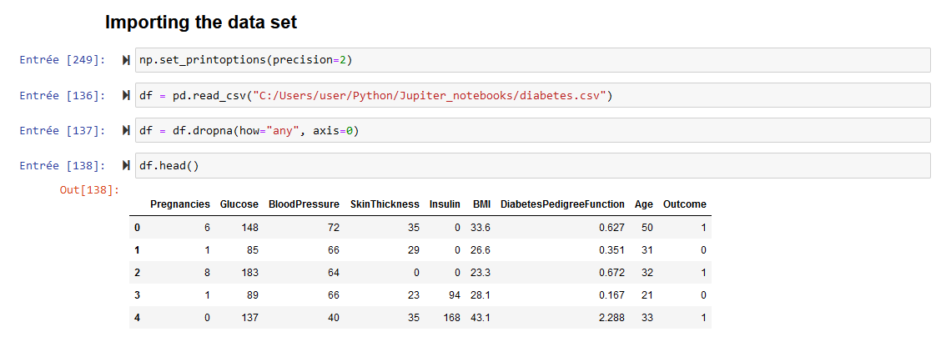
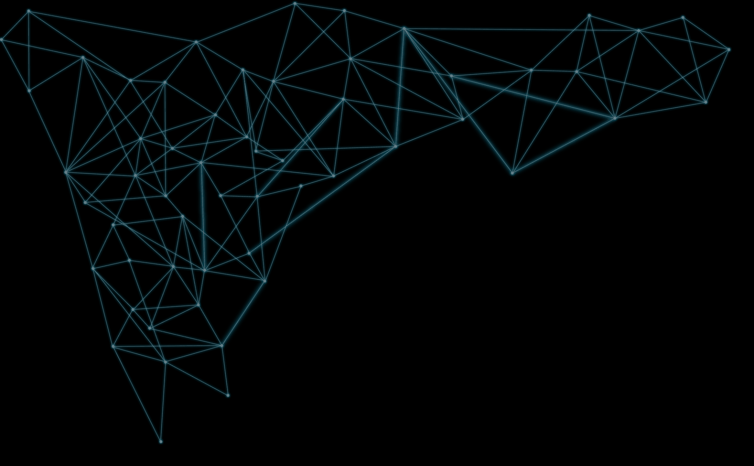
First, we use this data set from Kaggle which tracks diabetes in Pima Native Americans. We use it to build a predictive model of how likely someone is to get or have diabetes given their age, body mass index, glucose and insulin levels, skin thickness, etc.

Slide 11
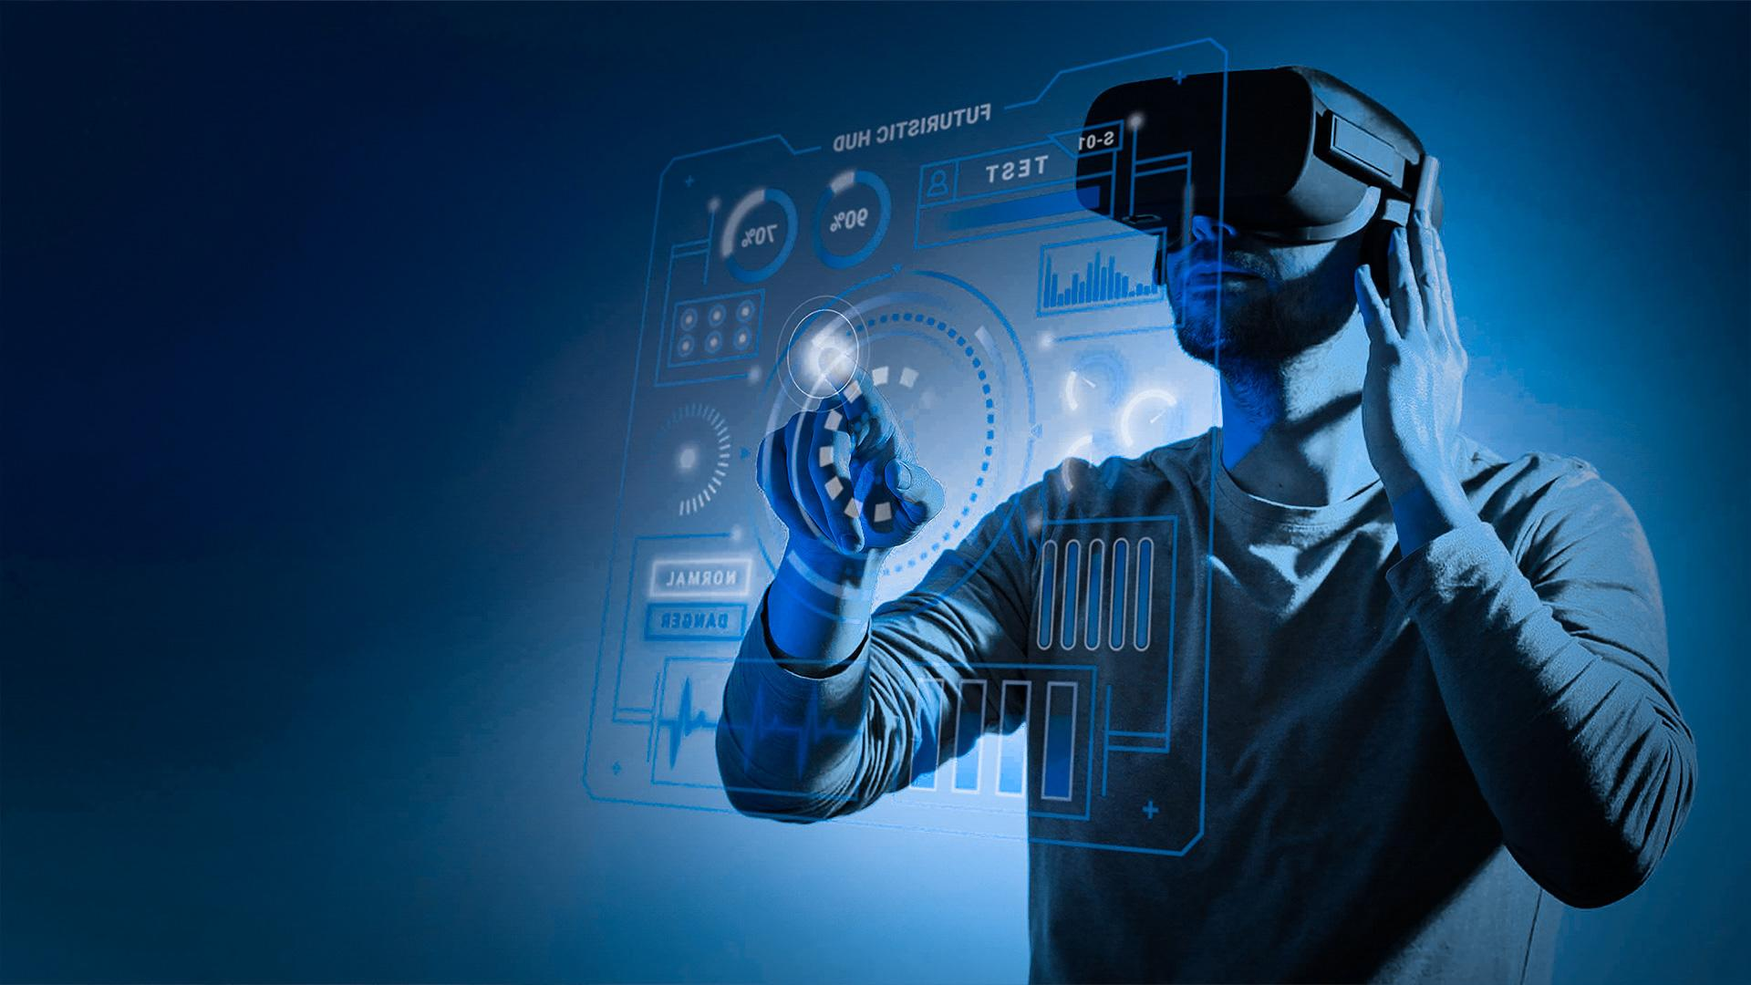
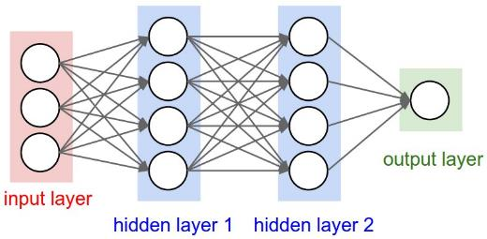
The first argument in the Dense function is the number of hidden units, a pa- rameter that you can adjust to improve the accuracy of the model

Slide 12
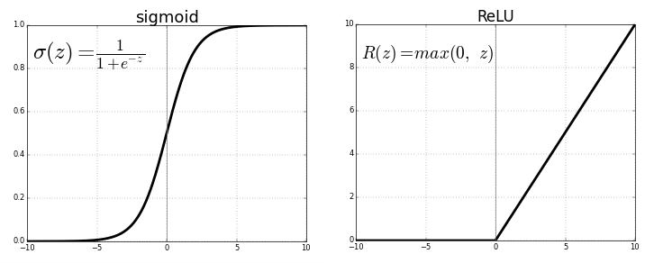
For the first two layers we use a relu (rectified linear unit) activation function. That choice means nothing, as you could have picked sigmoid. reluI is 1 for all positive values and 0 for all negative

Slide 13
Model Parameters
• Loss:
Optimizer-adam:
Epoch
he goal of the neural network is to minimize the loss function, There are many functions we can use. We pick binary-crossentropy because our label data is binary (1) diabetic and (0) not diabetic.
use the optimizer function adam, Adaptative mo-
ment estimation. It’s an algorithm designed to minimize the loss function in the
quickest way possible.
means how many times to run the model. it is an iterative process.
You could add additional epochs, but the accuracy might not change much.

Slide 14
03
Results & Analysis

Slide 15
Precision
75%
85%
Traning
Testing

Slide 16
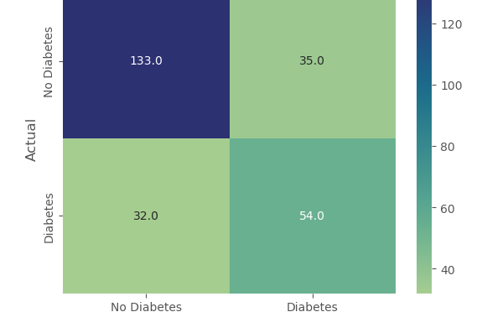
Confusion Matrix
Do you know what helps you make your point clear? Lists like this one: Total in dataframe(Diabetes)=86 - wrong prediction=32
Total in dataframe(No Diabetes)=168 - wrong prediction=35

Slide 17
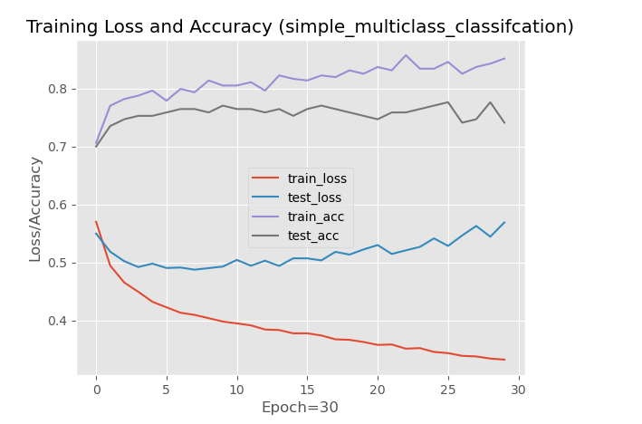
Analysis of the results
The accuracy
you can see that the model can not be trainedanymore as the trend for accuracy on both datasets not risin
The loss
you can see that the model has comparable perfor-mance on both train and validation datasets
Follow the link in the graph to modify its data and then paste the new one here. For more info, click here

Slide 18
Limitations
This dataset only has eight categories
A carrefull approach can permit us to say the number of (1) out-comes are thery low
The amout of Data collected is not voluptuous,The accuracy May seem to be Low rn in comparaison to orther machine learning alogorithm,But if a More Large Dataset became available for this purpose the accuracy will be increased for sure

Slide 19
Conclusions
04

Slide 20
Conclusions
There are several advantages to using neural networks for classificationtasks
1.They are able to learn complex relationships between the input features and the target class. 2.They are able to handle large amounts of data. 3.They can learn from unstructured data. 4.They are flexible and adaptable. 5.They can be trained to perform well on a wide range of classification tasks.

