Slide 1
Protein Estimation by Lowry’s Method

Slide 2
Points to discuss
Discuss the aim of the experiment (detailing why protein estimation is necessary) and the chemical reactions given in the manual.
Photometry (colorimeter and spectrophotometer)
Beer Lambert’s Law (Theory and formula)
General Information about Proteins
Amino acids
Classification
Peptide bonds
Importance of Lowry’s Method
Chemical reactions involved
Applications of protein estimation
Application of photometry(disease diagnosis, enzyme analysis, microflora study)

Slide 3
General Information about Proteins
One of the biomolecules
made up of hundreds or thousands of smaller units called amino acids
There are 20 different types of amino acids(Standard Amino acid) that can be combined to make a protein
The sequence of amino acids determines each protein’s unique 3-dimensional structure and its specific function.
The sequence of amino acid residues in a protein is defined by the sequence of a gene, which is encoded in the genetic code.
Functions of proteins
catalyze metabolic reactions
Act as transporting molecules
Structural component

Slide 4
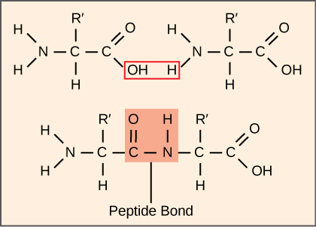
Peptide bond (amide bond)
covalent chemical bond linking two consecutive amino acid monomers along
synthesized when the carboxyl group of one amino acid molecule reacts with the amino group of the other amino acid molecule, causing the release of a molecule of water (Condensation reaction)
A linear chain of amino acid residues linked via peptide bond is called a polypeptide

Slide 5
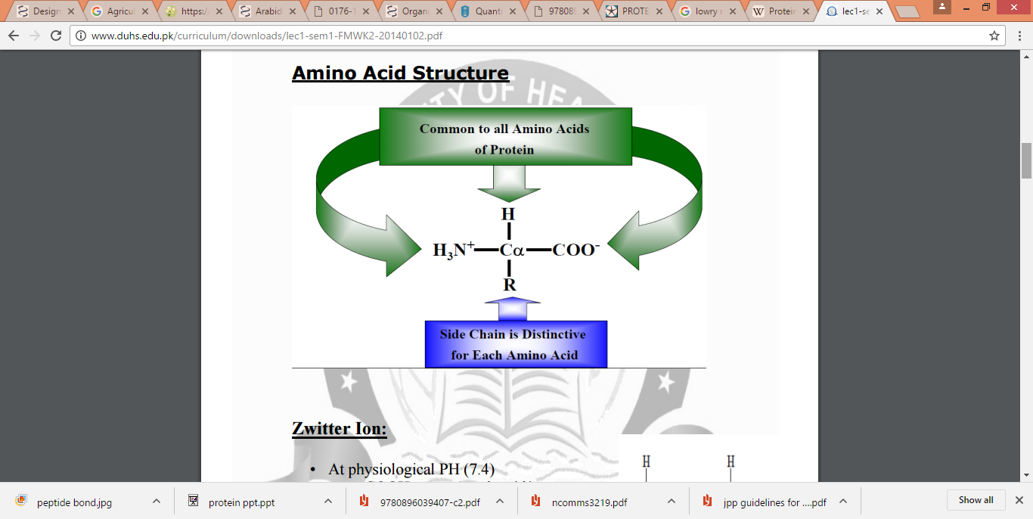

Slide 6
Classification of amino acids
Non-Polar amino acids
Glycine, Alanine, Valine, Leucine, Isoleucine, Proline, Methionine
2. Polar Amino acids
Serine, Threonine, Cysteine, Asparagine, Glutamine
3. Aromatic Amino Acids
Tyrosine, Tryptophan, Phenyl Alanine
4. Charged Amino Acid
-vely charged
Aspartate, Glutamate
+vely charged
Histidine, Lysine, Arginine

Slide 7
Importance of Lowry’s Method
Various methods are also used
Biuret Method
BCA (Bicinchoninic acid assay )
Bradford
Lowry’s method is widely used because of its Sensitivity and Specificity
Effective at protein concentration between 0.01-1mg/ml

Slide 8
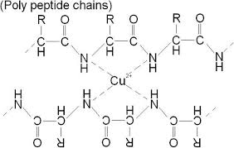
Chemical reactions
1] Biuret reaction
Copper reduced and electron released
Alkali conditions
The reaction of the cupric ions with the nitrogen atoms involved in peptide bonds leads to the displacement of the peptide hydrogen atoms under the alkaline conditions. A tri or tetra dentate chelation with the peptide nitrogen produces the "biuret" color(Blue-purple color)

Slide 9
2] Lowry’s reaction
Cu⁺ formed during the biuret reaction reacts further with Folin’s , leading to a deeper color
Folin’s reagent is reduced to poly molybdenum (blue color)
Protein –Cu+ complex(Biuret complex )+ Folin’s reagent
Blue color depends partly on the tyrosine and tryptophan
Polymolybdenum
(Deep blue)

Slide 10
Procedure
Make Dilutions of Standard BSA(200ug/ml) viz. 50ug/ml,100ug/ml,150ug/ml,200ug/ml
Make upto 1 ml with Distilled water
Simultaneously run Blank and Test(unknown)
Add reagent C (freshly prepared), Wait for 10 min
Add Folin’s reagent, wait for 20 min
Plot a standard curve for absorbance at 740 nm against BSA concentration (μg/ml)(filter no. 4)
From the standard curve obtain the concentration of unknown sample
Bovine Serum Albumin (BSA) as a standard protein, because of its easy availability and low cost with improved purity.

