Slide 1
To study the phenomenon of plasmolysis using onion peel

Slide 2
Topics to be covered…..
• Distinguish between diffusion and osmosis.
• Describe the effects of hypertonic, isotonic, and hypotonic solutions on animal and plant cells.
• Explain how the presence of a cell wall affects osmotic behaviour of plant cells.
Significance of plasmolysis

Slide 3
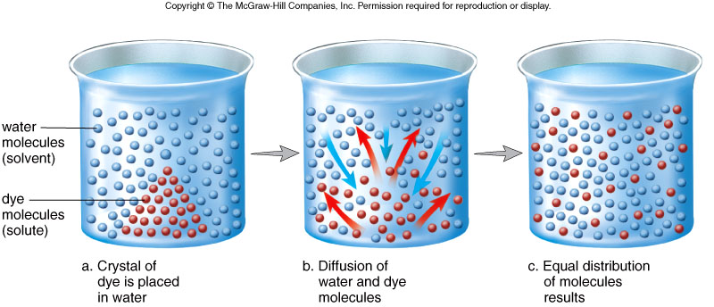
Diffusion
Diffusion is a process by which molecules move from an area of higher concentration to lower concentration

Slide 4
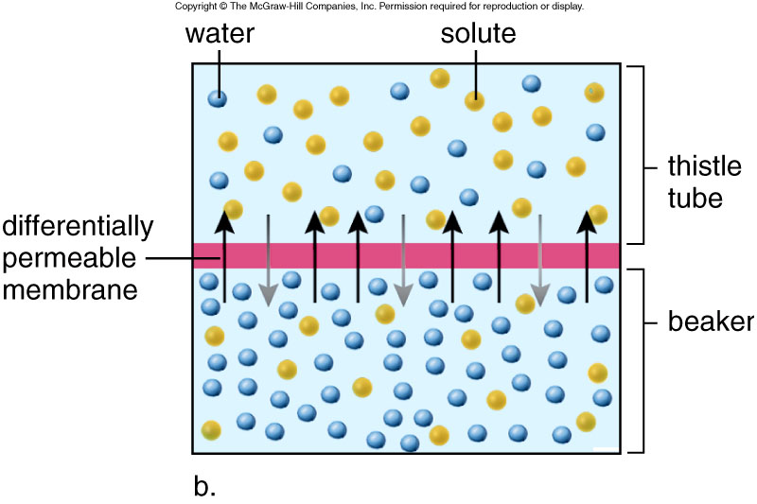
Osmosis
Osmosis is the diffusion of water across a selectively permeable membrane
Think of it as a “special case” of diffusion... the diffusion of water

Slide 5
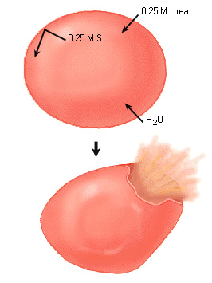
Hypotonic Solution
The solute concentration is higher inside the cell, the water concentration is higher outside the cell.
Net movement = Water into the cell
May cause Cytolysis

Slide 6
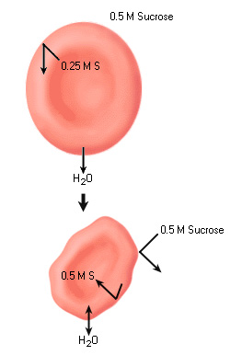
Hypertonic Solution
The solute concentration is higher outside the cell, the water concentration is higher inside the cell.
Net movement = Water out of the cell
May cause Plasmolysis

Slide 7
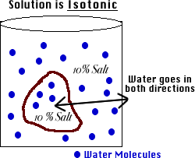
Isotonic Solution
The solute and water concentrations are EQUAL on both sides of the membrane.
Equilibrium

Slide 8
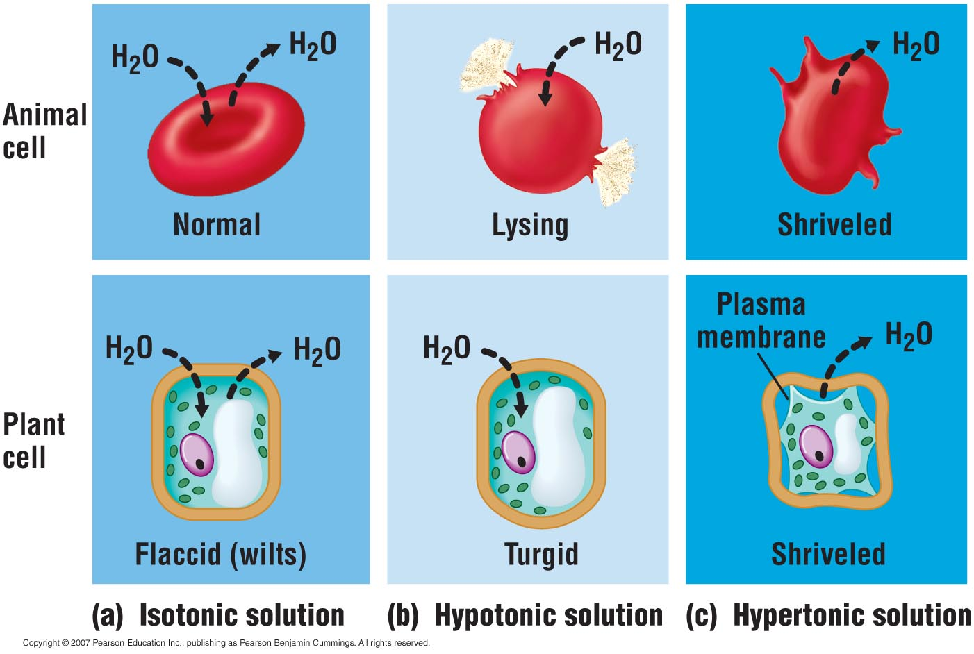
Osmosis
Study this!!

Slide 9
Terminologies
1. Protoplasm – The material comprising the inside of the cell; it is called protoplast when it separates from the cell wall through plasmolysis.
2. Turgor Pressure- When the plant cell is placed in water, it will swell but will not burst. Due to the negative osmotic potential of the cell sap, water moves into the cell and causes the plasma membrane to press against the cell wall. This pressure responsible for pressing the plasma membrane against cell wall is called turgor pressure.
Turgor pressure may also be defined as the hydrostatic pressure developed inside the cell on the cell wall due to endosmosis.
3. Wall Pressure- As a result of turgor pressure on the cell wall, the rigid cell wall exerts an equal pressure in the opposite direction called wall pressure. Under these conditions, the plant cell is said to be turgid.
When wall pressure becomes equal to turgor pressure, entry of water into the cell stops and the water potential becomes equal to that of the environment.

Slide 10
4. Deplasmolysis- if we place the plasmolysed plant cell in a hypotonic solution, water moves into the cell by osmosis and become turgid again.
5. Ctyorrhysis – Permanent and irreversible collapse of the cell wall due to too much water being lost through plasmolysis
6. Crenation- Crenation is a phenomenon which occurs when cells of animal origin are exposed to a hypertonic solution, meaning that the solution which bathes the cells has a high concentration of solutes. In crenation, the cells shrink and their shapes become distorted, often with a ruffled or scalloped edge.

Slide 11
Protocol
Label the slides as S1(10% NaCl), S2 (5%NaCl), S3 (0.9% NaCl), S4( distilled water).
We need a thin layer of cells of the red part of the onion. It is not possible to directly cut a single cell layer, so we need to use the “peeling method” to obtain a single layer of cells. Obtain a small piece of onion about (1cm x 1cm). The onion layer is about 2mm thick.
Spread the peel into each slides
Add 2drops of each solution
Observe them under microscope. Only consider those cells that are filled with the red pigment. White cells are broken and have lost the red pigment.

Slide 12
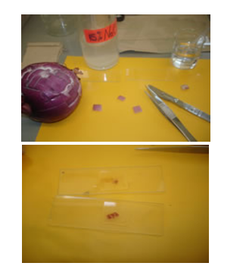
Preparing a wet-mount slide of onion cells
Prepared wet-mount slides of onion cells

Slide 13
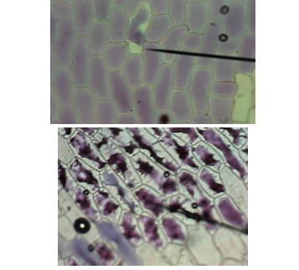
Osmotically Balanced Onion Cells under the Microscope
Osmotically Unbalanced Onion Cells under the Microscope

Slide 14
Significance of Plasmolysis
Helps to understand the living nature of a cell.
Helps to preserve meat, jellies and used in pickling as their salting kills bacteria by plasmolysis.
Used to prove permeability of cell wall and selectively permeable nature of plasma membrane.

Slide 15

Plasmolysis is a laboratory phenomenon and does not occur in nature. It is an experimental artifact.

