Slide 1
Agent based self-configuration of Wi-Fi sensor networks
Franco Minucci
2018

Slide 2
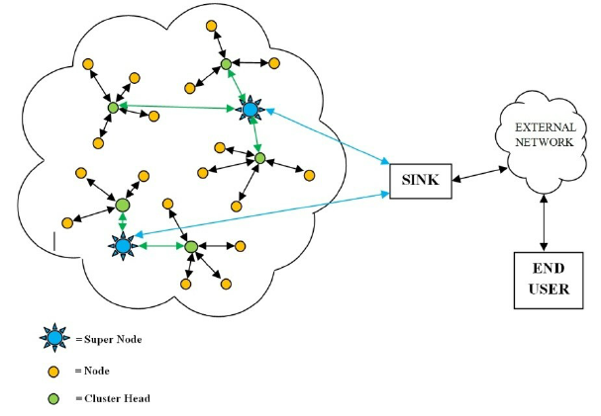
Introduction – What are we talking about?
“Wireless sensor network (WSN) refers to a group of spatially dispersed and dedicated sensors for monitoring and recording the physical conditions of the environment and organizing the collected data at a central location.” (from Wikipedia)
We are talking about:
A wireless network
Spatially dispersed nodes distributed in a large environment
Wireless communication is an essential function but it is the mean, not the purpose
Star (or tree) topology

Slide 3
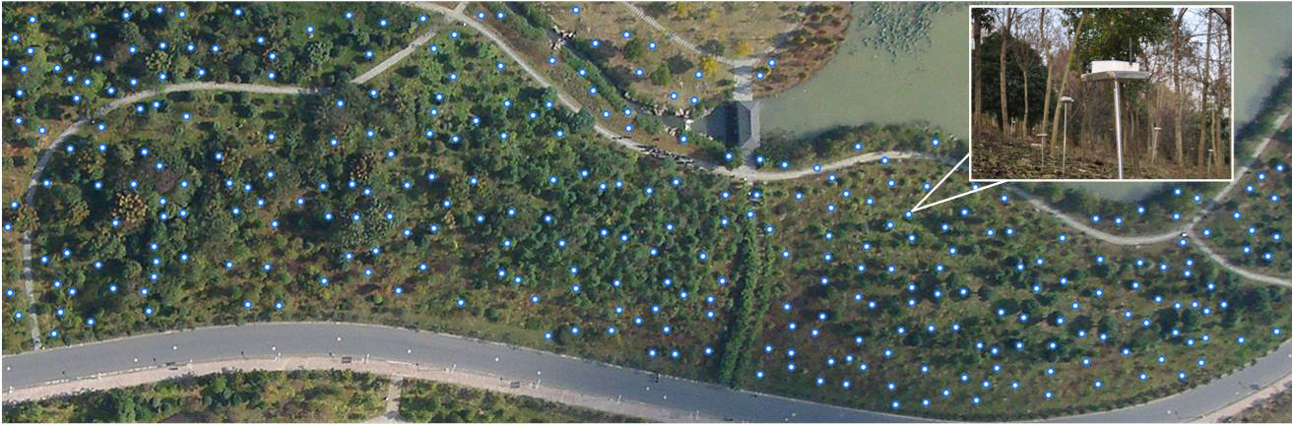

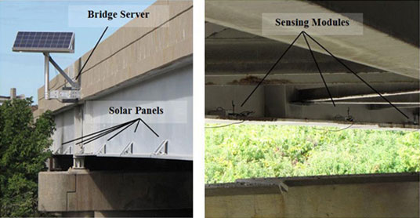
Introduction – Some WSN application example
Forest Monitoring
http://www.cs.iit.edu/~winet/projects.html
Structural monitoring
Internet of Things!
(Source: Nokia)
https://www.scsolutions.com/permanent-wireless-monitoring-system-on-the-telegraph-road-bridge-for-bridge-health-assessment/

Slide 4
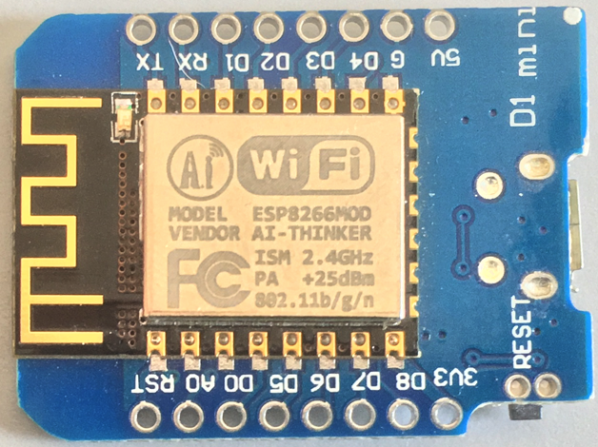
Introduction – The role of Wi-Fi
Pros:
High availability
Low cost
High bit rate
Cons:
Complex static configuration
No self healing
High power
Limited connectivity*
*Only a limited amount of nodes (typically 5 to 16) can connect to embedded each access point.

Slide 5
Research Question
Can intelligent nodes, based on hybrid agents, address the weakness of standard Wi-Fi?
Self-configuration / Self-recovery
Reduce the impact of spatial dispersion / visibility
Eliminate the effect connection limits

Slide 6
Goals and constraints
Low Energy consumption => Sensor nodes are battery powered
Good connectivity => Possibly there should always be a path between 2 nodes
Self-configuration / Self-recovery => Nodes can spawn or die

Slide 7
Assumptions
All the nodes have the same capability:
station
access point
both at the same time
Stations can connect only to a single access point
Access Point nodes can broadcast messages to all stations in range

Slide 8
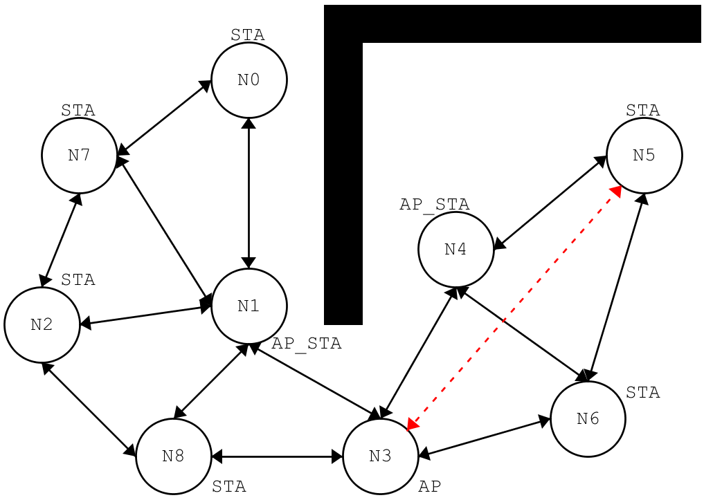
Example Scenario
Walls obstructs visibility (N1 and N4)
Visibility is limited by distance (N3 and N5)

Slide 9
Software Implementation – Main function
The main program is responsible for:
I/O operations
Keeping track of time
Running the simulation
The run method of each AgentNode is executed at every cycle in random order.
When the battery of an AgentNode is empty it “dies” and gets removed from the grid
When there are no agent left, the program ends.

Slide 10
Software implementation – AgentNode, World
AgentNode
World
AgentNode contains all the agent logic and behavior
World contains all the simulation status including:
Number of nodes
Number of walls
Position of each node in the global grid

Slide 11
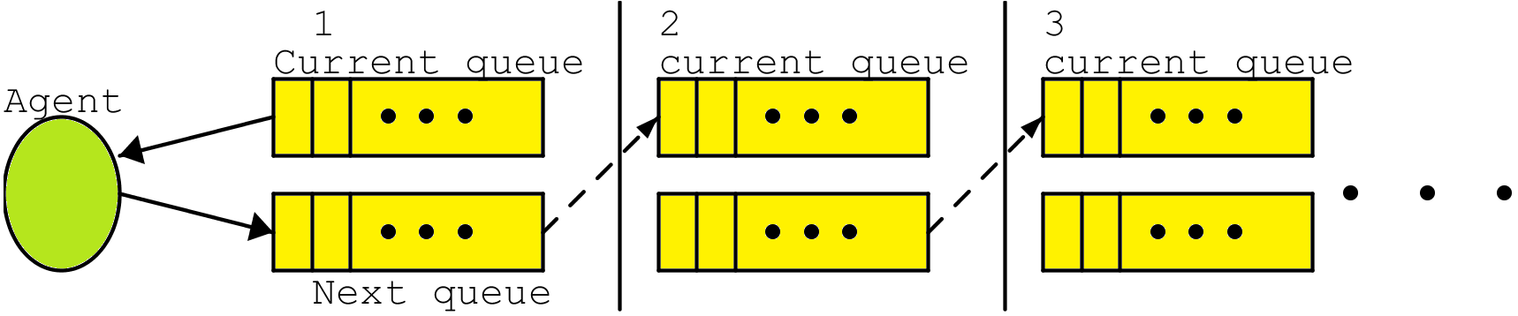
Event queues
Events (such as packet transmissions) are saved into a queue.
Each agent gets in input the current queue and writes in the next queue.
At the end of each iteration:
oldest queue discarded
new queue becomes the current one (think about double buffering in computer graphics).

Slide 12
Agent architecture
AgentNode has two behavioral components:
Reactive
BDI
AgentNodes communicate with each other using globally shared queues.
Meant to take care of simple task that do not require
“much intelligence”
Meant to perform the more complicated tasks

Slide 13
AP Selection strategies
Four different connection strategies:
“closest” => Connect to the closest access point
“random” => Select a random access point from the visible AP list
“bidding” => All access points put a random number in the SSID and the stations connect to the highest one
“sorted” => The list of visible APs is sorted using the address as key. Stations try to connect to the last one of the queue.
When a strategy fails, each node tries to use the next one

Slide 14
World Map and Visibility
The world is modeled as a 2D grid
Each cell can be empty or contain a node or an obstacle
Visibility is computed using breadth-first search:
visibility threshold is the maximum amount of steps for communication

Slide 15
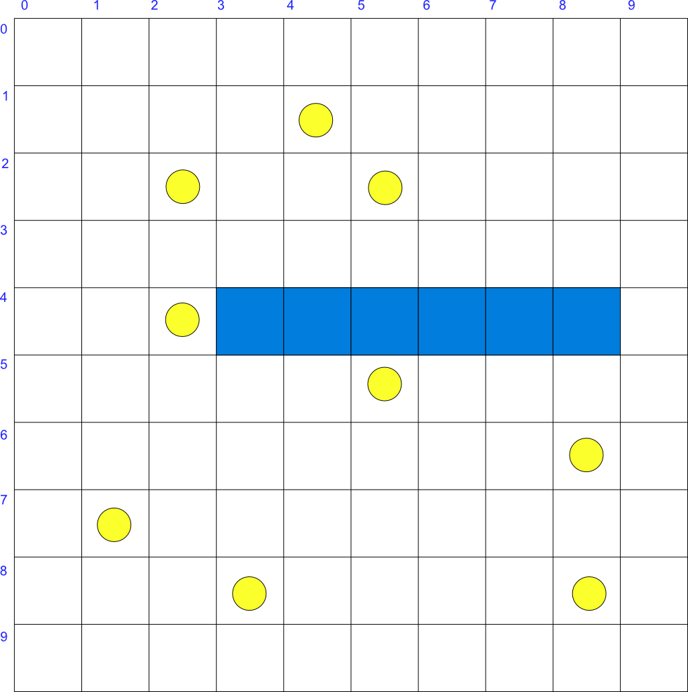
Results – Configurations
World parameters:
{world: width= 10, height= 10, v_threshold= 6}
Agents parameters:
{agent: mac= 1, x= 2, y= 2}
{agent: mac= 2, x= 5, y= 5}
{agent: mac= 3, x= 8, y= 6}
{agent: mac= 4, x= 1, y= 7}
{agent: mac= 5, x= 3, y= 8}
{agent: mac= 6, x= 4, y= 1}
{agent: mac= 7, x= 8, y= 8}
{agent: mac= 8, x= 5, y= 2}
{agent: mac= 9, x= 2, y= 4}
{agent: mac= 10, x= 0, y= 5}
{agent: mac= 11, x= 0, y= 3}
{agent: mac= 12, x= 9, y= 3}
{agent: mac= 13, x= 5, y= 7}
{agent: mac= 14, x= 3, y= 6}
Walls:
{wall: x= 3, y= 4}
{wall: x= 4, y= 4}
{wall: x= 5, y= 4}
{wall: x= 6, y= 4}
{wall: x= 7, y= 4}
{wall: x= 8, y= 4}
Configurations are described in .cfg files
10 configurations have been used but many more are possible
Only the most representative data are shown in this presentation, raw results are available
Lifetime is defined as the last timestamp at which a node was active

Slide 16
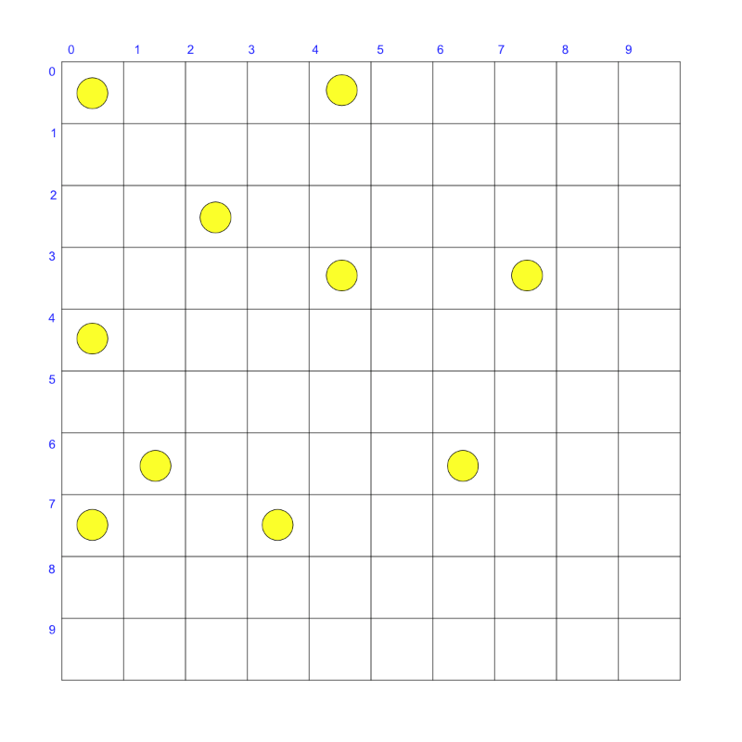
Results – Power consumption example
Configuration 2

Slide 17
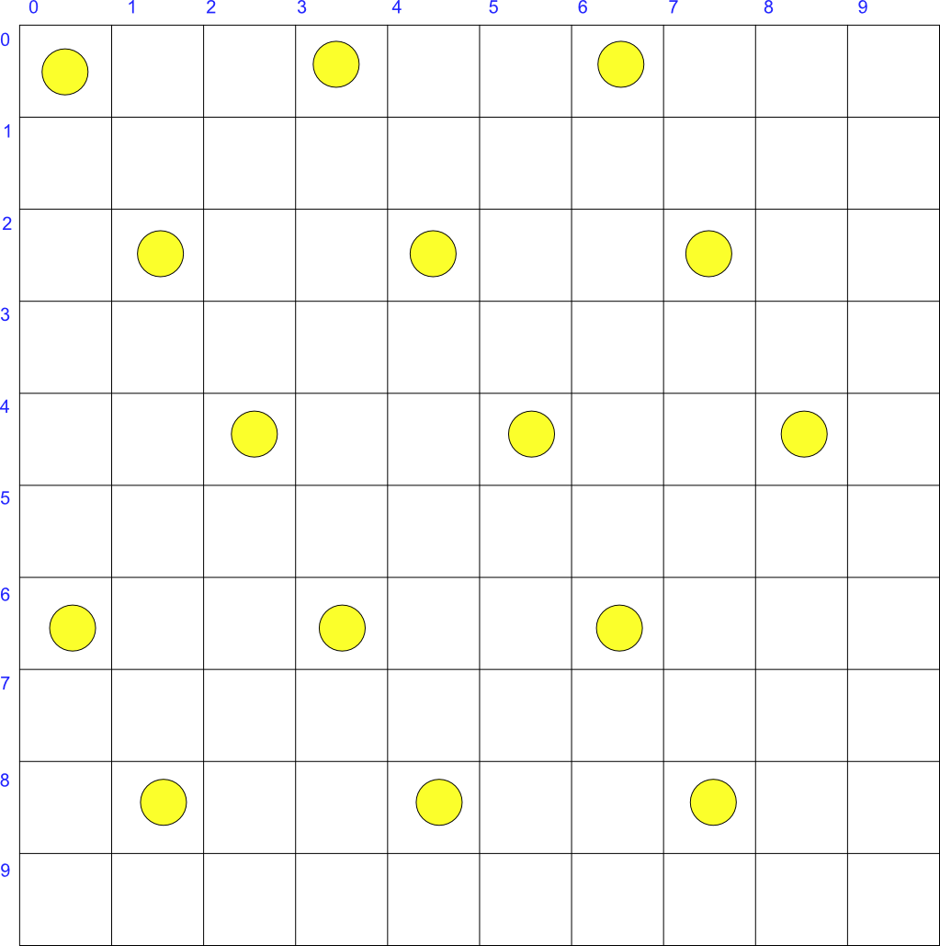
Results – Lifetime vs Visibility

Slide 18
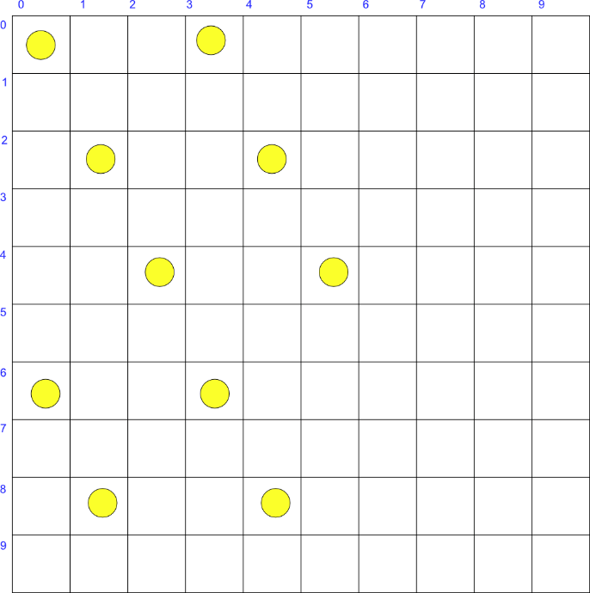

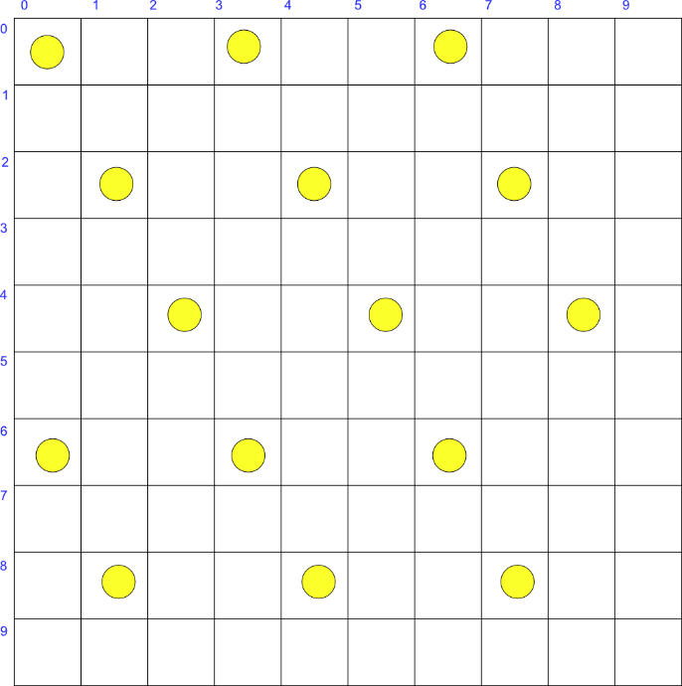
Results – Lifetime vs Number of nodes
Config 8
Config 9
Config 5

Slide 19
Conclusions
The system does not always converge to a configuration that guarantees full network connectivity
Access point nodes consume more power because they transmit more messages.
Power consumption increases with the number of nodes (keeping the visibility constant)
Visibility affects the ability of the system to generate e fully connected network and so power consumption
Higher visibility implies less access point nodes and so less power consumption

Slide 20
Future Work
Add propagation models
Add mobility effects
3D
Improve power consumption model
Improve the behavior function by implementing more complicated coordination
Add functionality like RSSI based collaborative localization
Try on real devices (ESP8266, CC3220, etc…)

Slide 21
Reference
“A Simple-to-Use BDI Architecture for Agent Modeling and Simulation”, P. Caillou, B. Gaudou, A. Grignard, C. Quang Truong, P. Taillandier – Advances in Social Simulation 2015
“Plans and Resource-Bounded Practical Reasoning”, M.E. Bratman, D.J. Israel, M.E. Pollack – Computational Intelligence,4; 1988
“BDI Agents: From Theory to Practice”, A.S. Rao, M.P. Georgeff – Procedings of the First International Conference on Multi-Agent Systems, 1995
“Cognitive Radio Networking and Communications: An Overview” Y.C. Liang, K.C. Chen, G. Ye Li, P. Mähönen – IEEE Transactions on Vehicular Technology
“Consensus and Cooperation in Networked Multi-Agent Systems”, R. Olfati-Saber, J.A. Fax, R.M. Murray – Proceedings of the IEEE, 2007
“Cognitive Networks: Adaptation and Learning to Achieve End-to-End Performance Objectives”, R.W. Thomas, D.H. Friend, L.A. Da Silva, A.B. MacKenzie – IEEE Communications Magazine
“Trends in the development of communication networks: Cognitive networks”, C. Fortuna, M. Mohorcic – Computer Networks, 2009
“An Introduction to Multi Agent Systems”, M. Wooldridge, Wiley 2009
“Agent Architecture: An Overview”, K.O. Chin, K.S. Gan, R. Alfred, P. Anthony, D. Lukose – Transactions on Science and Technology, 2014
“WLAN-Opp: Ad-hoc-less opportunistic networking on smartphones”, S. Trifunovic, M. Kurant, A. Hummel, F. Legendre – Ad Hoc Networks, Elsevier, vol.25, 2015
“Delegate MAS Patterns for Large-Scale Distributed Coordination and Control Applications”, T. Holveot, D. Weyns, P. Valckenaers - Proceedings of the 15th European Conference on Pattern Languages of Programs
“Agent Technologies for Sensor Networks”, A. Rogers, N.R. Jennings, D.D. Corkill – IEEE Intelligeng Systems, issue 02, vol 24, 2009

Slide 22

Thanks!

