Slide 1
Access points self-configuration in embedded Wi-Fi sensor networks
Franco Minucci
2018

Slide 2
1 Objectives
Given a wireless sensor network made of embedded Wi-Fi modules with limited capabilities and energy availability, the objective is to study a multi agent system that:
Autonomously decides the optimal number of Access Point nodes
The distribution of Access point nodes
According to the following metrics:
Energy consumption
Full connectivity
Self-recovery
The network configuration must follow a plan to achieve the best performance and adapt it depending on the environment state.

Slide 3
2 Research Questions
Can the nodes autonomously build a fully connected network?
Which kind of information do they need?
Which protocol do they need to follow?
Can the nodes build an energy-optimal network configuration?
How does visibility affect power consumption?
How does the number of nodes affect power consumption?
How does the system react to death of nodes?

Slide 4
3 Hypotheses
The nodes can build a fully connected network:
Stations need to know the visible access points and decide which one to pick
Access points need to know if they need to be a station of one another and if they can turn off the AP behavior (and become simple stations to save energy)
Nodes can chose a network topology such that the total battery life is maximized
Only local information is needed (visible nodes)
The geographical distribution plays a role
If a station dies, the other stations are not impacted; if an access point dies, the stations previously attached to it try to find a different arrangement without affecting the rest of the network

Slide 5
Constraints
Nodes can only form networks with a star topology with access point nodes as central node of the star (the final topology will be a tree).
Each node has a limited battery life and each operation consumes some battery power
Stations can only communicate between them through an access point. Access Points behave as routers.
Access points can only serve a limited amount of nodes

Slide 6
Assumptions
All the nodes have the same capability and can become stations, access point or both at the same time.
Self-containment / no gateway: the nodes can only exchange data among them but not with an external network
Each station can only connect to a single access point
Access point nodes can still scan for beacons to find other access points
Access Point nodes can send broadcast messages to all the stations visible to them

Slide 7
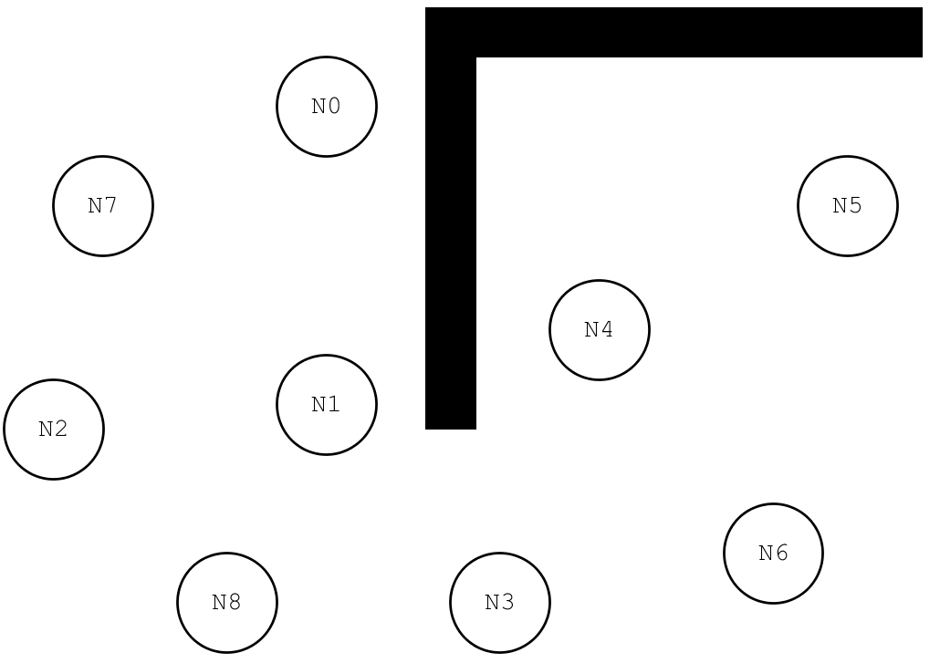
Example Scenario

Slide 8
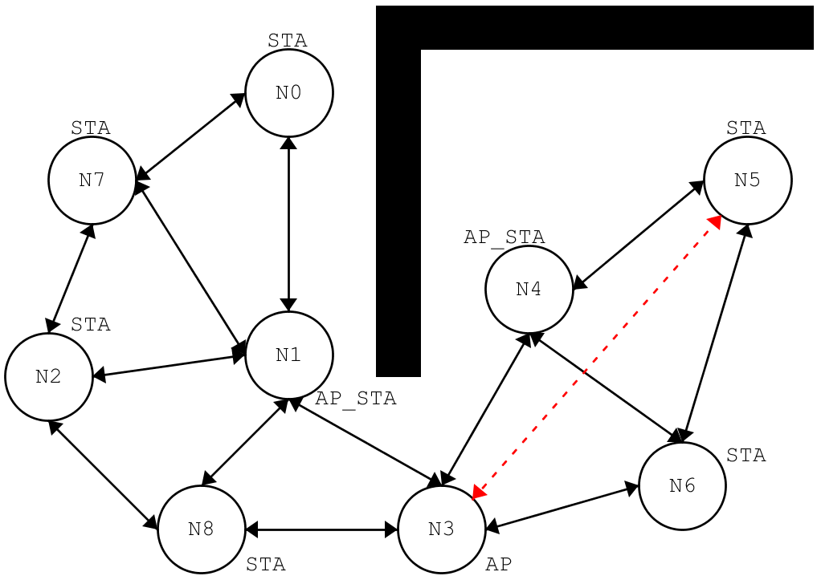
Example Scenario – possible configuration
The wall obstructs visibility between the nodes
The distance is also an obstacle for visibility (N3 and N5 are too far)

Slide 9
Software Implementation
The program is divided in 2 modules:
AgentNode
World
AgentNode contains all the agent logic and beahvior
World contains all the simulation status including:
Number of nodes
Number of walls
Position of each node in the global grid
The simulation is coordinated in the main program which is also responsible for I/O operations and keeping track of time.
At each iteration, the run method of each agent is executed.
When there are no agent left, the program ends.

Slide 10
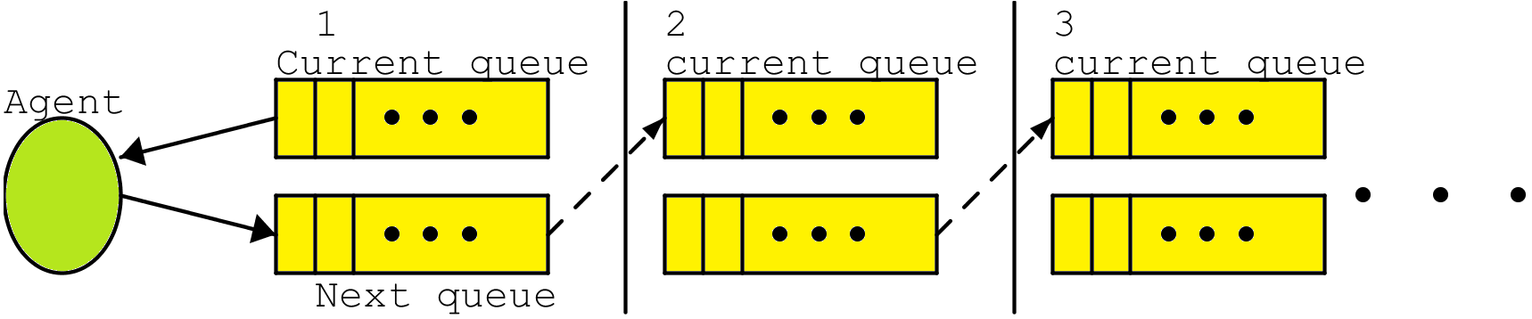
Event management
Events (such as packet transmissions) are saved into a queue.
Each agent gets in input the current state queue and writes in the next state queue.
At the end of each iteration, the oldest queue is discarded and the next state queue becomes the current one (analogous to double buffering in computer graphics).

Slide 11
Agent architectures
Each agent has two behavioral components:
Reactive
BDI
The reactive component is meant to take care of simple task that do not require “much intelligence” (e.g. reply to ping messages). It performs a preliminary “input filtering” passing to the BDI part only the necessary information.
The BDI part is meant to perform the more complicated tasks like managing connection requests, decide when to turn on or off the AP and STA states and how to select the access point to which the node wants to connect.

Slide 12
World Map and Visibility
The world is modeled as a 2D grid
Each cell can be empty or contain a node or an obstacle
Visibility is computed using breadth-first search on each node: the visibility threshold is the maximum amount of steps allowed to reach another node on the grid.

Slide 13
Results
!!!!Work in progress!!!!

Slide 14
Conclusions
At this stage, the system does not always converge to a configuration that guarantees full network connectivity
Access point nodes consume more power because they are involved in network management and traffic forwarding which means sending and receiving more packets
The more nodes you have, the more power the network consumes
Visibility affects the ability of the system to generate e fully connected network and indirectly power consumption.
Less visibility means more access point nodes

Slide 15
Future Work
Add propagation models
Add mobility effects
3D
Improve power consumption model
Add different wireless protocols (Bluetooth, Zigbee, etc…)
Add different criteria for Access point nodes selection (Power fairness for example)
Add different routing constraints

Slide 16
Reference
“A Simple-to-Use BDI Architecture for Agent Modeling and Simulation”, P. Caillou, B. Gaudou, A. Grignard, C. Quang Truong, P. Taillandier – Advances in Social Simulation 2015
“Plans and Resource-Bounded Practical Reasoning”, M.E. Bratman, D.J. Israel, M.E. Pollack – Computational Intelligence,4; 1988
“BDI Agents: From Theory to Practice”, A.S. Rao, M.P. Georgeff – Procedings of the First International Conference on Multi-Agent Systems, 1995
“Cognitive Radio Networking and Communications: An Overview” Y.C. Liang, K.C. Chen, G. Ye Li, P. Mähönen – IEEE Transactions on Vehicular Technology
“Consensus and Cooperation in Networked Multi-Agent Systems”, R. Olfati-Saber, J.A. Fax, R.M. Murray – Proceedings of the IEEE, 2007
“Cognitive Networks: Adaptation and Learning to Achieve End-to-End Performance Objectives”, R.W. Thomas, D.H. Friend, L.A. Da Silva, A.B. MacKenzie – IEEE Communications Magazine
“Trends in the development of communiation networks: Cognitive networks”, C. Fortuna, M. Mohorcic – Computer Networks, 2009
“An Introduction to MultiAgent Systems”, M. Wooldridge, Wiley 2009
“Agent Architecture: An Overview”, K.O. Chin, K.S. Gan, R. Alfred, P. Anthony, D. Lukose – Transactions on Science and Technology, 2014

Slide 17

Thanks!

