Slide 1
Access points self-configuration in embedded Wi-Fi sensor networks
Franco Minucci
2018

Slide 2
1 Objectives
Given a wireless sensor network made of embedded Wi-Fi modules with limited capabilities and energy availability, the objective is to study a multi agent system that:
Autonomously decides the optimal number of Access Point nodes
The distribution of Access point nodes
According to the following metrics:
Energy consumption
Full connectivity
Self-recovery
The network configuration must follow a plan to achieve the best performance and adapt it depending on the environment state.

Slide 3
2 Research Questions
Can the nodes build a fully connected network?
Can the nodes build an energy-optimal network configuration?
How does visibility affect power consumption?
How does the number of nodes affect power consumption?
How does the system react to death of nodes?

Slide 4
3 Hypotheses

Slide 5
Constraints
Nodes can only form networks with a star topology with access point nodes as central node of the star.
Each node has a limited battery life
Stations can only communicate between them through an access point. Access Points behave as routers.

Slide 6
Assumptions
All the nodes have the same capability and can become stations, access point or both at the same time.
All the nodes can see at least one other node
Self-containment / no gateway: the nodes can only exchange data among them but not with an external network
Each station can only connect to a single access point
Access point nodes can still scan the spectrum to find other access points
Access Point nodes can send broadcast messages to all the stations visible to them

Slide 7
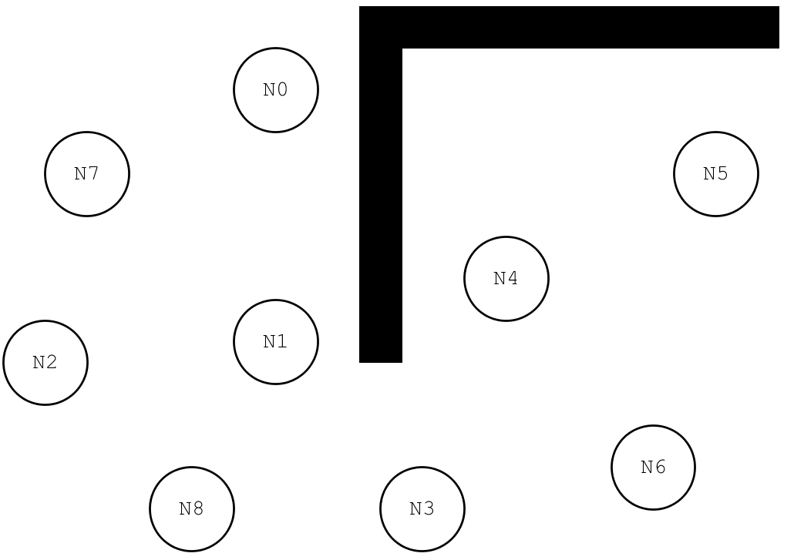
Example Scenario

Slide 8
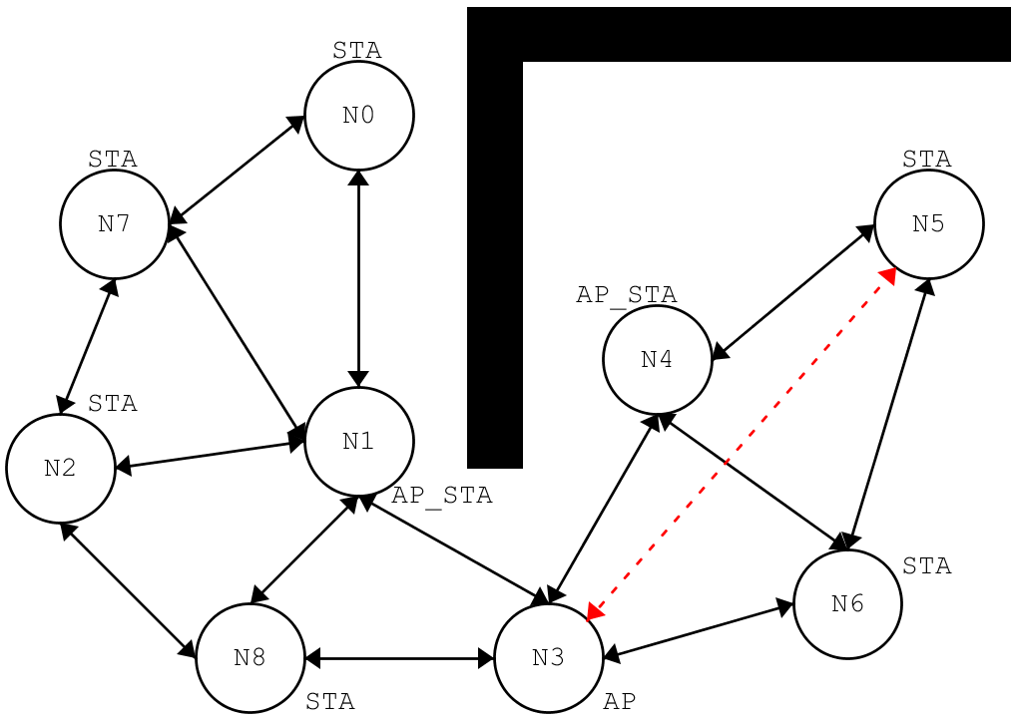
Example Scenario – possible configuration
The wall obstructs visibility between the nodes
The distance is also an obstacle for visibility (N3 and N5 are too far)

Slide 9
Software Architecture - general
AgentNode
WiFi
<<Enumeration>>
Mode
AP
STA
AP_STA
+ID
1
1..1
+SSID
-WiFi
-MACAddress
1
1..1
-PlansDB[*]
-CurrentPlan
-CurrentMode
-CurrentAP
#AssociatedNodes[*]
-BatteryLevel
-VisibleNetworks[*]
+sense()
+select_plan()
+execute()
+deliberate()
+connect(SSID)
+disconnect()
+set_mode(mode)
1..*
+scan(Nodes)
+send()
+receive()
Plan
0..*
+next()
+read(filename)
+steps()

Slide 10
Main loop

Slide 11
Software Architecture – Reactive

Slide 12
Software Architecture - BDI
Sense() is used to update the state vector:
External: visible nodes, connected/disconnected, etc…
Internal: Battery level, etc…
deliberate() is used to verify that actual state is the desired one (it basically compares desires to beliefs and generate intentions = deliberative phase)
selectPlan() is where the filtering takes process. The current plan can continue its execution or be changed if needed
Nodes can only sense the state of the current simulation step and the actions they take only affect the next step
sense()
OK
deliberate()
NOK
select_plan()
execute()

Slide 13
World Map and Visibility
The world will be modeled as a 2D grid
Each cell can contain a node or an obstacle or be empty
Visibility is computed using breadth-first search on each node: visibility threshold is the maximum amount of steps to reach another node on the grid.

Slide 14
Configuration files

Slide 15
Results files

Slide 16
Results

Slide 17
Conclusions
At this stage, the system does not always converge to a configuration that guarantees full network connectivity
Access point nodes consume more power because they are involved in network management which means sending and receiving more packets

Slide 18
Future Work

Slide 19

Thanks!

