Slide 1
Access points self-configuration in embedded Wi-Fi sensor networks
Franco Minucci
2018

Slide 2
1 Objective
Given a wireless sensor network based on embedded Wi-Fi modules with limited capabilities, the object is to study a multi agent system architecture that autonomously decides the optimal Access Point nodes number and distribution according to the following metrics:
Energy consumption
Received signal strength and hidden nodes problem
Self-recovery
Traffic management
The network configuration must follow a plan to achieve the best performance and adapt it depending on the environment state.

Slide 3
2 Research Questions
How to select an Access Point?
How each node can select if being an Access Point, a Station or both?
How does the system react to generation and death of nodes?
Can the system work with only local knowledge?
Can the network adapt locally if the environment only affects part of it?
How do the nodes cooperate to avoid conflicts? (e.g. same SSID name for more than one AP)
How does the system react to moving nodes?

Slide 4
Assumptions
The network has a star topology, with the access point as central node of the star.
All the nodes have the same capability and can become stations, access point or both at the same time.
No external technology used for communication between the nodes.
All the nodes can see at least one node belonging to the network.
Self-containment / no gateway: the nodes can only exchange data between them and not with an external network
Each access point can only serve a limited amount of nodes
Access point nodes consume 1.5x the power of stations
Hybrid nodes consume 2x the power of stations
Stations can only connect to a single access point

Slide 5
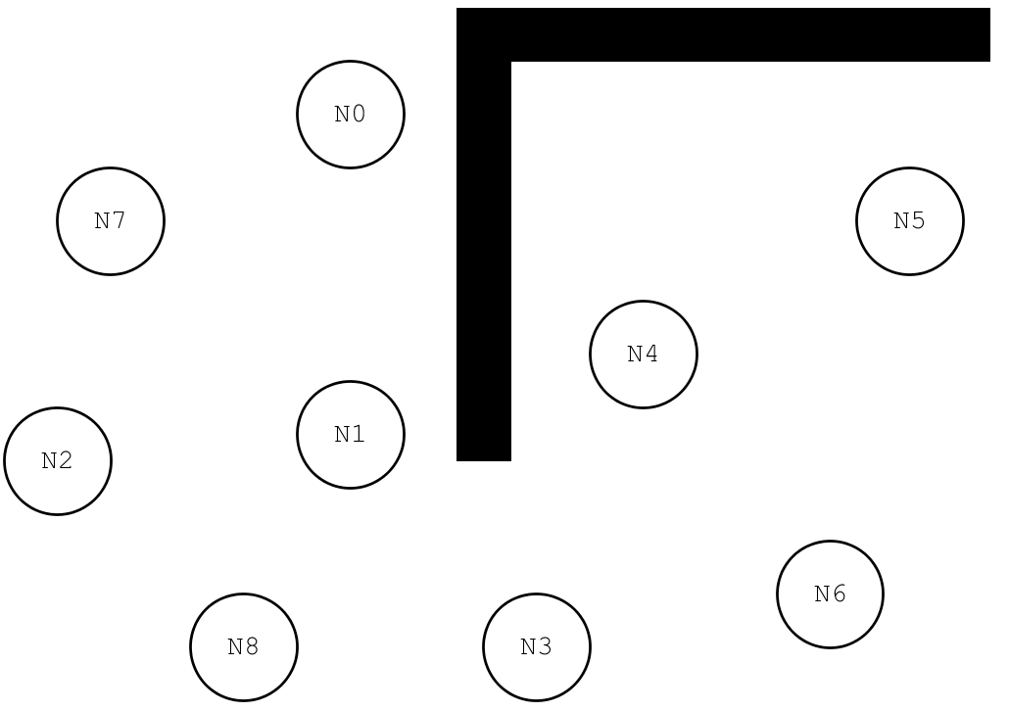
Example Scenario

Slide 6
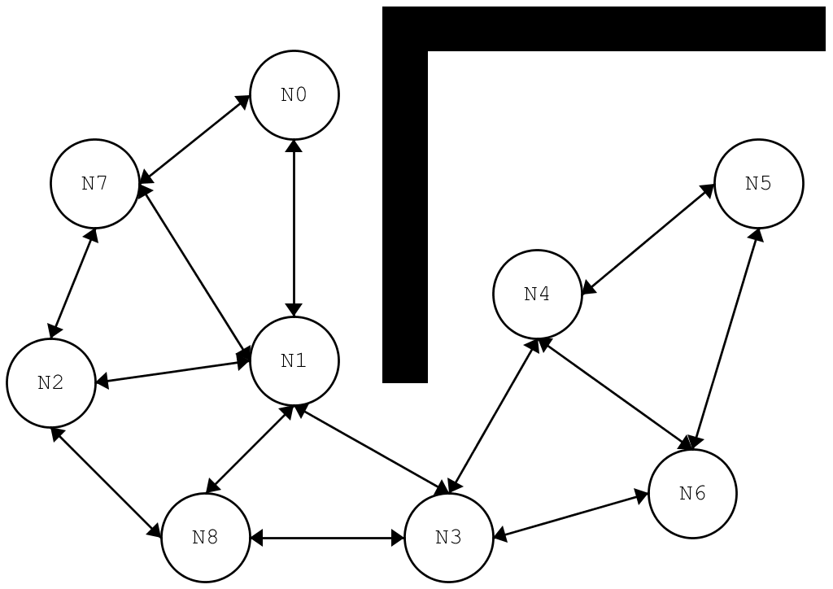
Example Scenario - visibility

Slide 7
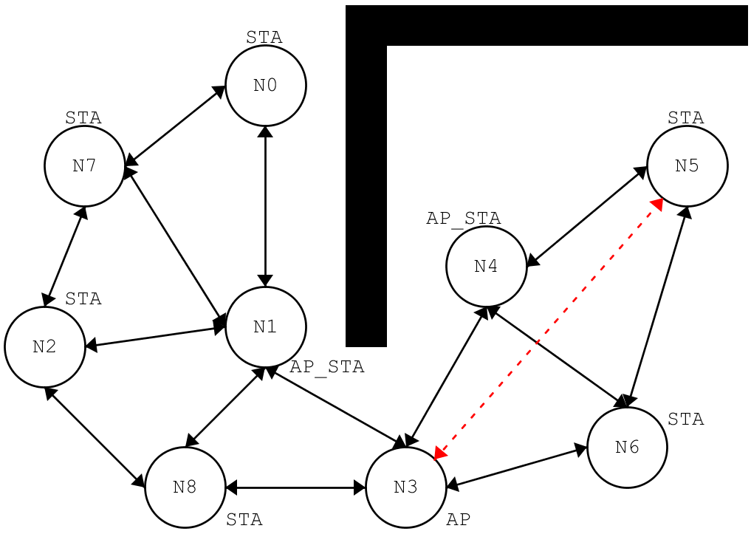
Example Scenario – possible configuration

Slide 8
Software Architecture
AgentNode
WiFi
<<Enumeration>>
Mode
AP
STA
AP_STA
+ID
1
1..1
+SSID
-WiFi
-MACAddress
1
1..1
-PlansDB[*]
-CurrentPlan
-CurrentMode
-CurrentAP
#AssociatedNodes[*]
-BatteryLevel
-VisibleNetworks[*]
+sense()
+select_plan()
+execute()
+deliberate()
+connect(SSID)
+disconnect()
+set_mode(mode)
1..*
+scan(Nodes)
+send()
+receive()
+ap_deliver()
Plan
0..*
+next()
+read(filename)
+steps()

Slide 9
Software Architecture
Sense() is used to update the state vector:
External: visible nodes, connected/disconnected, etc…
Internal: Battery level, etc…
deliberate() is used to verify that actual state is the desired one (it basically compares desires to beliefs and generate intentions = deliberative phase)
selectPlan() is where the filtering takes process. The current plan can continue its execution or be changed if needed
Nodes can only sense the state of the current simulation step and the actions they take only affect the next step
sense()
OK
deliberate()
NOK
select_plan()
execute()

Slide 10
Software Implementation
The simulation software will be implemented in Python 3
The simulation will proceed in controllable steps
No multithreading if not needed: at each step the node can sense the current state but their updates will only be visible in the following steps
(Unless, I will find time to do it) No GUI
Plan objects will be implemented as generators/coroutines and initialized by reading the sequence of steps from a text file

Slide 11
Simulation
This represents the simulation global state:
Agent Nodes -> Set of all the nodes belonging to the network
Nodes Location -> Geographical location of the each node
Implemented as a grid
Each cell can contain a node or a block
A block obstructs visibility
States -> Contains the state of all simulation steps+1
compute_visibility(Nodes n1,n2) -> computes if 2 nodes can see each other
Visibility depends on the distance between nodes
RSSI is calculated as inverse of the distance between nodes multiplied by a constant which depends on the grid size
spawn_node() -> Add new node to the next step nodes list
kill_node() -> Removes a node from the next step node list

Slide 12
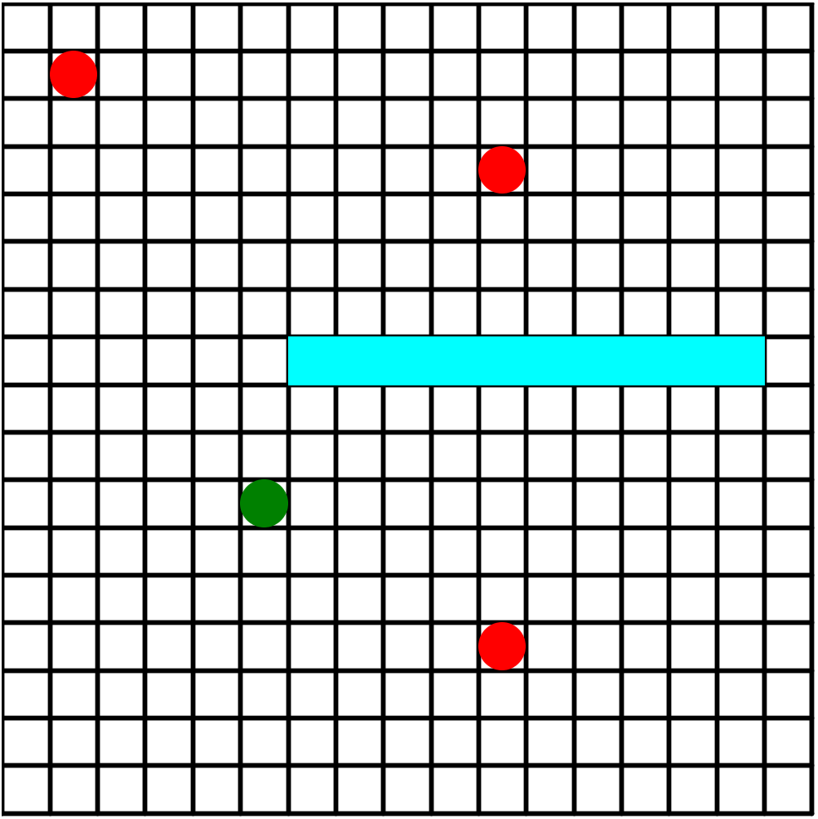
Compute visibility
Given the positions of two nodes A,B as x_{A},y_{A} ; x_{B},y_{B} and a visibility threshold thr:
If (distance > thr) then no visibility
Else use “raycasting” to find obstacles:
If No obstacles => visibility
No visibility

Slide 13
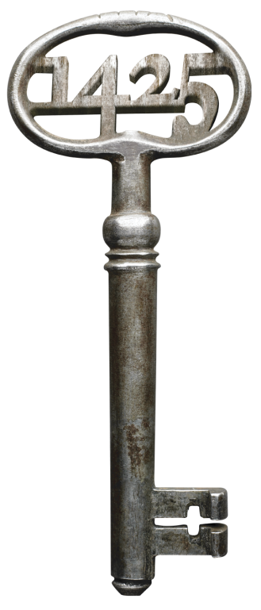
Thanks!

