Slide 1
Access points self-configuration in embedded Wi-Fi sensor networks
Franco Minucci
2018

Slide 2
1 Objective
Given a wireless sensor network made of embedded Wi-Fi modules with limited capabilities and energy availability, the objective is to study a multi agent system that:
Autonomously decides the optimal number of Access Point nodes
The distribution of Access point nodes
According to the following metrics:
Energy consumption
No hidden nodes problem
Self-recovery
The network configuration must follow a plan to achieve the best performance and adapt it depending on the environment state.

Slide 3
2 Research Questions
How does a distributed configuration perform compared to a centralised configuration mechanism?
How does the system react to generation and death of nodes?
Can the nodes coordinate with only local knowledge or do they need to know the full state of the network?
Can the network adapt locally to environmental changes or should the full network be reconfigured continuously?
How do the nodes cooperate to avoid conflicts? (e.g. same SSID name for more than one AP)
Does the system tolerate mobility and at which cost?

Slide 4
Constraints
Nodes can only form networks with a star topology with access point nodes as central node of the star.
Each access point can only serve a limited amount of nodes
Each node has a limited battery life
Stations can only communicate between them through an access point. Access Points behave as routers.

Slide 5
Assumptions
All the nodes have the same capability and can become stations, access point or both at the same time.
All the nodes can see at least one other node belonging to the network.
Self-containment / no gateway: the nodes can only exchange data between them and not with an external network
Access point nodes consume more power than stations
Bridge nodes (which behave as stations and access point at the same time) consume more power than stations and access points
Each station can only connect to a single access point
Access point nodes can still scan the spectrum to find other access points
Access Point nodes can send broadcast messages to all the stations attached to them

Slide 6
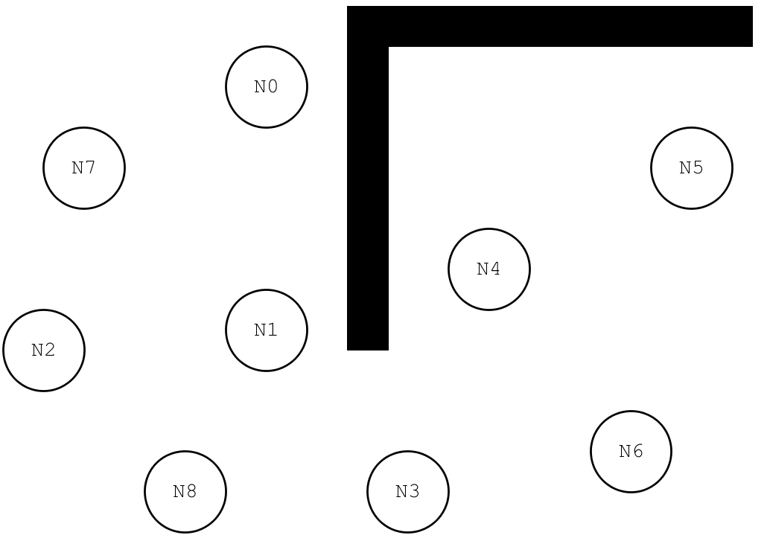
Example Scenario

Slide 7
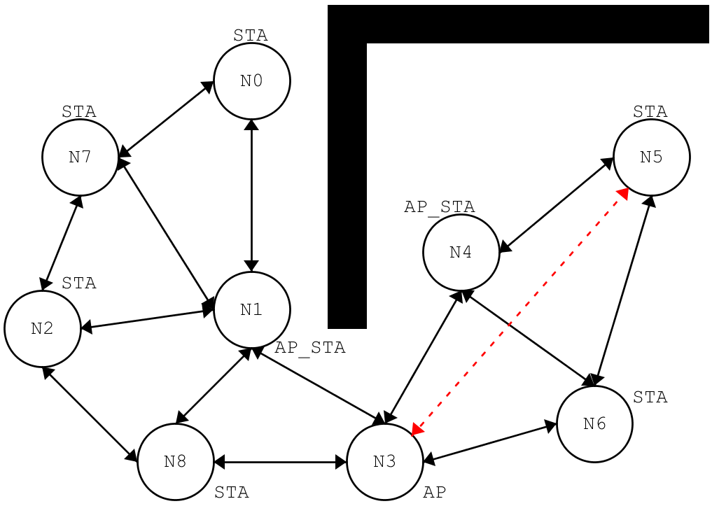
Example Scenario – possible configuration
The wall obstructs visibility between the nodes
The distance is also an obstacle for visibility (N3 and N5 are too far)

Slide 8
Software Architecture - general
AgentNode
WiFi
<<Enumeration>>
Mode
AP
STA
AP_STA
+ID
1
1..1
+SSID
-WiFi
-MACAddress
1
1..1
-PlansDB[*]
-CurrentPlan
-CurrentMode
-CurrentAP
#AssociatedNodes[*]
-BatteryLevel
-VisibleNetworks[*]
+sense()
+select_plan()
+execute()
+deliberate()
+connect(SSID)
+disconnect()
+set_mode(mode)
1..*
+scan(Nodes)
+send()
+receive()
Plan
0..*
+next()
+read(filename)
+steps()

Slide 9
Software Architecture – Reactive

Slide 10
Software Architecture - BDI
Sense() is used to update the state vector:
External: visible nodes, connected/disconnected, etc…
Internal: Battery level, etc…
deliberate() is used to verify that actual state is the desired one (it basically compares desires to beliefs and generate intentions = deliberative phase)
selectPlan() is where the filtering takes process. The current plan can continue its execution or be changed if needed
Nodes can only sense the state of the current simulation step and the actions they take only affect the next step
sense()
OK
deliberate()
NOK
select_plan()
execute()

Slide 11
Software Architecture - Plan
A plan is a set of of steps to follow to achieve the specified goal
Each node can perform a defined set of actions:
Change mode between station,access point or both (STA,AP, AP_STA)
Connect to a network identified by SSID
Disconnect from the currently associated network
Send data to another node (its configuration for example)
Receive data from another node

Slide 12
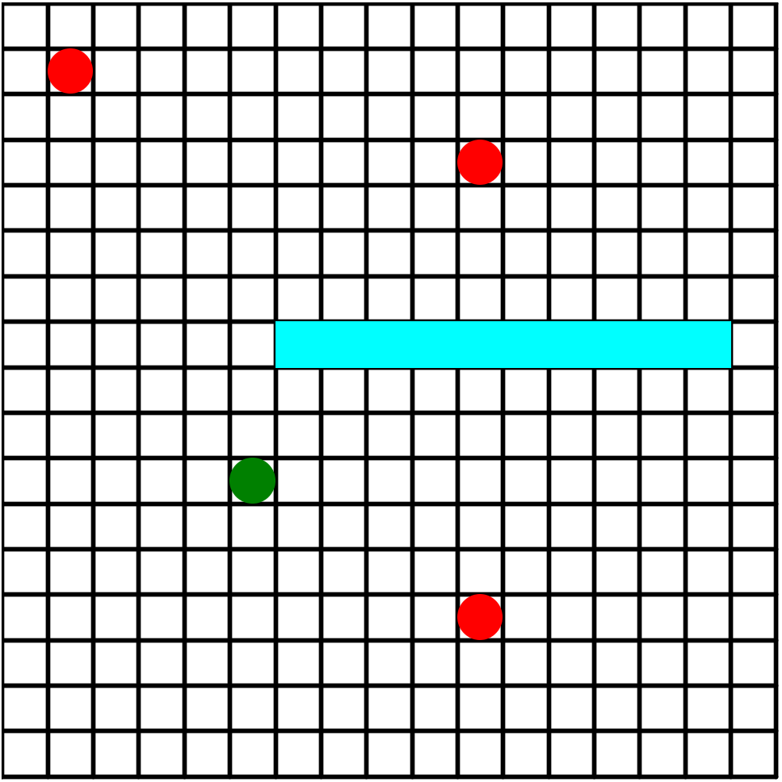
World Map and Visibility
The world will be modeled as a 2D grid
Each cell can contain a node or an obstacle or be empty
Given the positions of two nodes A,B as x_{A},y_{A} ; x_{B},y_{B} and a visibility threshold thr:
If (distance > thr) then no visibility
Else use “raycasting” to find obstacles:
If No obstacles => visibility
No visibility

Slide 13

Thanks!

