Slide 1
Customer’s Online loan
Inggriani Priscilia

Slide 2
TABLE OF CONTENTS
01
04
02
05
03
Business Understanding
Modeling & Evaluation
Understand about the problem and oal for this project
Create a machine learning model that fits our goals
Exploratory Data Analysis (EDA)
Business Recomendation
Provide business recommendation based on modeling results
Knowing well the data
Data Pre-Processing
Cleaning the data and choose the feature for modelling

Slide 3
01
Business Understanding

Slide 4

PROBLEM STATEMENT
ROLE
This online loan has 1413701 customers.
91% customers get a rejected loan.
Data Scientist at HCI
Made a machine modelling to predict a customers approval
Inncreased approve application loan customers.
Approval application Rate

Slide 5
Exploratory Data Analyst
Merge dataset train and dataset prev application
1413701 data
Some columns have a null
68413 duplicates
Select multiple columns that needs to model

Slide 6
PERCENTAGES Of DATA
91%
67%
92%
Rejected loans
Female customers
Cash Loans

Slide 7
03
DATA PRE-PROCESSING

Slide 8
DATA CLEANING
HANDLING DUPLICATED DATA
HANDLING NULL
Drop columns that not need for analysis.
Replace with mode or mean
Cleaning the duplicated data
FUTUTRE
HANDLING OUTLIER
Z-score : 1283912 data
Log transformation
Encoding
One Hot Coding

Slide 9
04
Modelling and Evalation

Slide 10
12 Features
Split Data Train (70%) : Test (30%)
Code gender
Name education type
Days Birth
Days Employed
Days Registration
Flag EMP Phone
Name Income Type Pensioner
Name IncomeType Working
Organization Type XNA
Code Reject Reason XAP
Name Contract Status Approved
Name Contract Status Refused
Handle Class Imbalance SMOTE data Train (1:1)

Slide 11
MODELLING
Model | Accuracy (%) | Precision (%) | Recall (%) | AUC(%) | F1(%)
Logistic Regression | 52 | 9 | 54 | 52 | 16
Decision Tree | 95 | 67 | 82 | 88 | 74
Random Forest | 97 | 80 | 79 | 88 | 80
Adaboost | 71 | 12 | 40 | 56 | 19
XGB | 70 | 13 | 42 | 57 | 19

Slide 12
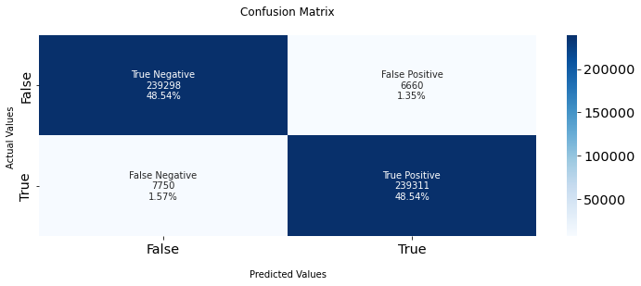
Future Importance:
Days Birth
Days Registration
Days Employed
Name Education Type
Name Contract status Refused
Name Contract Status Approved
Code Rject Reason XAP
Code Gender
Nome Income Type Working

Slide 13
05
Business Recomendation

Slide 14
Business Recommendation
Days birth dan Registration
Days employed and working income
Rejecting customers who are not in working age.
Long queue for apply, make it fast and simple
Take a look how long the customers working and they were working at company or stable income
Education Type
Customers with higher education, know about loans and no delays to pay

Slide 15
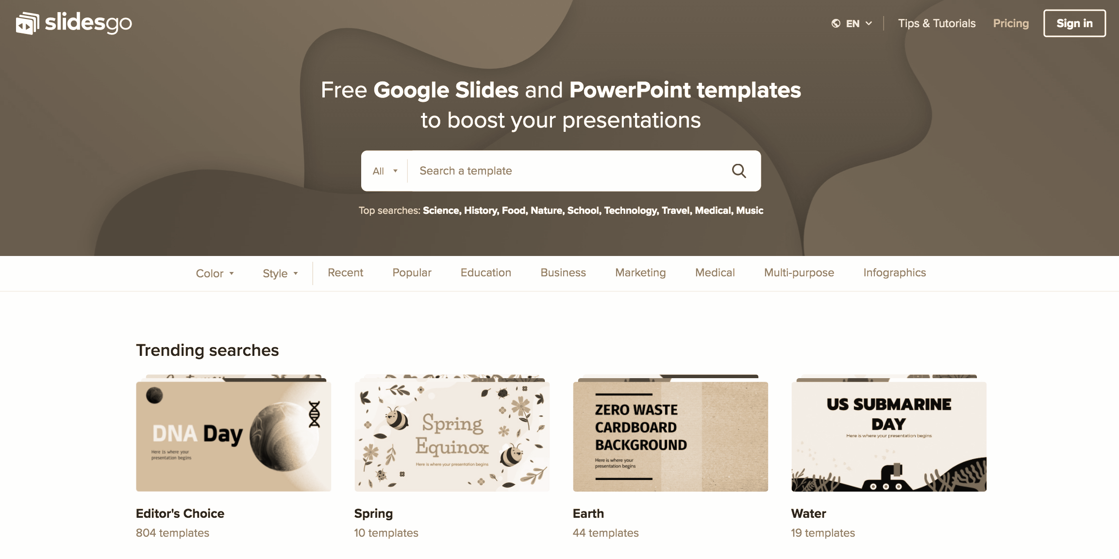
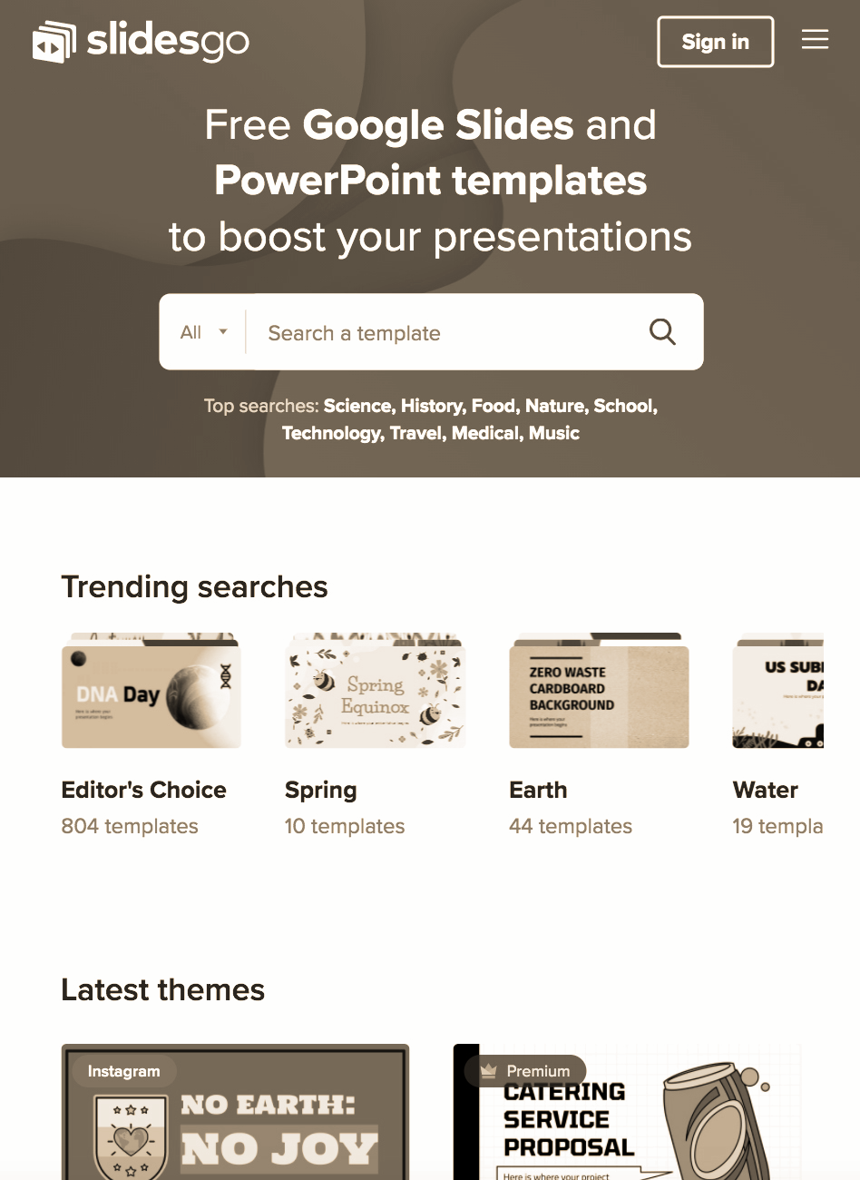

ONLINE PLATFORM
Can make an online excel/platform that automatically reject the customer application directly if they do not meet the 3-4 conditions.
Get know about the customers, give a full recommendation to apply the loan.
Manange the application website or online, so customers feel save to apply loans.

Slide 16
THANKS!
linkedIn : Inggriani Priscilia
Github : Inggriani Priscilia
https://github.com/inggridpris/Customer-s-Online-Loan

