Slide 1
Some examples of optimization in python

Slide 2

https://cs.lbl.gov/assets/CSSSP-Slides/20180719-Mueller.pdf

Slide 3
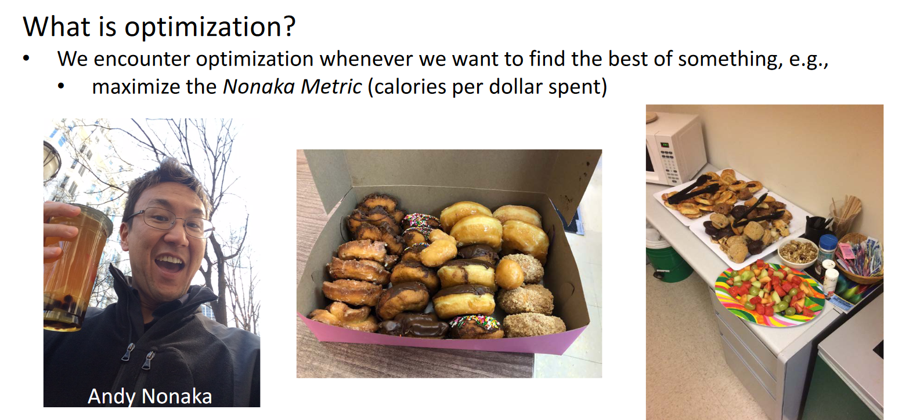

Slide 4
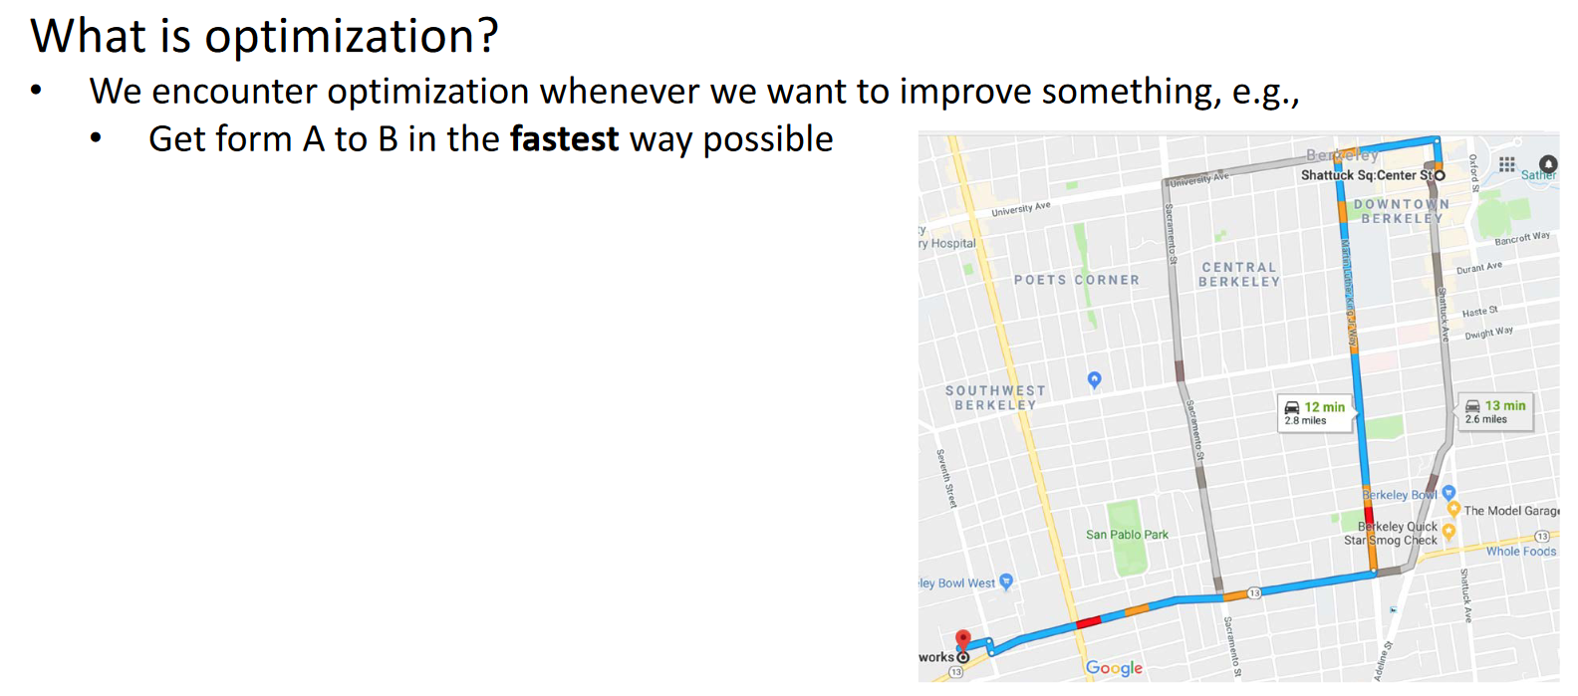

Slide 5
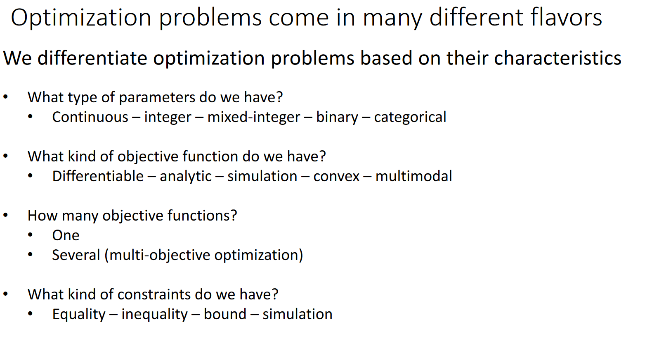

Slide 6
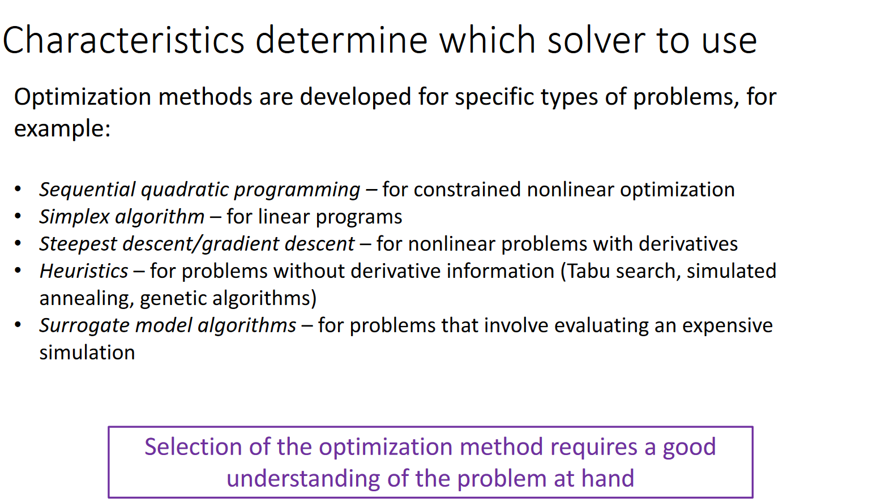

Slide 7
Linear Programming
https://realpython.com/linear-programming-python/

Slide 8
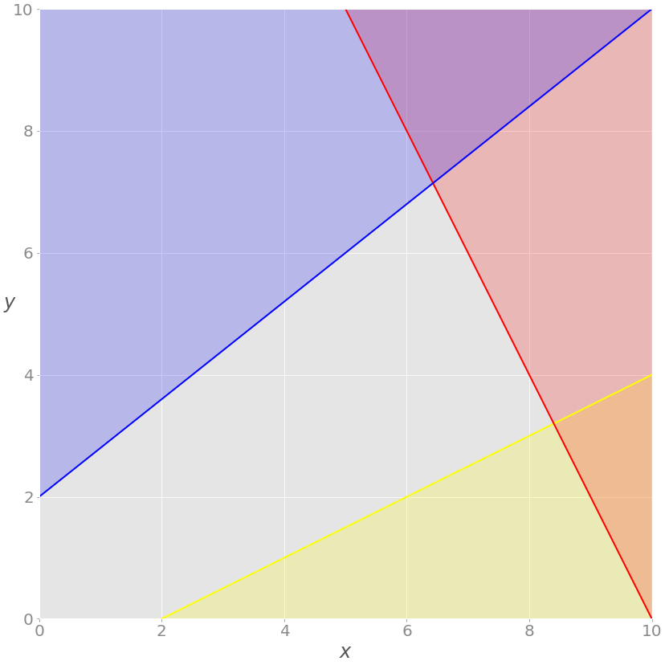
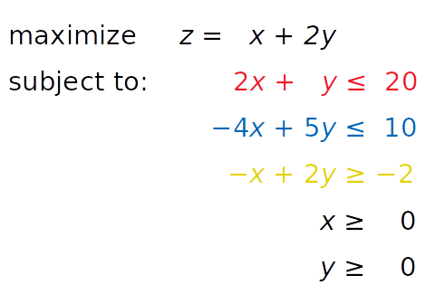
Simple 2 variable example
https://realpython.com/linear-programming-python/

Slide 9
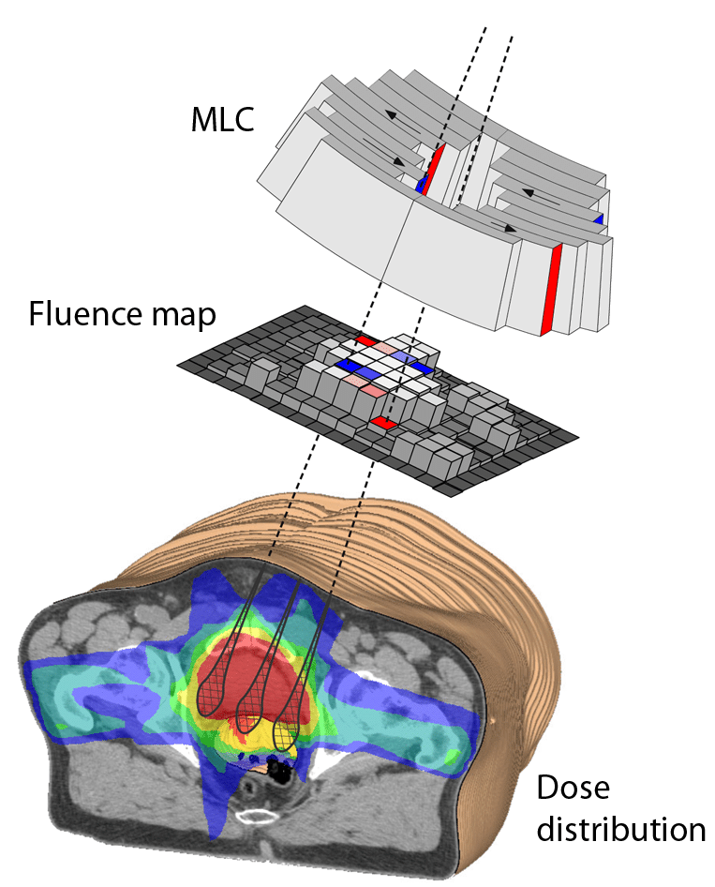
Practical example: Fluence optimization in radiotherapy
Let’s say we have some prescription and some tolerance
Our variables are our beamlet weights [x1,x2,x3…] = X̂
Minimize total_fluence: x1+x2+x3…
Subject to:
As.X̂ <= prescription + tolerance
As.X̂ >= prescription - tolerance
As is called the sensitivity matrix
it describes the dose deposited everywhere in the patient for each beamlet.
As such it has size [n_beamlets, n_voxels_in_patient]
Q: how do we go from ‘voxel based’ prescription
to ‘DVH’ prescription, or vice-versa?
https://www.researchgate.net/publication/263553090_Concepts_for_the_efficient_Monte_Carlo-based_treatment_plan_optimization_in_radiotherapy/figures?lo=1

Slide 10

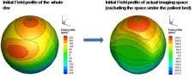
Practical example: Passive shimming
Shim_field = -ActualField
Iron_thicknesses = [t1,t2,t3…] = t
Want to minimize the amount of iron used
Minimize t1+t2+t3+t4…
Subject to
As.t <= Shim_field + tolerance
As.t >= Shim_field - tolerance
https://mriquestions.com/passive-shimming.html

Slide 11
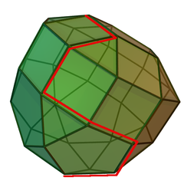
Why is linear programming so fast!?
https://en.wikipedia.org/wiki/Simplex_algorithm
It can be shown that for a linear program in standard form, if the objective function has a maximum value on the feasible region, then it has this value on (at least) one of the extreme points.^{[10]} This in itself reduces the problem to a finite computation since there is a finite number of extreme points, but the number of extreme points is unmanageably large for all but the smallest linear programs.^{[11]}
…BUT. It can also be shown that, if an extreme point is not a maximum point of the objective function, then there is an edge containing the point so that the value of the objective function is strictly increasing on the edge moving away from the point.^{[12]}

Slide 12
A few take homes
Linear optimization is extremely fast and powerful.
There is an implementation in scipy which I suspect will be fine for most things, but python also interfaces with more powerful commercial solvers like gurobi.
In many situations, the problem can be directly framed as a linear optimization – excellent!
In other situations, the problem may not truly be linear, but can be approximated as linear, at least in some region.
This idea is the basis of some fancy algorithms like COBYLA: constrained optimization by linear approximation
If we start adding integers into the equation, life starts getting a lot harder!

Slide 13
Bayesian Optimization
For expensive objective functions
Approximate objective function with surrogate function that is ‘easy’ to optimize
Update the surrogate every time we get more information
https://github.com/fmfn/BayesianOptimization

Slide 14
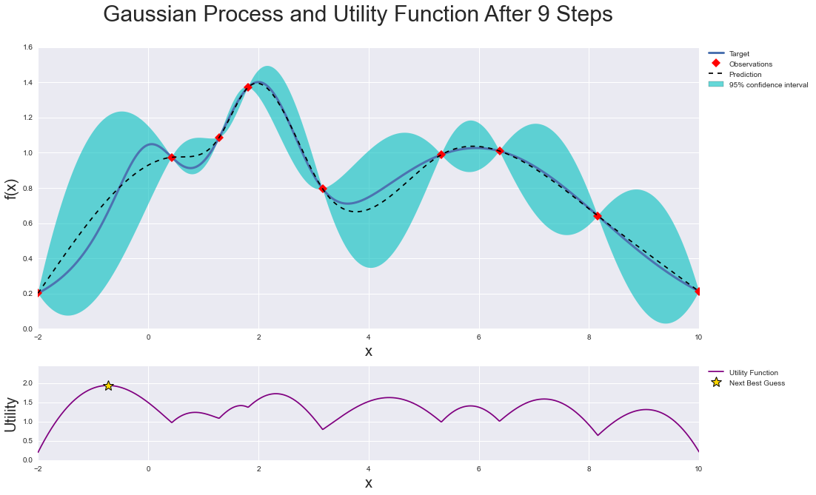

Slide 15
What makes this Bayesian?
At each step, we are incorporating our prior knowledge about the objective function.
One other part of our ‘prior knowledge’ is a (weak) assumption: on some scale, the objective function is smooth – points close enough together will be well correlated

Slide 16
Exploration versus Exploitation
https://github.com/fmfn/BayesianOptimization/blob/master/examples/exploitation_vs_exploration.ipynb

Slide 17
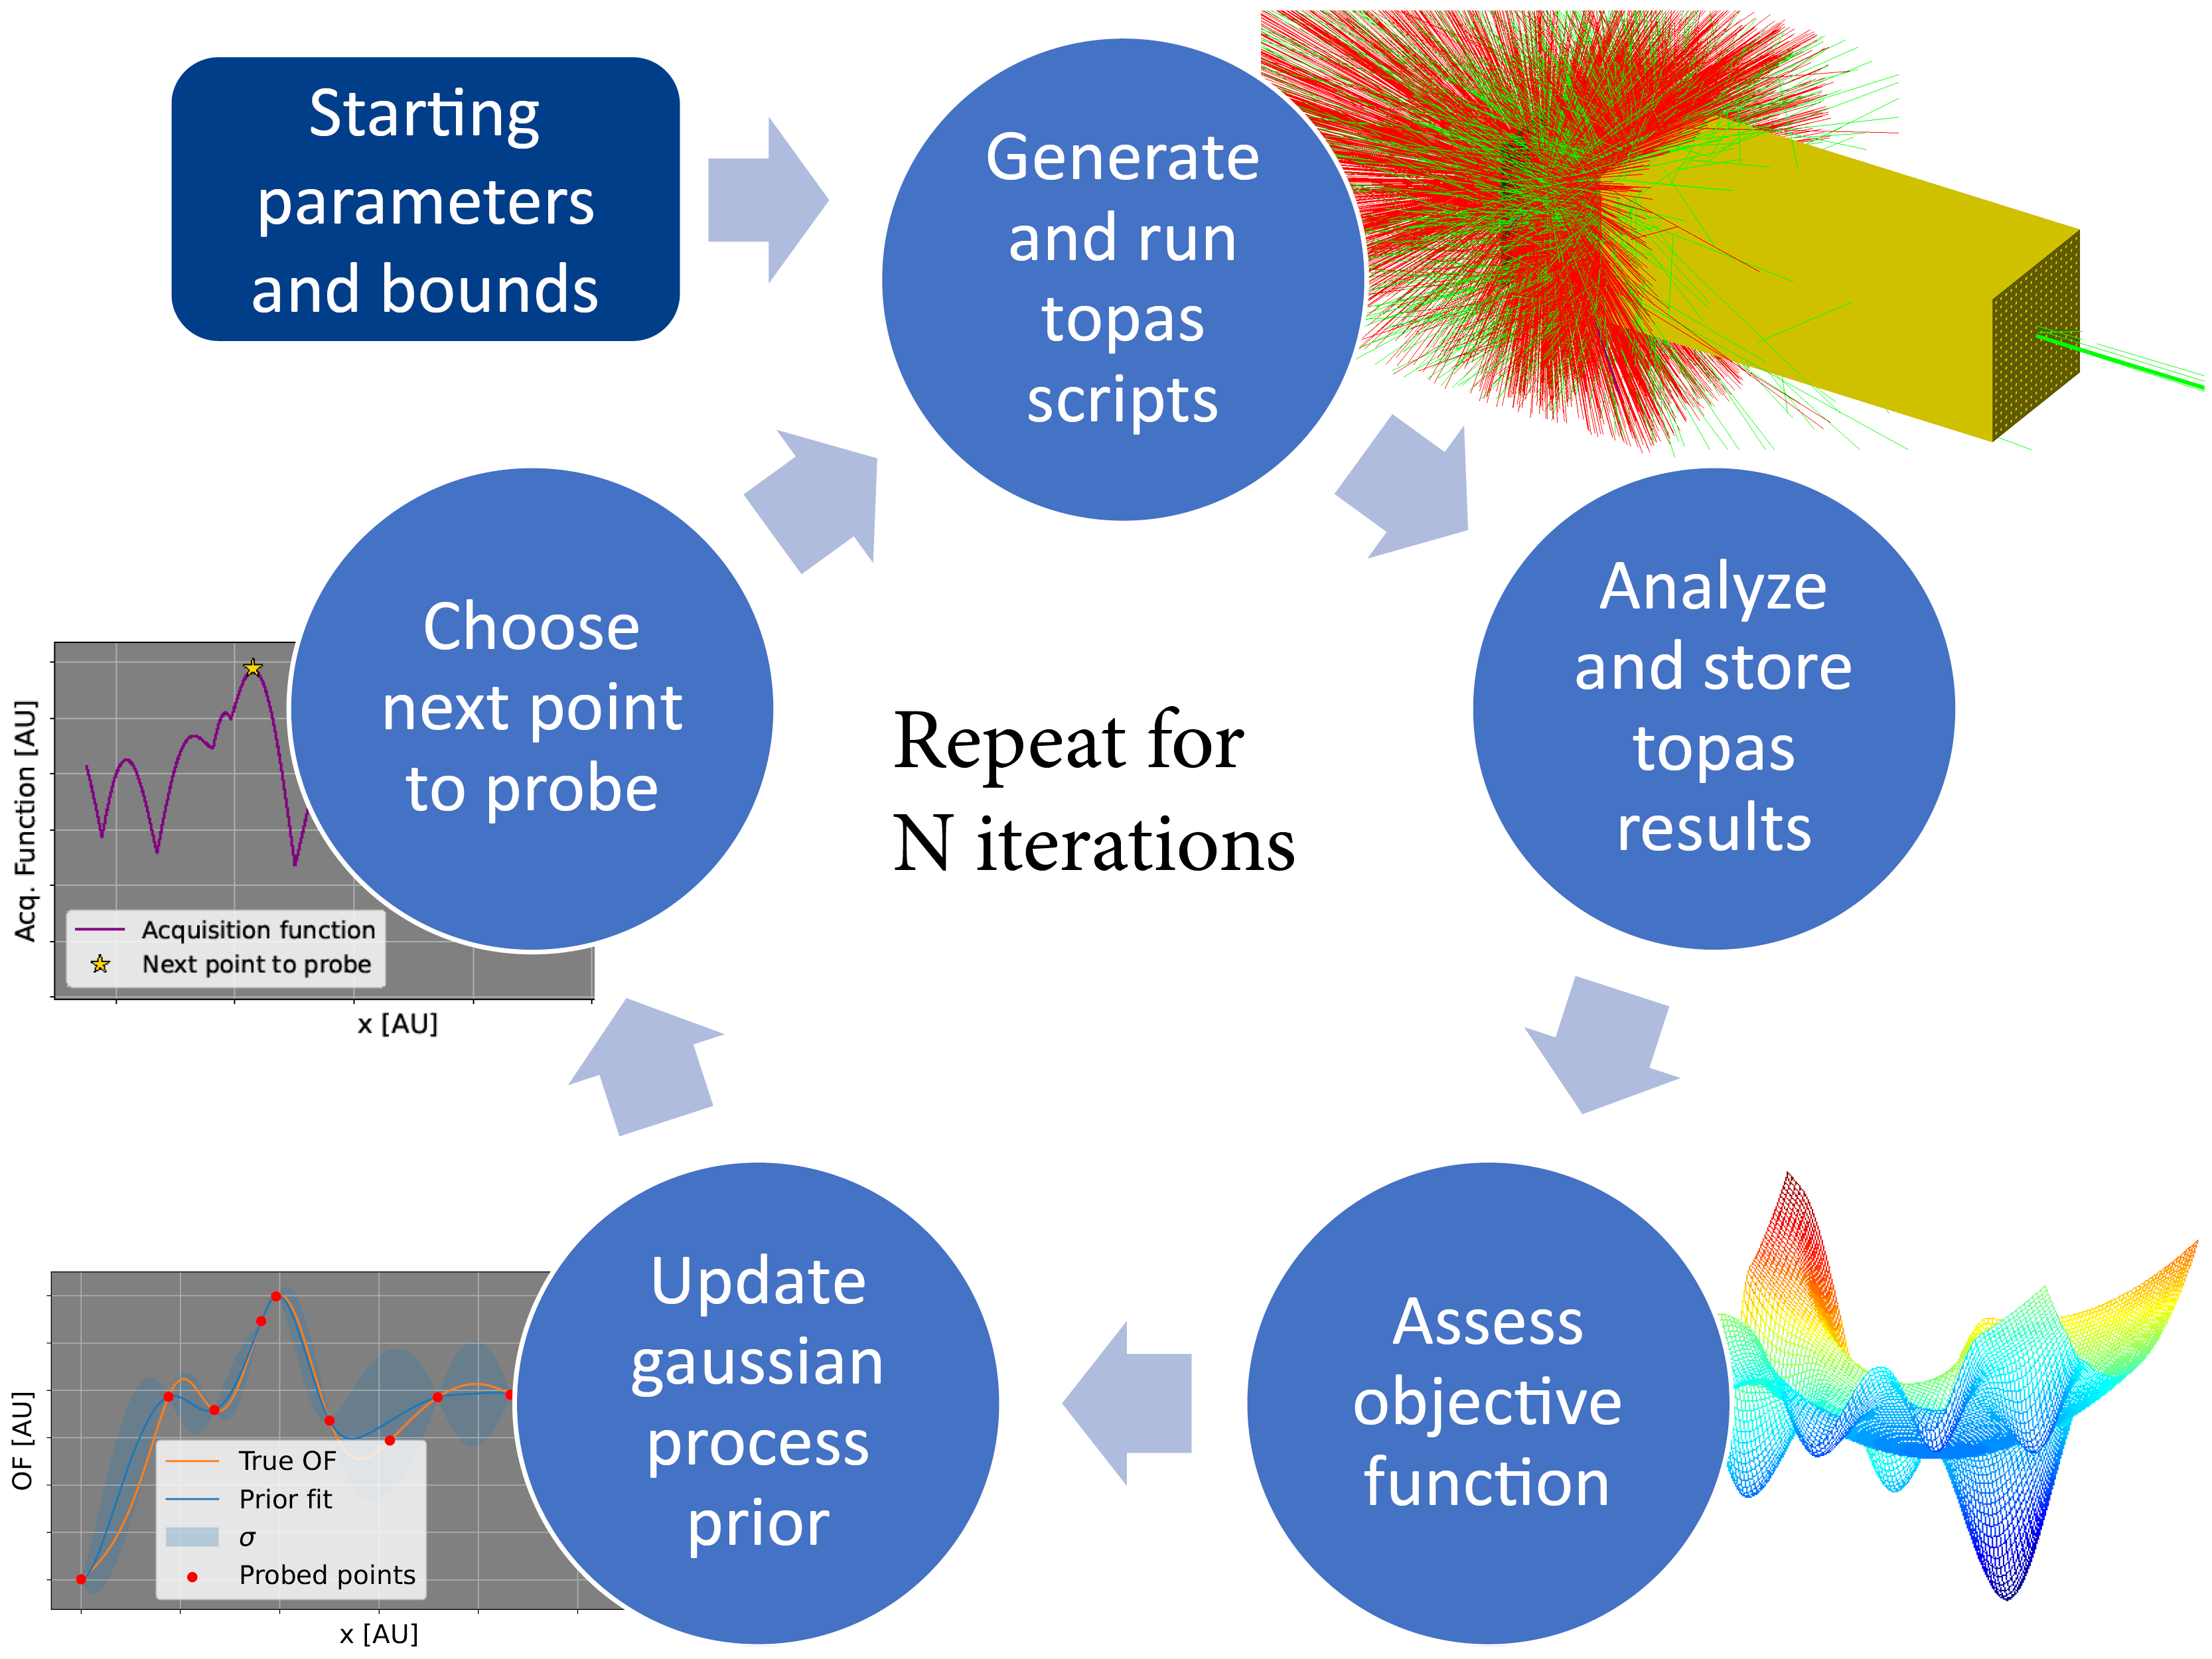
Practical example
Using Bayesian optimization to guide Monte Carlo sims
https://acrf-image-x-institute.github.io/TopasOpt/

Slide 18
Practical example: optimization of machine learning hyper parameters
https://towardsdatascience.com/a-conceptual-explanation-of-bayesian-model-based-hyperparameter-optimization-for-machine-learning-b8172278050f
Making a Science of Model Search: Hyperparameter Optimization in Hundreds of Dimensions for Vision Architectures
http://proceedings.mlr.press/v28/bergstra13.pdf

