Slide 1
4RA: Travelling-Platform
Barbu Robert Gabriel
Berbecaru-Iovan Andrei
Iftimi Ruxandra
Ionescu Radu-Constantin
Stefanoiu Rares-Andrei

Slide 2
This platform offers you a wide array of communication means with fellow tourists from the travelling community, offering you a unique environment well suited for discovering the best travel destination for your next trip.
This app supports group chats with text messages. These groups are based on specific individual destinations, ranging from local to international trips to bring people closer and create a sense of community and belonging.
Join us and let your once in a lifetime adventure start NOW!

Slide 3
Features list
reviews section – allows users to freely share their thoughts on their travel experiences at the hotels where they stayed
authentication system – preserves the security and permissions of various user types
roles administration system – to ensure that only certain types of users can perform certain critical actions (the admin has absolute control over the entire product; the manager can publish his estates; the user can book his dream holiday)
modern design – the user navigates a visually pleasant application
description section for each location – as stipulated by the stakeholders, the user can see a lot of details about each estate
navigation menu – to facilitate the user experience, a navigation bar helps to access the most common functionalities
search bar – due to the vast amount of information present on this app, the user could have felt overwhelmed
booking services – in order to properly manage the wide array of incoming booking requests, special systems were designed to make sure that no two bookings overlap

Slide 4
Future features list
The afore mentioned features are part of the initial version of this product. Following their successful implementation, the team plans on releasing future versions based on users’ feedbacks and the stakeholders agenda. However, as of today (16.11.2023), this is the road map:
version 1.0.0: the features described in this document form the initial version
version 1.0.1: bug fixes
version 1.0.2: expanding the roles’ pool to include additional user types such as receptionists, editors and many to announced
version 1.1.0: bringing AI into your holiday planning! A chatbot designed to ease the in-app navigation
version 1.1.1: bug fixes
Please keep in mind that the exact details and features are subject to change and that these are just some general guidelines. We would love to receive your feedback and additional ideas!

Slide 5
Non-Functional requirements
Responsiveness: This app provides a smooth and responsive user interface, ensuring that users experience minimal lag or delays when navigating through pages or performing actions
Intuitiveness: The user interface should be intuitive, allowing users to easily understand how to navigate the app and complete common tasks without the need for extensive guidance.
Load Time: Pages within the app should load quickly, with a goal of three seconds or less, to enhance user satisfaction and engagement.

Slide 6
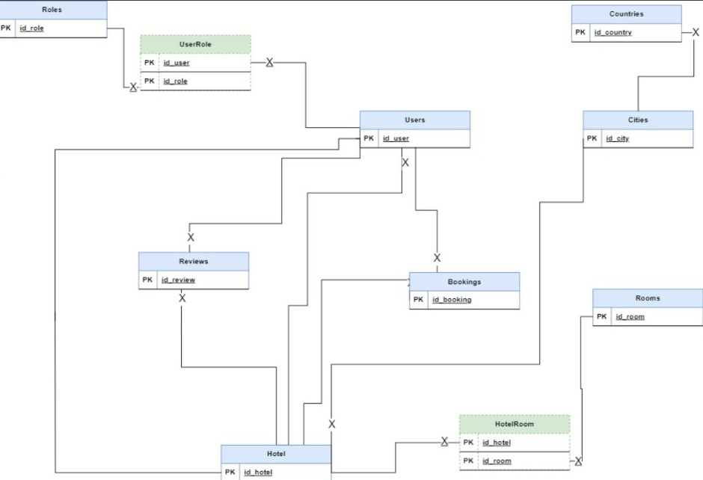
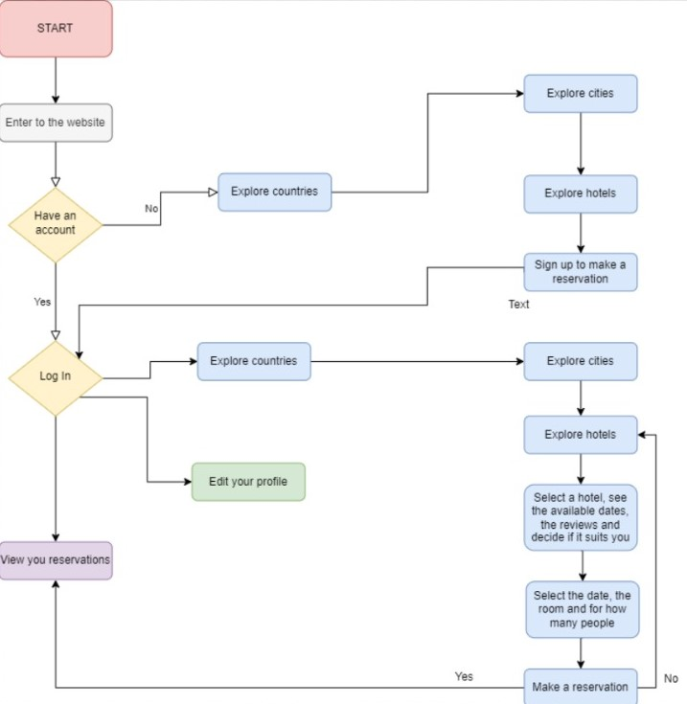
UML and Workflow

Slide 7
User Stories
as a manager of a hotel I would like to edit the information for my hotel.
as a user I want to see information about a possible holiday destination.
as a user I want to leave a review for hotels.
as an admin I want to create and administrate the places from the platform.
as a user I want to edit my information if I completed them wrong.
as an admin I want to be able to delete reviews if they are inappropiate.
as a manager of a hotel I want to manage the rooms I have and add or remove them.
as a user I want an easy way to find a hotel in a country and city that I want.
as an admin I want to have different features for myself after I log in.
as a user I want to have photos and description for the countries, cities and hotels that I'm interested in.

Slide 8
Backlog creation
We used Trello for keeping track of the tasks https://trello.com/b/Y9VQDw32/travelling-platform

Slide 9
User Persona and User Journey Map
Name: Dimitri Ivanov
Summary Quote: "Elevate your stay to unparalleled luxury – managing exclusive hotels for your extraordinary experience."
Personal Background:
Age: 40
Education: Business Management degree
Family Status: Unmarried, dedicated to his career
Professional Background:
Job Occupation: Entrepreneur and Manager of Exclusive Hotels
Income Level: High net worth, primarily through hotel management
User Environment: Dimitri oversees a chain of upscale hotels in premium locations worldwide. He utilizes state-of-the-art technology for hotel management and promotion. Frequent travel is part of his routine to ensure the excellence of his establishments.
Psychographics: Dimitri is driven by a passion for providing guests with unparalleled luxury and unique experiences. He enjoys the challenge of managing and promoting high-end hotels, ensuring guest satisfaction. He is motivated by the desire to maintain a reputation for opulence and exceptional service.
End Goal(s): Dimitri's end goal is to leverage a travel app platform to effectively manage bookings, showcase the unique features of his hotels, and provide guests with extraordinary experiences.
Scenario: "As a manager of exclusive hotels, I am dedicated to offering guests an unforgettable stay marked by luxury and sophistication. The ideal travel app for me would seamlessly connect travelers with my chain of upscale hotels. From seamless reservations to personalized concierge services, the app should reflect the essence of opulence and showcase the unique features of each property. Efficiently managing bookings, ensuring guest satisfaction, and maintaining the reputation of my hotels are vital to the success of my business."

Slide 10
User Persona and User Journey Map
Name: Maria Sanchez
Summary Quote: "Create memories on a budget, showing my children the world's wonders."
Personal Background:
Education: High school graduate
Persona Group: Single mother
Family Status: Divorced with two children (ages 10 and 12)
Professional Background:
Job Occupation: Part-time administrative assistant
Income Level: $30,000 per year
User Environment: Maria spends most of her time in a small apartment with limited access to technology. She owns a basic smartphone and a shared family computer and she often collaborates with other parents for childcare and support.
Psychographics: Maria values budget-friendly options due to financial constraints. She is interested in local attractions and cultural experiences for her children. Motivated by the desire to provide enriching experiences despite limited resources. Pain points include financial stress, time constraints, and the need for family-friendly options.
End Goal(s): Maria's end goal is to plan an affordable and enjoyable vacation for her children, exploring new places and creating lasting memories on a tight budget.
Scenario: "In the midst of juggling work, childcare, and household responsibilities, I dream of taking my kids on a vacation they'll cherish. I aim to find a travel solution that caters to our limited budget while offering kid-friendly activities. Ideally, I want an app that suggests affordable destinations, provides family-friendly accommodations, and offers discounts on attractions. This way, I can plan a memorable vacation without breaking the bank, making the most of our quality time together."

