Slide 1
4RA: Travelling-Platform
Barbu Robert Gabriel
Berbecaru-Iovan Andrei
Iftimi Ruxandra
Ionescu Radu-Constantin
Stefanoiu Rares-Andrei

Slide 2
This platform offers you a wide array of communication means with fellow tourists from the travelling community, offering you a unique environment well suited for discovering the best travel destination for your next trip.
This app supports group chats with text messages. These groups are based on specific individual destinations, ranging from local to international trips to bring people closer and create a sense of community and belonging.
Join us and let your once in a lifetime adventure start NOW!

Slide 3
Features list
reviews section – allows users to freely share their thoughts on their travel experiences at the hotels where they stayed
authentication system – preserves the security and permissions of various user types
roles administration system – to ensure that only certain types of users can perform certain critical actions (the admin has absolute control over the entire product; the manager can publish his estates; the user can book his dream holiday)
modern design – the user navigates a visually pleasant application
description section for each location – as stipulated by the stakeholders, the user can see a lot of details about each estate
navigation menu – to facilitate the user experience, a navigation bar helps to access the most common functionalities
search bar – due to the vast amount of information present on this app, the user could have felt overwhelmed
booking services – in order to properly manage the wide array of incoming booking requests, special systems were designed to make sure that no two bookings overlap

Slide 4
Future features list
The afore mentioned features are part of the initial version of this product. Following their successful implementation, the team plans on releasing future versions based on users’ feedbacks and the stakeholders agenda. However, as of today (16.11.2023), this is the road map:
version 1.0.0: the features described in this document form the initial version
version 1.0.1: bug fixes
version 1.0.2: expanding the roles’ pool to include additional user types such as receptionists, editors and many to announced
version 1.1.0: bringing AI into your holiday planning! A chatbot designed to ease the in-app navigation
version 1.1.1: bug fixes
Please keep in mind that the exact details and features are subject to change and that these are just some general guidelines. We would love to receive your feedback and additional ideas!

Slide 5
Non-Functional requirements
Responsiveness: This app provides a smooth and responsive user interface, ensuring that users experience minimal lag or delays when navigating through pages or performing actions
Intuitiveness: The user interface should be intuitive, allowing users to easily understand how to navigate the app and complete common tasks without the need for extensive guidance.
Load Time: Pages within the app should load quickly, with a goal of three seconds or less, to enhance user satisfaction and engagement.

Slide 6
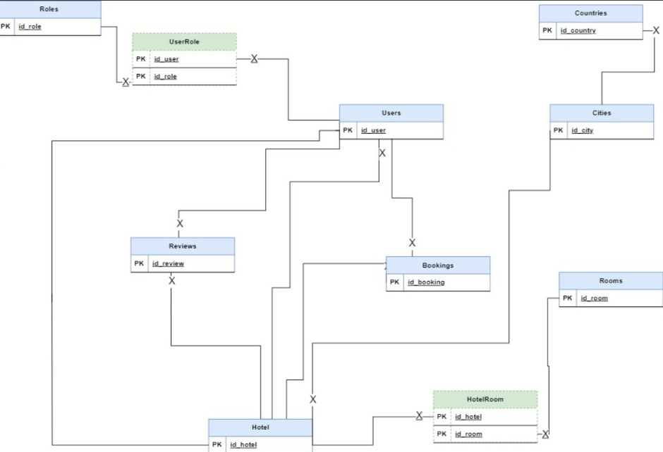
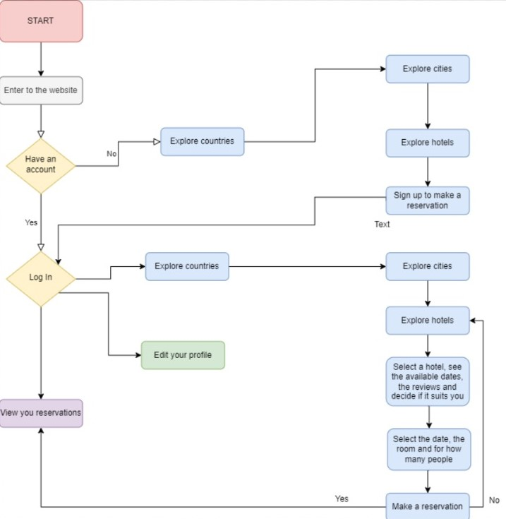
UML and Workflow

Slide 7
User Stories
as a manager of a hotel I would like to edit the information for my hotel.
as a user I want to see information about a possible holiday destination.
as a user I want to leave a review for hotels.
as an admin I want to create and administrate the places from the platform.
as a user I want to edit my information if I completed them wrong.
as an admin I want to be able to delete reviews if they are inappropiate.
as a manager of a hotel I want to manage the rooms I have and add or remove them.
as a user I want an easy way to find a hotel in a country and city that I want.
as an admin I want to have different features for myself after I log in.
as a user I want to have photos and description for the countries, cities and hotels that I'm interested in.

Slide 8
Backlog creation
We used Trello for keeping track of the tasks https://trello.com/b/Y9VQDw32/travelling-platform

Slide 9
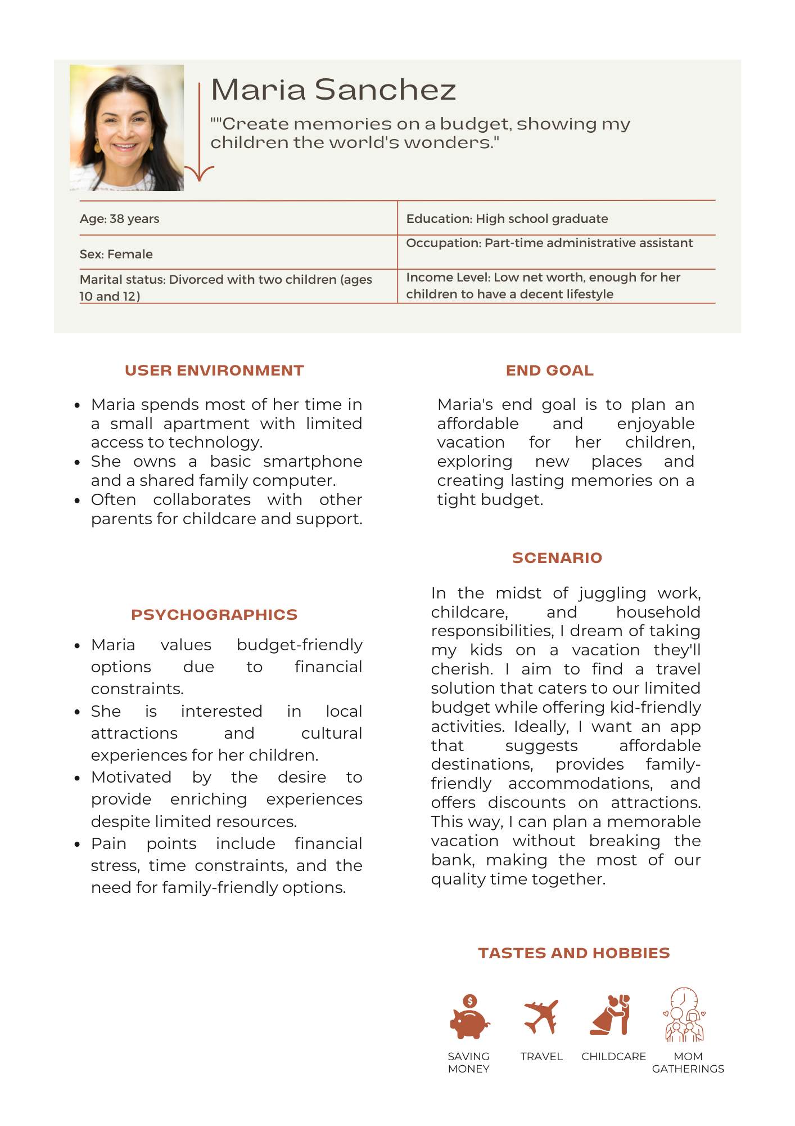
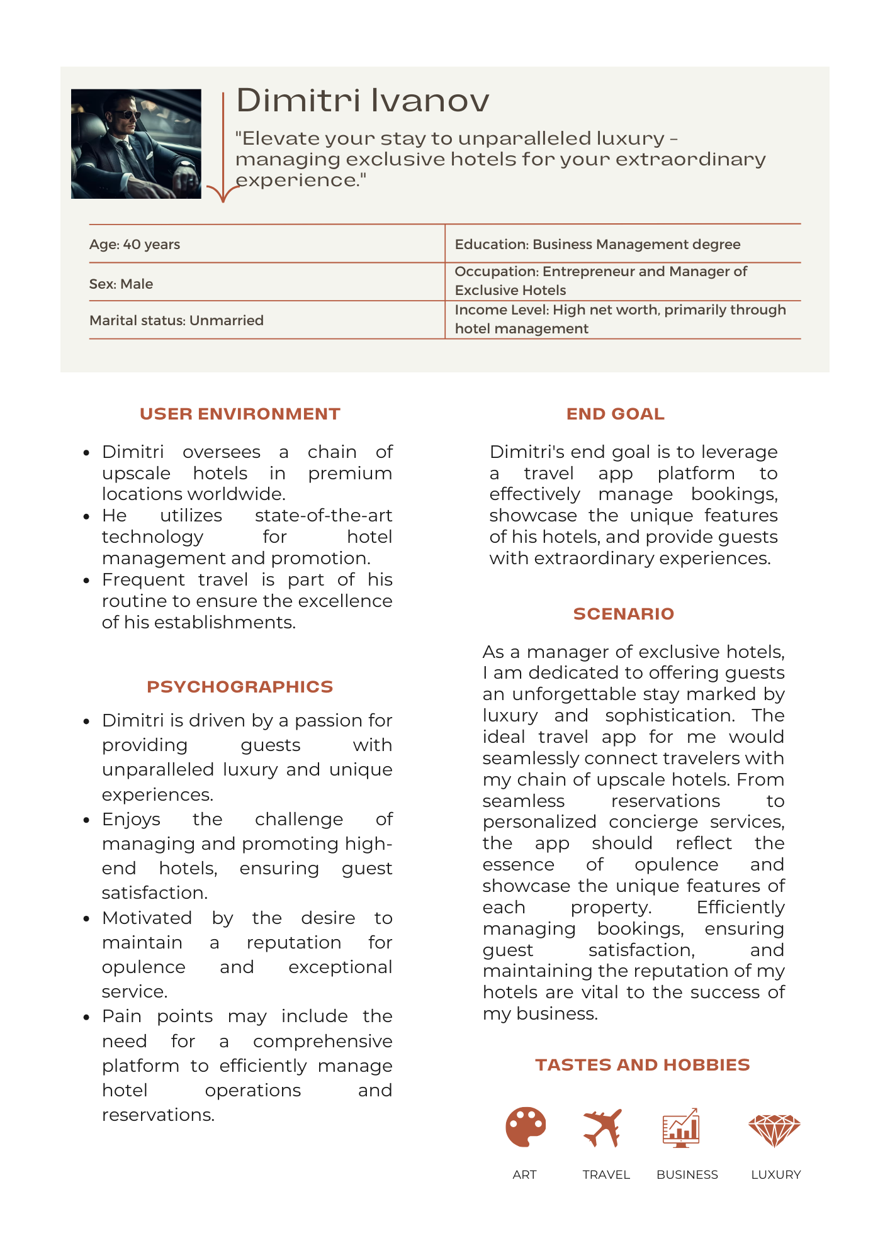
User Persona and User Journey Map (SCENARIO)

