Slide 1

Windows Azure
Scott Guthrie
Corporate Vice President
Windows Azure
Email: scottgu@microsoft.com
Twitter: @scottgu
高校联盟 官方微信 unitive

Slide 2



Windows Azure
flexible
open
solid
高校联盟 官方微信 unitive

Slide 3

Global Footprint
高校联盟 官方微信 unitive

Slide 4
Inside a Datacenter →
video
高校联盟 官方微信 unitive

Slide 5
pay only for what you use
→
高校联盟 官方微信 unitive
Notes:
And with Windows Azure you pay only for what you use – enabling you to avoid upfront costs, and scale as your business grows.

Slide 6


Virtual Machines
Windows Server and Linux
Flexible Workload Support
Virtual Private Networking
高校联盟 官方微信 unitive

Slide 7


demo
Windows Azure
高校联盟 官方微信 unitive

Slide 8
virtual machine portability
高校联盟 官方微信 unitive

Slide 9


Windows Azure
Your Data Center
高校联盟 官方微信 unitive

Slide 10
Windows Azure
Your Data Center
高校联盟 官方微信 unitive

Slide 11
Windows Azure
Other Service Providers
Your Data Center
高校联盟 官方微信 unitive

Slide 12
Windows Azure
Other Service Providers
no lock-in
Your Data Center
高校联盟 官方微信 unitive

Slide 13



VM with persistent drive
Windows Azure Storage
高校联盟 官方微信 unitive

Slide 14

VM with persistent drive
Windows Azure Storage
高校联盟 官方微信 unitive

Slide 15

VM with persistent drive
Windows Azure Storage
高校联盟 官方微信 unitive

Slide 16
VM with persistent drive
reliable and always on
Windows Azure Storage
高校联盟 官方微信 unitive

Slide 17
WEST
DC
EAST
DC
> 500 miles
continuous storage
geo-replication
Windows Azure Storage
高校联盟 官方微信 unitive

Slide 18

Web Sites
Build with ASP.NET, Node.js or PHP
Deploy in seconds with FTP, Git or TFS
Start for free, scale up as your traffic grows
高校联盟 官方微信 unitive

Slide 19
demo
Web Sites
高校联盟 官方微信 unitive
Notes:
IaaS

Slide 20


Web Sites
shared
reserved
1
shared
Shared instanceS
:-)
高校联盟 官方微信 unitive

Slide 21
Web Sites
shared
reserved
2
shared
Shared instanceS
:-)
:-)
高校联盟 官方微信 unitive

Slide 22

Web Sites
shared
reserved
1
0
reserved
Shared instanceS
RESERVED instance
:-)
:-)
:-)
高校联盟 官方微信 unitive

Slide 23
Web Sites
shared
reserved
2
reserved
RESERVED instance
RESERVED instance
:-)
:-)
高校联盟 官方微信 unitive

Slide 24



Web Sites
shared
reserved
2
reserved
RESERVED instance
RESERVED instance
:-)
:-)
:-)
:-)
:-)
:-)
:-)
:-)
高校联盟 官方微信 unitive

Slide 25

Mobile Services
Easily build cloud back-ends
Data, identity, push notifications, background jobs
Windows 8, Windows Phone, iOS, Android, HTML5
高校联盟 官方微信 unitive

Slide 26




Data
ID Services
<//>
Custom Script(s)
高校联盟 官方微信 unitive
Notes:
(Step 2. As part of quickstart, we give you a pre-configured Win8 to do app connected to your mobile service. It would be ideal to show future of multiple client)

Slide 27

Notification Hubs
iOS app
Windows 8
app
Tag: Breaking News
Service Bus
Notification Hub
App back-end
高校联盟 官方微信 unitive

Slide 28
Notification Hubs
iOS app
Windows 8
app
APNs
WNS
Service Bus
Notification Hub
Tag: Breaking News
App back-end
高校联盟 官方微信 unitive

Slide 29
demo
Mobile Services
高校联盟 官方微信 unitive
Notes:
IaaS

Slide 30

Cloud Services
Build infinitely scalable apps and services
Support rich multi-tier architectures
Automated application management
高校联盟 官方微信 unitive

Slide 31
demo
Cloud Services (Dev)
高校联盟 官方微信 unitive

Slide 32


service
package
service
package
高校联盟 官方微信 unitive

Slide 33










→ Provision Role Instances
→ Deploy App Code
→ Configure Network
service
package
virtual machine
virtual machine
virtual machine
virtual machine
Server Rack 1
Server Rack 2
高校联盟 官方微信 unitive

Slide 34

→ Provision Role Instances
→ Deploy App Code
→ Configure Network
service
package
Windows Azure Datacenter
高校联盟 官方微信 unitive

Slide 35

→ Provision Role Instances
→ Deploy App Code
→ Configure Network
service
package
Windows Azure Datacenter
高校联盟 官方微信 unitive

Slide 36




→ Provision Role Instances
→ Deploy App Code
→ Configure Network
Network Load Balancer
← Network load-balancer configured for traffic
Windows Azure Datacenter
高校联盟 官方微信 unitive

Slide 37




Network Load Balancer
Windows Azure Datacenter
高校联盟 官方微信 unitive

Slide 38
demo
Cloud Services (Mgmt)
高校联盟 官方微信 unitive

Slide 39
focus on apps, not infrastructure
高校联盟 官方微信 unitive

Slide 40









application building blocks
big data
database
storage
traffic
cloud services
caching
messaging
identity
media
CDN
networking
高校联盟 官方微信 unitive

Slide 41

SQL Database
Relational SQL Server Engine in the Cloud
Clustered for high availability
Fully Managed Service
SQL Reporting support
高校联盟 官方微信 unitive

Slide 42
demo
SQL Database
高校联盟 官方微信 unitive

Slide 43

Cache
Low latency, in-memory distributed cache
Dynamically grow and shrink cache size
High availability support
Memcached protocol support
高校联盟 官方微信 unitive

Slide 44

distributed cache
Web Roles
300MB
300MB
300MB
300MB
1.2GB Distributed Cache
高校联盟 官方微信 unitive

Slide 45
Web Roles
12GB Cache
Worker Role
12GB Cache
Worker Role
24GB Distributed Cache
2
高校联盟 官方微信 unitive

Slide 46
Web Roles
12GB Cache
Worker Role
12GB Cache
Worker Role
12GB Cache
Worker Role
12GB Cache
Worker Role
48GB Distributed Cache
24GB Distributed Cache
4
高校联盟 官方微信 unitive

Slide 47

Service Bus
Secure messaging and relay capabilities
Easily build hybrid apps
Enable loosely coupled solutions
高校联盟 官方微信 unitive

Slide 48



Tightly Coupled
Drivers
Tracking
Store Front End
Shipping Service
高校联盟 官方微信 unitive

Slide 49



Tightly Coupled
Drivers
Tracking
Store Front End
Shipping Service
高校联盟 官方微信 unitive

Slide 50
Loosely Coupled
Drivers
Tracking
Store Front End
Order Queue
Shipping Service
高校联盟 官方微信 unitive

Slide 51

Loosely Coupled
Drivers
Tracking
Store Front End
Order Queue
Shipping Service
高校联盟 官方微信 unitive

Slide 52
Loosely Coupled
Drivers
Tracking
Store Front End
Order Queue
Shipping Service
高校联盟 官方微信 unitive

Slide 53



Loosely Coupled
Tracking
Tracking
Store Front End
Order Queue
Shipping Service
高校联盟 官方微信 unitive

Slide 54
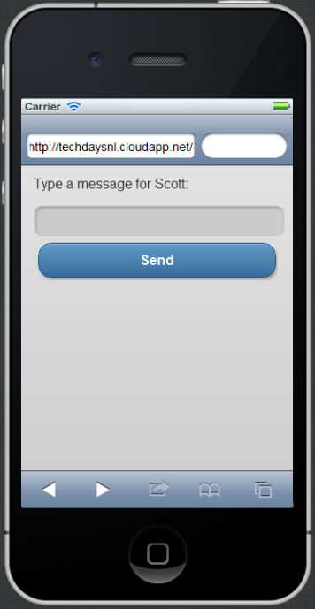




ASP.NET MVC 4 Mobile App
Service Bus Queue
Internet
Hi!
高校联盟 官方微信 unitive

Slide 55
demo
Services Bus Queues
高校联盟 官方微信 unitive

Slide 56






cloud application
service bus relay
Internet
Enterprise
app behind
firewall
高校联盟 官方微信 unitive

Slide 57
demo
Service Bus Relay
高校联盟 官方微信 unitive

Slide 58

Media Services
Create, manage and distribute content
Target any device or media format
Ingest, Encode, Protect, Stream
高校联盟 官方微信 unitive

Slide 59
demo
Media Services
高校联盟 官方微信 unitive

Slide 60
application building blocks
big data
database
storage
traffic
cloud services
caching
messaging
identity
media
CDN
networking
高校联盟 官方微信 unitive

Slide 61
Windows Azure Store
Consume services from ecosystem of partners
Easily try and purchase
Billing integrated within your Azure bill
高校联盟 官方微信 unitive

Slide 62

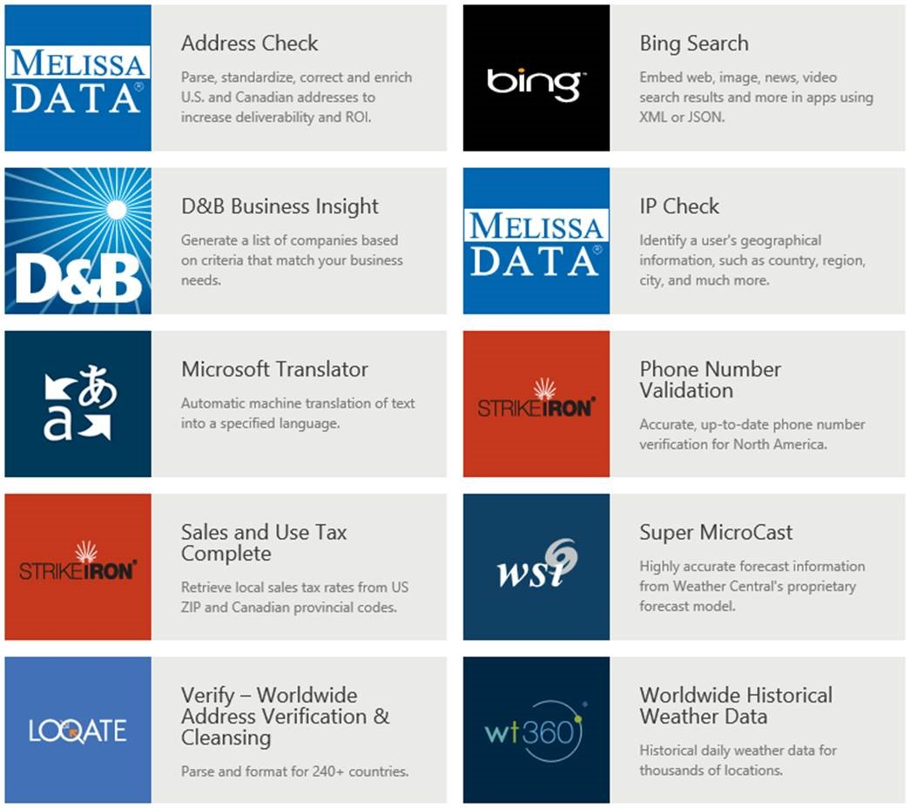
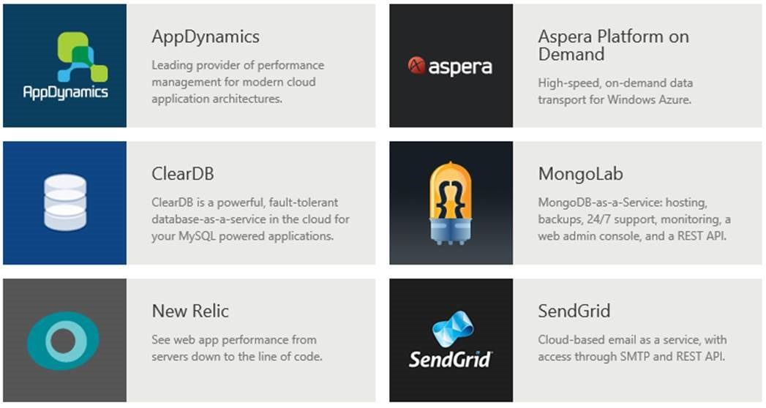

高校联盟 官方微信 unitive

Slide 63
demo
Windows Azure Store
高校联盟 官方微信 unitive

Slide 64
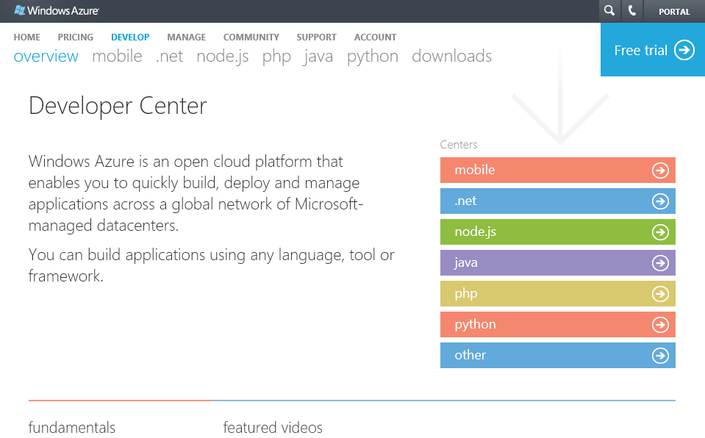
multiple languages
→ http://www.windowsazure.com/en-us/develop/overview/
高校联盟 官方微信 unitive

Slide 65
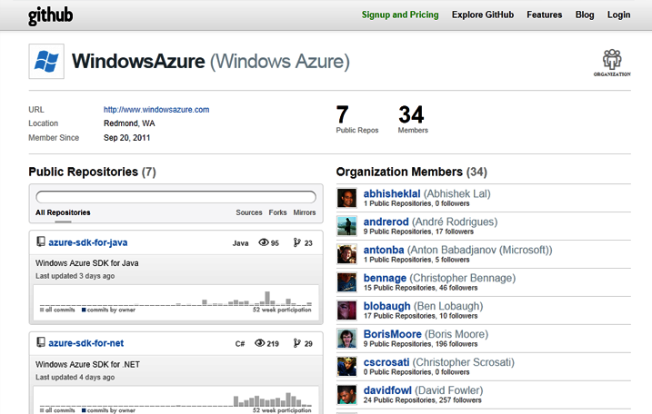
open source
→ http://github.com/windowsazure
高校联盟 官方微信 unitive

Slide 66
Australia
Austria
Belgium
Brazil
Canada
Chile
Colombia
Costa Rica
Cyprus
Czech Republic
Denmark
Finland
France
Germany
Greece
Hong Kong
Hungary
India
Ireland
Israel
Italy
Japan
Korea
Luxembourg
Malaysia
Mexico
Netherlands
New Zealand
Norway
Peru
Philippines
Poland
Portugal
Puerto Rico
Romania
Russia
Singapore
Spain
Sweden
Switzerland
Trinidad & Tobago
UK
United States
New Countries:
Algeria
89
countries and territories
Argentina
Belarus
Bulgaria
Croatia
Dominican Rep
Ecuador
Egypt
El Salvador
Estonia
Guatemala
Iceland
Indonesia
Jordan
Kazakhstan
Kenya
Kuwait
Latvia
Liechtenstein
Lithuania
Macedonia
Malta
Montenegro
Morocco
Azerbaijan
Nigeria
Oman
Pakistan
Panama
Paraguay
Qatar
Saudi Arabia
Serbia
Slovakia
Slovenia
South Africa
Sri Lanka
Taiwan
Thailand
Tunisia
Turkey
UAE
Ukraine
Uruguay
Venezuela
Bahrain
高校联盟 官方微信 unitive
Notes:
Australia
Austria
Belgium
Brazil
Canada
Chile
Colombia
Costa Rica
Cyprus
Czech Republic
Denmark
Finland
France
Germany
Greece
Hong Kong
Hungary
India
Ireland
Israel
Italy
Japan
Korea
Luxembourg
Malaysia
Mexico
Netherlands
New Zealand
Norway
Peru
Philippines
Poland
Portugal
Puerto Rico
Romania
Russia
Singapore
Spain
Sweden
Switzerland
Trinidad & Tobago
UK
United States
New Countries:
Algeria
Argentina
Azerbaijan
Bahrain
Belarus
Bulgaria
Croatia
Dominican Rep
Ecuador
Egypt
El Salvador
Estonia
Guatemala
Iceland
Indonesia
Jordan
Kazakhstan
Kenya
Kuwait
Latvia
Liechtenstein
Lithuania
Macedonia
Malta
Montenegro
Morocco
Nigeria
Oman
Pakistan
Panama
Paraguay
Qatar
Saudi Arabia
Serbia
Slovakia
Slovenia
South Africa
Sri Lanka
Taiwan
Thailand
Tunisia
Turkey
UAE
Ukraine
Uruguay
Venezuela

Slide 67
Windows Azure
flexible
open
solid
高校联盟 官方微信 unitive
Notes:
With today’s release, Windows Azure is more flexible than ever.
Windows Azure helped pioneer the concept of Platform as a Service – and provides a rich set of managed, scalable services. Today, we are making these services even richer.
Windows Azure also now supports Infrastructure as a Service – including the ability to host both Windows and Linux Virtual Machines in the cloud.
Some of you might be surprised to hear the word Linux at a Microsoft event. Our support of Linux is just one example of how we are embracing openness in a fundamental new way.
With today’s release, we are supporting more operating systems, more languages, more open protocols, and releasing all of our SDKs on GitHub under an open source license.
The end result is a truly unique offering.
You can now use both Platform as a Service and Infrastructure as a Service together.
You can now use the best of both the Microsoft ecosystem and open source ecosystem together.
And you can now build better and more scalable solutions than ever before.

Slide 68

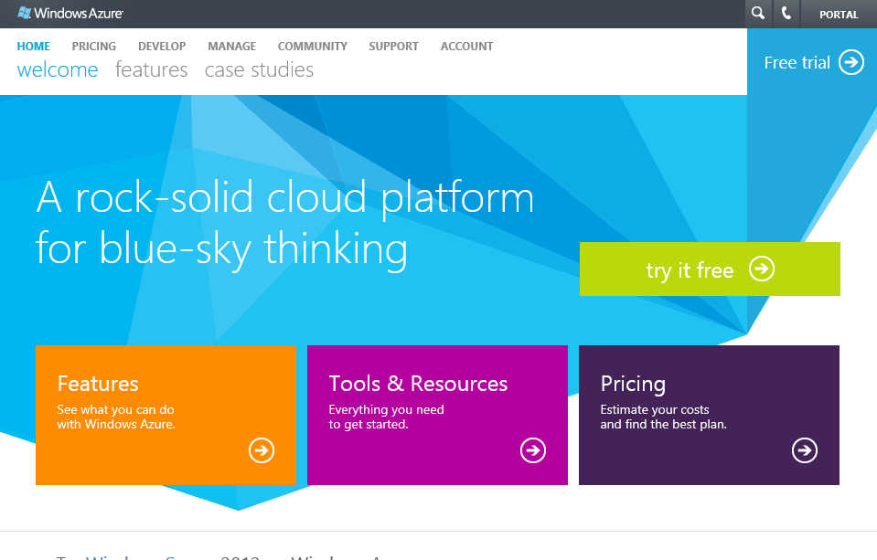
start now.
http://WindowsAzure.com
高校联盟 官方微信 unitive

Slide 69

© 2011 Microsoft Corporation. All rights reserved. Microsoft, Windows, Windows Vista and other product names are or may be registered trademarks and/or trademarks in the U.S. and/or other countries.
The information herein is for informational purposes only and represents the current view of Microsoft Corporation as of the date of this presentation. Because Microsoft must respond to changing market conditions, it should not be interpreted to be a commitment on the part of Microsoft, and Microsoft cannot guarantee the accuracy of any information provided after the date of this presentation. MICROSOFT MAKES NO WARRANTIES, EXPRESS, IMPLIED OR STATUTORY, AS TO THE INFORMATION IN THIS PRESENTATION.
高校联盟 官方微信 unitive

