Slide 1
Icons
notebook,
learning
mouse
learn, ideas
file, paper
share, concepts
share,
speech bubble
play, fun,
entertainment
share,
speech bubble
thought bubble
coffee,
work, office
computer monitor
luggage, travel
badge, registration
global, location
the cloud
search, learning
airplane, travel
this way,
look here
decorative arrow
this way, arrow
Birds of a feather
finance, calculator
this way, arrow
hands-on labs
twitter
this way, connect
高校联盟 官方微信 unitive

Slide 2
Icons Reversed
notebook,
learning
mouse
learn, ideas
file, paper
share, concepts
share,
speech bubble
play, fun,
entertainment
share,
speech bubble
thought bubble
coffee,
work, office
computer monitor
luggage, travel
badge, registration
global, location
the cloud
search, learning
airplane, travel
this way,
look here
decorative arrow
this way, arrow
Birds of a feather
finance, calculator
this way, arrow
hands-on labs
twitter
this way, connect
高校联盟 官方微信 unitive

Slide 3


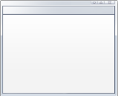



Asap asynchronicity
  Synchronicity encourages dependency, avoid dependency if at all possible
  Loosely couple “process” from “process-trigger”
  And try to process “as soon as possible.”
高校联盟 官方微信 unitive

Slide 4










application building blocks
big data
database
storage
traffic
caching
messaging
identity
media
CDN
networking
高校联盟 官方微信 unitive

Slide 5
cloud data services
big data
database
storage
traffic
caching
messaging
identity
media
CDN
networking
高校联盟 官方微信 unitive

Slide 6




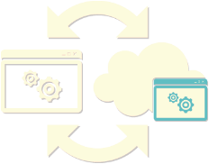

Common Scenarios
Public Cloud
SQL Server in a Windows Azure Virtual Machine
move existing
tier 2 & 3 apps
develop
& test
backup database
to the cloud
extend on-prem
applications
高校联盟 官方微信 unitive
Notes:
Slide Objectives:
Explain the benefits of Virtual Machines + SQL Server
Speaking Points:
Notes:

Slide 7
application building blocks
big data
database
storage
traffic
caching
messaging
identity
media
CDN
networking
高校联盟 官方微信 unitive

