Slide 1
Module 7
Using Classification and Clustering with Azure Machine Learning Models
Notes:
Azure Learning Pass
There are demonstrations and labs in this course that require access to Microsoft® Azure®. You need to allow sufficient time for the setup and configuration of a Microsoft Azure pass that will give access for you and your students.
Details of how to acquire Microsoft Azure passes are available here:
Access to Microsoft Learning Azure Passes for Students of Authorized Microsoft Learning Partners
https://aka.ms/ftte6f
20774A
07: Using Classification and Clustering with Azure Machine Learning Models

Slide 2
Module Overview
Using classification algorithms Clustering techniques Selecting algorithms
Notes:
20774A
07: Using Classification and Clustering with Azure Machine Learning Models

Slide 3
Lesson 1: Using classification algorithms
Understanding classification Two-class classification Multiclass classification Evaluating classification-based models Demonstration: Using Azure ML Studio modules for classification
Notes:
20774A
07: Using Classification and Clustering with Azure Machine Learning Models

Slide 4
Understanding classification
Classification places individual items into categories
Classification can be two-class classification or multiclass classification
Notes:
20774A
07: Using Classification and Clustering with Azure Machine Learning Models

Slide 5
Two-class classification
Nonlinear Regression
Linear Regression
Notes:
20774A
07: Using Classification and Clustering with Azure Machine Learning Models

Slide 6
Multiclass classification
Multiclass logistic regression
Multiclass decision forest
Multiclass decision jungle
Multiclass neural network
One-vs-all
Notes:
20774A
07: Using Classification and Clustering with Azure Machine Learning Models

Slide 7
Evaluating classification-based models
Two-class or multiclass?
Use Azure Machine Learning: Algorithm Cheat Sheet
Test models against data
Notes:
20774A
07: Using Classification and Clustering with Azure Machine Learning Models

Slide 8
Demonstration: Using Azure ML Studio modules for classification
In this demonstration, you will see how to:
Use Azure Machine Learning Studio to create a classification model
Notes:
Preparation Steps
Ensure that the MT17B-WS2016-NAT, 20774A-LON-DC, and 20774A-LON-DEV virtual machines are running, and that you are logged on to 20774A-LON-DEV as ADATUM\AdatumAdmin.
Demonstration Steps
On the 20774A-LON-DEV virtual machine, open Internet Explorer and browse to https://studio.azureml.net.
On the Microsoft Azure Machine Learning Studio page, click Sign in here.
Sign in with your Microsoft account credentials to Machine Learning Studio.
Ensure that EXPERIMENTS is selected in the navigation pane, and then click + NEW to create an experiment.
Click Blank Experiment.
From the experiment items, expand Saved Datasets.
Expand Samples.
Drag Adult Census Income Binary Classification dataset to the workspace near the top.
From the experiment items, expand Data Transformation.
Expand Manipulation.
Drag Select Columns in Dataset below the saved dataset on the workspace.
Drag the output from the saved dataset to the input on Select Columns in Dataset.
Click Select Columns in Dataset and, in Properties, click Launch column selector.
In the first column, click WITH RULES.
Under Begin With, select ALL COLUMNS.
In the first column select Exclude.
20774A
07: Using Classification and Clustering with Azure Machine Learning Models
(More notes on the next slide)

Slide 9
Notes:
In the second column select column names.
Click in the third column and select fnlwgt, capital-gain, and capital-loss.
Click the tick on the bottom right of the dialog box.
From the experiment items, expand Data Transformation.
Expand Sample and Split.
Drag Split Data below the Select columns in dataset module on the workspace.
Select Split data module.
In Properties, change the Fraction of rows in the first output dataset value to 0.75.
Drag the output from the Select columns in dataset module to the Split Data module.
From the experiment items, expand Machine Learning, expand Initialize Model, and expand Classification.
Drag Two-Class Boosted Decision Tree to your workspace to the left of the Split Data module.
From the experiment items, expand Machine Learning and expand Train.
Drag Train Model to your workspace beneath Split Data.
Drag the first result dataset from Split Data to the right-hand input for Train Model.
Drag the output from Two-Class Boosted Decision Tree to the left-hand input for Train Model.
Select the Train Model module and, in Properties, click Launch column selector.
Click Press enter to enter a column name and select or type income.
Click the tick on the bottom-right of the dialog box.
From the experiment items, expand Machine Learning and expand Score.
Drag Score Model to your workspace beneath Train Model.
(More notes on the next slide)
20774A
07: Using Classification and Clustering with Azure Machine Learning Models

Slide 10
Notes:
37. Drag the output from Train Model to the left-hand input of Score Model and drag the right-hand output of Split Data to the right-hand input of Score Model.
Right-click Score Model and click Run selected.
When the model run has completed, right-click Score Model, point to Scored dataset, and click Visualize.
Click Age and note that the chances of having a high salary increase with age up to a point and then dramatically decrease.
Close the visualization by clicking the x at the top-right of the window.
From the experiment items, expand Machine Learning, expand Evaluate, and drag Evaluate Model to the workspace beneath Score Model.
Drag the output from Score Model to the left-hand input of Evaluate Model.
Right-click Evaluate Model and click Run selected.
When the model run has completed, right-click Evaluate Model, point to Evaluation results, and click Visualize.
Note the true and false positives and negatives.
Close the visualization by clicking the x at the top-right of the window.
Question
You want to use a Support Vector Machine algorithm with four possible outcomes. How can you achieve this?
( ) Option 1: This is not possible.
( ) Option 2: You can change the Number of Classifications value to 4.
( ) Option 3: You can use the Multiclass Support Vector Machine Algorithm.
( ) Option 4: You can use multiple Support Vector Machine Algorithms with the One-vs-all algorithm.
Answer
(√) Option 4: You can use multiple Support Vector Machine Algorithms with the One-vs-all algorithm.
(More notes on the next slide)
20774A
07: Using Classification and Clustering with Azure Machine Learning Models

Slide 11
Lesson 2: Clustering techniques
Understanding clustering The K-Means clustering algorithm Anomaly detection Demonstration: Using clustering in Azure ML Studio
Notes:
20774A
07: Using Classification and Clustering with Azure Machine Learning Models

Slide 12
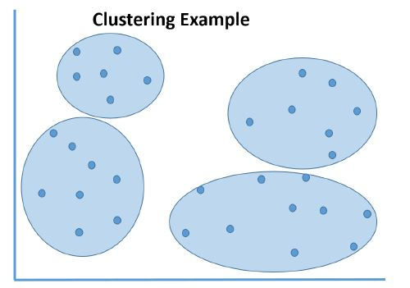
Understanding clustering
Notes:
20774A
07: Using Classification and Clustering with Azure Machine Learning Models

Slide 13
The K-Means clustering algorithm
Items are added to the cluster with the closest mean value
Mean value affects membership and membership affects mean value—therefore several iterations are required
After the K-Means algorithm, data should go through the Train Clustering Model module or the Sweep Clustering module
Notes:
20774A
07: Using Classification and Clustering with Azure Machine Learning Models

Slide 14
Anomaly detection
Anomaly detection searches for unusual values
Useful for fraud detection
Can be difficult to train due to limited anomalies in training data
Machine Learning has two algorithms:
One-class support vector machine
PCA-based anomaly detection
Notes:
20774A
07: Using Classification and Clustering with Azure Machine Learning Models

Slide 15
Demonstration: Using clustering in Azure ML Studio
In this demonstration, you will see how to:
Use clustering in Azure Machine Learning Studio
Notes:
Demonstration Steps
On the 20774A-LON-DEV virtual machine, open Internet Explorer and browse to https://studio.azureml.net.
On the Microsoft Azure Machine Learning Studio page, click Sign in here.
Sign in with your Microsoft account credentials to Machine Learning Studio.
Ensure that EXPERIMENTS is selected in the navigation pane, and then click + NEW to create an experiment.
Click Blank Experiment.
From the experiment items, expand Saved Datasets.
Expand Samples.
Drag the Forest fires data dataset to the workspace near the top.
From the experiment items, expand Data Transformation, expand Manipulation, and drag Select Columns in Dataset beneath Forest fires data.
Drag the output from Forest fires data to the input for Select Columns in Dataset.
Click Select Columns in Dataset.
In Properties, click Launch column selector.
In AVAILABLE COLUMNS, select temp and click the button to add this to SELECTED COLUMNS.
Repeat step 13 for RH, wind, rain, and month.
Click the tick to confirm the selected columns.
From the experiment items, expand Machine Learning, expand Initialize Model, expand Clustering, and drag K-Means Clustering to the workspace adjacent to Select Columns in Dataset.
From the experiment items, expand Machine Learning, expand Train, and drag Train Clustering Model to the workspace beneath Select Columns in Dataset.
20774A
07: Using Classification and Clustering with Azure Machine Learning Models
(More notes on the next slide)

Slide 16
Notes:
Drag the output from K-Means Clustering to the left input of Train Clustering Model.
Drag the output of Select Columns in Dataset to the right input of Train Clustering Model.
Click Train Clustering Model, and, in Properties, click Launch column selector.
Type temp, RH, wind, rain, month.
Click the tick to confirm the selected columns.
From the experiment items, expand Machine Learning, expand Score, and drag Assign Data to Clusters beneath Train Clustering Model.
Drag the left-hand output from Train Clustering Model to the left-hand input for Assign Data to Clusters.
Drag the right-hand output from Train Clustering Model to the right-hand input for Assign Data to Clusters.
Right-click Assign Data to Clusters and click Run selected.
When the model has been run, from the experiment items, expand Data Transformation, expand Manipulation, and drag Select Columns in Dataset beneath Assign Data to Clusters.
Drag the output from Assign Data to Clusters to the input for the lower Select Columns in Dataset.
Click the lower Select Columns in Dataset module and, in Properties, click Launch column selector.
Select Assignments and click the arrow to add it to SELECTED COLUMNS.
Repeat Step 30 for month and rain.
Click the tick to confirm the selected columns.
Right-click the lower Select Columns in Dataset and click Run selected.
(More notes on the next slide)
20774A
07: Using Classification and Clustering with Azure Machine Learning Models

Slide 17
Notes:
When the model has run, right-click the lower Select Columns in Dataset, point to Results dataset, and click Visualize.
Click the month column and, in Visualizations, change compare to to Assignments.
Note that both groups increase in August and September, but to different degrees.
Close the visualization by clicking the x at the top-right of the window.
Question
If many new, similar members are added, what effect can this have on the clusters?
( )Option 1: It will never affect the clusters; the new members will just join the nearest cluster.
( )Option 2: The new members can affect the mean value of the cluster which could change cluster membership.
( )Option 3: The new members will automatically form a new cluster.
( )Option 4: New members cannot be added if they will not be members of an existing cluster.
Answer
(√) Option 2: The new members can affect the mean value of the cluster which could change cluster membership.
(More notes on the next slide)
20774A
07: Using Classification and Clustering with Azure Machine Learning Models

Slide 18
Lesson 3: Selecting algorithms
An overview of choosing Machine Learning algorithms The Algorithm Cheat Sheet Evaluating a model
Notes:
20774A
07: Using Classification and Clustering with Azure Machine Learning Models

Slide 19
An overview of choosing Machine Learning algorithms
Narrow down choice of algorithms with Algorithm Cheat Sheet
Test algorithms with historic data
Notes:
20774A
07: Using Classification and Clustering with Azure Machine Learning Models

Slide 20
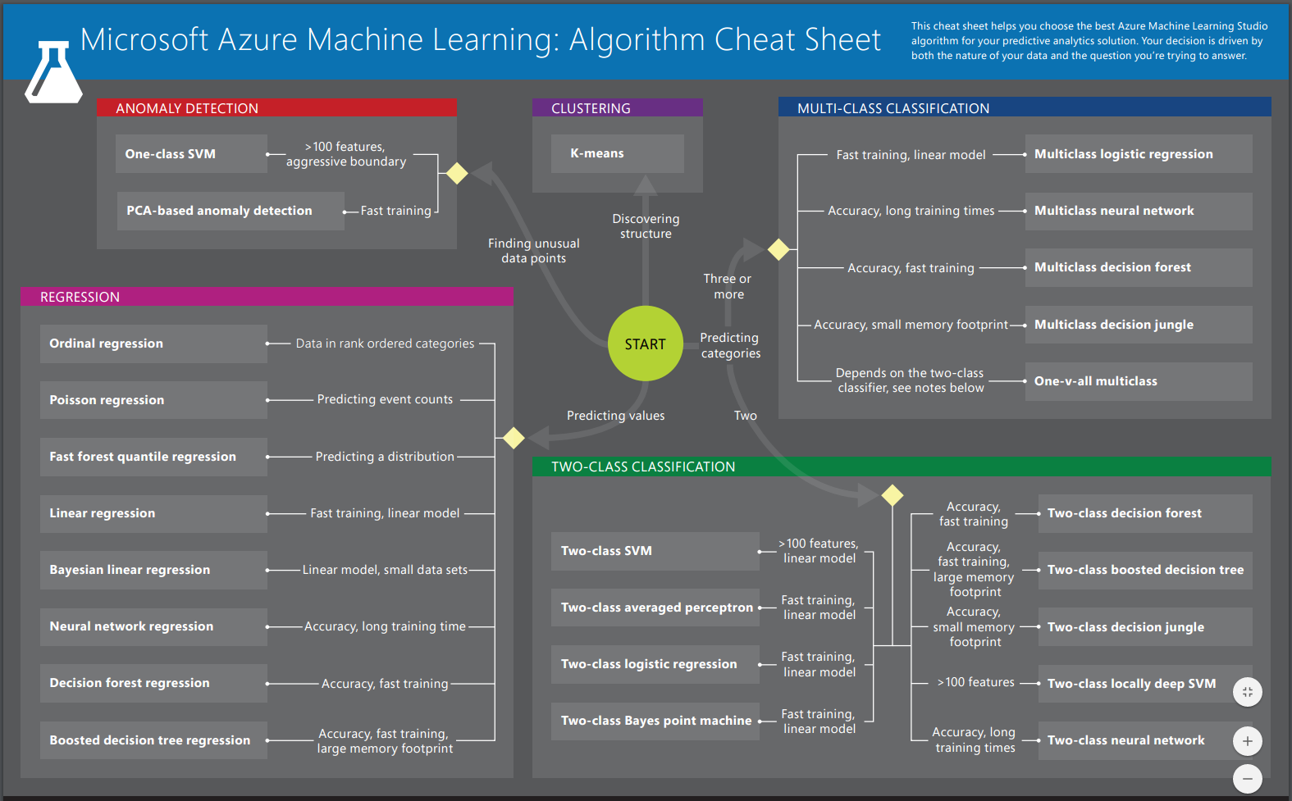
The Algorithm Cheat Sheet
Machine Learning Cheat Sheet
Notes:
20774A
07: Using Classification and Clustering with Azure Machine Learning Models

Slide 21
Evaluating a model
Partition your data for training and testing
Use a module to evaluate your model
Notes:
Question
Discuss real world scenarios and use the Algorithm Cheat Sheet to choose a selection of algorithms that should be tested.
Answer
There is no correct answer for this discussion.
20774A
07: Using Classification and Clustering with Azure Machine Learning Models

Slide 22
Lab: Using classification and clustering with Machine Learning models
Exercise 1: Apply Azure ML Studio modules for classification Exercise 2: Working with K-Means clustering
Logon Information
Virtual machine: 20774A-LON-DEV
User name: ADATUM\AdatumAdmin
Password: Pa55w.rd
Estimated Time: 45 minutes
Notes:
20774A
07: Using Classification and Clustering with Azure Machine Learning Models

Slide 23
Lab Scenario
You work as a data scientist for Adatum Consultants, a company that provides machine learning services and advice for a range of clients. Some of your clients are looking to use machine learning for insights from operational data sources throughout their organizations.
Notes:
20774A
07: Using Classification and Clustering with Azure Machine Learning Models

Slide 24
Lab Review
In this lab, you used classification and clustering to group individual data items.
Notes:
20774A
07: Using Classification and Clustering with Azure Machine Learning Models

Slide 25
Module Review and Takeaways
In this module, you learned how to:
Apply classification algorithms
Use clustering techniques
Choose machine learning algorithms
Notes:
20774A
07: Using Classification and Clustering with Azure Machine Learning Models

