Slide 1
Data integration
Kenny Billiau

Slide 2
Outline
Who am I?
What should I do?
What have I done?
What I need you for!

Slide 3
Who Am I?
Kenny Billiau (pronounced: bi-joo)
Born 1981
Raised in Menen, Belgium

Slide 4
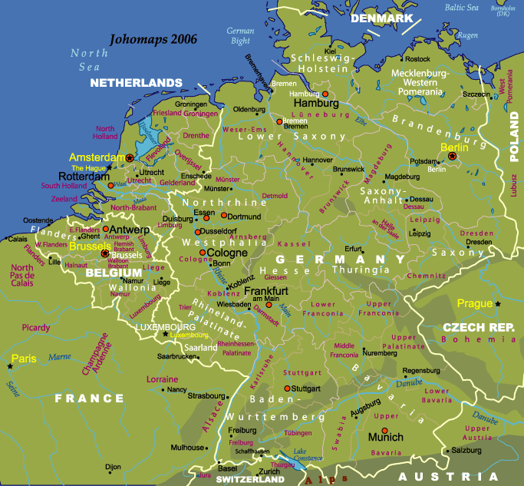
Belgium?

Slide 5
Who Am I?
From 1999 until 2003: studied Engineering at Hogeschool West-Vlaanderen in Kortrijk
From 2004 until 2006: studied more Engineering with speciality computer science at Hogeschool Gent
Master thesis: Automatic update process of an rRNA database
From 2006 until 2010: worked in the bioinformatics group of Yves Van de Peer as web developer
  General Support: supplementary data websites, ...
  Teaching MySQL at University of Gent
  BOGAS: Bioinformatics Online Genome Annotation System
  PLAZA: Comparative Genomics Platform

Slide 6
What should I do?
Get to know the project!
Come up with data integration concepts for goFORSYS
  Data Handling
  Data Collection
  Data Storage
  Data Retrieval
  General Organization

Slide 7
What have I done?
Get to know the project
  Talking to everybody
    Who are the data producers?
    Who's the audience?
    Gathering of general lore
  Figuring out what data flows around
    How complex is everything?
  What tools is everyone using?
  What are the current solutions?

Slide 8
What have I done?
Data Integration
  Data Handling
    Talked and talked and now we have a sample identifier
    Made a website for this
  General Organization
    Got us a central access point: http://chlexda.goforsys.de
      CHLamidomonas Experiment DAta
      Peter (IT) and me have applied for the subdomain
    Documented everything on a WIKI
      Will also be available on CHLEXDA
      Is also available for you!

Slide 9
What have I done?
Data Integration
  Data Handling
    Complex data?
      You will get a personal treatment
      Timo
      Mark
      Jens
      ... ?

Slide 10
What have I done?
Data Integration
  Data Handling
    Most data is simple
      Timepoints
      Measurements
      Some meta data ...
    => Template! :)
      Excel, TAB-delimited, it's what you prefer
      It's a bit very naive :(
    Adam, Falvia, Daniel Vosloh, Tabea, Stephanie, Susann, Michael Sandmann?, Sunil?, Daniel Veyel?

Slide 11
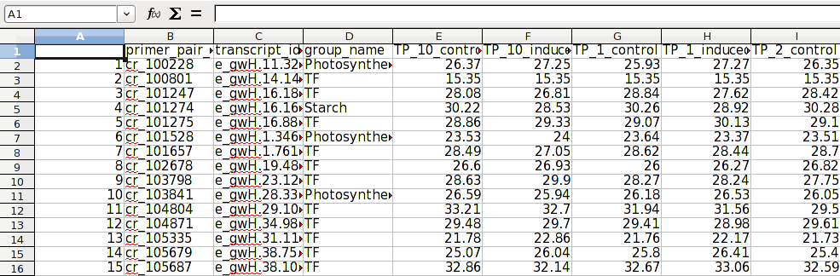
What have you done?

Slide 12
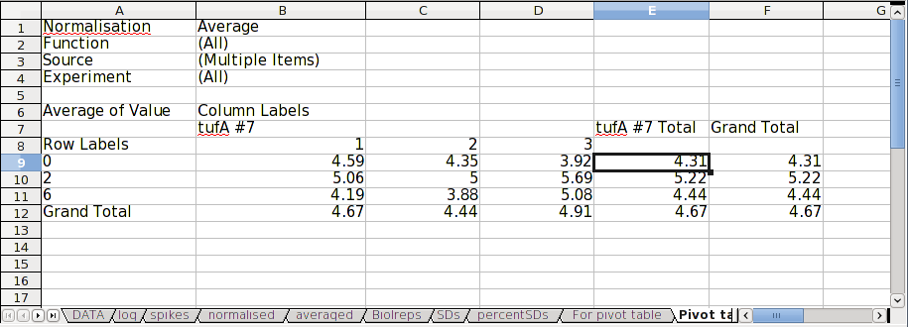
What have you done?

Slide 13
What I need you for!
Some issues I alone cannot decide on
  RAW or analyzed data?
    Remember the normalization problem?
    Do you want to give me the RAW data?
    No template possible any longer! => everyone gets a personal treatment :)

Slide 14
Thanks for our attention

