Slide 1

kk
A Project Report On
ATM Interface
By
Batch: 2021-6520
Under the Guidance of,
Chittaranjan Ghosh.
Technical Trainer
EduBridge
(School of coding)

Slide 2
Introduction
An AUTOMATED TELLER MACHINE (ATM) is an Electronic Telecommunications Device that enables customers of financial institutions to perform financial transactions, such as cash Withdrawals,
Deposits, Transfer Funds, or Obtaining Account Information, at any time
And without the need for direct interaction with bank staff. This machine also allows to check their account at any time and without the
Need for a human teller. ATM is the back bone of retail banking Sector.
Modules:-
*Customer Module
* Transaction Module
I have developed this Application in java, MySQL.

Slide 3
Function of an ATM
To dispense with Cash
To accept Deposits of cash (in certain ATMs)
To carry out non cash functions like linking of Aadhar Card to the account
To change the PIN
To Carry out certain other instructions of the customer for which he is not required to go to the Bank
Software Requirements:
Front end: Java.
Back end: MySQL workbench 8.0 CE.
Browser: Best result on Google Chrome
Operating System : Window

Slide 4
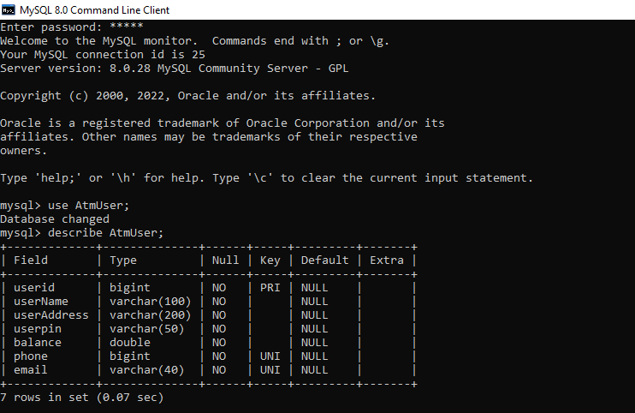
Data Dictionary:
Create Database Placement:

Slide 5
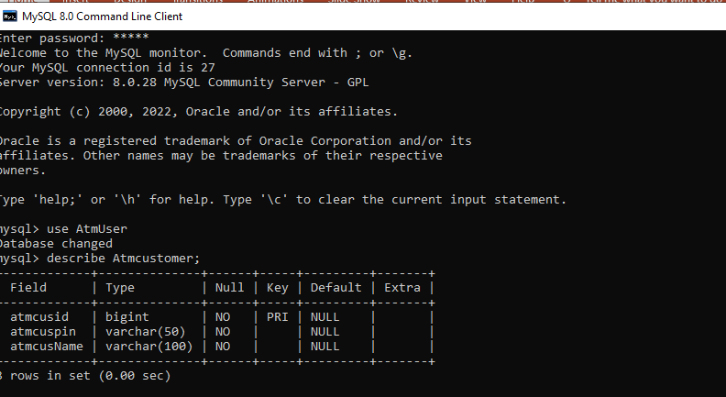

Slide 6
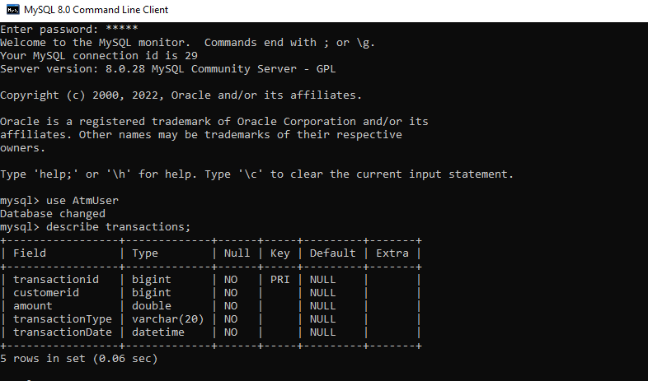

Slide 7
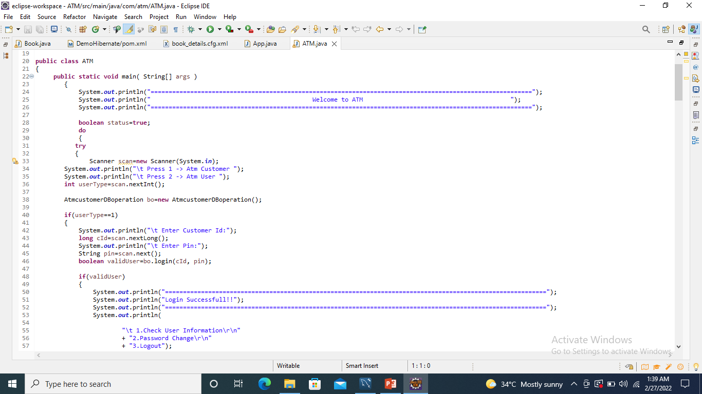
Screenshots:- Coding:-

Slide 8
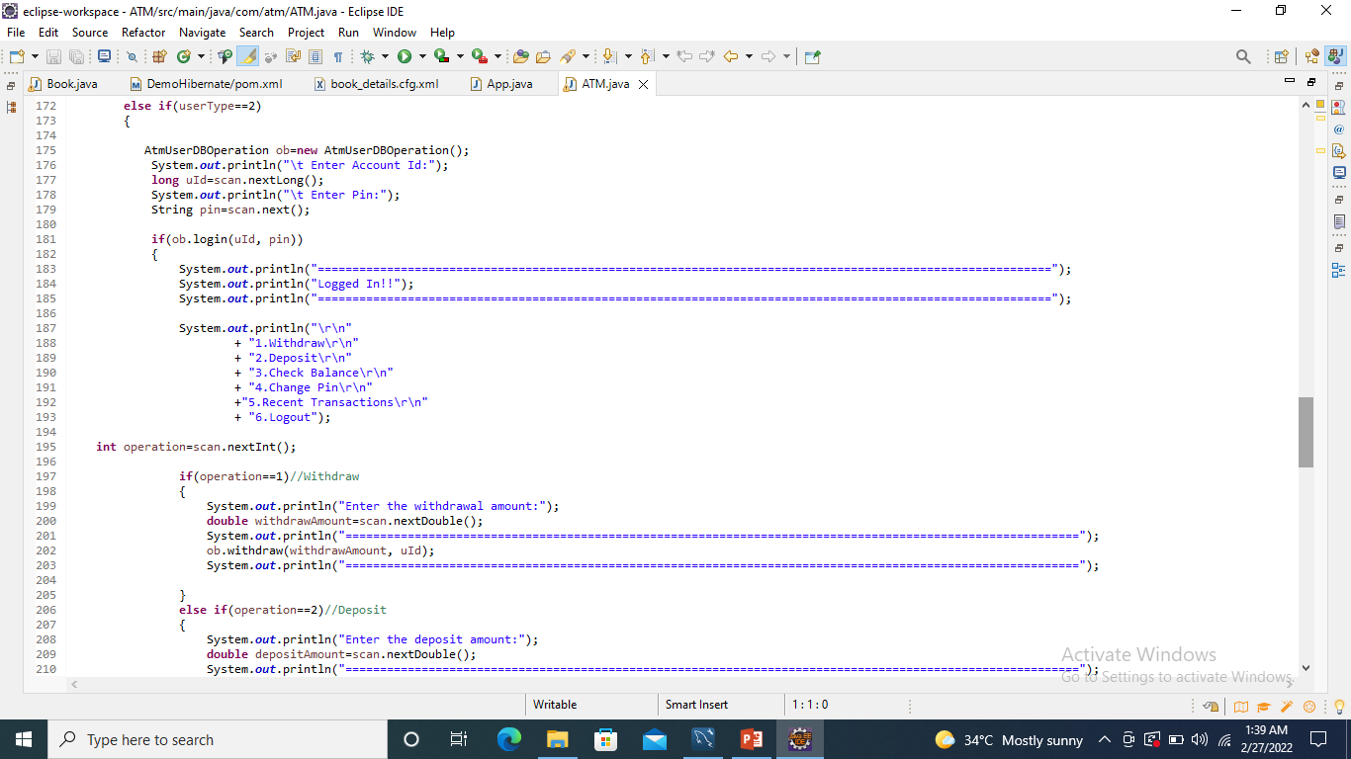

Slide 9
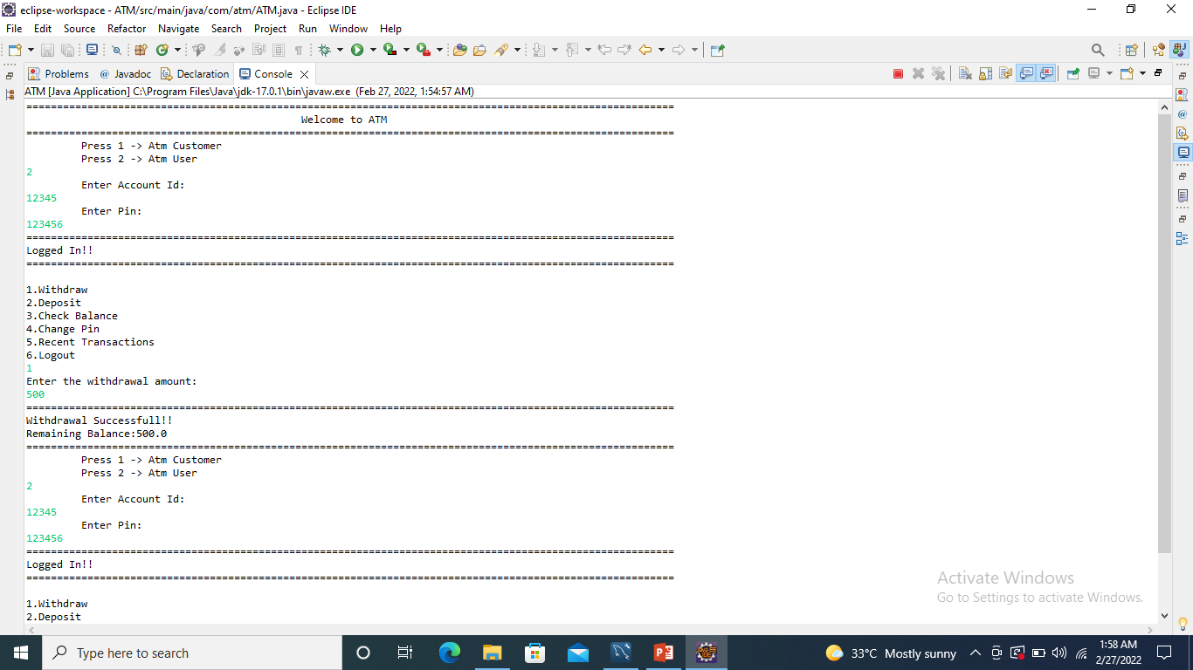
Runtime:-

Slide 10
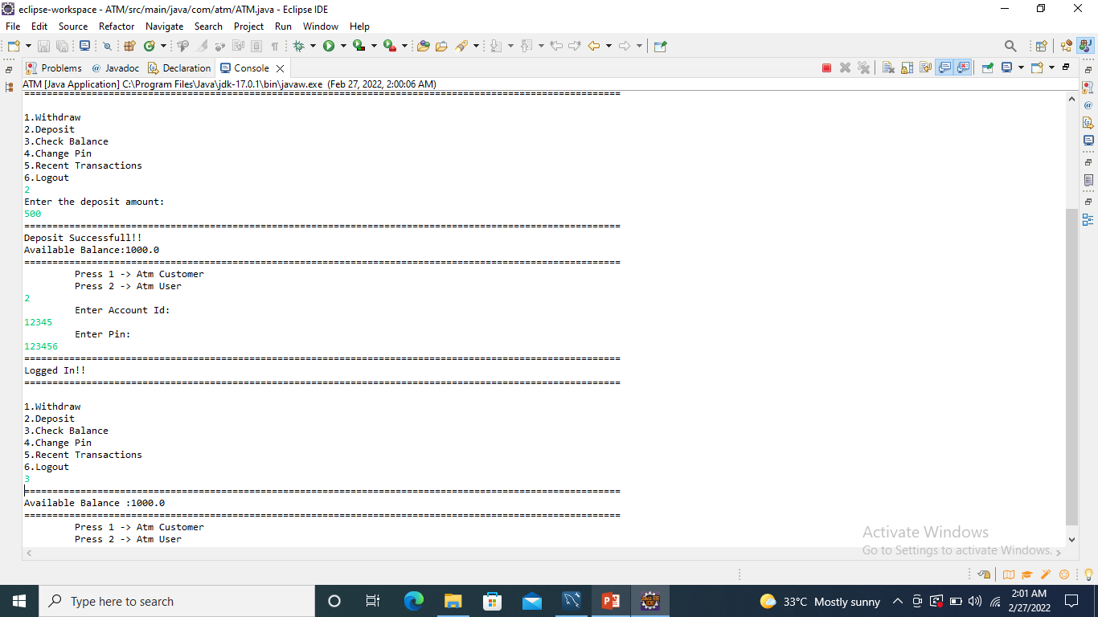

Slide 11
Thank You…..

