Slide 1

kk
A Project Report On
Grocery Shooping App
By
Mayuri Ingle
Batch: 2021-6520
Under the Guidance of,
Chittaranjan Ghosh.
Technical Trainer
EduBridge
(School of coding)

Slide 2
Introduction: OurprojectexplainsabouttheE-commerceShoppingWebsitenameMyCart.This project mainly explains the various actions related to shop online. You can search various products and shuffle according to category. Our Project Include Modules:- * Shopping Management * Customer Management * Manage Transactions
I have developed this Application in Java, JSP, Servlets, Hibernate and MySQL. It’s a web-based projects so I have used HTML, CSS, JavaScript and Bootstrap also. The main feature of the project is to make shopping easier. You can access this website from anywhere and everywhere.
In Admin module, admin can add the Category and Products in the specific category. He can also view the total number of users at present in the website. And category and product details also. Admin can only see the admin page and cart if he wants to order something.
In User module, user can access the website and buy products and products to cart and buy and shuffle by category. New user can register and login after that to shop. In Cart, admin and user both can access, they can add the products and buy if they want.

Slide 3
Software Requirements: Front end: Java/J2EE technologies (Servlet, JSP), HTML, CSS, JavaScript, Bootstrap, Hibernate. Back end: MySQL workbench 8.0.23CE. Middleware/Server: Apache Tomcat v8.5. IDE: Eclipse IDE for Java EE Developers Browser: Best result on Google Chrome Operating System: Window 10

Slide 4
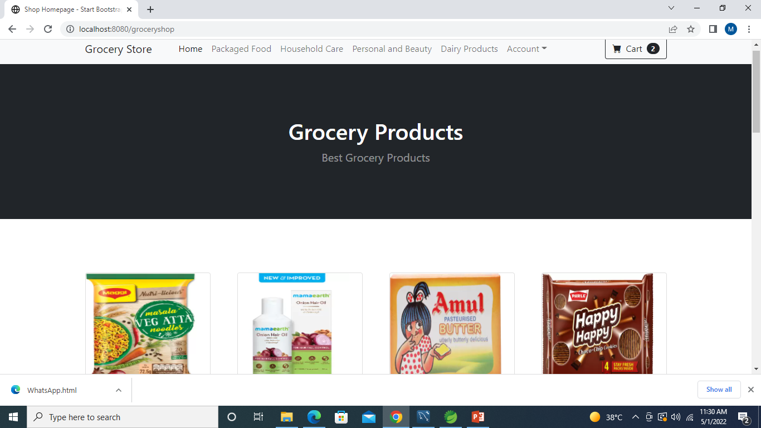
Screenshots:- Home Page:

Slide 5
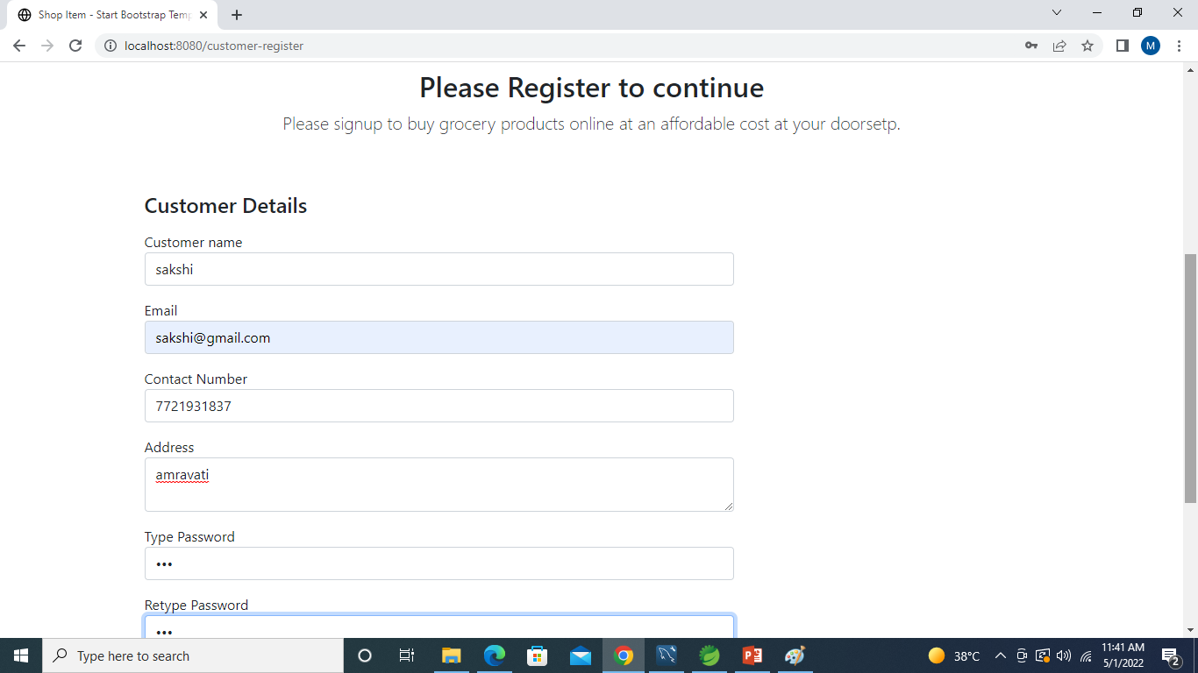
Register Page:

Slide 6
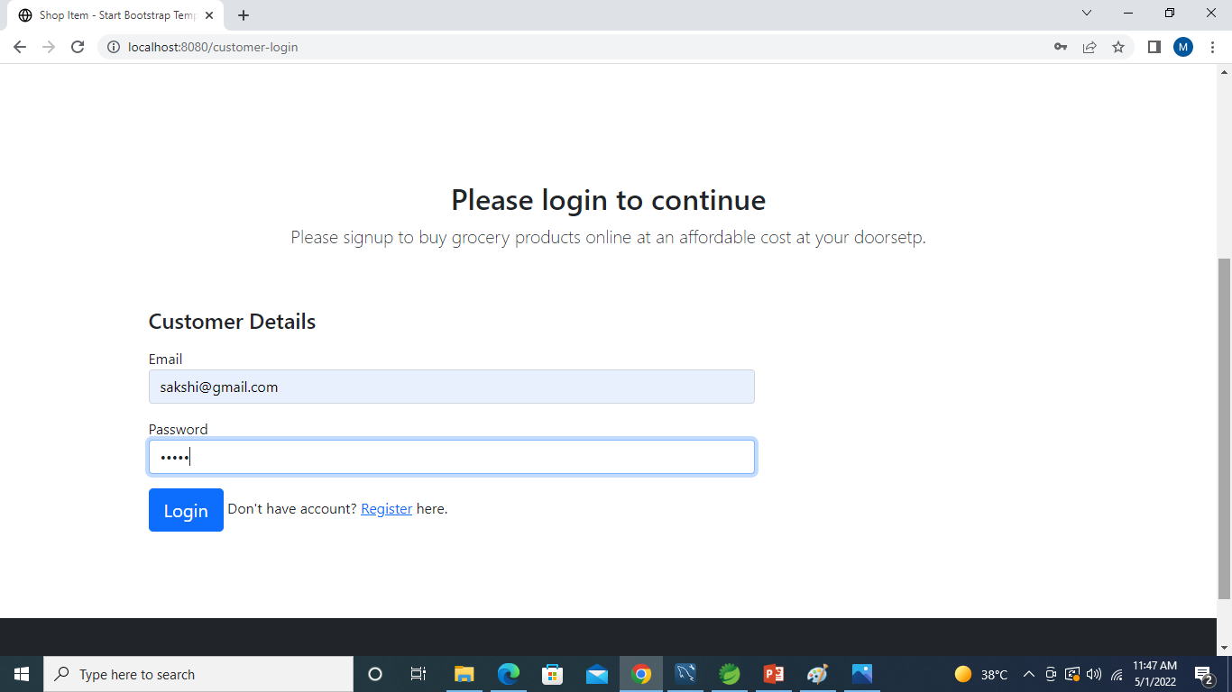
Login Page:

Slide 7
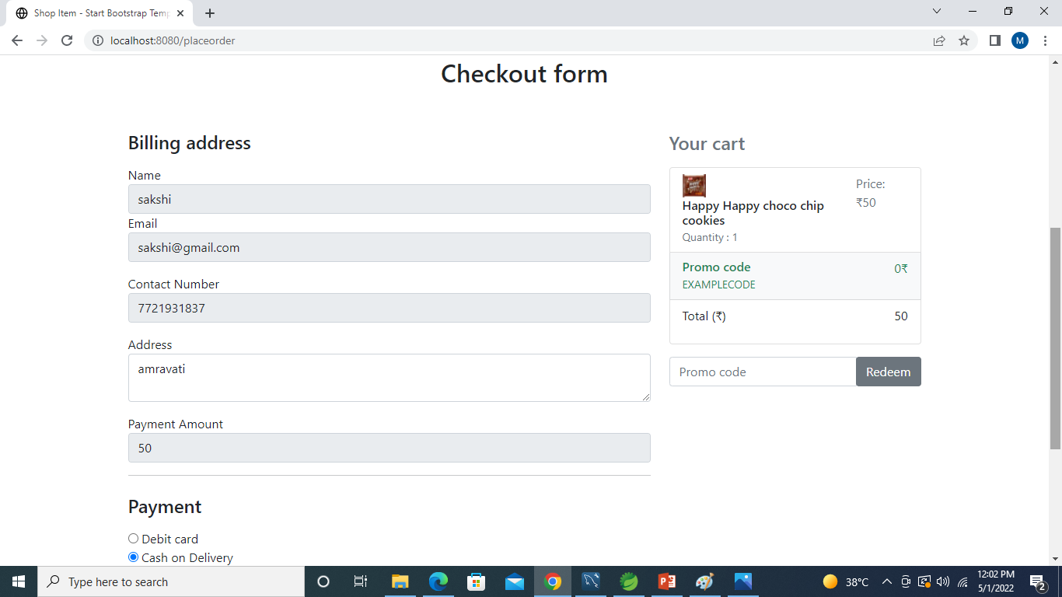
Place Order:

Slide 8
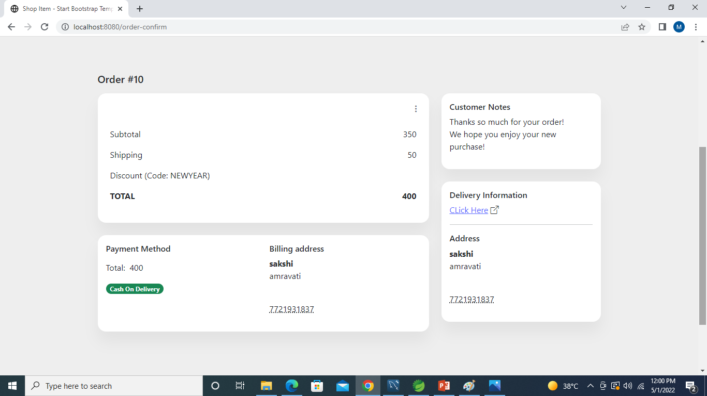
Order Conform:

Slide 9
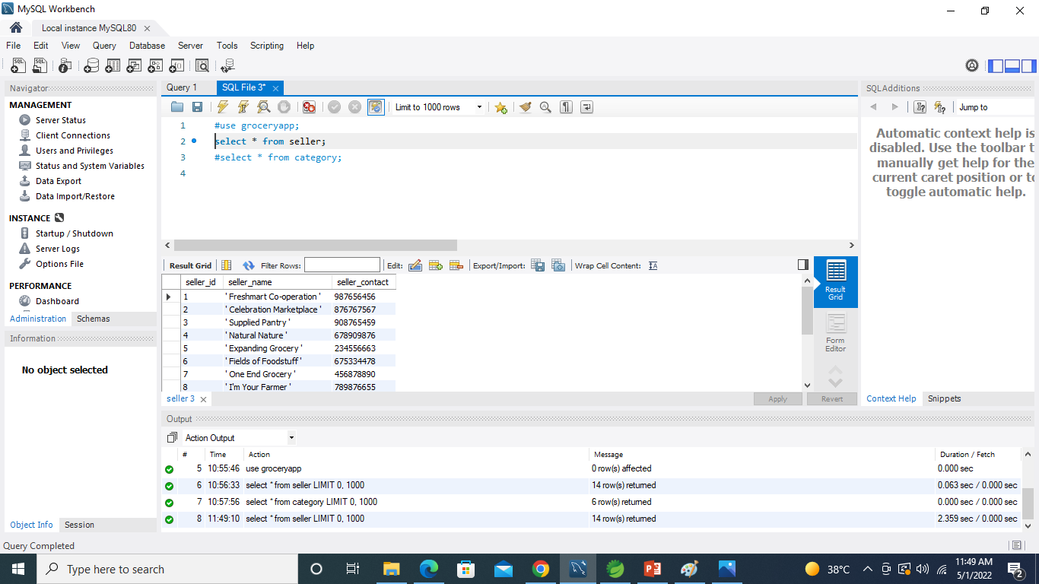
Data Added in Database SuccessFully: Table seller:

Slide 10
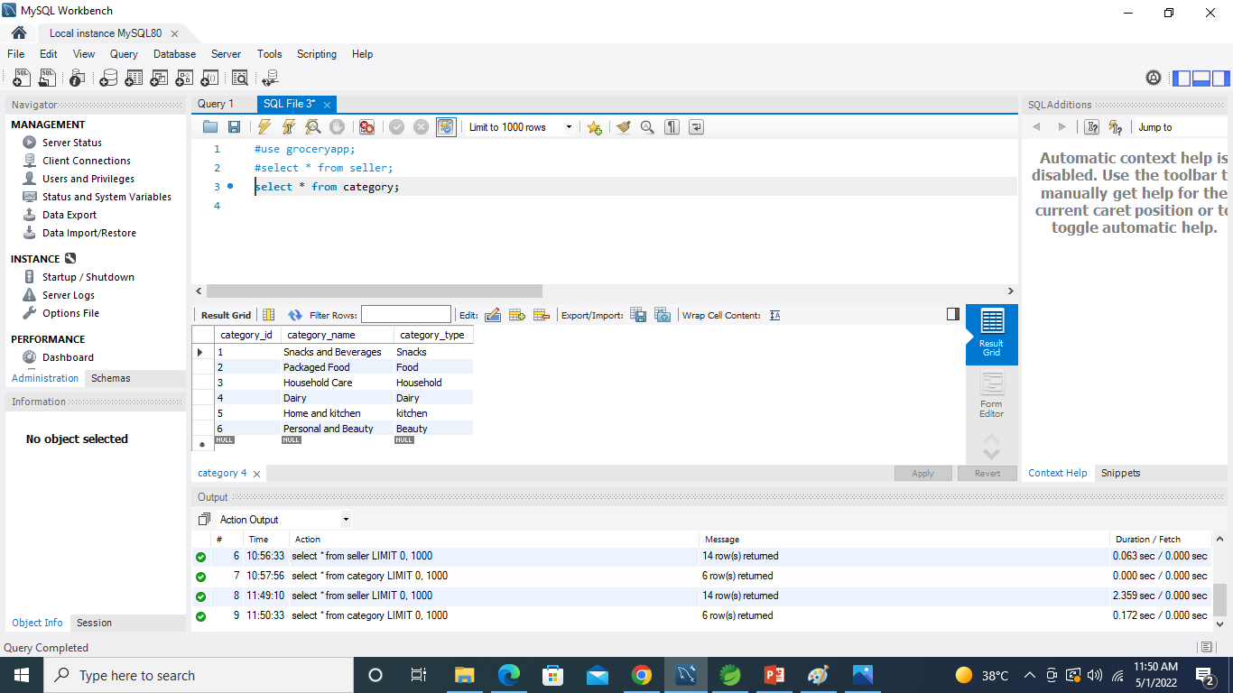
Table category:

Slide 11
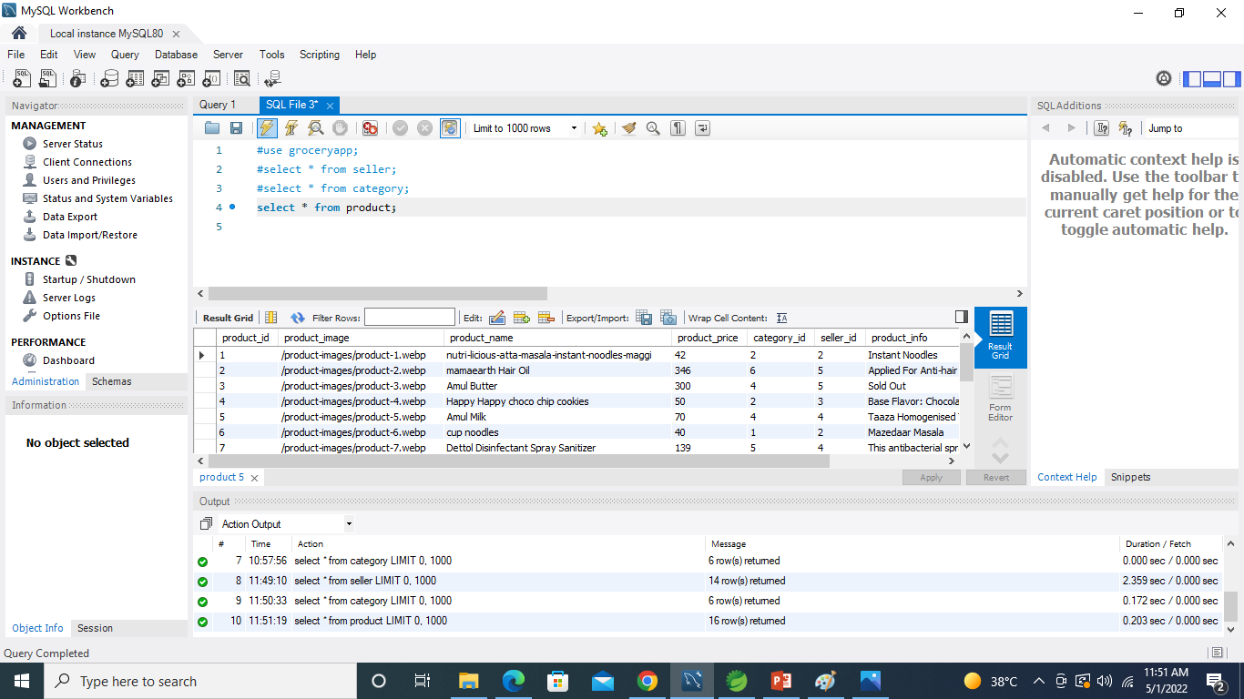
Table Product:

Slide 12
Thank You…..

