Slide 1
Selenium Web Driver Project for GlobalSQA Website
By: Shubhangi Ingle (2021-5532)
Guided By: Amruta Deore

Slide 2
Introduction About Website
This website is for Cheat sheets, Mind maps, Free EBooks.
In this project our main focus is to test the Tester’s Hub Module.
In Tester’s Hub, the different Web Element are available for testing purpose.

Slide 3
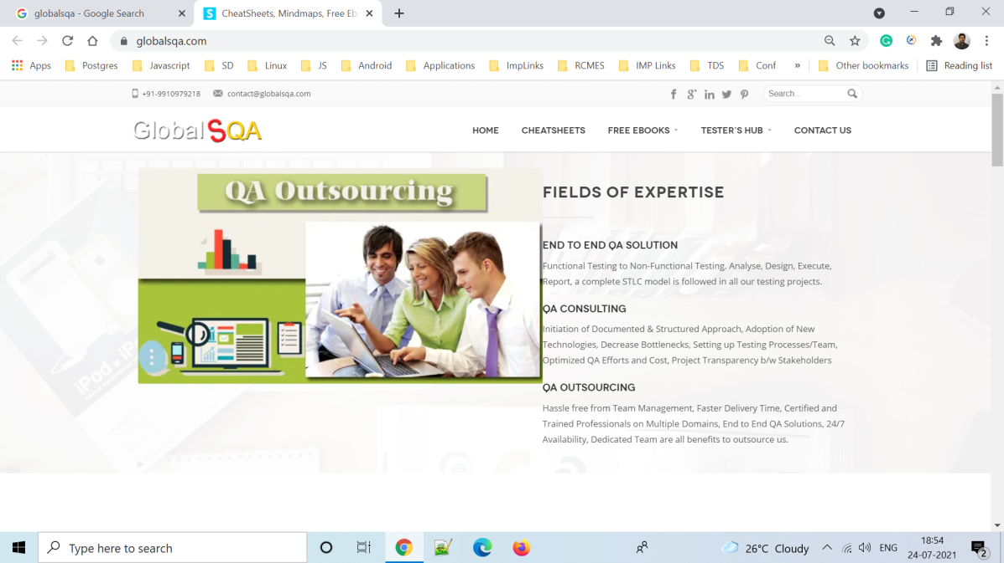
Launch the browser and GlobalSQA Website
System.setProperty("webdriver.chrome.driver", "C:\\Selenium WebDriver\\Chrome Driver\\chromedriver.exe");
WebDriver driver = new ChromeDriver();
//open webpage
driver.get("https://www.globalsqa.com/");

Slide 4
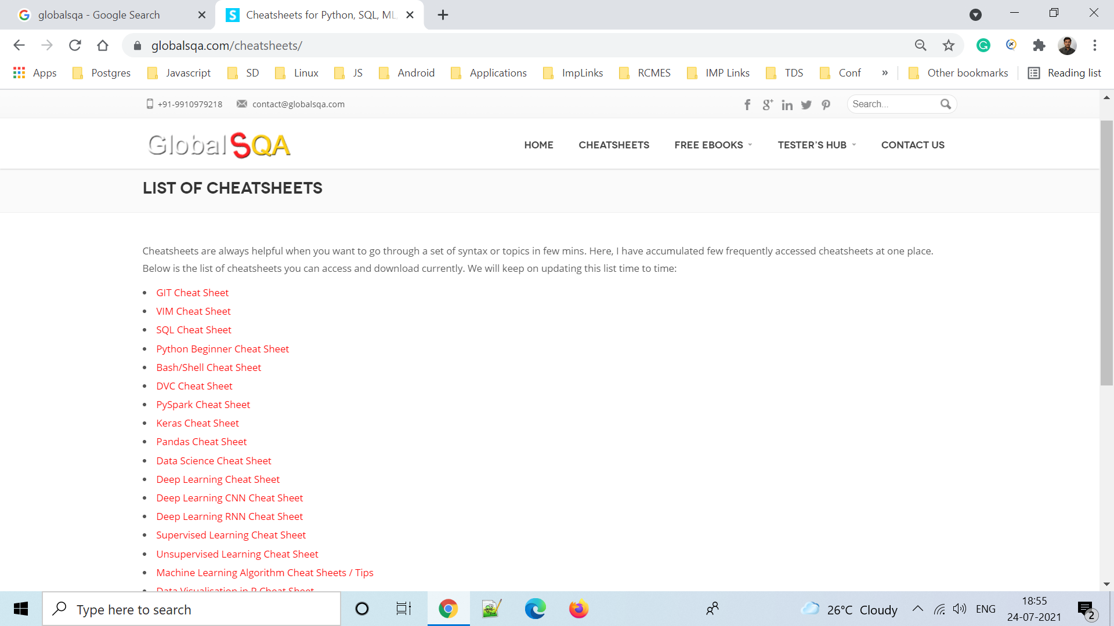
To Verify Cheat Sheet Menubar
//open cheetsheet tab
driver.findElement(By.xpath("//header/div[2]/div[1]/div[1]/div[3]/div[1]/ul[1]/li[2]/a[1]")).click();

Slide 5
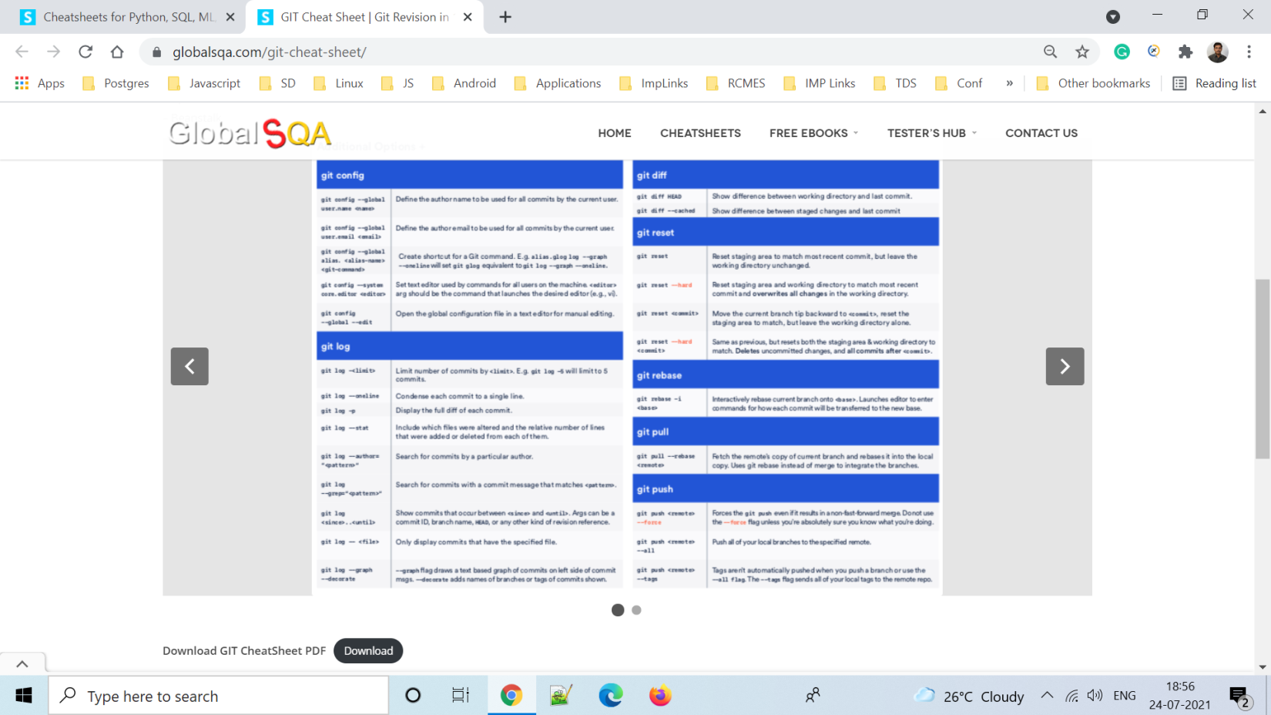
To Verify GIT Cheat Sheet Link And It is Open in New Window
//open GIT Cheat Sheet window
driver.findElement(By.xpath("//a[contains(text(),'GIT Cheat Sheet')]")).click();

Slide 6
To Verify Switching to Child Window
String Mainwindow = driver.getWindowHandle();
// To handle all new opened window
Set<String> s1 =driver.getWindowHandles();
Iterator<String> itr = s1.iterator();
while(itr.hasNext())
{
String ChildWindow = itr.next();
if(!Mainwindow.equalsIgnoreCase(ChildWindow))
{
driver.switchTo().window(ChildWindow);
//click on slide arrow button
driver.findElement(By.xpath("//body/div[@id='wrapper']/div[1]/div[2]/div[1]/div[1]/div[1]/div[1]/div[1]/a[2]")).click();
//click on slide arrow button
driver.findElement(By.xpath("//body/div[@id='wrapper']/div[1]/div[2]/div[1]/div[1]/div[1]/div[1]/div[1]/a[1]")).click();
//click on download button
driver.findElement(By.xpath("//a[contains(text(),'Download')]")).click();
Thread.sleep(3000);

Slide 7
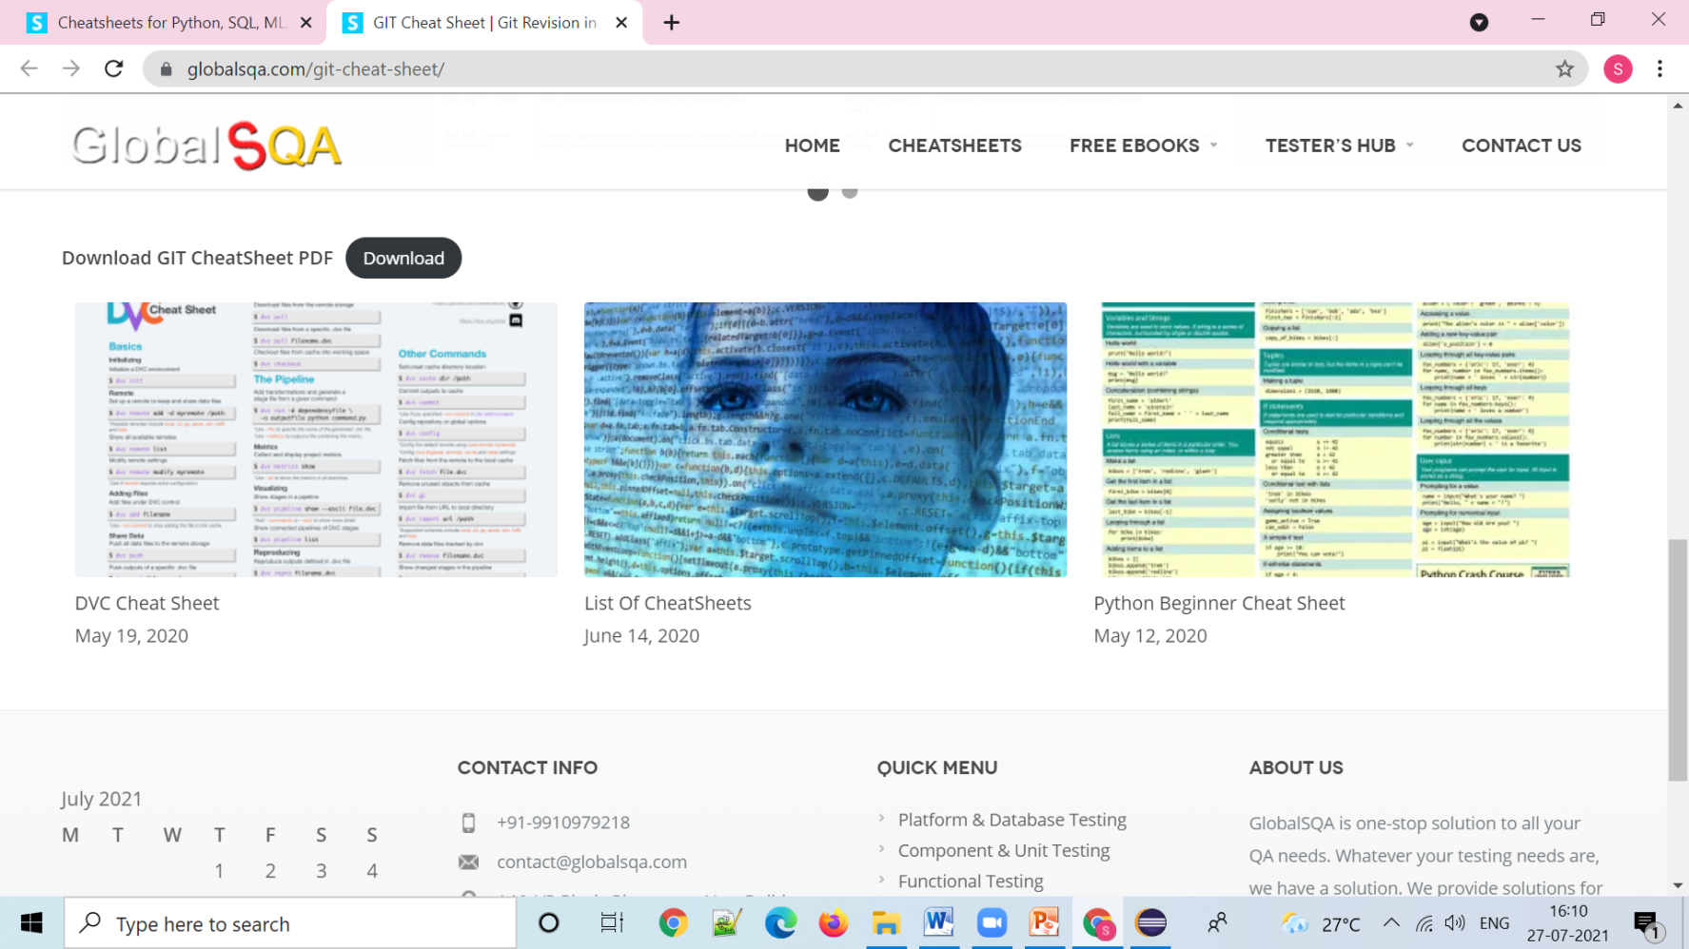
To Verify DVC Cheat Sheet Image
//click on first image DVC Cheat Sheet
driver.findElement(By.xpath("//body/div[@id='wrapper']/div[1]/div[2]/div[1]/div[1]/div[1]/nav[1]/div[1]/ul[1]/li[2]/a[1]/img[1]")).click();
Thread.sleep(3000);

Slide 8
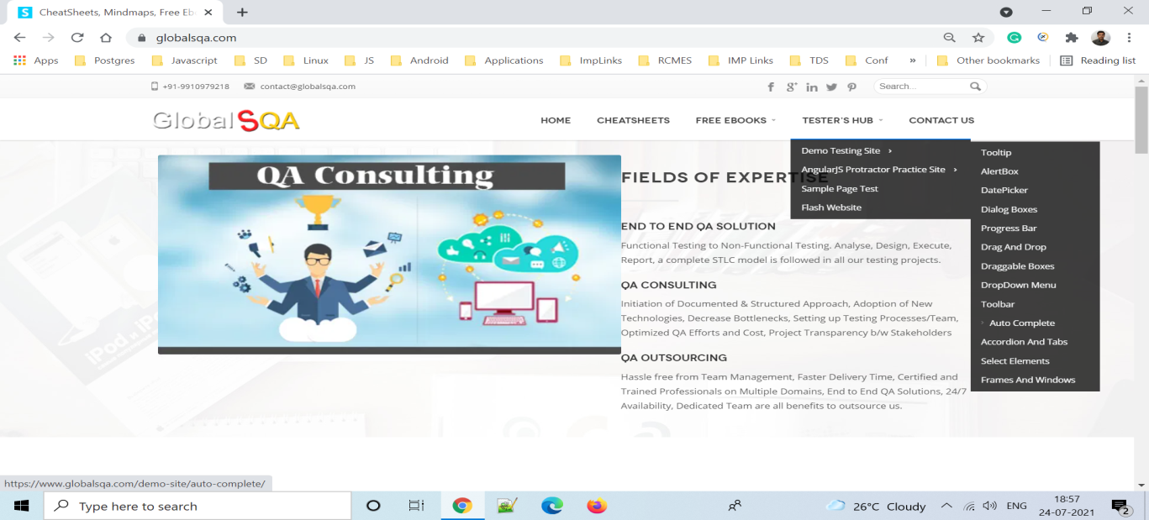
To verify Mouse Hover to Tester’s Hub and Click on AutoComplete
//TesterHub web Element
WebElement TesterHub = driver.findElement(By.xpath("//header/div[2]/div[1]/div[1]/div[3]/div[1]/ul[1]/li[4]/a[1]"));
Actions action = new Actions(driver);
//mouse hover to element
action.moveToElement(TesterHub).build().perform();
//mouse hover to demo testing site
WebElement DemoTsting = driver.findElement(By.xpath("//body[1]/div[1]/header[1]/div[2]/div[1]/div[1]/div[3]/div[1]/ul[1]/li[4]/div[1]/ul[1]/li[1]/a[1]/span[1]"));
action.moveToElement(DemoTsting).build().perform();
//click on auto complete
driver.findElement(By.xpath("//span[contains(text(),'Auto Complete')]")).click();

Slide 9
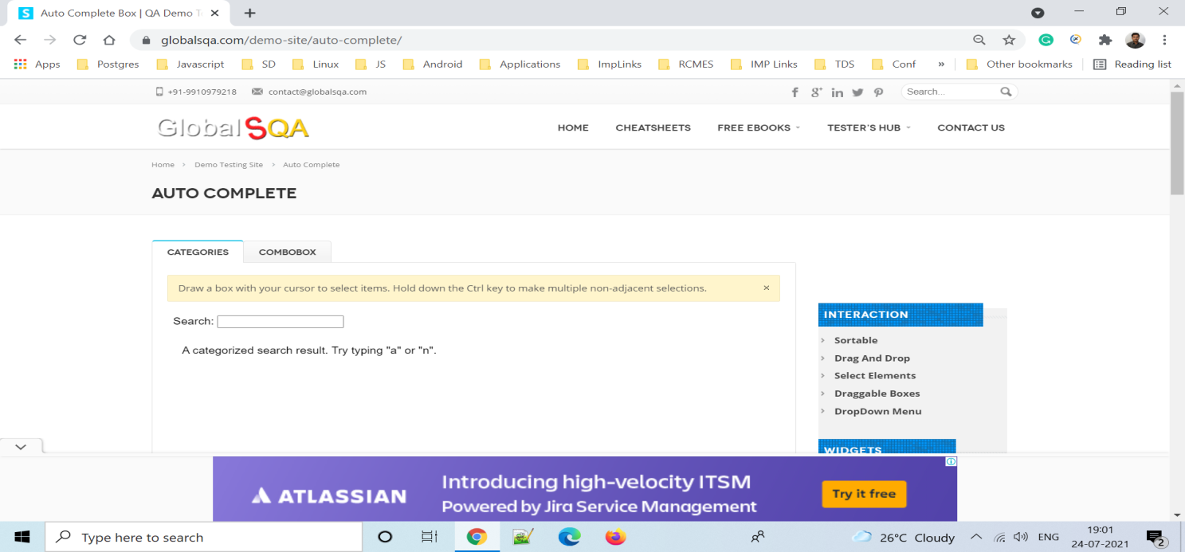
To verify Auto-Complete
//click on categories
driver.findElement(By.id("Categories")).click();
System.out.println("Categories clicked");
//Switch to Frame using xpath of the frame
WebElement iframe = driver.findElement(By.xpath("//body/div[@id='wrapper']/div[1]/div[2]/div[1]/div[1]/div[2]/div[1]/div[1]/div[1]/p[1]/iframe[1]"));
driver.switchTo().frame(iframe);
System.out.println("********We are switch to the iframe*******");

Slide 10
Cont…
//write text in search
driver.findElement(By.id("search")).sendKeys("a");
WebDriverWait wait = new WebDriverWait(driver,30);
wait.until(ExpectedConditions.visibilityOfAllElementsLocatedBy(By.id("ui-id-1")));
//list of autocomplete menu
List<WebElement> list = driver.findElements(By.id("ui-id-1"));
System.out.println("Auto Suggest List: " + list.size());
for (WebElement a : list)
{
System.out.println("Values are = " + a.getText());
if (a.getText().equalsIgnoreCase("annk K12"));
a.click();
//Thread.sleep(3000);
break;
}

Slide 11
Cont…
// swith to default page
driver.switchTo().defaultContent();
//click on comboBox
driver.findElement(By.id("ComboBox")).click();
System.out.println("ComboBox clicked");
WebElement iframe1 = driver.findElement(By.xpath("//body/div[@id='wrapper']/div[1]/div[2]/div[1]/div[1]/div[2]/div[1]/div[1]/div[2]/p[1]/iframe[1]"));
driver.switchTo().frame(iframe1);
System.out.println("********We are switch to the iframe*******");
driver.manage().timeouts().implicitlyWait(200, TimeUnit.MILLISECONDS);
//click on button
driver.findElement(By.xpath("//button[@id='toggle']")).click();
Select select =new Select(driver.findElement(By.id("combobox")));
select.selectByVisibleText("Java");
System.out.println("Java is selected");

Slide 12
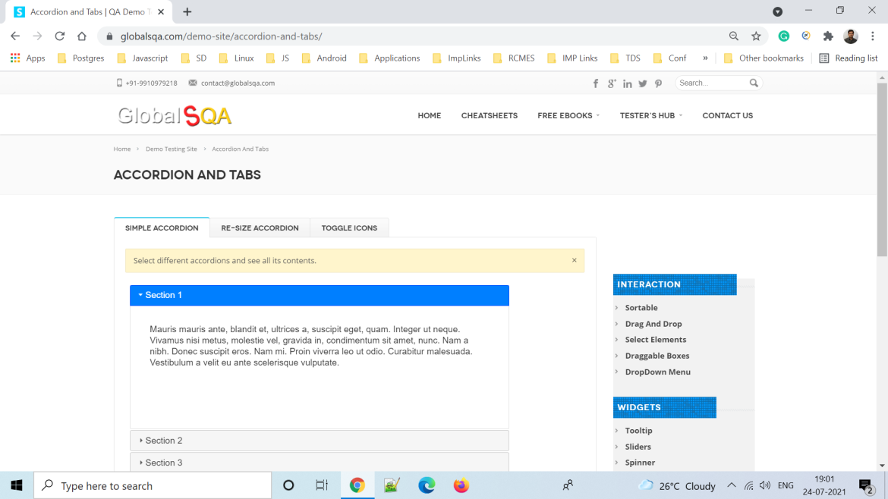
To Verify Accordion And Tabs
//Switch to Frame using xpath of the frame
WebElement iframe = driver.findElement(By.xpath("//body/div[@id='wrapper']/div[1]/div[2]/div[1]/div[1]/div[2]/div[1]/div[1]/div[1]/p[1]/iframe[1]"));
driver.switchTo().frame(iframe);
System.out.println("********We are switch to the iframe*******");
driver.manage().timeouts().implicitlyWait(200, TimeUnit.MILLISECONDS);
//click on Section 2
driver.findElement(By.cssSelector("#ui-id-3")).click();
System.out.println("Section 2 is Clicked");

Slide 13
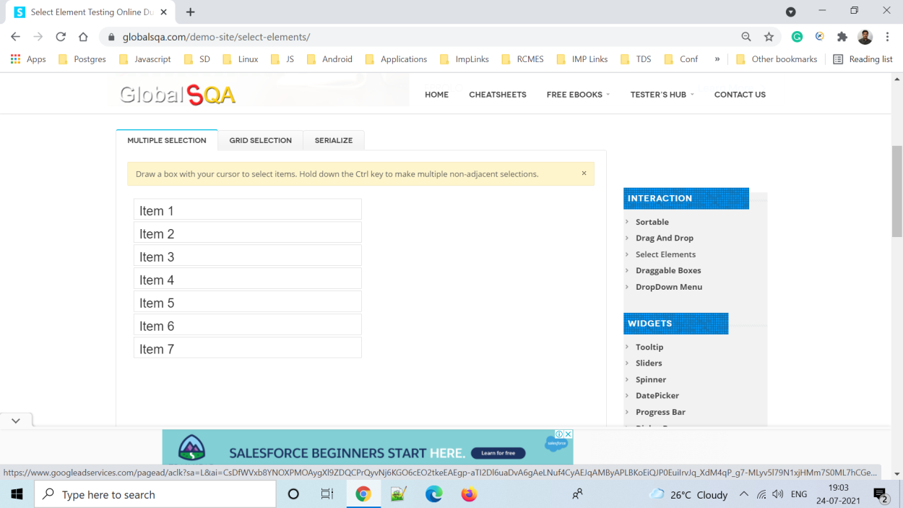
To Verify Multiple Select

Slide 14
To Verify Multiple Select
//click on select element
driver.findElement(By.xpath("//span[contains(text(),'Select Elements')]")).click();
WebElement iframe2= driver.findElement(By.xpath("//body/div[@id='wrapper']/div[1]/div[2]/div[1]/div[1]/div[2]/div[1]/div[1]/div[1]/p[1]/iframe[1]"));
driver.switchTo().frame(iframe2);
System.out.println("switch to iframe");
Actions builder = new Actions(driver);
WebElement select = driver.findElement(By.id("selectable"));
List<WebElement> options = select.findElements(By.tagName("li"));
System.out.println(options.size());
builder.keyDown(Keys.CONTROL).click(options.get(2)).click(options.get(4)).click(options.get(6)).build().perform();

Slide 15
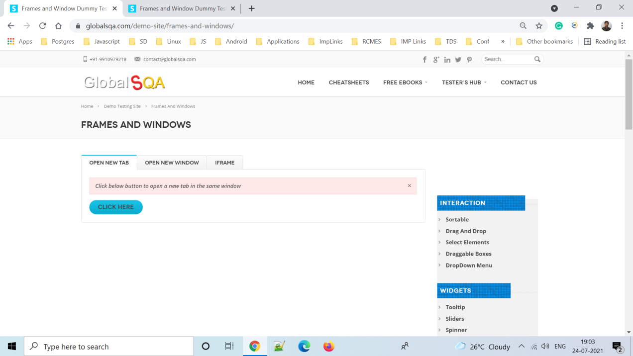
To Verify Frames And Windows

Slide 16
To Verify Frames And Windows
//click on button click here
driver.findElement(By.xpath("//body/div[@id='wrapper']/div[1]/div[2]/div[1]/div[1]/div[2]/div[1]/div[1]/div[1]/a[1]")).click();
String Mainwindow = driver.getWindowHandle();
// To handle all new opened window
Set<String> s1 =driver.getWindowHandles();
Iterator<String> itr = s1.iterator();
while(itr.hasNext()){
String ChildWindow = itr.next();
if(!Mainwindow.equalsIgnoreCase(ChildWindow)){
driver.switchTo().window(ChildWindow);
driver.close();
System.out.println("window closed");}
}
// Switching to Parent window i.e Main Window.
driver.switchTo().window(Mainwindow);
System.out.println("Back to main window");

Slide 17
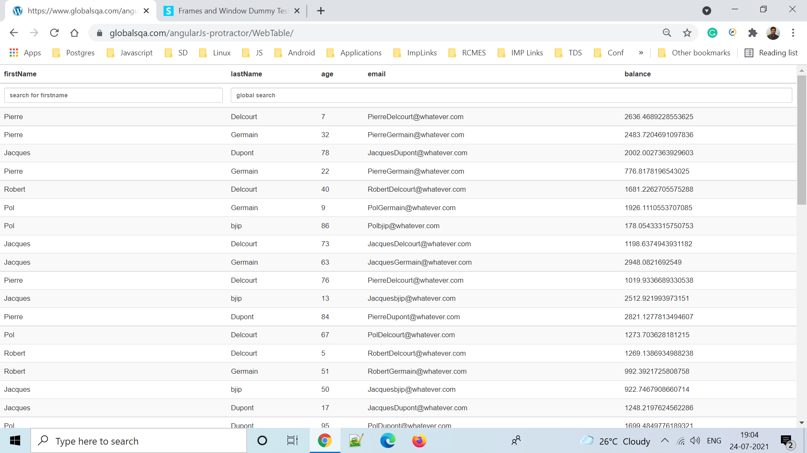
To Verify Web Table
//click on web table
driver.findElement(By.xpath("//header/div[2]/div[1]/div[1]/div[3]/div[1]/ul[1]/li[4]/div[1]/ul[1]/li[2]/div[1]/ul[1]/li[4]/a[1]")).click();
driver.findElement(By.xpath("//thead/tr[2]/th[1]/input[1]")).sendKeys("pol");
driver.findElement(By.xpath("//thead/tr[2]/th[2]/input[1]")).sendKeys("80");

Slide 18
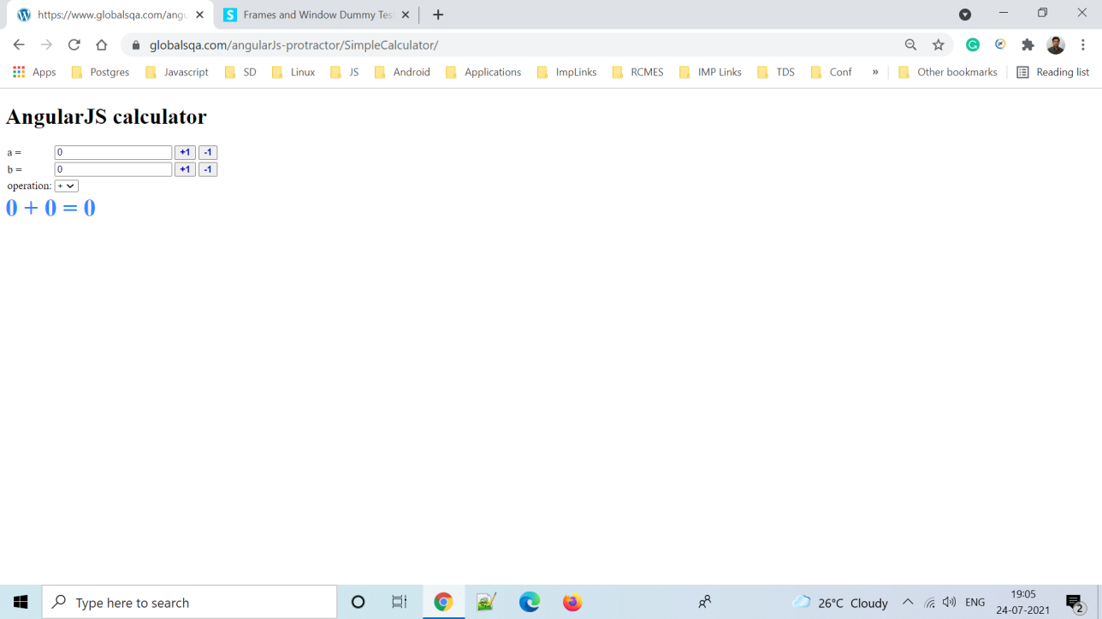
To Verify Simple Calculator

Slide 19
To Verify Simple Calculator
driver.findElement(By.xpath("//span[contains(text(),'Simple Calculator')]")).click();
driver.findElement(By.xpath("//tbody/tr[1]/td[2]/input[1]")).sendKeys("5");
driver.findElement(By.xpath("//tbody/tr[1]/td[3]/button[1]")).click();
System.out.println("A's Plus button clicked");
driver.findElement(By.xpath("//tbody/tr[1]/td[3]/button[2]")).click();
System.out.println("A's minus button clicked");
driver.findElement(By.xpath("//tbody/tr[2]/td[2]/input[1]")).sendKeys("4");
driver.findElement(By.xpath("//tbody/tr[2]/td[3]/button[1]")).click();
System.out.println("B's Plus button clicked");
driver.findElement(By.xpath("//tbody/tr[2]/td[3]/button[2]")).click();
System.out.println("B's minus button clicked");
Select drplist= new Select(driver.findElement(By.xpath("//tbody/tr[3]/td[2]/select[1]")));
drplist.selectByVisibleText("*");

Slide 20
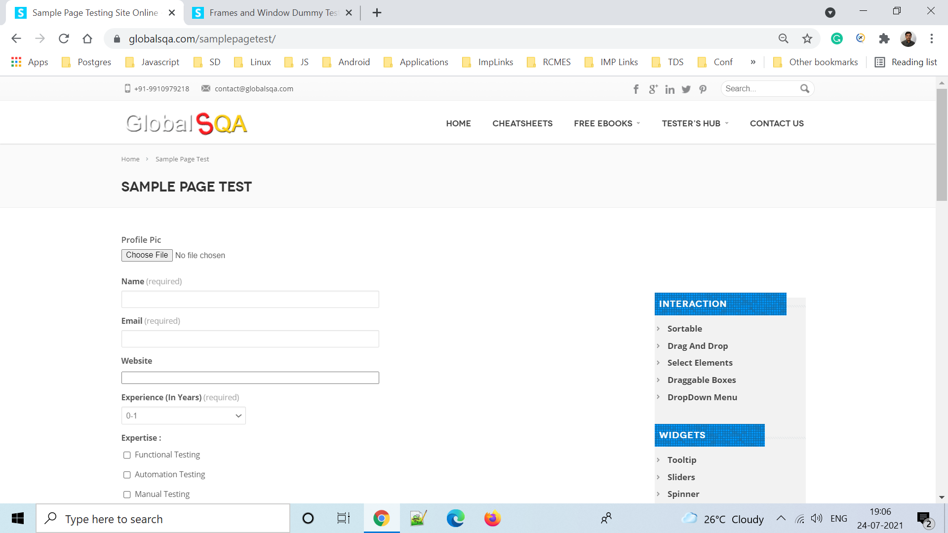
To Verify Sample Page Test Form

Slide 21
Cont…
//click on sample page
driver.findElement(By.xpath("//span[contains(text(),'Sample Page Test')]")).click();
//Upload photo
driver.findElement(By.name("file-553")).sendKeys("C:\\Users\\Shubhangi\\Downloads\\download (2).jpg");
System.out.println("Photo uploaded");
driver.findElement(By.id("g2599-name")).sendKeys("Shubhangi");
driver.findElement(By.id("g2599-email")).sendKeys("shubh@gmail.com");
driver.findElement(By.id("g2599-website")).sendKeys("www.shubhangi.com");
//Dropdown List
Select drplist =new Select(driver.findElement(By.id("g2599-experienceinyears")));
drplist.selectByVisibleText("3-5");

Slide 22
Cont…
//checkboxes
driver.findElement(By.xpath("//body/div[@id='wrapper']/div[1]/div[2]/div[1]/div[1]/div[2]/div[2]/form[1]/div[5]/label[2]/input[1]")).click();
driver.findElement(By.xpath("//body/div[@id='wrapper']/div[1]/div[2]/div[1]/div[1]/div[2]/div[2]/form[1]/div[5]/label[3]/input[1]")).click();
driver.findElement(By.xpath("//body/div[@id='wrapper']/div[1]/div[2]/div[1]/div[1]/div[2]/div[2]/form[1]/div[5]/label[4]/input[1]")).click();
//radio buttons
driver.findElement(By.xpath("//*[@id=\"contact-form-2599\"]/form/div[6]/label[2]/input")).click();
driver.findElement(By.xpath("//*[@id=\"contact-form-2599\"]/form/div[6]/label[3]/input")).click();

Slide 23
Cont…
//Alert button
driver.findElement(By.xpath("//button[contains(text(),'Alert Box : Click Here')]")).click();
Alert alert = driver.switchTo().alert();
System.out.println("Text is:" +alert.getText());
alert.dismiss();
alert.accept();
driver.findElement(By.id("contact-form-comment-g2599-comment")).sendKeys("This is demo project");
//submit button
driver.findElement(By.xpath("//button[contains(text(),'Submit')]")).submit();
driver.manage().timeouts().implicitlyWait(200, TimeUnit.MILLISECONDS);
//scroll up
JavascriptExecutor js = (JavascriptExecutor) driver;
js.executeScript("window.scrollBy(0, -2000)");
//Thread.sleep(3000);
System.out.println("Scroll Up");
//click on go back
driver.findElement(By.xpath("//a[contains(text(),'go back')]")).click();

Slide 24
Thank You…

