Slide 1
Domain-Driven Design
Take care of the heart and your software stays healthy.
by Ingmar van der Steen
Notes:
It is a way of designing software that is characterized by having a strong link between a model of the domain for which software is developed and the actual implementation of this software.
If you take care of the heart (=domain) of your software, it becomes much more easy to implement business features.
In this presentation I will demonstrate how to achieve this code-wise.
DDD is a lot: people, process (event storming) and patterns (CQRS)

Slide 2
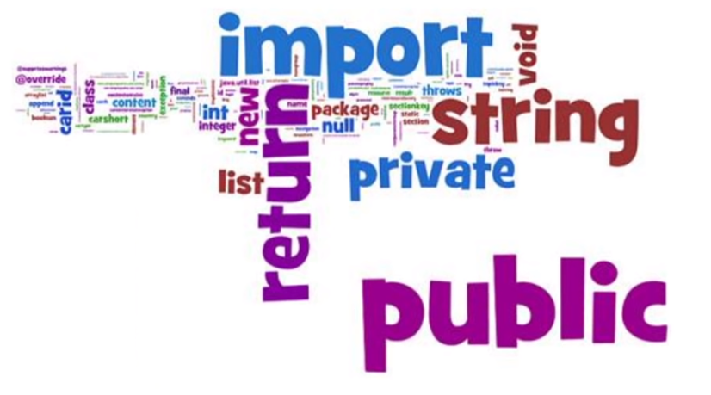
What developers tend to do…
Picture adopted from Kevin Henley
Notes:
The picture of the word clouds of your software is telling this:
- Developers tend to translate all the domain concepts to technical stuff which dominates the codebase
- Developers tend to forget domain concepts and talk only in their technical language and map requirements to their own technical world
- In software development, solving the technical problems is challenging let alone the domain you try to understand and implement

Slide 3
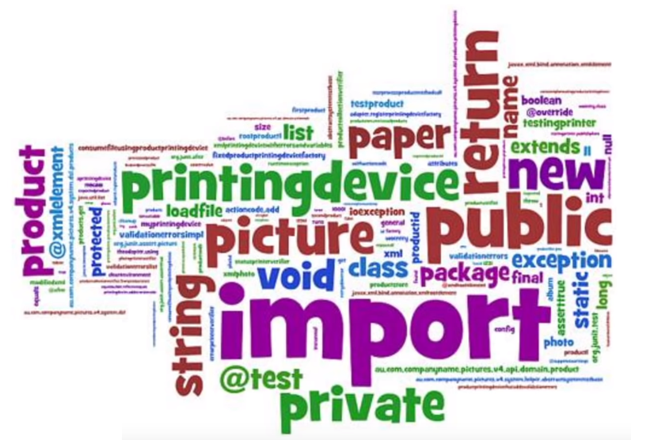
What developers need to do…
Picture adopted from Kevin Henley
Notes:
- It closes the gap between the model and its implementation
- It rewards you with the ease of learning, adding, explaining and tracing the domain
- DDD can be implemented in a lot of places and this presentation gets you started on code level (not CQRS, event storming)

Slide 4
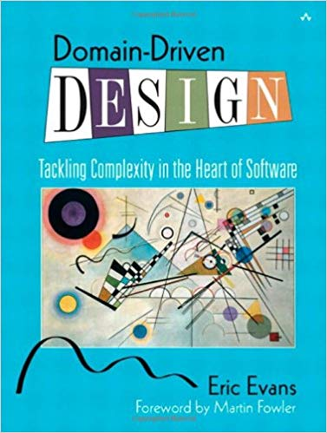
What developers need to do as well…
Picture adopted from Amazon
Notes:
- Tackling complexity in the Heart (= domain) of Software
- Reading the book and naively implement it in order to see the potential benefits
I like theory but I always want to implement a concrete example to prove it to myself (university)
I did not reached the end of the book yet and read it a couple of times
- You keep iterating when starting these kind of designs
- A clean domain-driven design gives challenges

Slide 5
Introducing our Payments domain
Payment Instruction: A payment made from an Ordering Account to a Beneficiary Account.
Notes:
- Based on domain found at Bank Mendes Gans
- Complex and dynamic UI with multiple validations across fields

Slide 6
Introducing our Payments domain
Ordering Account: The Ordering Account is the account from which the money is debited.
Beneficiary Account: The Beneficiary Account is the account to which the money is credited.
Beneficiary Bank: The bank to which the Beneficiary Account belongs.
Notes:
- Based on domain found at Bank Mendes Gans
- Complex and dynamic UI with multiple validations across fields

Slide 7
Introducing our Payments domain
Currency: The currency of the Payment Instruction in which the money is transferred.
Amount: The amount of money transferred in the Payment Instruction.
Fedwire code: a 9 digit code for banks used in the US which identifies financial institutions.
Notes:
- Based on domain found at Bank Mendes Gans
- Complex and dynamic UI with multiple validations across fields

Slide 8
Communicating our Payments domain
Story 1 | Validation of a Payment Instruction
In order to | add a valid Payment Instruction
As a | user of the system
I want to | receive a validation error when it’s not valid
Scenario 1.1 | Fedwire is mandatory
Given | the Beneficiary Bank
And | the Country of the bank is USA
And | the Currency is USD
When | the user adds the Payment Instruction
Then | Fedwire is mandatory
Notes:
- Link of domain model and implementation promotes talking in the same unambiguous language.
- Team members need to train themselves to use an ubiquitous language and the responsibility lies in the team to correct each other in this matter.
- This involves correcting it in the code base, requirements, SCRUM artifacts and in day-to-day meetings.

Slide 9
Building our Payments domain
Domain-driven Design
isolate domain with
express with
Layered Architecture
Services
Entities
Value Objects
Repositories
encapsulate with
access with
encapsulate with
Factories
encapsulate with
Aggregates
encapsulate with
access with

Slide 10
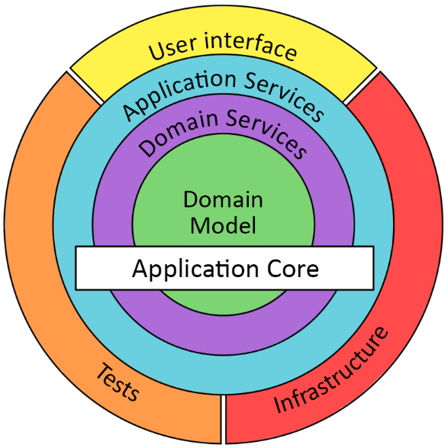
Layered Architecture
Notes:
- The advantage of doing so is that we don't scatter or duplicate the domain across layers and it promotes reuse of the domain layer in another type of application or flow. (drive UI and validation)
- Don’t be dependent on technical frameworks like Spring or use exotic annotations which require dependencies
- ING Mobile banking app (Android / Back end share domain.jar)
- Protect it using Maven enforcer plugin

Slide 11
Enforcing dependencies
<plugin> <groupId>org.apache.maven.plugins</groupId> <artifactId>maven-enforcer-plugin</artifactId> <executions> <execution> <configuration> <rules> <bannedDependencies> <excludes> <exclude>*</exclude> </excludes> <includes> <include>junit</include> </includes> </bannedDependencies> </rules> <fail>true</fail> </configuration> </execution> </executions> </plugin>

Slide 12
Anti-pattern: Fat Service
public List<String> addPayment(PaymentInstructionDTO paymentInstructionDTO) { List<String> msg = new ArrayList<>(); validate(paymentInstructionDTO, msg); paymentInstructionDTO.setPaymentCurrency("USD"); if (msg.isEmpty()) { String orderingAccount = paymentInstructionDTO.getOrderingAccountIdentification(); String beneficiaryAccount = paymentInstructionDTO.getOrderingAccountIdentification(); String amount = paymentInstructionDTO.getAmount(); paymentInstructionDAO.store(beneficiaryAccount, orderingAccount, amount); } return msg; }
Notes:
- Example of Fat Service layer and empty Domain Object shells
- I was more conscious of the anti-patterns (e.g. Fat service layer, use of primitive types all the way) found in projects I did
Example of End-to-End flow of posting, validating, storing all in Strings
TOCTOU

Slide 13
Anti-pattern: Fat Service
Mutating state (TOCTOU)
Calling a validation method
public List<String> addPayment(PaymentInstructionDTO paymentInstructionDTO) { List<String> msg = new ArrayList<>(); validate(paymentInstructionDTO, msg); paymentInstructionDTO.setPaymentCurrency("USD"); if (msg.isEmpty()) { String orderingAccount = paymentInstructionDTO.getOrderingAccountIdentification(); String beneficiaryAccount = paymentInstructionDTO.getOrderingAccountIdentification(); String amount = paymentInstructionDTO.getAmount(); paymentInstructionDAO.store(beneficiaryAccount, orderingAccount, amount); } return msg; }
Strings everywhere
Notes:
- Example of Fat Service layer and empty Domain Object shells
- I was more conscious of the anti-patterns (e.g. Fat service layer, use of primitive types all the way) found in projects I did
Example of End-to-End flow of posting, validating, storing all in Strings
TOCTOU

Slide 14
Building our Payments domain
Domain-driven Design
isolate domain with
express with
Layered Architecture
Services
Value Objects
Entities
Repositories
encapsulate with
access with
encapsulate with
Factories
encapsulate with
Aggregates
encapsulate with
access with
Notes:
TODO: hide

Slide 15
Entities
“Objects which have continuity through a life cycle and are being distinct independent of its attribute values over time.”
Notes:
Life cycle
Distinct independent of attribute values (a person is the same person although his height/weight changes over time)

Slide 16
Entities
public interface Entity<T> { boolean hasSameIdentityAs(T entity); }
Notes:
How do you know
Watch out with implementation of equals( ) and include this method in the comparison

Slide 17
Entities
public final class PaymentInstruction implements Entity<PaymentInstruction>
Notes:
- BMG Payment system: PaymentInstruction had a lifecycle with editing/approving the payment
- BMG Payment system: OrderingAccount had a lifecycle managing customer accounts

Slide 18
Building our Payments domain
Domain-driven Design
isolate domain with
express with
Layered Architecture
Services
Value Objects
Entities
Repositories
encapsulate with
access with
encapsulate with
Factories
encapsulate with
Aggregates
encapsulate with
access with
Notes:
TODO: hide

Slide 19
Value Objects
“Represent a descriptive aspect of the domain with no conceptual identity.”
Notes:
If attributes change over time you talk about a different object and it has no life cycle.

Slide 20
Value Objects: Currency
private Currency(final String currencyCode) { this.currencyCode = currencyCode; } public static Optional<Currency> create(final String currencyCode, final List<String> msgs) { if (currencyCode == null || currencyCode.length() != 3) { msgs.add("Currency code has 3 characters"); return Optional.empty(); } return Optional.of(new Currency(currencyCode)); }
Notes:
- Private constructor
- TOCTOU
- Only a non-null object returned when it is a valid domain object
- Aggregating validation messages

Slide 21
Building our Payments domain
Domain-driven Design
isolate domain with
express with
Layered Architecture
Services
Value Objects
Entities
Repositories
encapsulate with
access with
encapsulate with
Factories
encapsulate with
Aggregates
encapsulate with
access with
Notes:
TODO: hide

Slide 22
Aggregates
“A cluster of associated objects that is treated as a unit for the purpose of data changes.”
Notes:
PaymentInstruction is an Entity and also an Aggregate

Slide 23
Aggregates
ePaymentInstruction
eOrdering Account
Beneficiary Account
Amount
Fedwire
Currency
Beneficiary Bank
Notes:
Aggregate Root: single entity
Only Aggregate roots can be obtained directly with database queries.
Other objects inside the boundary must be found by traversal of associations.
It gives encapsulation
Ordering Account has global identity and not local identity

Slide 24
Building our Payments domain
Domain-driven Design
isolate domain with
express with
Layered Architecture
Services
Value Objects
Entities
Repositories
encapsulate with
access with
encapsulate with
Factories
encapsulate with
Aggregates
encapsulate with
access with
Notes:
TODO: hide

Slide 25
Factories
“Aggregates can become complex object graphs of which the construction should be the responsibility of factories.”
Notes:
Calling constructors sacrifices encapsulation of the Aggregates and it clouds the design of your objects.

Slide 26



Factories (and Dozers)
ePaymentInstruction DTO
PaymentInstruction Domain Object
ePaymentInstruction ORM Entity
Notes:
Dozer simply maps the data into the DTO using reflection and safes a lot of boilerplate code.
It keeps our Domain clean by removing technical noise
We cannot use such a mapper if we are creating a Domain Object, because it will not give you validation when constructing the Aggregate.

Slide 27
Factories: PaymentInstructionFactory
public PaymentInstruction createPaymentInstructionDO(final PaymentInstructionDTO dto) throws BusinessRuleNotSatisfied { final List<String> msgs = new ArrayList<>(); final Optional<Currency> paymentCurrency = Currency.create(dto.getPaymentCurrency(),msgs); final Optional<Fedwire> fedwire = Fedwire.create(dto.getFedwireCode(),paymentCurrency,…,msgs); return new PaymentInstruction(…,paymentCurrency.orElse(null),fedwire.orElse(null),…,msgs); } public PaymentInstructionDTO createPaymentInstructionDTO(final PaymentInstruction paymentInstruction) { return DozerBeanMapperSingletonWrapper.getInstance().map(paymentInstruction, PaymentInstructionDTO.class); }
Notes:
Calling constructors sacrifices encapsulation of the Aggregates and it clouds the design of your objects.

Slide 28
Entities: PaymentInstruction
public PaymentInstruction(final OrderingAccount orderingAccount, final BeneficiaryAccount beneficiaryAccount, final Currency paymentCurrency, final Amount amount,…) throws BusinessRuleNotSatisfied { this.paymentCurrency = paymentCurrency; this.orderingAccount = orderingAccount; this.beneficiaryAccount = beneficiaryAccount; this.fedwire = fedwire; this.amount = amount; SemanticBusinessRuleMap.satisfiedBy(this, validationMessages);
}
Notes:
- BMG Payment system: PaymentInstruction had a lifecycle with editing/approving the payment
- BMG Payment system: OrderingAccount had a lifecycle managing customer accounts

Slide 29

Enforce domain rules using Java compiler
public void send(@ApprovedPayment PaymentInstruction this) { // send approved payment over the wire } public @ApprovedPayment PaymentInstruction approve() { approved = true; return this; }

Slide 30
Enforce domain rules using Java compiler
PaymentInstruction paymentInstruction = paymentInstructionFactory.createPaymentInstructionDO(paymentInstructionDTO); paymentInstruction.send(); // error: call to send() not allowed on the given receiver paymentInstruction = paymentInstruction.approve(); paymentInstruction.send();

Slide 31
Building our Payments domain
Domain-driven Design
isolate domain with
express with
Layered Architecture
Services
Value Objects
Entities
Repositories
encapsulate with
access with
encapsulate with
Factories
encapsulate with
Aggregates
encapsulate with
access with
Notes:
TODO: hide

Slide 32
Repositories
“Represent all objects of a certain type as a collection with querying capabilities.”

Slide 33
Repositories
public interface PaymentInstructionRepository { void add(PaymentInstruction paymentInstruction); PaymentInstruction find(Long paymentInstructionId) throws BusinessRuleNotSatisfied; }
Notes:
Separated Interface pattern
Lives in Domain
Implementation outside Domain

Slide 34
Repositories
@Repository public class PaymentInstructionRepositoryImpl implements PaymentInstructionRepository { @PersistenceContext private EntityManager entityManager; @Autowired private PaymentInstructionFactory paymentInstructionFactory; @Override @Transactional(propagation=Propagation.REQUIRES_NEW) public void add(final PaymentInstruction paymentInstruction) { … }

Slide 35
Building our Payments domain
Domain-driven Design
isolate domain with
express with
Layered Architecture
Services
Value Objects
Entities
Repositories
encapsulate with
access with
encapsulate with
Factories
encapsulate with
Aggregates
encapsulate with
access with
Notes:
TODO: hide

Slide 36
Services
“A process or transformation in the domain which is not a natural
responsibility of an Entity or a Value Object.”
Notes:
Not responsibility because of added noise / dependencies

Slide 37
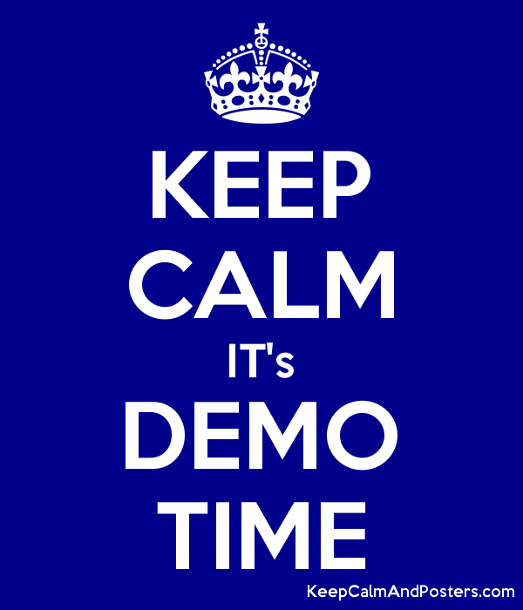

Slide 38
With domain-driven design,
we achieve better understanding and traceability of the domain.
the ubiquitous language promotes the adoption of BDD.
the pattern language isolates and encapsulates the domain.

Slide 39

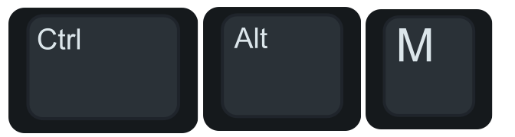
What can you do tomorrow?
Notes:
- CTRL + ALT + M
- Identify Domain Objects to get rid of Fat Service layer and e2e primitive types
- Creating metrics to measure how Domain-driven your design is // TODO

Slide 40

Thanks!

