Slide 1
Security … and practice
Ingmar van der Steen
ingmars@infosupport.com
Notes:
Intro ik, ING, security satellite, BufSec

Slide 2
Security, why bother?

Slide 3
Security, why bother?
Isn’t that up to the infra people?

Slide 4
Security, why bother?
Isn’t that up to the infra people?
We use technology XYZ, aren’t we secure by default?

Slide 5
Security, why bother?
Isn’t that up to the infra people?
We use technology XYZ, aren’t we secure by default?
Don’t we hire people to do security?

Slide 6
Security, why bother?
Isn’t that up to the infra people?
We use technology XYZ, aren’t we secure by default?
Don’t we hire people to do security?
We didn’t have any security incident, aren’t we doing fine?

Slide 7
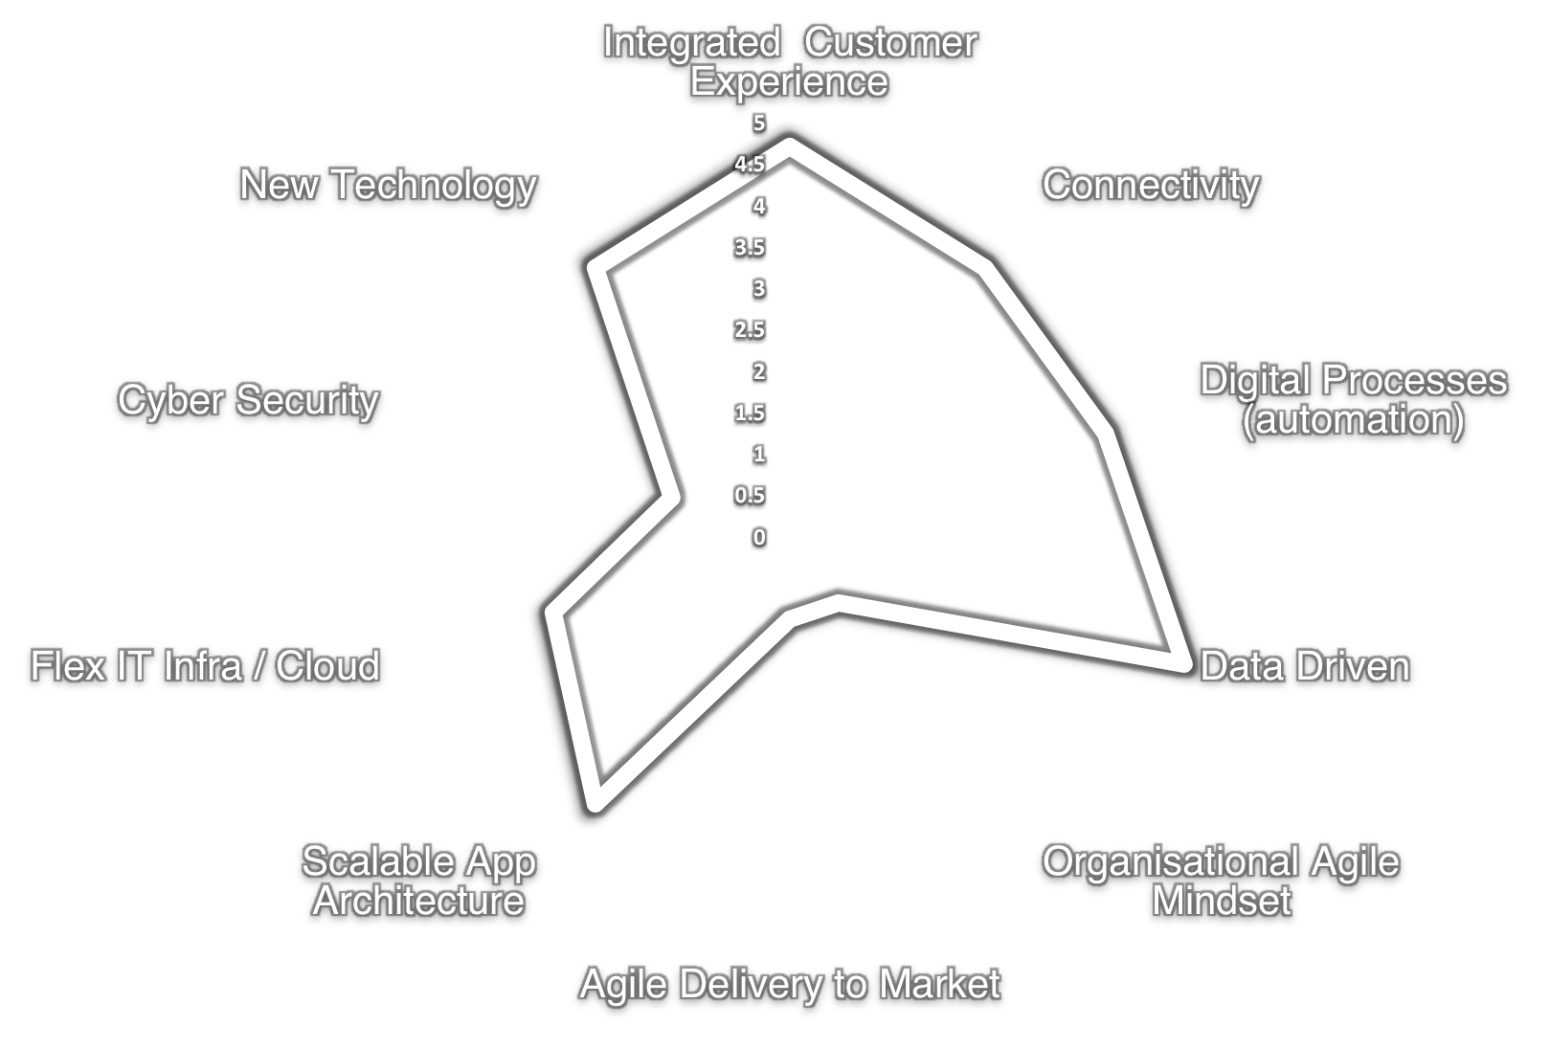
The Digital Company
Current
Notes:
IS
Inventarisatie van huidige stand van zaken / Gaps.
We hadden alle assen even goed op waarde geschat, minder focus voor Security. Geen toezichthouder, daardoor minder geneigd hier mee aan de slag te gaan.
We hebben de noodzaak van agile ondervonden en zijn er behoorlijk goed in geworden.
UIT: Geliefd bij Management vanwege korte TTM, excellent Customer experience
UIT: Security is achtergebleven en dat hebben we aan den lijve ondervonden.

Slide 8
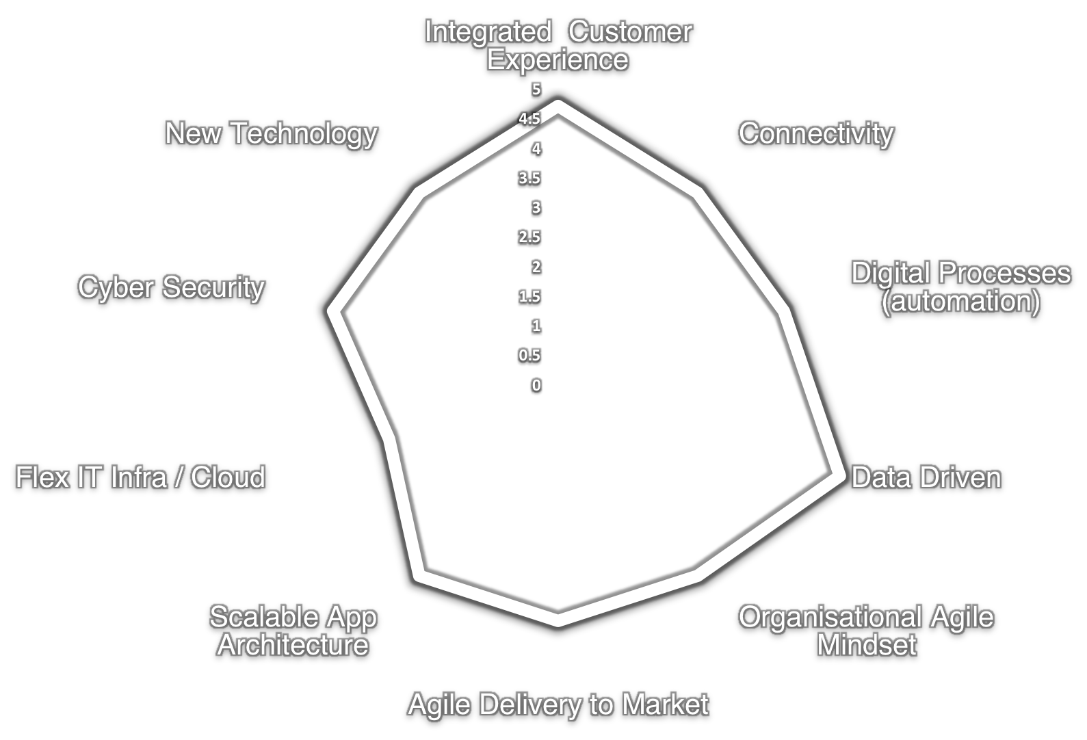
The Digital Company
Target
Notes:
IS
In: We hebben het assessment inmiddels opnieuw uitgevoerd en scoren een stuk beter op het gebied Cyber Security
Uit: Bedankt

Slide 9
Our 3 area’s of our technology policy
Software Architecture | Way of Working | Data & AI
Notes:
Binnen deze areas stuurt het technologiebeleid op het vergroten van kennis en kunde (capabilities) en opbouw van associatie bij onze doelgroep.
Security, Privacy & Ethiek krijgen een prominente plek binnen alle areas.

Slide 10
How does security fit in these areas?
Software Architecture | Way of Working | Data & AI
Notes:
Gebieden die ik denk dat relevant zijn voor Infosupport om afstudeeropdrachten op te hebben en zo bijdrage te leveren aan deze area’s.

Slide 11
How does security fit in these areas?
Software Architecture | Way of Working | Data & AI
secure software coding
secure software design
security & iOT

Slide 12
How does security fit in these areas?
Software Architecture | Way of Working | Data & AI
secure software coding | security testing
secure software design | secure deployment & ops
security & iOT | security maturity
 | security & being agile
 | releasing secure software

Slide 13
How does security fit in these areas?
Software Architecture | Way of Working | Data & AI
secure software coding | security testing | security & AI
secure software design | secure deployment & ops | cloud security
security & iOT | security maturity | privacy, compliancy and policy
 | security & being agile
 | releasing secure software

Slide 14
How does security fit in these areas?
Software Architecture | Way of Working | Data & AI
secure software coding | security testing | security & AI
secure software design | secure deployment & ops | cloud security
security & iOT | security maturity | privacy, compliancy and policy
 | security & being agile
 | releasing secure software

Slide 15
Security Maturity
Measure Security Maturity at our clients
Creating awareness
Communication towards stakeholders:
“How do you become digitally succesful?”

Slide 16

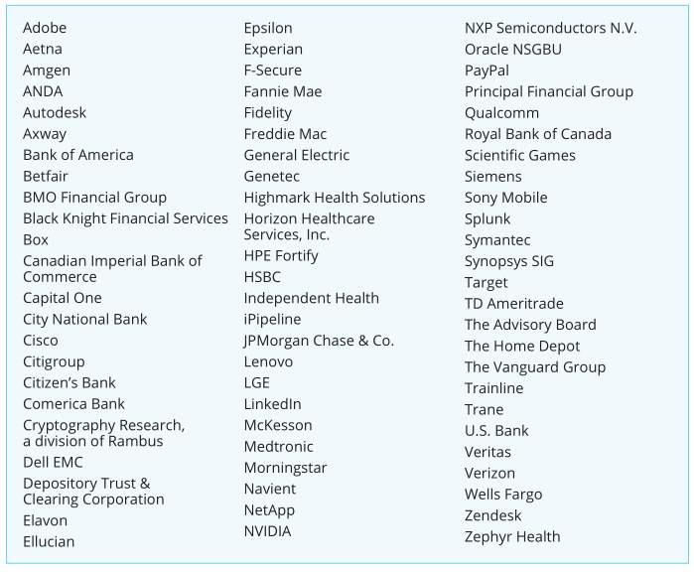

Slide 17
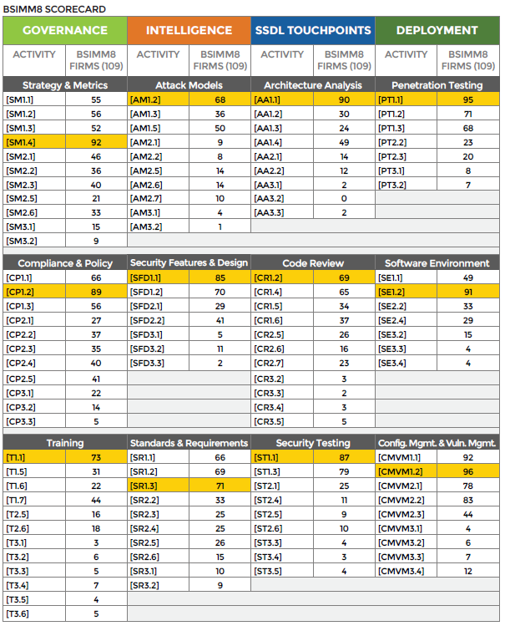

Slide 18
Domain
Security by Design
Development
Security Testing
Process & Documentation
People

Slide 19
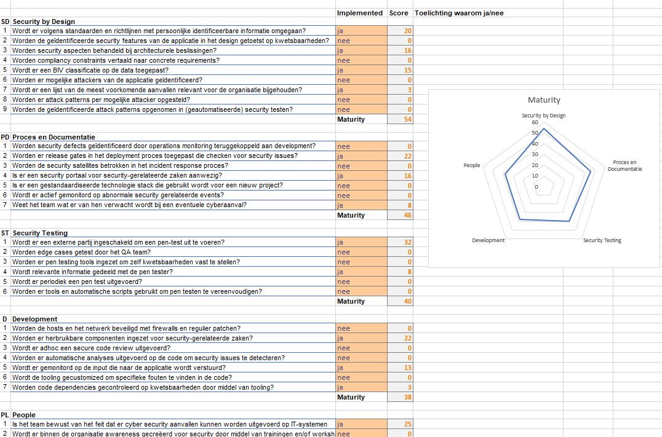

Slide 20
How does security fit in these areas?
Software Architecture | Way of Working | Data & AI
secure software coding | security testing | security & AI
secure software design | secure deployment & ops | cloud security
security & iOT | security maturity | privacy, compliancy and policy
 | security & being agile
 | releasing secure software

Slide 21
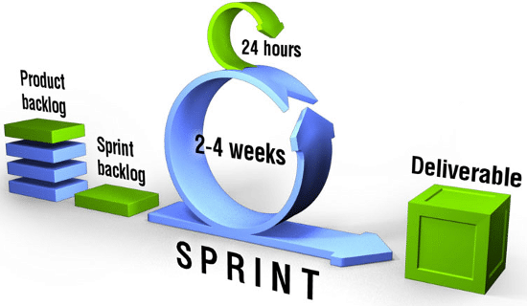
Security & being agile: SCRUM

Slide 22
API
>-
Discount
Shipping
Address
Same as invoice
Different
Complaint
Drop files to upload

Slide 23
Security & being agile: SCRUM

Slide 24
Security & being agile: story
As a company
I want to be able to generate discount codes
So that I can give discount on products for certain clients

Slide 25

Security & being agile: attacker story
As a hacker
I want to be able to predict discount codes
So that I can buy items with discount at any given time

Slide 26
Security & being agile: sprint backlog
to be able to give clients discount by generating discount codes
to be able to revoke an used discount code
to be able to predict discount codes
to be able to reuse an used discount code

Slide 27
How does security fit in these areas?
Software Architecture | Way of Working | Data & AI
secure software coding | security testing | security & AI
secure software design | secure deployment & ops | cloud security
security & iOT | security maturity | privacy, compliancy and policy
 | security & being agile
 | releasing secure software

Slide 28
Secure software design: integrity

Slide 29
Secure software design: integrity
the data should not be modified in an undetected manner…

Slide 30
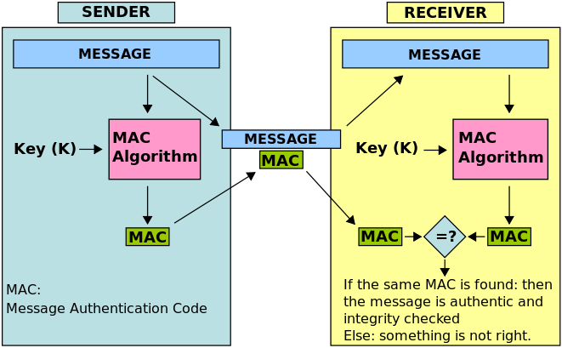
Secure software design: integrity
Source picture: wikipedia

Slide 31
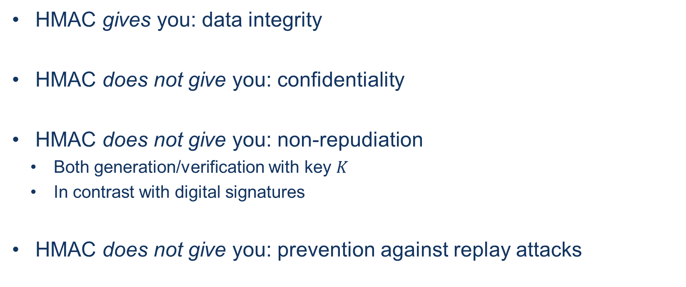
Secure software design: integrity
HMAC gives you: data integrity
HMAC does not give you: confidentiality
HMAC does not give you: non-repudiation
  Both generation/verification with key $K$
  In contrast with digital signatures
HMAC does not give you: prevention against replay attacks

Slide 32
Secure software coding: integrity
private static boolean isMessageAuthentic(Mac macAlgorithm, String receivedMsg, byte[] receivedTag) {
byte[] receivedMsgBytes = receivedMsg.getBytes(Charset.forName("UTF-8"));
macAlgorithm.update(receivedMsgBytes);
byte[] computedTag = macAlgorithm.doFinal();
return Arrays.equals(computedTag, receivedTag);
}

Slide 33
Secure software coding: integrity
private static boolean isMessageAuthentic(Mac macAlgorithm, String receivedMsg, byte[] receivedTag) {
byte[] receivedMsgBytes = receivedMsg.getBytes(Charset.forName("UTF-8"));
macAlgorithm.update(receivedMsgBytes);
byte[] computedTag = macAlgorithm.doFinal();
return Arrays.equals(computedTag, receivedTag);
}

Slide 34
Arrays.equals implementation
public static boolean equals(byte[] a, byte[] a2) {
if (a==a2)
return true;
if (a==null || a2==null)
return false;
int length = a.length;
if (a2.length != length)
return false;
for (int i=0; i<length; i++)
if (a[i] != a2[i])
return false;
return true;
}

Slide 35
Arrays.equals implementation
public static boolean equals(byte[] a, byte[] a2) {
if (a==a2)
return true;
if (a==null || a2==null)
return false;
int length = a.length;
if (a2.length != length)
return false;
for (int i=0; i<length; i++)
if (a[i] != a2[i]) // fail-fast allows for timing attack
return false;
return true;
}

Slide 36
Solution: MessageDigest.isEqual
public static boolean isEqual(byte[] digesta, byte[] digestb) {
if (digesta == digestb) return true;
if (digesta == null || digestb == null) {
return false;
}
if (digesta.length != digestb.length) { // length is not a secret
return false;
}
int result = 0;
for (int i = 0; i < digesta.length; i++) {
result |= digesta[i] ^ digestb[i]; // XOR both arrays
}
return result == 0;
}

Slide 37
How does security fit in these areas?
Software Architecture | Way of Working | Data & AI
secure software coding | security testing | security & AI
secure software design | secure deployment & ops | cloud security
security & iOT | security maturity | privacy, compliancy and policy
 | security & being agile
 | releasing secure software

Slide 38
Releasing secure software:
Black box and White box

Slide 39
Releasing secure software:
Black box and White box
Black Box
Input
Output

Slide 40
Releasing secure software:
Black box and White box
Black Box
Input
Output
White box Box
Input
Output

Slide 41
Releasing secure software:
Black box and White box
Exploitability
Black Box
Input
Output
White box Box
Input
Output

Slide 42
Releasing secure software:
Black box and White box
Exploitability
Black Box
Input
Output
Root Cause Analysis
White box Box
Input
Output

Slide 43
Releasing secure software:
Black box and White box
Exploitability
Deployment issues
Black Box
Input
Output
Root Cause Analysis
White box Box
Input
Output

Slide 44
Releasing secure software:
Black box and White box
Exploitability
Deployment issues
Black Box
Input
Output
Root Cause Analysis
Code Coverage
White box Box
Input
Output

Slide 45
Releasing secure software:
Black box and White box
3rd parties
Exploitability
Deployment issues
Black Box
Input
Output
Root Cause Analysis
Code Coverage
White box Box
Input
Output

Slide 46
Releasing secure software:
Black box and White box
3rd parties
Exploitability
Deployment issues
Black Box
Input
Output
# False positives and negatives
Root Cause Analysis
Code Coverage
White box Box
Input
Output

Slide 47
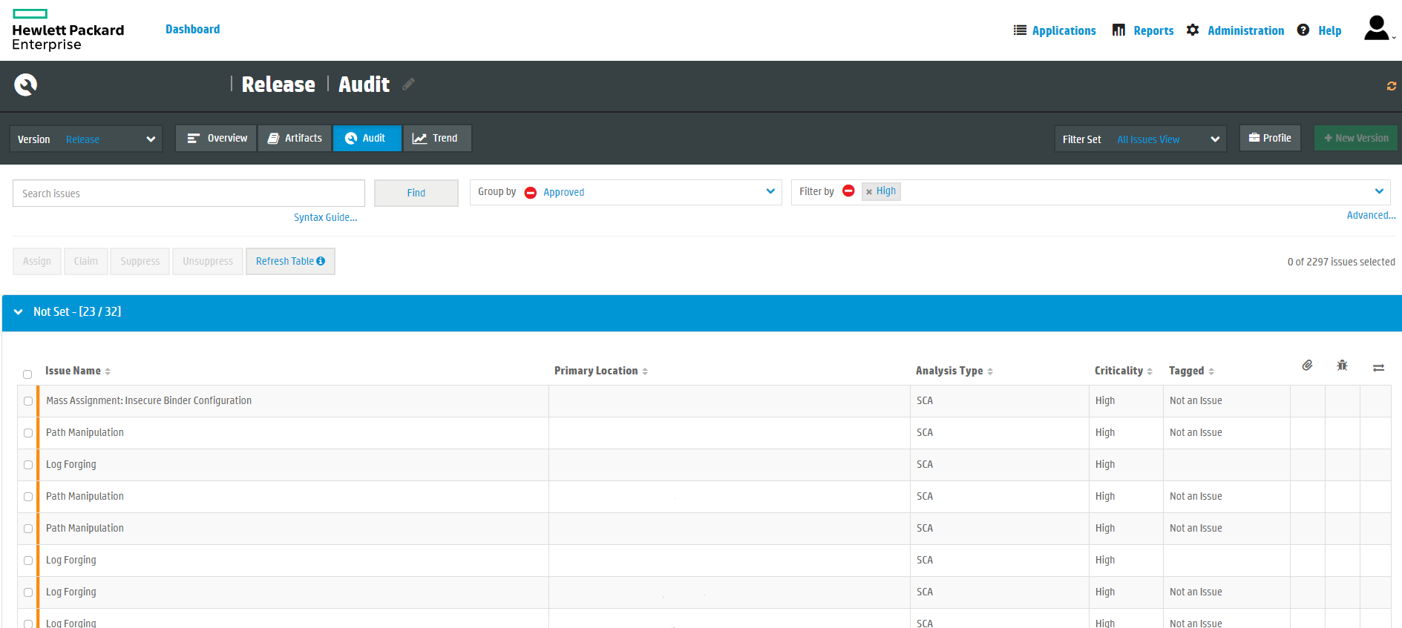
Releasing secure software: Static Code Analysis

Slide 48
Releasing secure software: Static Code Analysis
../../tomcat/conf/server.xml

Slide 49
Releasing secure software: Static Code Analysis
twenty-one%0a%0aINFO:+User+logged+out%3dbadguy

Slide 50
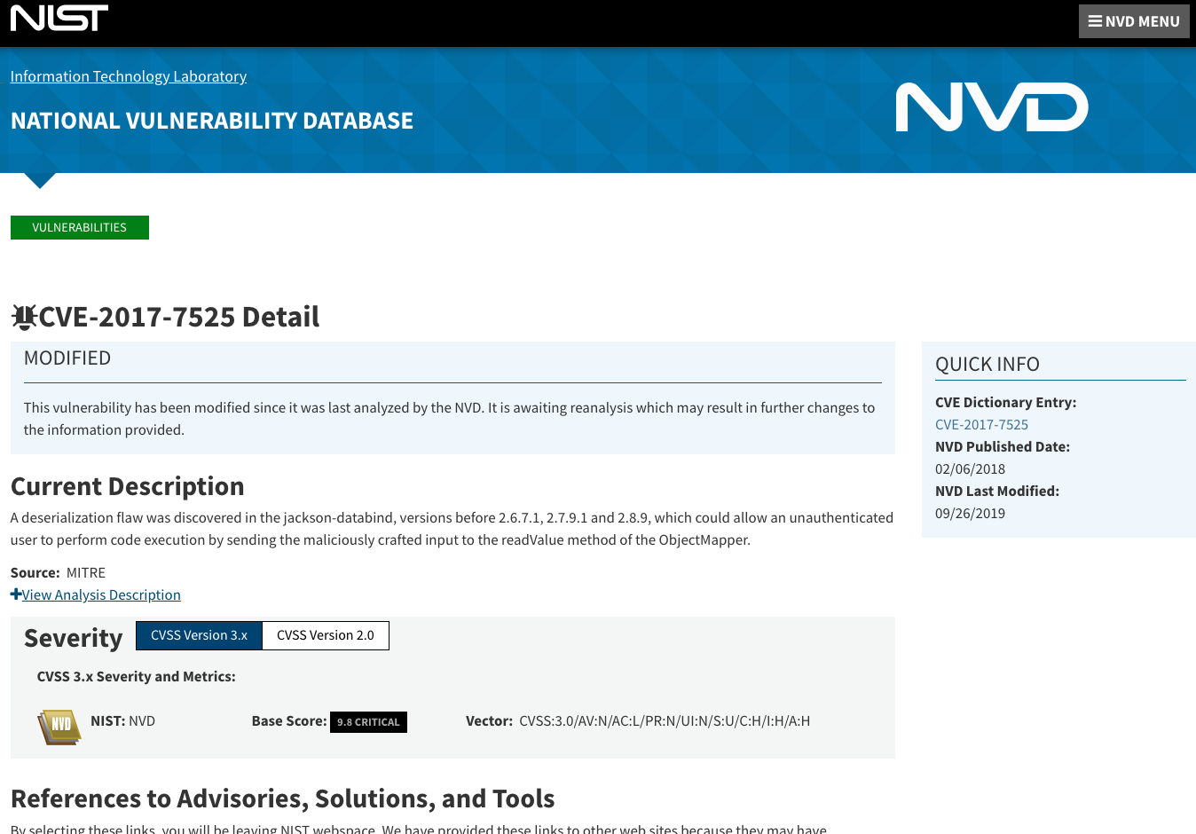
Releasing secure software: dependencies

Slide 51
Releasing secure software: dependencies
https://adamcaudill.com/2017/10/04/exploiting-jackson-rce-cve-2017-7525/

Slide 52
Key takeaways
Security needs to be present in:
Design, Development, Testing, Process and People
Do not implement crypto yourself
Make security and impact explicit on your back log
Keep security in mind when designing, building & releasing software

Slide 53

Become a security champion

